Slide 1
NO | 대분류 | 소분류 | 내용 | 수식 | 비고
1 | Gradient Descent | Gradient Descent
2 |  | SGD
3 |  | Momentum
4 |  | RMSProp
5 |  | Adam
6 | Newton Method | Newton Method
7 |  | Gauss-Newton Method
8 |  | Levenberg-Marquardt Method
9 |  | Quasi Newton Method
10 | Constrained Optimization | Lagrange Multiplier

Slide 2
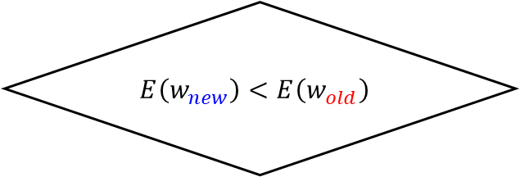
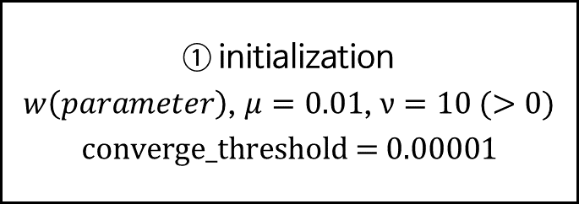
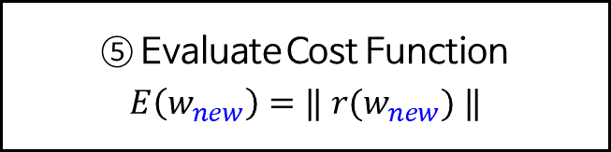

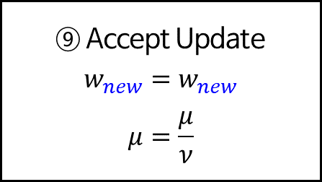
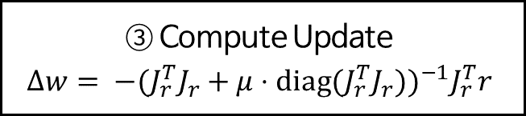
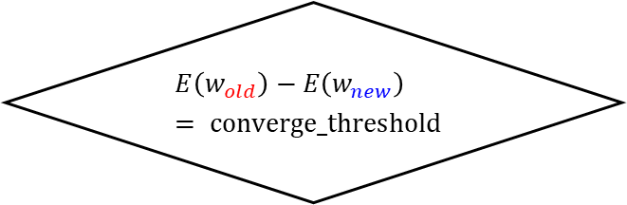

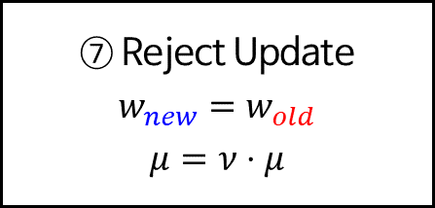
Levenberg-Marquardt Method
Start
① initialization
$w\left(parameter\right)$, $μ=0.01$, $ν=10 (>0)$
$$\text{converge}\text{_}\text{threshold}\text{ = 0.00001}$$
② Compute Residuals and Jacobian
$r$, $J_{r}$
③ Compute Update
$$Δw= {−(J_{r}^{T}J_{r}+μ⋅\text{diag}\text{(}J_{r}^{T}J_{r}))}^{−1}J_{r}^{T}r$$
④ Update Parameters
$$w_{new}=w_{old}+Δw$$
⑤ Evaluate Cost Function
$$E\left(w_{new}\right)=‖ r(w_{new}) ‖$$
⑦ Reject Update
$$w_{new}=w_{old}$$
$$μ=ν⋅μ$$
$$E\left(w_{new}\right)<E\left(w_{old}\right)$$
No
⑥
Yes
⑨ Accept Update
$$w_{new}=w_{new}$$
$$μ=\frac{μ}{ν}$$
$$E\left(w_{old}\right)−E\left(w_{new}\right)= \text{converge}\text{_}\text{threshold}$$
No
⑧
Yes
Stop

