Slide 1
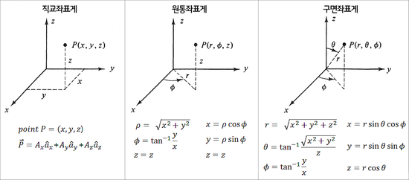
$$r$$
$$r$$
$$r$$
$$r$$
$$r$$
$$r$$
$$r$$
$$r$$
$$r$$

Slide 2
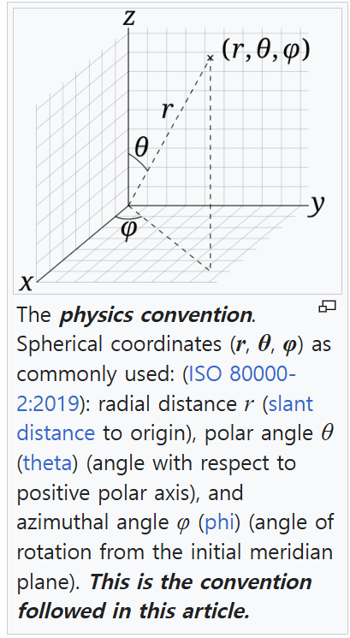
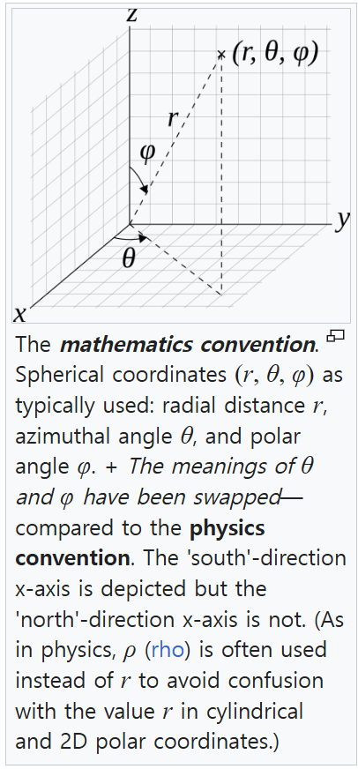

Slide 3




Yaw
Z
Y
Pitch
X
Roll
직교 좌표계
원통 좌표계
Yaw
Z
Yaw
Z
$$P(x, y, z)$$
$$P(r, φ, z)$$
z
Y
z
Y
Pitch
$$r$$
Pitch
x
X
X
$$ϕ$$
Roll
y
Roll

Slide 4
Z
Roll
X
Pitch
Y
Yaw

