Slide 1


start_axis = 1
45$°$
45$°$
start_axis = 0
start_axis = 2
45$°$
start_axis = 3
45$°$

Slide 2
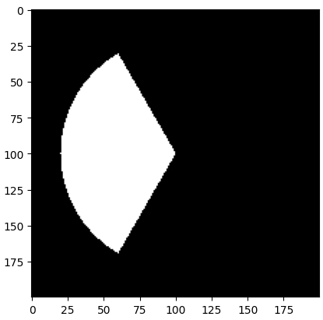


start_axis = 1
r = 80
$$θ_{1}=30$$
$θ_{2}=$150
(u, v) = (100, 100)

