Slide 1
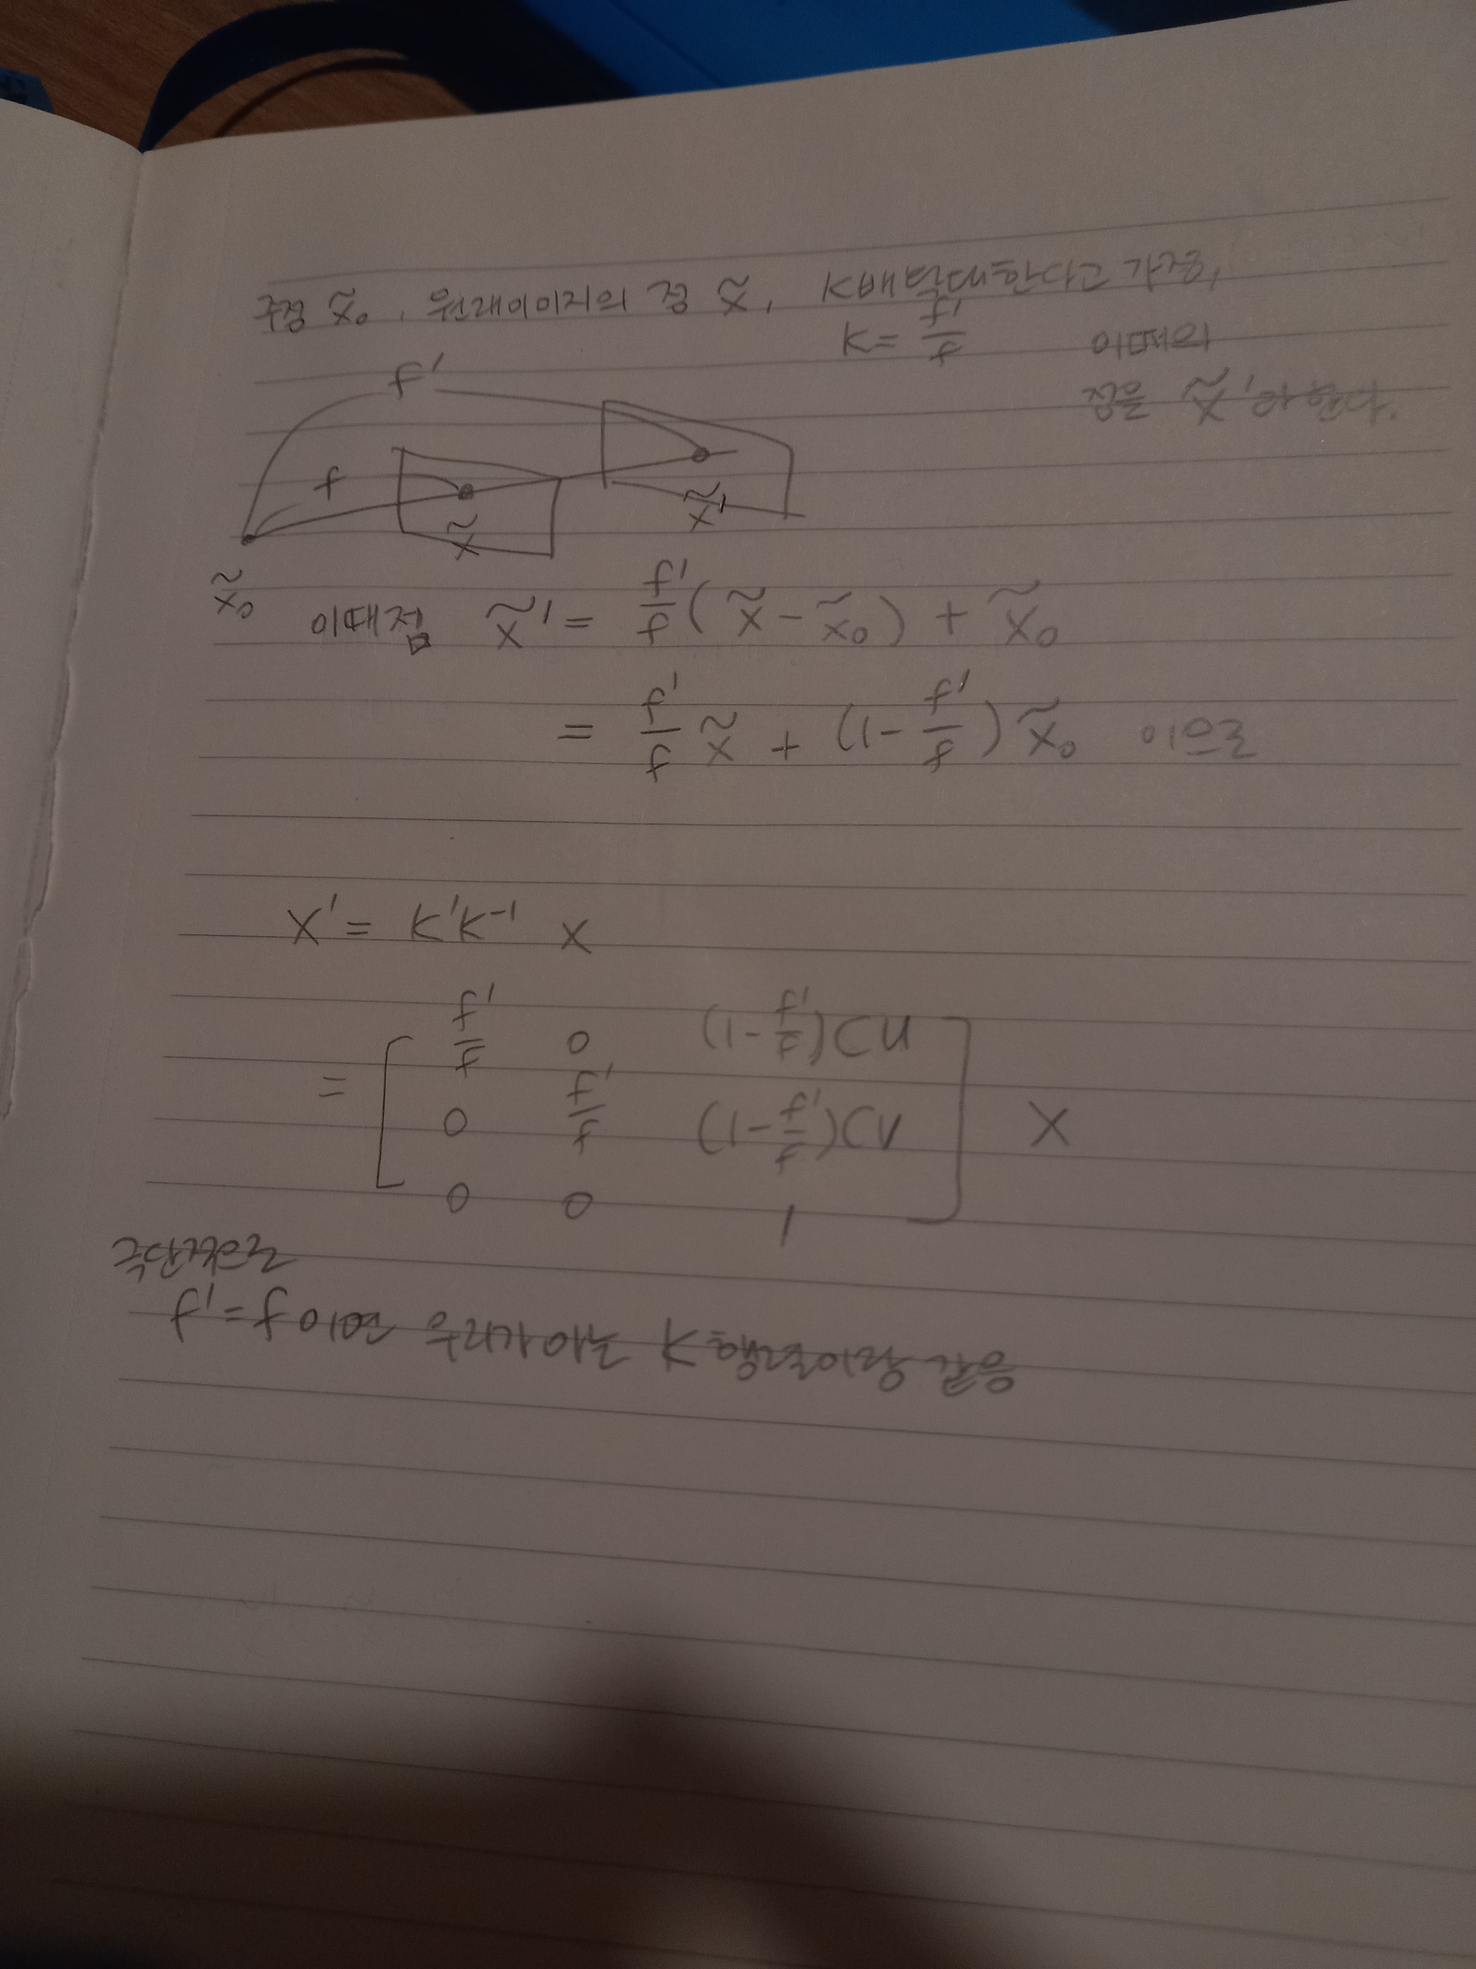







$$I′$$
$$I$$
$$f′$$
$$\tilde{x}′$$
$$\tilde{x}$$
$$f$$
$${\tilde{x}}_{0}$$

