Slide 1
0 번째 축 = height
1 번째 축 = width
0.8425 | 0.3970
0.5268 | 0.7384
0.5639 | 0.3080
0.8425 | 0.3970
0.5268 | 0.7384
0.5639 | 0.3080

Slide 2

0 번째 축 = channel
1 번째 축 = height
2 번째 축 = width
8
0
8
0
2
8
8
0
2
8
6
4
0
2
8
6
4
0
8
6
4
0
8
6
4
4
8
4
9
4
6
4
9
6
6
4
9
6
8
0
0
6
0
5
0
8
0
5
7
8
0
5
7
8
4
4
7
4
3
4
8
4
3
9
8
4
3
9
2
4
4
9
2
4
4
2
4
4
8
0
2
8
6
4
0
8
6
4
4
9
6
8
0
0
5
7
8
4
4
3
9
2
4
4

Slide 3
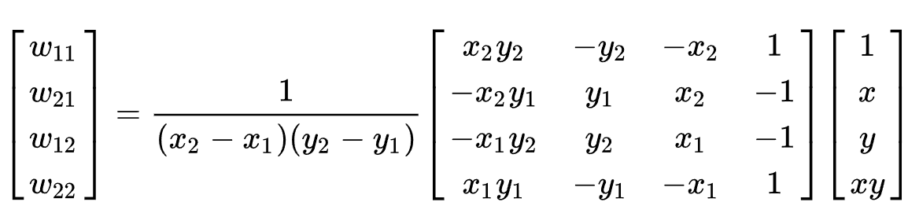
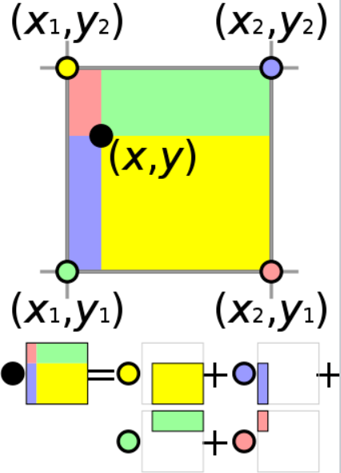
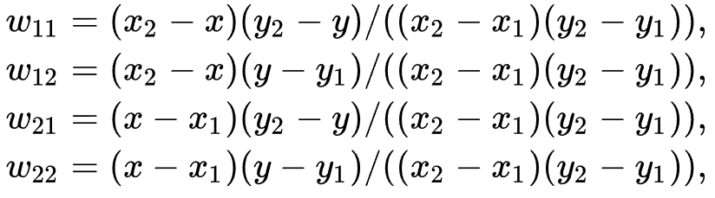




$$w_{21}$$
$$w_{11}$$
$$w_{22}$$
$$w_{12}$$

Slide 4
-1
-0.3333
0.3333
1
-1
-0.7143
0
1
2
3
-0.7143
-0.3333
4
5
6
7
0.3333
8
9
10
11
1
12
13
14
15
input value
grid value
output(-0.7143, -0.7143) = 2.1429

Slide 5
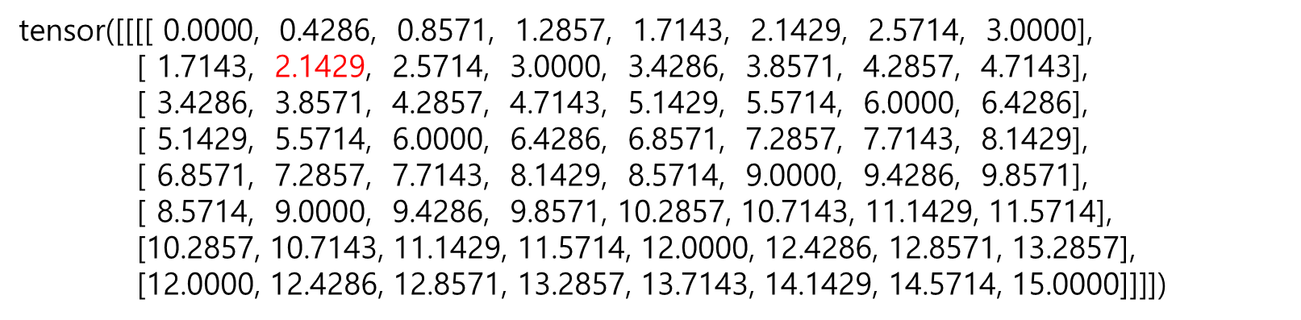
tensor([[[[ 0.0000, 0.4286, 0.8571, 1.2857, 1.7143, 2.1429, 2.5714, 3.0000],
[ 1.7143, 2.1429, 2.5714, 3.0000, 3.4286, 3.8571, 4.2857, 4.7143],
[ 3.4286, 3.8571, 4.2857, 4.7143, 5.1429, 5.5714, 6.0000, 6.4286],
[ 5.1429, 5.5714, 6.0000, 6.4286, 6.8571, 7.2857, 7.7143, 8.1429],
[ 6.8571, 7.2857, 7.7143, 8.1429, 8.5714, 9.0000, 9.4286, 9.8571],
[ 8.5714, 9.0000, 9.4286, 9.8571, 10.2857, 10.7143, 11.1429, 11.5714],
[10.2857, 10.7143, 11.1429, 11.5714, 12.0000, 12.4286, 12.8571, 13.2857],
[12.0000, 12.4286, 12.8571, 13.2857, 13.7143, 14.1429, 14.5714, 15.0000]]]])

Slide 6
-1
-1
-0.5
0
0.25
0.5
0.75
1
0.7143
-0.75
0
1
2
3
-0.7143
-0.5
-0.25
4
5
6
7
0
8
9
10
11
0.5
12
13
14
15
1
input value
grid value
output(0.7143, -0.7143) = 3.2143

Slide 7
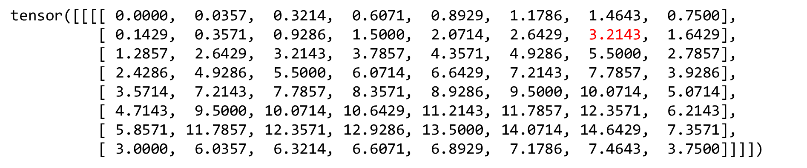
tensor([[[[ 0.0000, 0.0357, 0.3214, 0.6071, 0.8929, 1.1786, 1.4643, 0.7500],
[ 0.1429, 0.3571, 0.9286, 1.5000, 2.0714, 2.6429, 3.2143, 1.6429],
[ 1.2857, 2.6429, 3.2143, 3.7857, 4.3571, 4.9286, 5.5000, 2.7857],
[ 2.4286, 4.9286, 5.5000, 6.0714, 6.6429, 7.2143, 7.7857, 3.9286],
[ 3.5714, 7.2143, 7.7857, 8.3571, 8.9286, 9.5000, 10.0714, 5.0714],
[ 4.7143, 9.5000, 10.0714, 10.6429, 11.2143, 11.7857, 12.3571, 6.2143],
[ 5.8571, 11.7857, 12.3571, 12.9286, 13.5000, 14.0714, 14.6429, 7.3571],
[ 3.0000, 6.0357, 6.3214, 6.6071, 6.8929, 7.1786, 7.4643, 3.7500]]]])

