Slide 1

Welcome to Math Club 2016-2017!
“Come for the snacks, stay for the math!”
President: David Yue
Vice President: Vincent Huang
Treasurer: Mukund Rao

Slide 2
Scheduling
Math Club will be held in room 1084/1085.
After today’s meeting, there will be another one next week (9/9). After that, there will be usually biweekly meetings every other Friday, with a few exceptions (Pi Day Party, etc.)
Join the Math Club Facebook group or listen to announcements for scheduling information! We will always post in the group if there is a math club meeting that week or not so check there first!
We have a Remind: Text @dyue to the number 81010

Slide 3
Competitions
AMCs
AMC 10/12 A is offered to everyone, including non-Math Club members. However, the AMC 10/12 B is Math Club exclusive, so make sure to attend that! (and join math club so you can!)
McNabb
Once in the Fall and once in the Spring
Purple Comet
COMC
Texas Regions Math League

Slide 4
Added Benefits: Food, Parties and More!
All members have to pay dues of $5 in order to participate in math club activities. An additional $15 will be required for the T-shirt (you can just pay $20 together if you want).
Dues are due (ha) by
Free (kinda) Snacks and T-Shirt with club dues
Membership includes access to….
Parties
Access and information about Math Competitions
Possible block lunch AMC prep sessions
Snacks!!!!

Slide 5
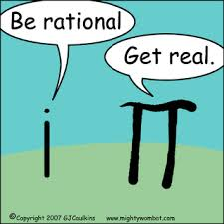
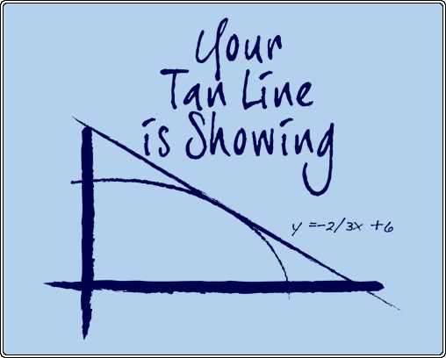
T-Shirts!!!
Over the next 4-6 weeks, we will be taking member submissions for T-shirt ideas
On the meeting following the deadline, everyone will vote on the best design
Winner receives extra snacks that meeting
PM an officer, or post your design in the Facebook group

Slide 6

We want your input!
If you have an idea of what we should do for a meeting or just a general improvement feel free to contact any of the officers either on Facebook or talk to us personally.
Either DM us on MySpace or send us a smoke signal

