Slide 1
Special Parts of a Triangle
Jasper Math Club 2016-2017

Slide 2
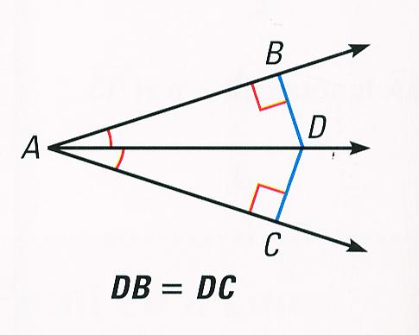
Angle Bisectors
-The angle bisector of angle BAC contains all points D such that the distance from D to AB equals the distance from D to AC. We also have angle BAD = angle CAD.

Slide 3
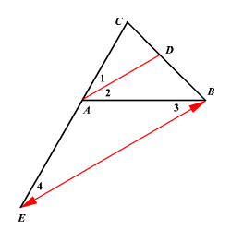
Angle Bisector Theorem
Given triangle ABC with angle bisector AD, AC:AB = DC:DB
Proof: Draw E on AC with AD||BE
-By parallel lines angle 3 = angle 2 = angle 1 = angle 4
-Therefore ABE is isosceles so AB=AE
-Then AC:AB = AC:AE = CD:DB, so we’re done.

Slide 4
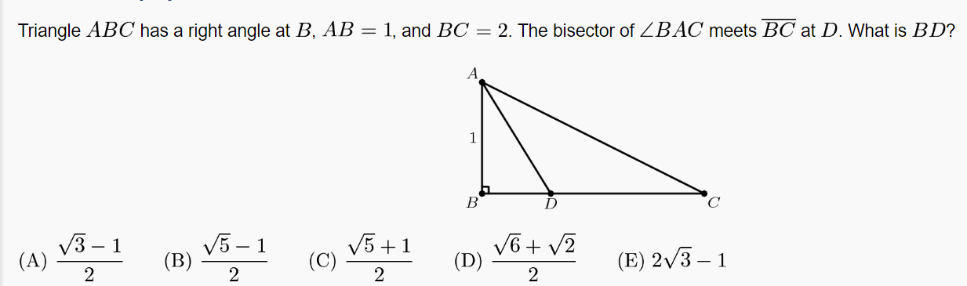
Easy Example: 2009 AMC10B #20

Slide 5
Solution Outline
Step 1: By the Pythagorean Theorem AC= sqrt(5)
Step 2: By the Angle Bisector Theorem BD:DC = 1/sqrt(5)
Step 3: We also know BD+DC=2 so solve for BD!
Step 4: BD=(sqrt(5)-1)/2 = (B)

Slide 6
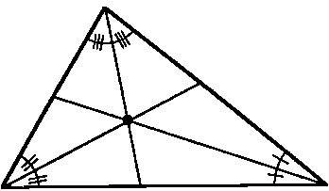
Incenters
In triangle ABC the angle bisectors of angles A,B,C meet at a point I, called the incenter of ABC. (Note: I always means incenter in this powerpoint.)

Slide 7
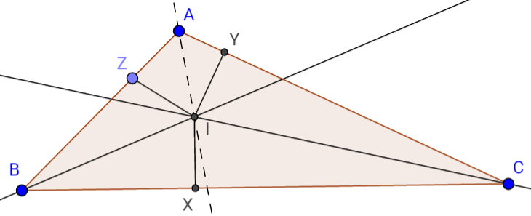
Proof Outline
I lies on the angle bisector of B -> IX=IZ
I lies on angle bisector of C -> IX = IY
Therefore IX=IZ -> I lies on the angle bisector of A so we’re done.

Slide 8
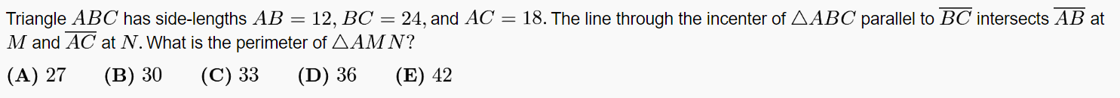
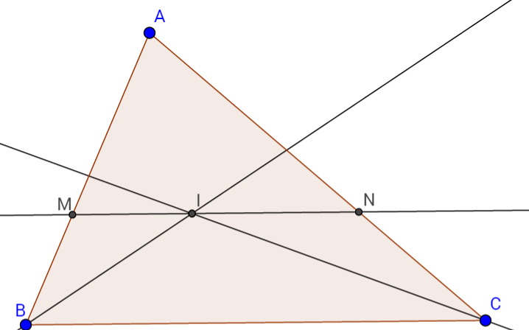
Medium Example: 2011 AMC12A #13

Slide 9
Solution Outline
Angle MBI = angle CBI = angle MIB (from alternate interior angles), so BMI is isosceles so IM=BM. Similarly IN=NC so AM+MI+IN+NA = AM+BM+CN+NA = AB + AC = 30 = (B)

Slide 10
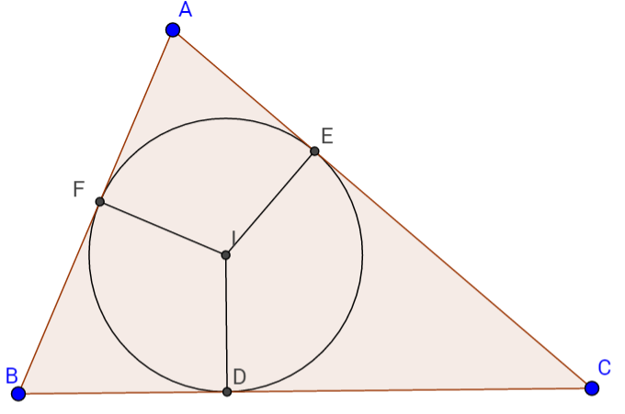
Incircles
We know from earlier that ID = IE = IF, so if we draw the circle centered at I through D,E, and F, it will be tangent to all three sides.

Slide 11
Remark on Incircles
Let x=AE=AF, y=BD=BF, z= CD=CE. If we know AB,BC,CA, we can find x,y,z:
y+z = BC, z+x = CA, x+y = AB -> solve the system for x,y, and z.

Slide 12
Easy Example
BC = 5, AC = 4, AB = 3. Find AE.

Slide 13
Solution Outline
Let AE=AF=x, BD=BF=y, CD=CE=z. We have x+y=3, y+z=5, z+x=4, so we can add these up and divide by two to get x+y+z=6, so x = 6-5 = 1.

Slide 14
Centroids
-center of mass of triangle (so you can do things like balance a paper triangle on a needle by putting the needle under the centroid)
-Let ABC be a triangle with centroid G and let M be the midpoint of BC. Then A,G,M are collinear and
-Therefore G lies on all three medians of triangle ABC
-Proof: https://ggbm.at/R9B3w8vk
-Since G is the center of mass, the areas of triangles GBC, GCA, GAB are equal.

Slide 15
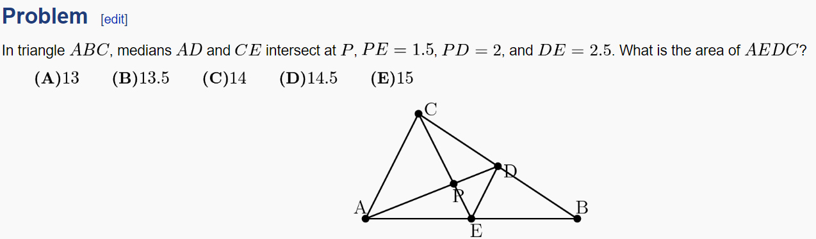
Medium Example: 2013 AMC10B #16

Slide 16
Solution Outline
Step 1: Notice PD, PE are perpendicular since triangle PDE is 3-4-5.
Step 2: Since PE=1.5, by the centroid stuff we know CE=4.5 and similarly AD=6.
Step 3: The area of [AEDC] = 0.5 x 4.5 x 6 = 13.5 = (B)!

Slide 17
Centroid Coordinates
The centroid is literally the average of the three vertices of ABC.
Example: If A = (0,0), B = (3,0), and C = (0,3), the centroid G of triangle ABC is

Slide 18
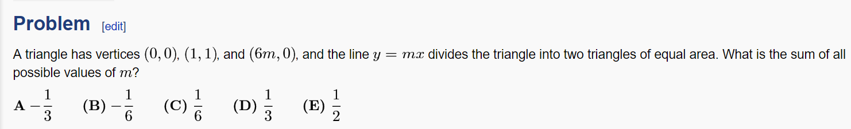
Hard Example: 2009 AMC12A Problem 14

Slide 19

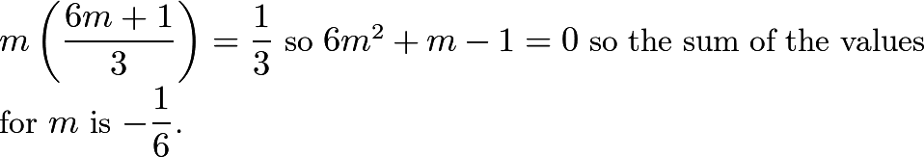
Solution Outline
Step 1: y=mx passes through (0,0) so the line must be a median since it divides the triangle into two triangles of equal area.
Step 2: Since y=mx is the median, the centroid lies on y=mx, so
is on the line.
Step 3: Plugging in the point from step 2 into the equation of the line we get
, so the answer is (B)

Slide 20
Note
The answers to geometry AMC questions are always B apparently.

Slide 21
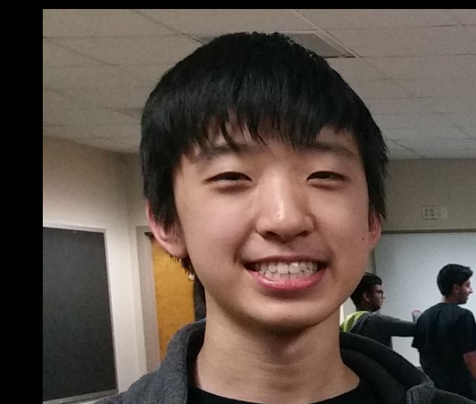
We Finished the Powerpoint!!

