Slide 1
Better Ruby Through Design Principles
@mikegehard
Tech Lead – UserAcq
LivingSocial

Slide 2
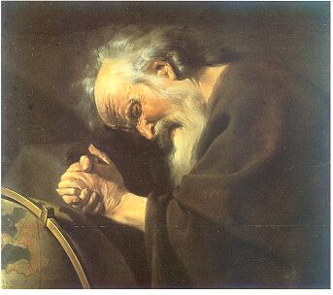
"Nothing endures but change.” Heraclitus of Ephesus (c.535 BC - 475 BC)

Slide 3
That's great but how does that apply to Ruby?

Slide 4
When did you last build an application that didn't change?

Slide 5
How is your app going to adjust to change?

Slide 6
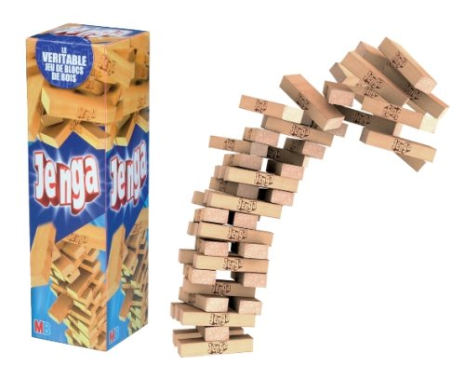

Slide 7


Slide 8
What decides how your app is going to withstand change?

Slide 9
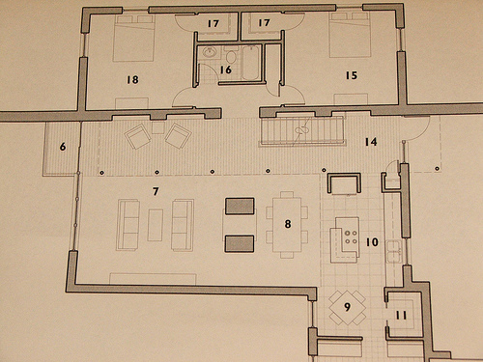
The design ⁽¹⁾

Slide 10
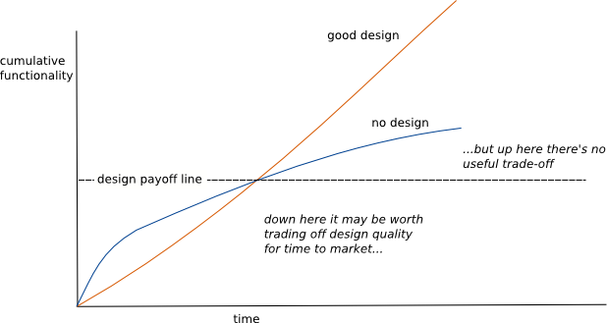
http://martinfowler.com/bliki/DesignStaminaHypothesis.html

Slide 11
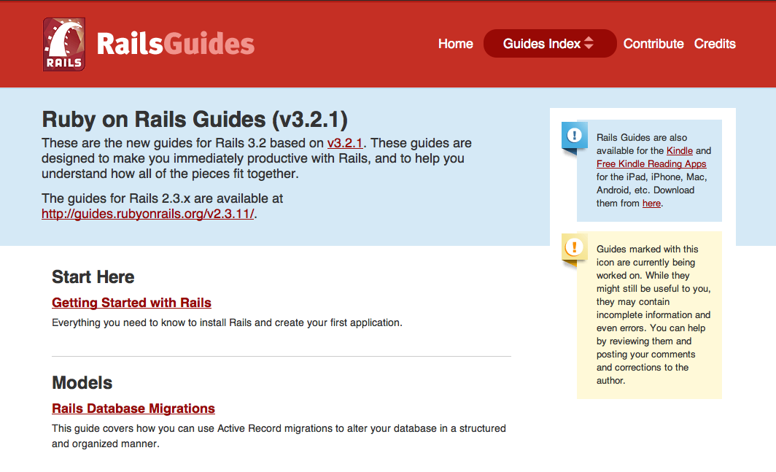
I'm using Rails so I don't need to do design

Slide 12
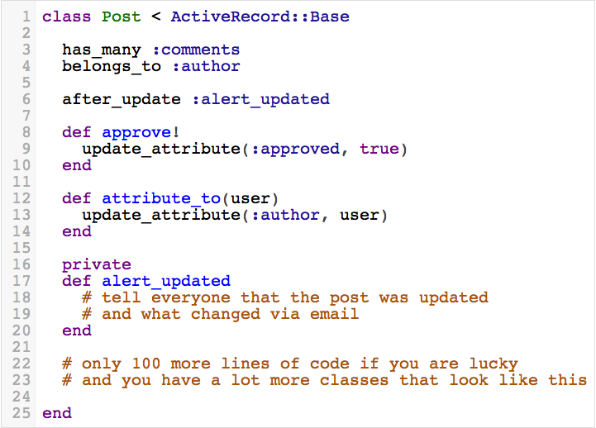

Slide 13
How do you measure the design of your application?

Slide 14

The interactions between classes ⁽²⁾

Slide 15
Processing Requirements
Parse a CSV file
Report status of the parsing via email

Slide 16
Processing Requirements Week Two
Parse either CSV or TSV file
Report status of the parsing via email

Slide 17
What is the difference?
Each class is responsible for one thing.
FileProcessor can be augmented without changing the class.

Slide 18
Processing Requirements Week Three
Parse either CSV or TSV file
Report status of the parsing via Email or SMS

Slide 19
What is the difference?
I can easily change how I report statuses because status reporters are interchangable.
FileProcessor depends on abstract idea of a reporter.
Contracts between FileReporter and supporting objects are small and easy to learn.

Slide 20
Future Processing Requirements
Parse either CSV, TSV or PDF files
Report status of the parsing via Email, SMS or fax.

Slide 21
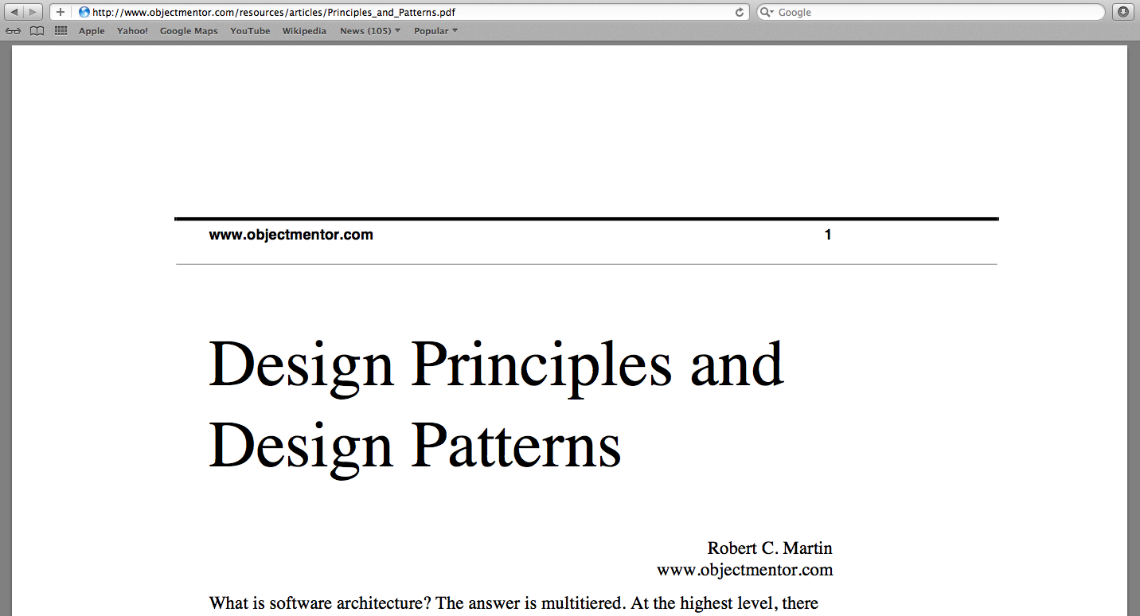

Slide 22
SOLID
Single Responsibility Principle
Open for extension/ closed to modification
Liskov Substitution Principle
Interface Segregation
Dependency Inversion

Slide 23
Image Attributions (1) http://www.flickr.com/people/span112/ (2) http://www.flickr.com/people/emsl/

