Slide 1
Better Ruby Through Design Principles
@mikegehard
https://github.com/msgehard
Tech Lead – User Acquisition
LivingSocial

Slide 2
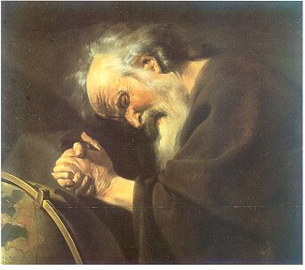
"Nothing endures but change.” Heraclitus of Ephesus (c.535 BC - 475 BC)

Slide 3
That's great but how does that apply to Ruby?

Slide 4
Is my application going to change?
Notes:
Apps change because their requirement change.

Slide 5
How is your application going to adjust to change?

Slide 6
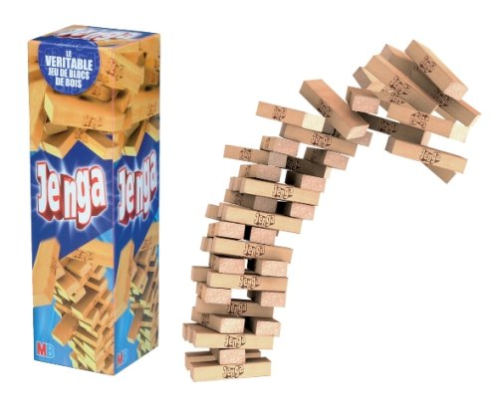

Slide 7
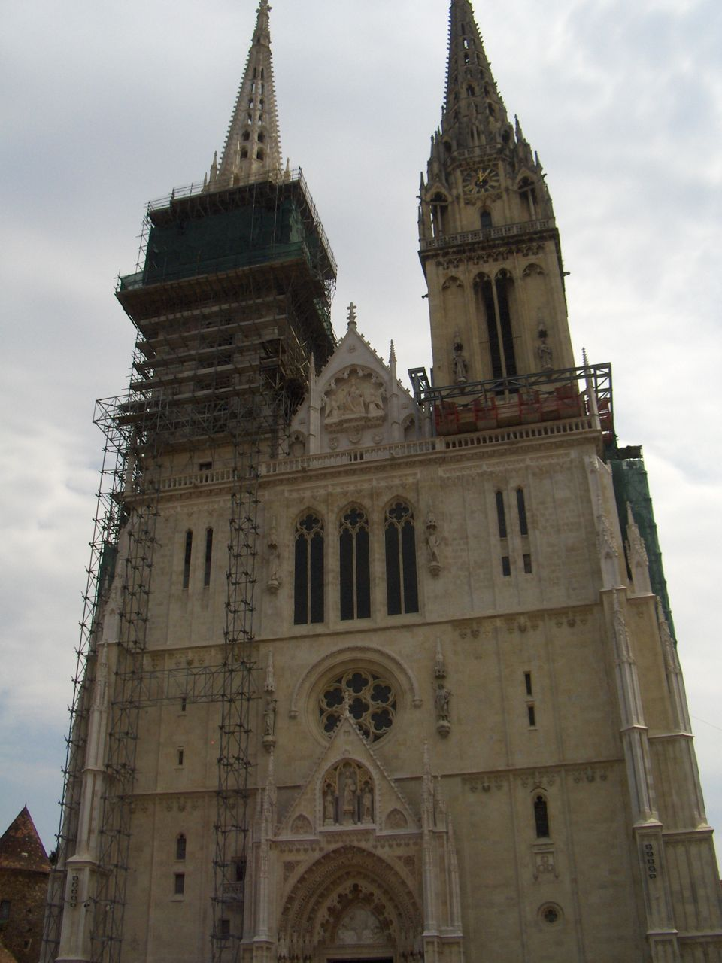

Slide 8
What decides how your app is going to respond to change?

Slide 9
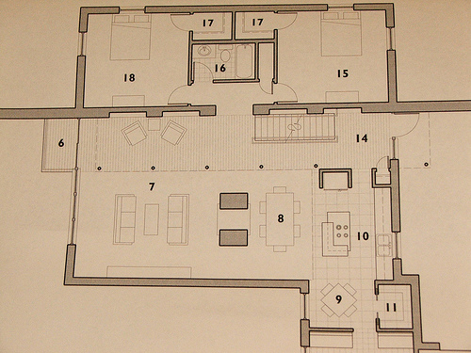
The design ⁽¹⁾

Slide 10

The interactions between classes ⁽²⁾

Slide 11
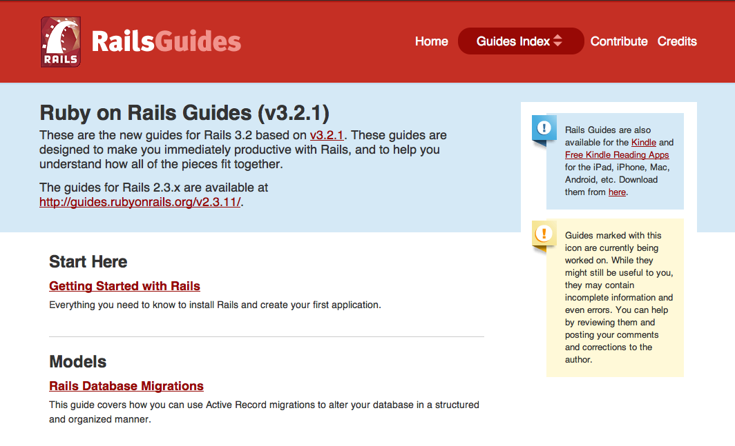
I'm using Rails so I don't need to do design

Slide 12
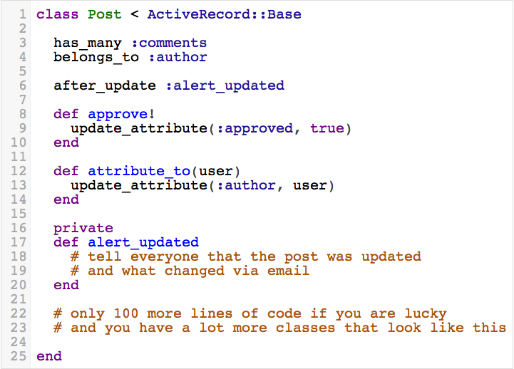

Slide 13


Slide 14
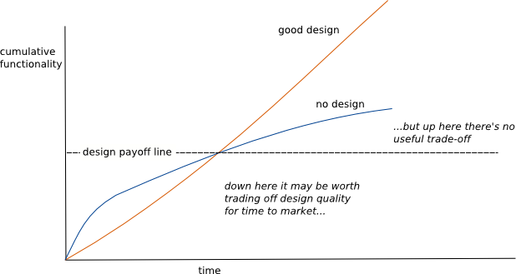
http://martinfowler.com/bliki/DesignStaminaHypothesis.html
Notes:
This is why you should pay attention to design, it pays off in the long run.
So if you feel like your app is going to not be around that long then you can stop listening.

Slide 15
Processing Requirements
Parse a CSV file
Report status of the parsing via email

Slide 16
Processing Requirements Week Two
Parse either CSV or TSV file
Report status of the parsing via email
Notes:
Show file_processor2.rb and file_processor2a.rb.

Slide 17
What is the difference?

Slide 18
FileProcessor is no longer responsible for file parsing.

Slide 19
FileProcessor can parse new file types without having to change.

Slide 20
Testing of parsing can be done in isolation.

Slide 21
Processing Requirements Week Three
Parse either CSV or TSV file
Report status of the parsing via Email or SMS

Slide 22
What is the difference?

Slide 23
Each class is responsible for one thing.

Slide 24
Reporters are functionally interchangeable and reusable.

Slide 25
Contracts between FileReporter and supporting objects are small and easy to learn.

Slide 26
FileProcessor depends on abstract idea of a reporter.

Slide 27
Testing of reporting can be done in isolation.

Slide 28
Future Processing Requirements
Download file from FTP site or Dropbox.
Parse either CSV, TSV or PDF files
Report status of the parsing via Email, SMS or Nagios.

Slide 29
SOLID

Slide 30
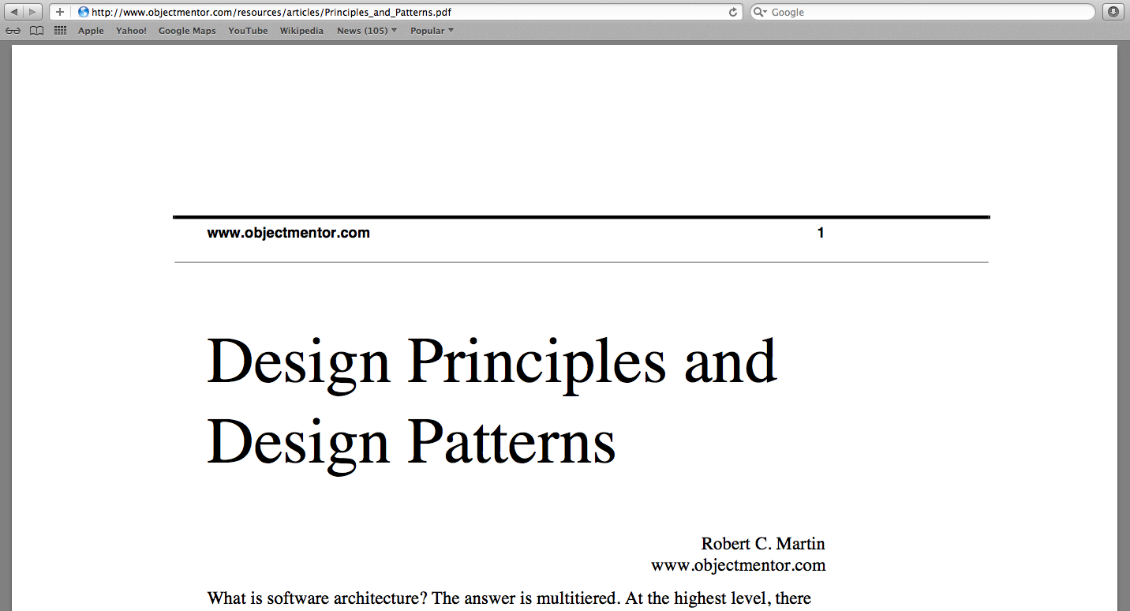

Slide 31
Single Responsibility Principle

Slide 32
Open for extension
Closed to modification

Slide 33
Liskov Substitution Principle

Slide 34
Interface Segregation

Slide 35
Dependency Inversion

Slide 36
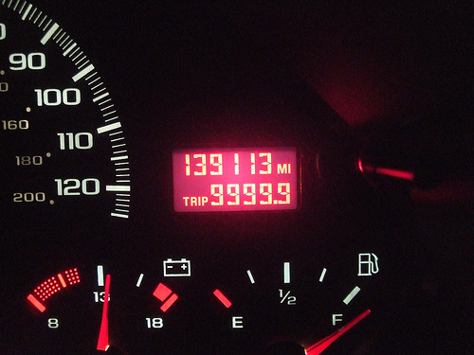
Your mileage may vary ⁽³⁾
Notes:
These are principles, not hard and fast rules.
Sometimes they conflict with other principles or just don’t make sense.

Slide 37
Image Attributions (1) http://www.flickr.com/people/span112/ (2) http://www.flickr.com/people/emsl/ (3) http://www.flickr.com/people/kennejima/ (4) http://www.flickr.com/people/27282406@N03/
References
http://www.objectmentor.com/resources/articles/Principles_and_Patterns.pdf
http://www.butunclebob.com/ArticleS.UncleBob.PrinciplesOfOod
http://confreaks.com/videos/240-goruco2009-solid-object-oriented-design
http://confreaks.com/videos/185-rubyconf2009-solid-ruby
http://blog.rubybestpractices.com/posts/gregory/055-issue-23-solid-design.html
http://mmiika.wordpress.com/oo-design-principles/

Slide 38

Any questions? ⁽⁴⁾
http://speakerrate.com/talks/9437
@mikegehard
https://github.com/msgehard
Notes:
Thanks to the conference organizers.
Thanks to you all for listening.
Thanks to the Boulder Ruby Group, especially David Hassler, for improving this talk via feedback.

