Slide 1
Better Ruby Through Design Principles
@mikegehard
Tech Lead – UserAcq
LivingSocial

Slide 2
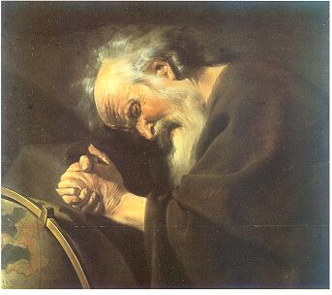
"Nothing endures but change.” Heraclitus of Ephesus (c.535 BC - 475 BC)

Slide 3
That's great but how does that apply to Ruby?

Slide 4
Who has built an application that hasn’t changed?
Notes:
Apps change because their requirement change.

Slide 5
How is your application going to adjust to change?

Slide 6
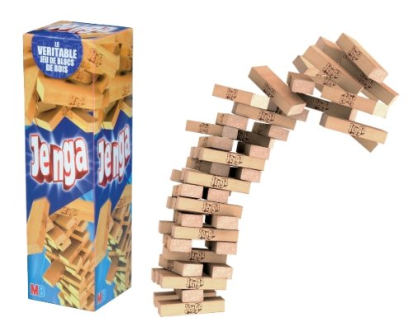

Slide 7
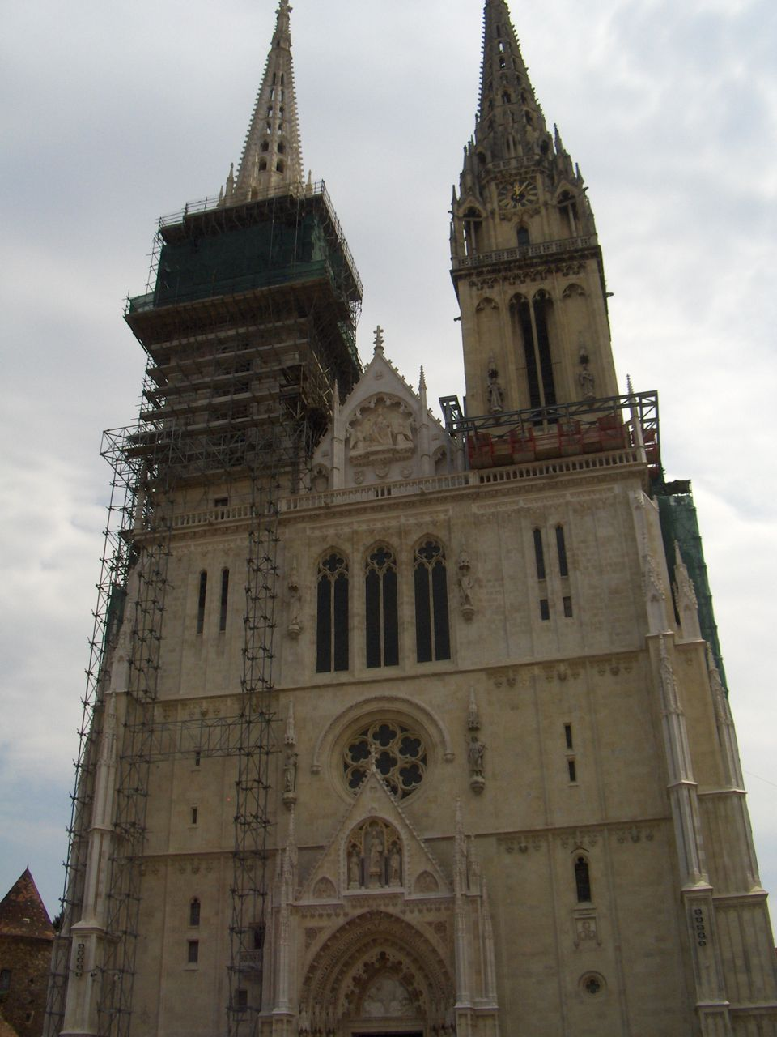

Slide 8
What decides how your app is going to withstand change?

Slide 9
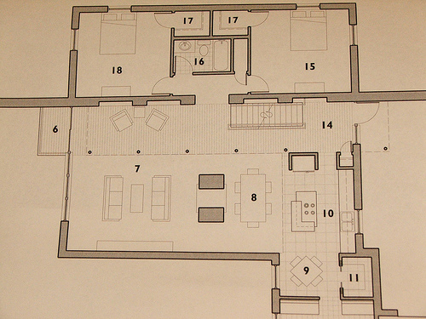
The design ⁽¹⁾

Slide 10

The interactions between classes ⁽²⁾

Slide 11
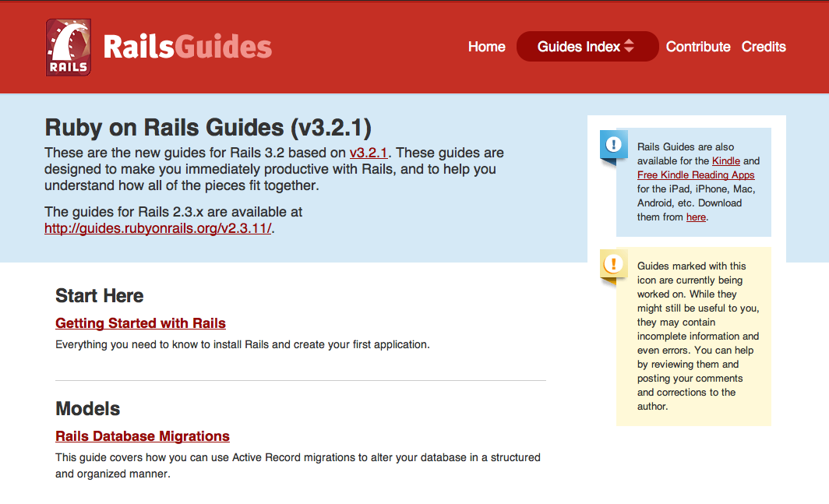
I'm using Rails so I don't need to do design

Slide 12
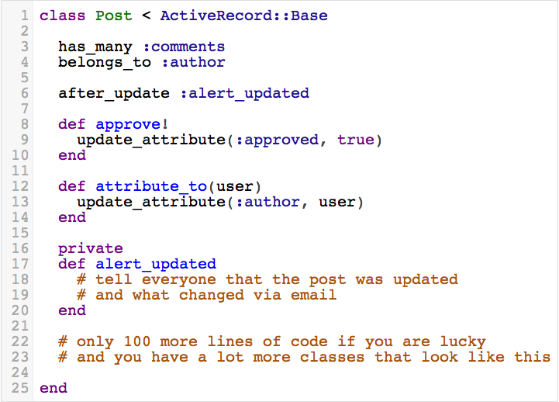

Slide 13
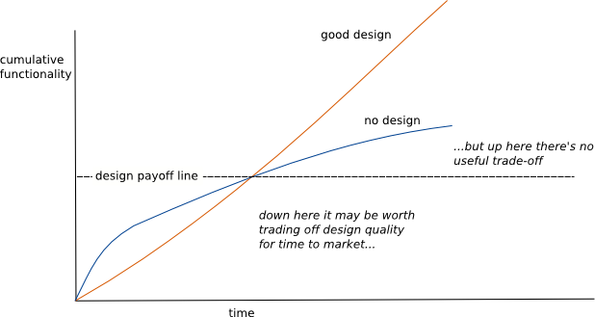
http://martinfowler.com/bliki/DesignStaminaHypothesis.html
Notes:
This is why you should pay attention to design, it pays off in the long run.
So if you feel like your app is going to not be around that long then you can stop listening.

Slide 14
Processing Requirements
Parse a CSV file
Report status of the parsing via email

Slide 15
Processing Requirements Week Two
Parse either CSV or TSV file
Report status of the parsing via email
Notes:
Show file_processor2.rb and file_processor2a.rb.

Slide 16
What is the difference?
FileProcessor is no longer responsible for file processing.
FileProcessor can parse new file types without changing the class.
Testing of parsing can be done in isolation.

Slide 17
Processing Requirements Week Three
Parse either CSV or TSV file
Report status of the parsing via Email or SMS

Slide 18
What is the difference?
Each class is responsible for one thing.
Reporters are functionally interchangeable.
Contracts between FileReporter and supporting objects are small and easy to learn.
FileProcessor depends on abstract idea of a reporter.
Testing of reporting can be done in isolation.

Slide 19
Future Processing Requirements
Parse either CSV, TSV or PDF files
Report status of the parsing via Email, SMS or Nagios.

Slide 20
SOLID

Slide 21
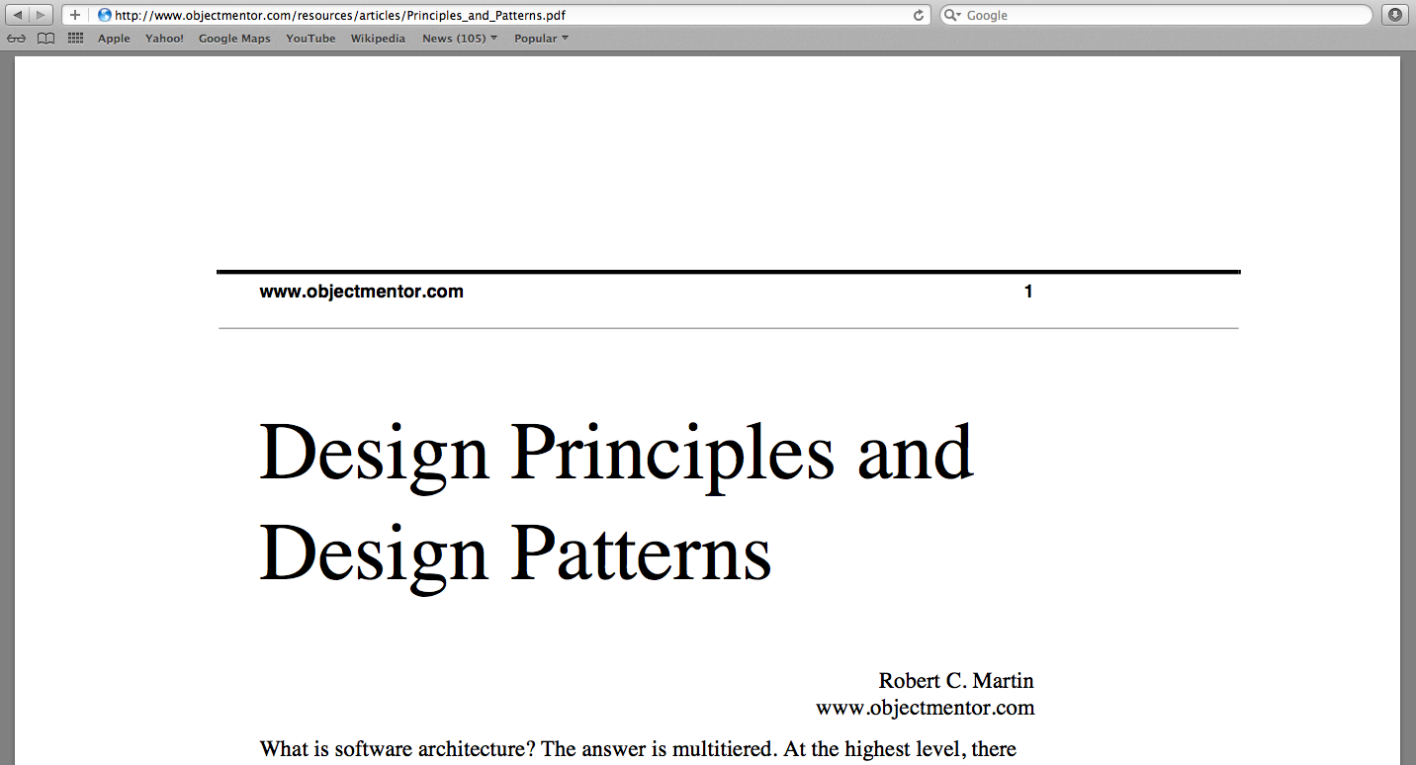

Slide 22
Single Responsibility Principle

Slide 23
Open for extension
Closed to modification

Slide 24
Liskov Substitution Principle

Slide 25
Interface Segregation

Slide 26
Dependency Inversion

Slide 27
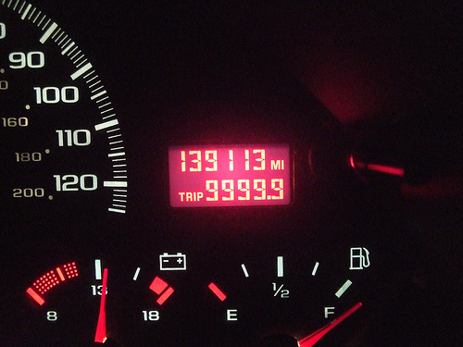
Your mileage may vary ⁽³⁾

Slide 28

Any questions? ⁽⁴⁾

Slide 29
Image Attributions (1) http://www.flickr.com/people/span112/ (2) http://www.flickr.com/people/emsl/ (3) http://www.flickr.com/people/kennejima/ (4) http://www.flickr.com/people/27282406@N03/
References
http://www.objectmentor.com/resources/articles/Principles_and_Patterns.pdf
http://www.butunclebob.com/ArticleS.UncleBob.PrinciplesOfOod
http://confreaks.com/videos/240-goruco2009-solid-object-oriented-design
http://confreaks.com/videos/185-rubyconf2009-solid-ruby
http://blog.rubybestpractices.com/posts/gregory/055-issue-23-solid-design.html
http://mmiika.wordpress.com/oo-design-principles/

