Slide 1
Better Ruby Through Design Principles
@mikegehard
Tech Lead – UserAcq
LivingSocial

Slide 2
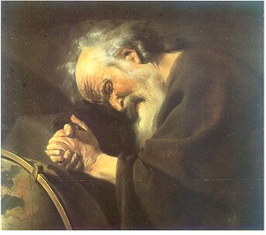
"Nothing endures but change.” Heraclitus of Ephesus (c.535 BC - 475 BC)

Slide 3
That's great but how does that apply to Ruby?

Slide 4
Who has built an application that hasn’t changed?
Notes:
Apps change because their requirement change.

Slide 5
How is your application going to adjust to change?

Slide 6
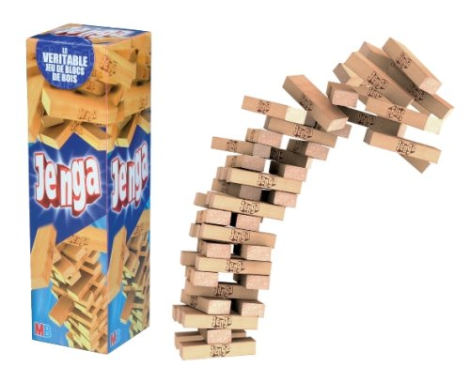

Slide 7
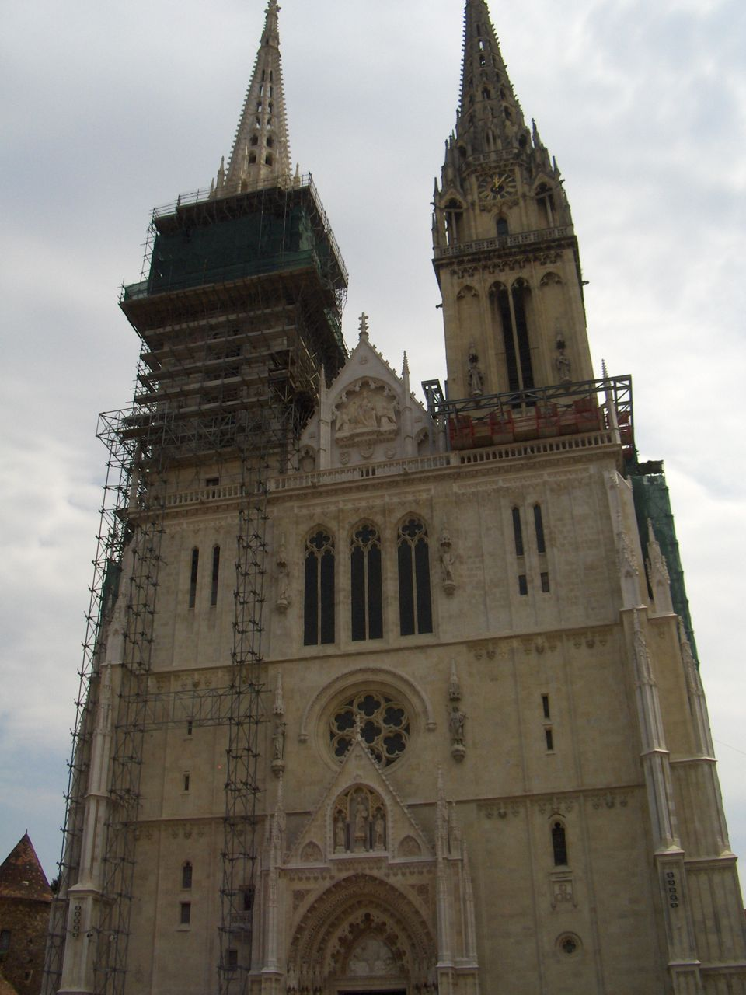

Slide 8
What decides how your app is going to withstand change?

Slide 9
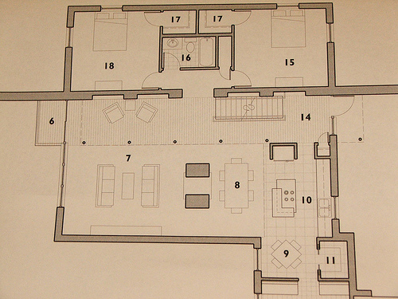
The design ⁽¹⁾

Slide 10
How do you measure the design of your application?

Slide 11

The interactions between classes ⁽²⁾

Slide 12
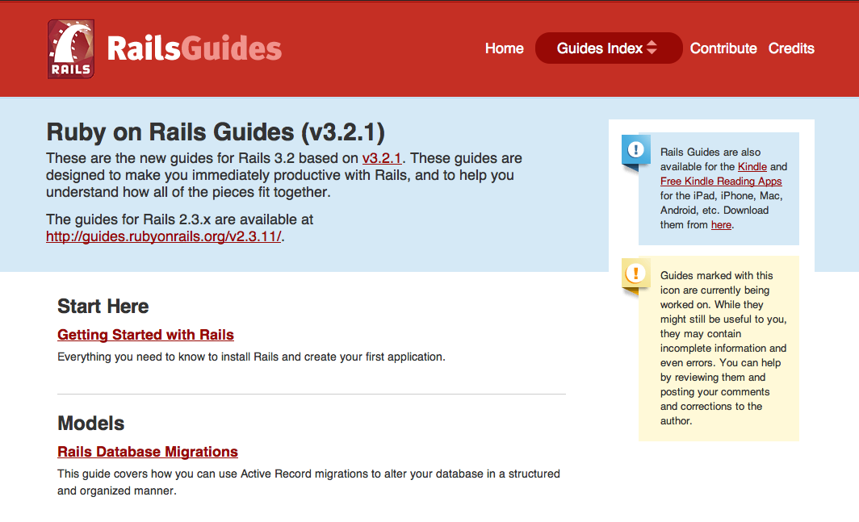
I'm using Rails so I don't need to do design

Slide 13
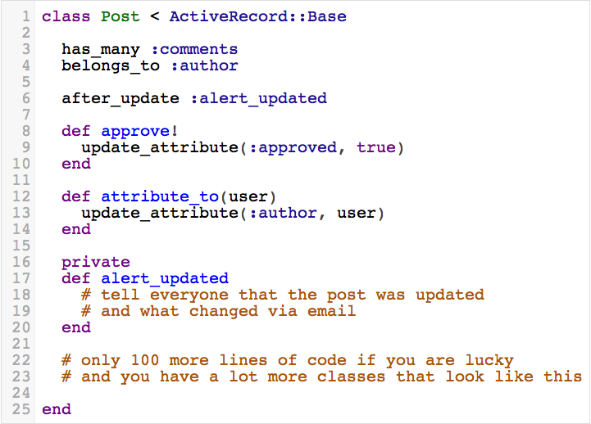

Slide 14
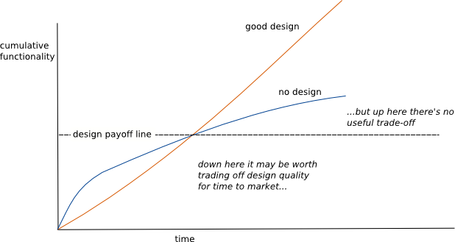
http://martinfowler.com/bliki/DesignStaminaHypothesis.html
Notes:
This is why you should pay attention to design, it pays off in the long run.
So if you feel like your app is going to not be around that long then you can stop listening.

Slide 15
Processing Requirements
Parse a CSV file
Report status of the parsing via email

Slide 16
Processing Requirements Week Two
Parse either CSV or TSV file
Report status of the parsing via email
Notes:
Show file_processor2.rb and file_processor2a.rb.

Slide 17
What is the difference?
FileProcessor is no longer responsible for file processing.
FileProcessor can parse new file types without changing the class.
Testing of parsing can be done in isolation.

Slide 18
Processing Requirements Week Three
Parse either CSV or TSV file
Report status of the parsing via Email or SMS

Slide 19
What is the difference?
Each class is responsible for one thing.
Reporters are functionally interchangeable.
Contracts between FileReporter and supporting objects are small and easy to learn.
FileProcessor depends on abstract idea of a reporter.
Testing of reporting can be done in isolation.

Slide 20
Future Processing Requirements
Parse either CSV, TSV or PDF files
Report status of the parsing via Email, SMS or Nagios.

Slide 21
SOLID
Single Responsibility Principle
Open for extension/ closed to modification
Liskov Substitution Principle
Interface Segregation
Dependency Inversion

Slide 22
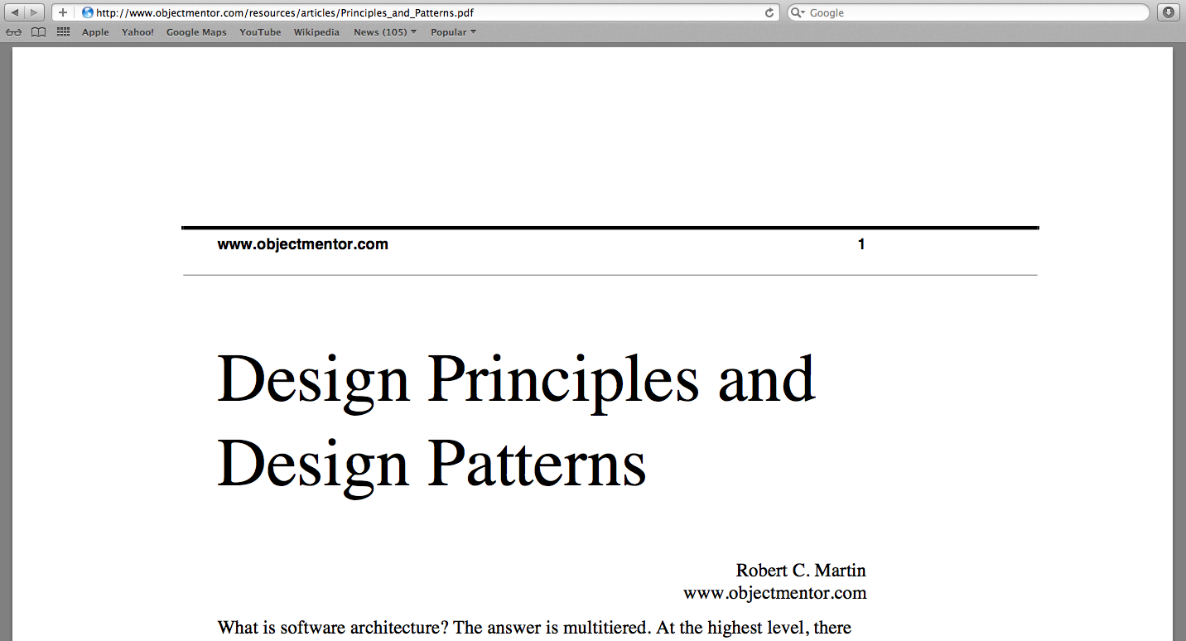

Slide 23
Image Attributions (1) http://www.flickr.com/people/span112/ (2) http://www.flickr.com/people/emsl/

Slide 24
References
http://www.objectmentor.com/resources/articles/Principles_and_Patterns.pdf
http://www.butunclebob.com/ArticleS.UncleBob.PrinciplesOfOod
http://confreaks.com/videos/240-goruco2009-solid-object-oriented-design
http://confreaks.com/videos/185-rubyconf2009-solid-ruby
http://blog.rubybestpractices.com/posts/gregory/055-issue-23-solid-design.html
http://mmiika.wordpress.com/oo-design-principles/

