Slide 1


Data Analysis Using Django
Coding Chameleons
GAUTAM(21103052)
ANIKET KALIA(21102083)
DISHA AGGARWAL(21105082)
PULKIT DEMBLA(21107094)
SYED ANSAR HAQUE(21107004)

Slide 2
PROBLEM STATEMENT ANALYSIS
Data Retrieval
Database Setup
API Develop -ment
Data Analysis
DATA REPRESEN - TATION
Market Analysis
Acquire H1B data from the excel sheets
Configure PostgreSQL database for storage
Create Django API for data access.
Derive
insights from H1B data.
Describe data as Piechart, graphs, bargraphs, etc.
Evaluate potential uses and target audience appeal.

Slide 3










REQUIRED SOFTWARE ANALYSIS
Django REST FRAMEWORK
Excel
Power BI
01
02
03
04
05
Python
Postgre SQL

Slide 4

DATA INGESTION
Excel Data Download and Cleaning:
Database Creation:
02
Create a new PostgreSQL database to store the H1B data.
Download H1B data files in CSV format.
Clean and preprocess data.
03
SQL Libraries Import in Jupyter Notebook:
Tables Creation:
01
06
Define database tables to represent the data structure.
Import SQL libraries for data manipulation in Jupyter Notebook
04
Establishing a Connection Between Python and PostgreSQL
Data Injection into Tables:
05
Python code to read CSV files and insert data into tables.
Write Python code to establish a connection to PostgreSQL

Slide 5
DJANGO API
Step 1
Create a Django App
Step 2
Define Models
Step 3
Create Migrations and Apply Them
Step 4
Create API Views and URL Patterns
Step5
Implement Serializer
Step 6
Use Django REST frameworks

Slide 6
API ENDPOINTS SOLUTION
Zenith Central Bank
01
Total number of results: 633933
03
02
Median : 75,500.00
Mean salary : 1,57,903.37
04
05
75% percentile salary: 1,00,360.00
25% percentile salary : 63,814.00

Slide 7
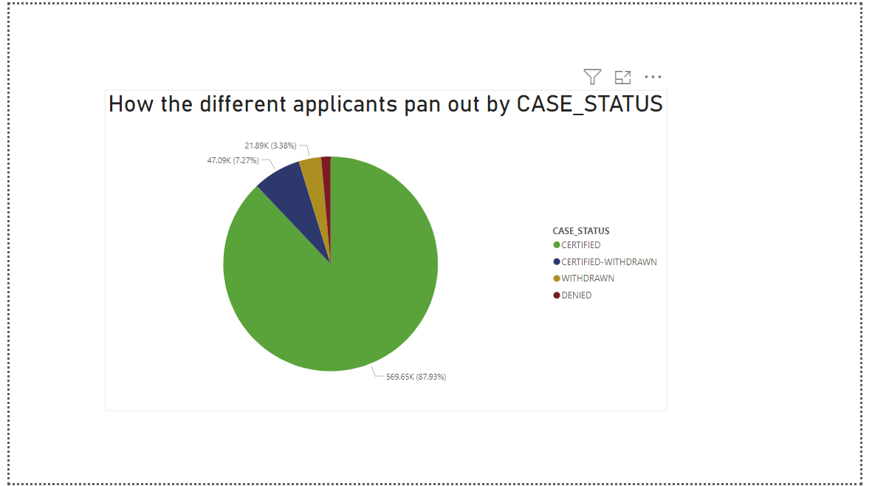

Slide 8
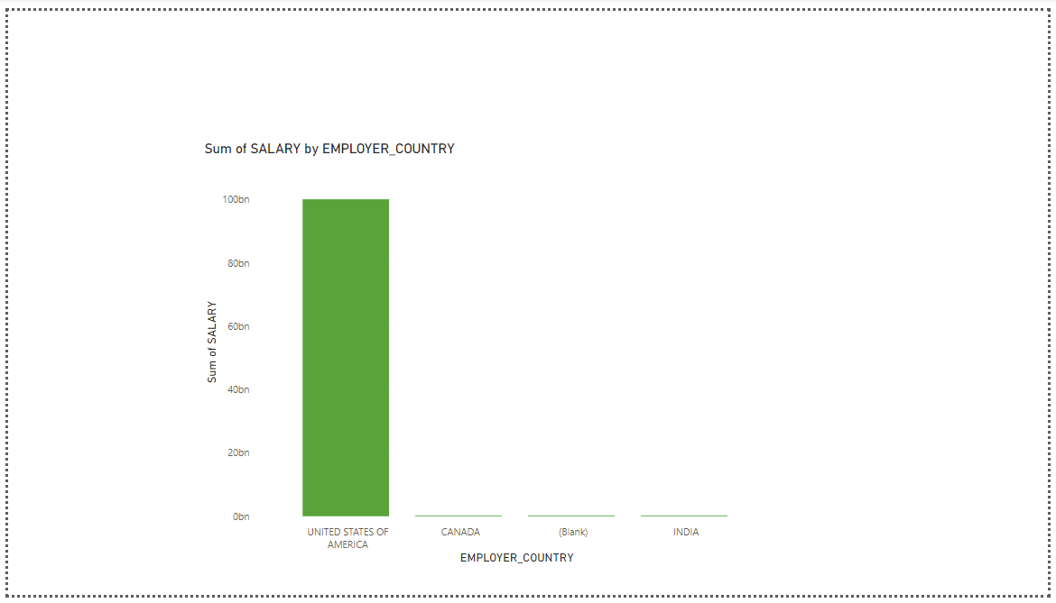

Slide 9
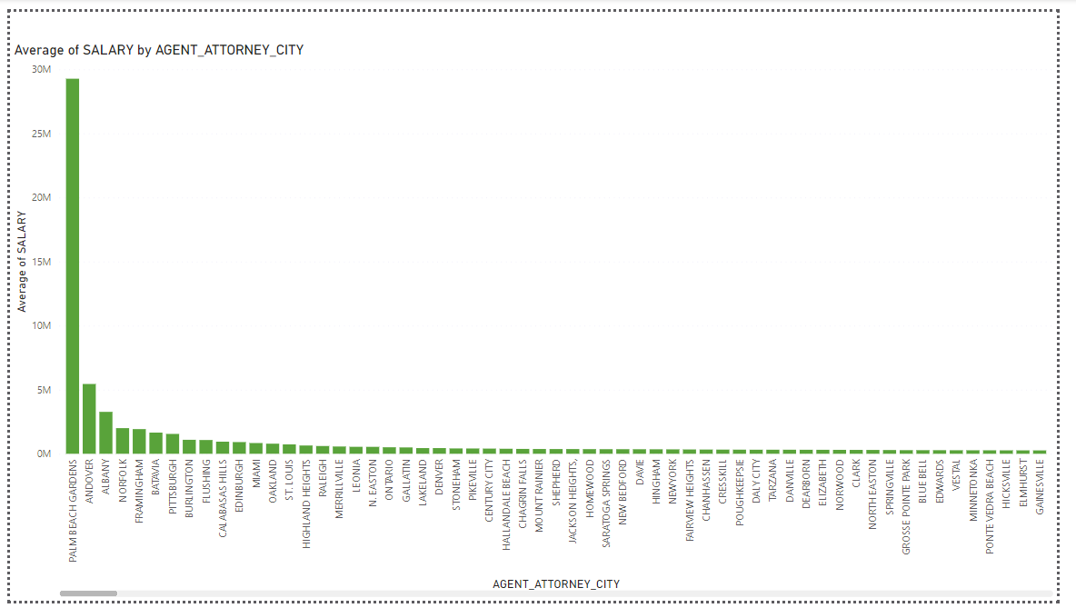

Slide 10






MARKET SCOPE FOR PRODUCT
Employment Trends and Market Demand
Analyzing H1B data can reveal trends in the demand for certain skills or job roles.
Insightful Data for Marketing Campaigns
Marketing teams can use these insights to tailor their campaigns based on the demand for specific skills or industries, targeting companies that frequently hire H1B workers.
Market Positioning
Salary Benchmarking
Companies can use the data to understand where they stand in terms of H1B hires compared to industry averages.
The mean, median, and percentile salary data can be used for salary benchmarking. Companies can use this information to ensure their compensation packages are competitive in the market.
Performance Optimization and User Experience
Performance measurement and optimization of the Django API contribute to a better user experience.
Educational Content
The insights gained from the project can be used to create educational content, such as blog posts, webinars, or whitepapers. d.

Slide 11

THANK YOU

