Slide 1
Sayogi
Name:Binod Gautam

Slide 2
Introduction
Sayogi is an innovative web-based application that provides a user-friendly platform for both service seekers and service providers. It enables service seekers to create detailed profiles that highlight their skills, experience, and expertise. Simultaneously, service providers can create service requests specifying their specific requirements.

Slide 3
Problem statement
Lack of a user-friendly and efficient platform connecting service seekers and providers
Existing methods are time-consuming, and unreliable, creating difficulties for both service seekers and providers.

Slide 4
Objectives
To create a user-friendly platform that simplifies service discovery, builds trust, and streamlines service request management for a seamless experience between service seekers and providers.

Slide 5
Development Methodology
My proposed project will follow the Waterfall Model as its methodology for software development. This model presents a linear sequence of development phases, each dependent on the completion of the previous phase. Since I have a well-defined vision for the project, the Waterfall Model aligns with my goals and is the appropriate approach for its development

Slide 6
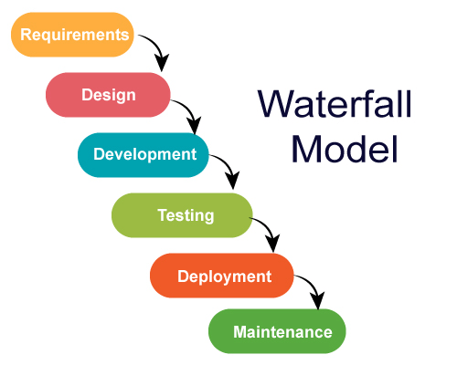
Development Methodology

Slide 7
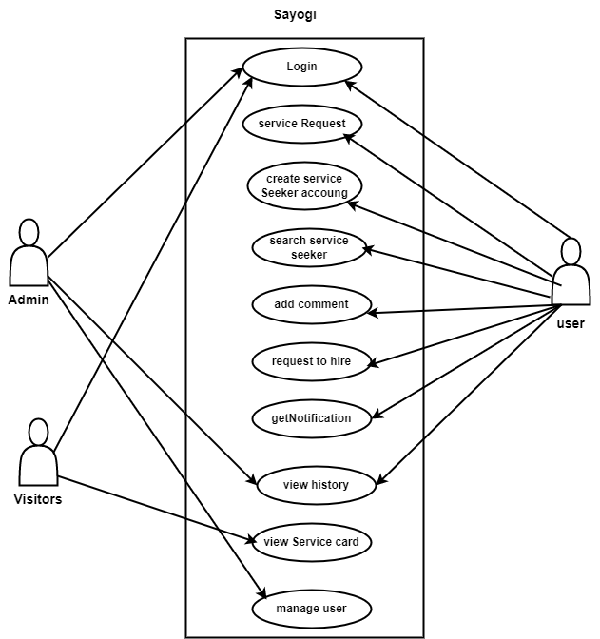
Functional requirements

Slide 8
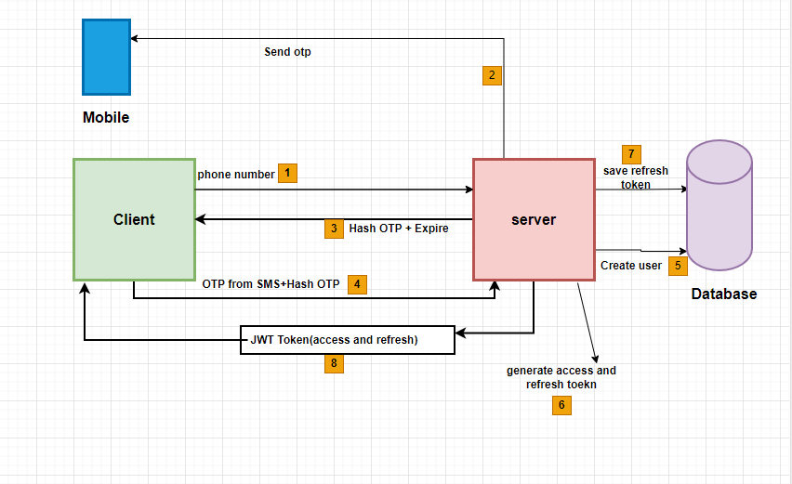
Non-functional requirements

Slide 9
Feasibility Study
Technical feasibility
The Technical Feasibility of the sayogi system has been evaluated, taking into account the necessary resources such as hardware, software, and human resources. It has been determined that all required resources are already available
Economic Feasibility
The sayogi Nepal System utilizes open-source technologies, meaning there is no need for additional software or hardware. As a result, the only recurring cost associated with the system is the internet connection

Slide 10
Feasibility Study
Operational Feasibility
The operational feasibility of the sayogi System was assessed, and we identified several challenges and vulnerabilities in the existing system. These issues were addressed during the development of the new system, resulting in a more robust and manageable platform for users. Detailed analysis and planning were conducted to ensure that the sayogi Nepal System is operationally feasible and meets the needs and expectations of its users.

Slide 11
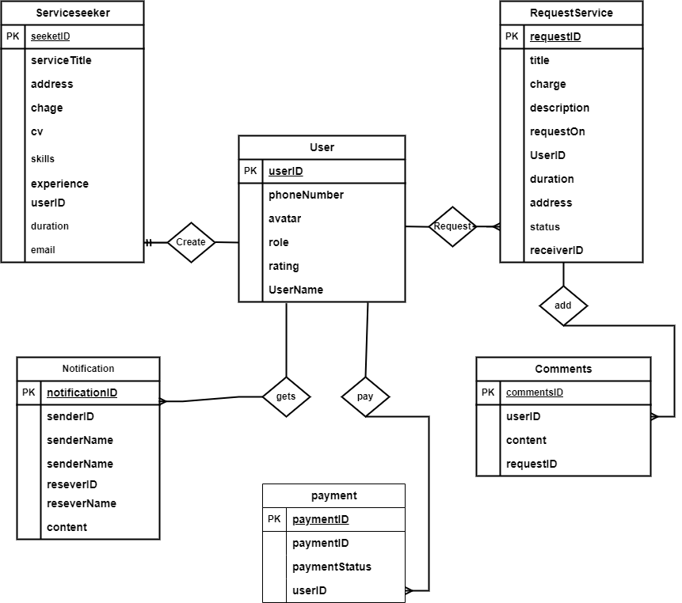
Data Modeling (ER-Diagram)

Slide 12
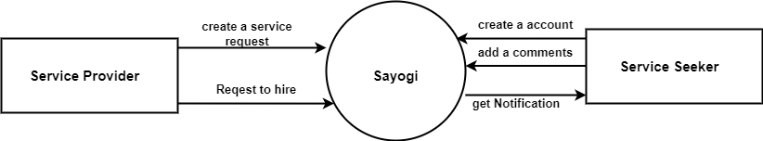
Process Modeling (DFD)

Slide 13
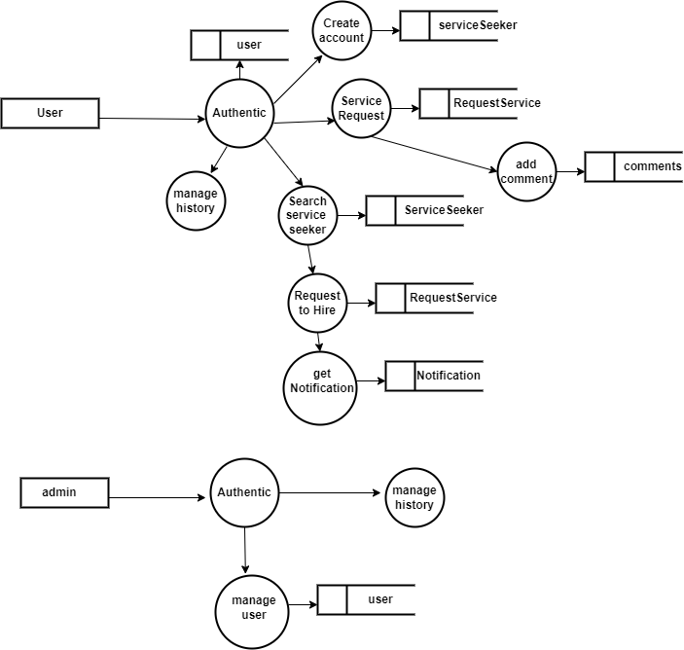
Process Modeling (DFD)

Slide 14
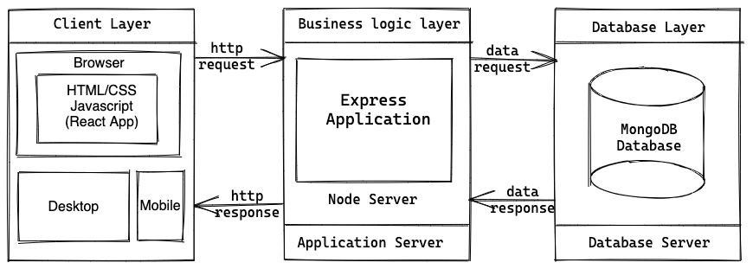
Architectural design

Slide 15
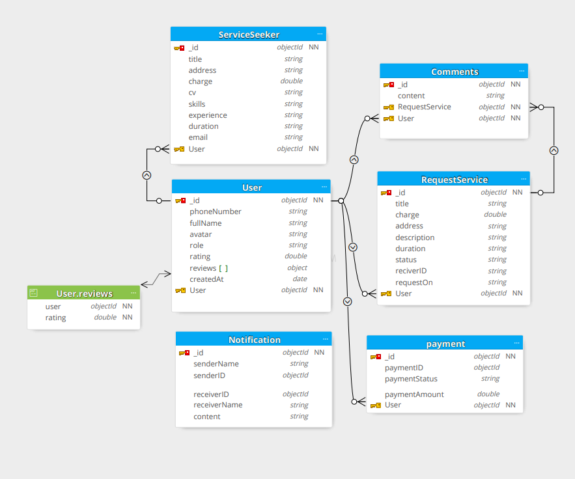
Database Schema

Slide 16
Tools and Techniques
Presentation layer: React JS , tailwind CSS
Business logic layer: Node JS, Express JS
Database layer: MongoDB
Server: Node JS Server
Tools: Figma, Docker, Insomnia, draw.io
Code Editor: visual studio code

