Slide 1
Project Presentation On Blognepal
By
Name: Ashwin Khatiwada
Roll No: 06
BCA 6th Sem

Slide 2
Introduction:
A BlogNepal is a web-based and mobile application that allows users to publish, manage, and organize content on the internet
It gives the digital communication that allows individuals or organizations to share their ideas, opinions, and experiences with the world
BlogNepal system provides a user-friendly interface for creating and publishing blog posts

Slide 3
Problem Statement:
In Nepal there is lacks of robust and user-friendly blog system.
No write and Earn System
Lack of Proper Analytics and Monetization of Blogs
Lack of SEO Friendly web application.

Slide 4
Objectives:
To customize design and layout with text editor on system
To Write and Earn through System
To analyze and monetize of the Blogs
To create SEO Friendly

Slide 5
Tools and Techniques:
Front-end: NextJS (ReactJS)
Back-end: ExpressJS
Database: MongoDB
Server: Node JS
Mobile application: React Native
Text Editor: VS Code

Slide 6
Feasibility Study:
Technical Feasibility:
The Technical Feasibility of the BlogNepal system has been evaluated, taking into account the necessary resources such as hardware, software, and human resources.
Economical Feasibility:
The system utilizes open-source technologies and does not require additional software or hardware. As a result, there are no recurring costs apart from the internet connection.
Operational Feasibility:
The operational feasibility of the BlogNepal System was assessed, and we identified several challenges and vulnerabilities in the existing system. These issues were addressed during the development of the new system, resulting in a more robust and manageable platform for users

Slide 7
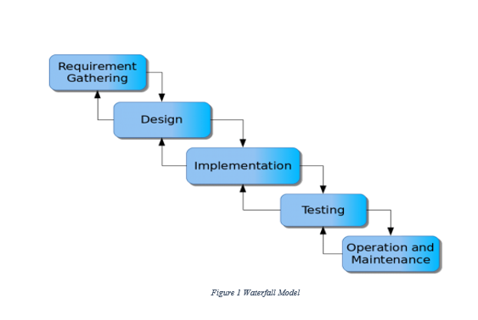
Methodology:
Fig: Waterfall Model
Since I have already clarified my goals and vision for the proposed system, I will be utilizing the Waterfall methodology for its development.

Slide 8
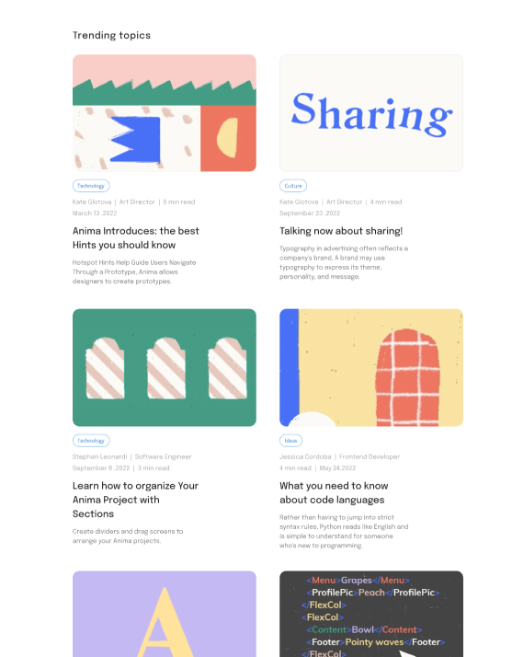
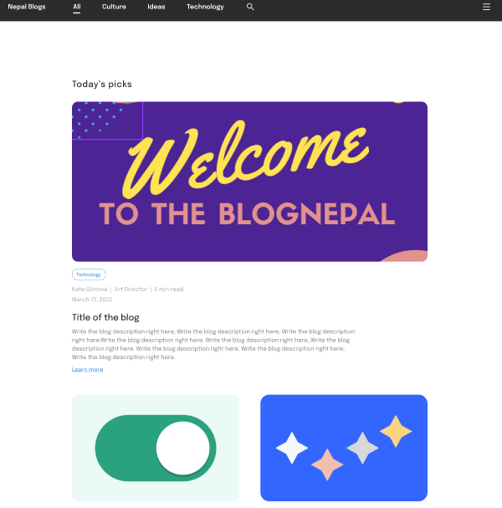
Prototype
WEB APP
Home Page

Slide 9
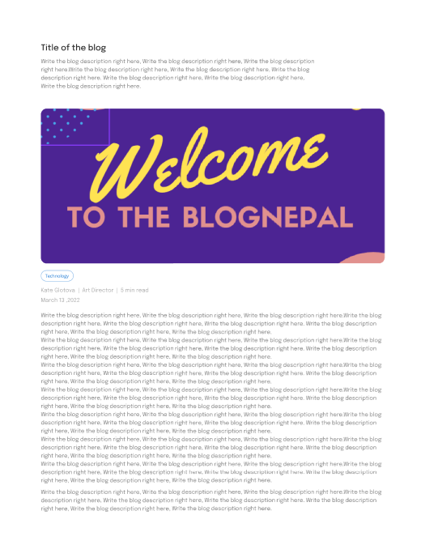
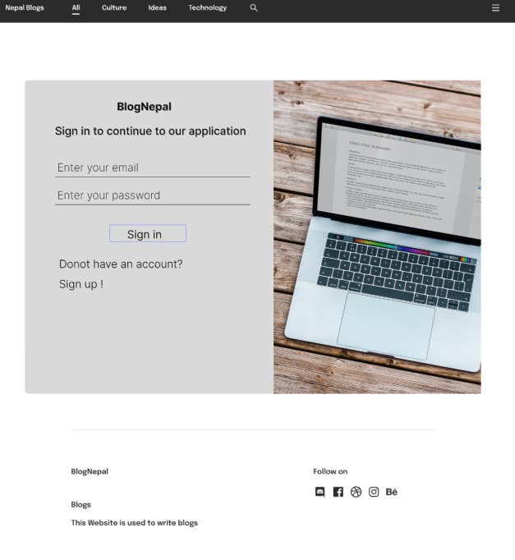

Slide 10
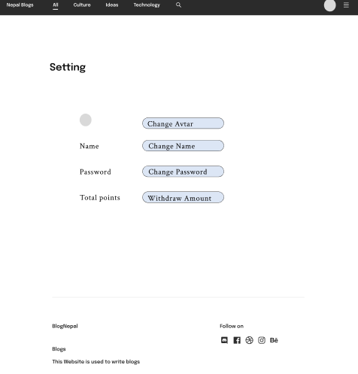

Slide 11
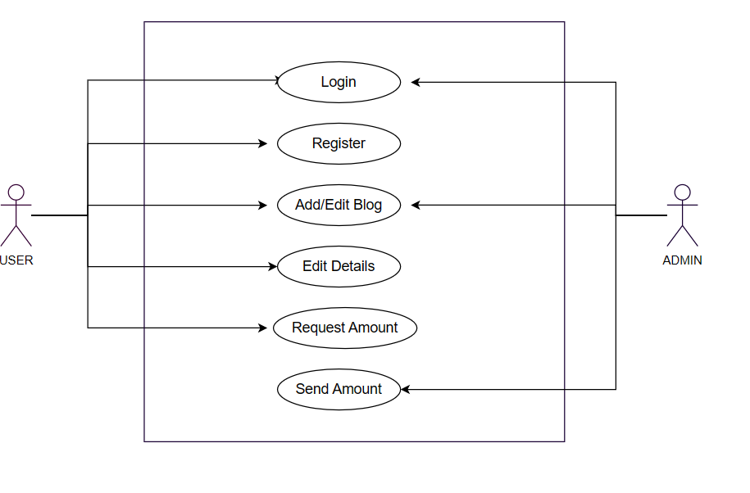
Use Case

Slide 12
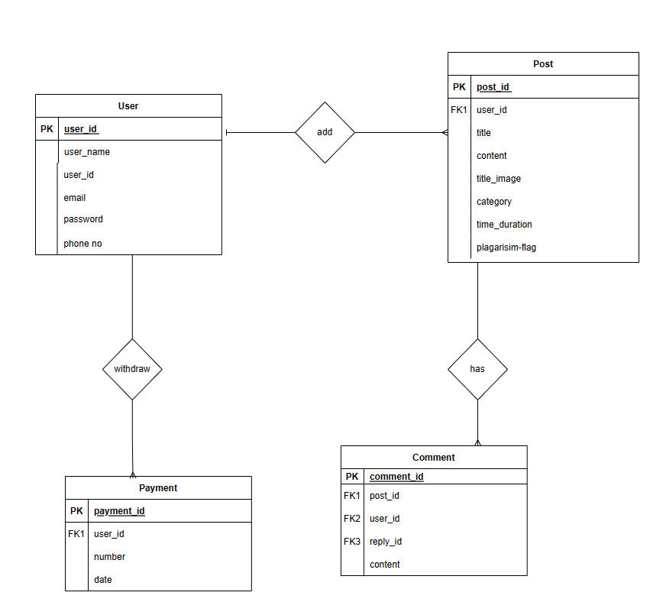
DFD

Slide 13
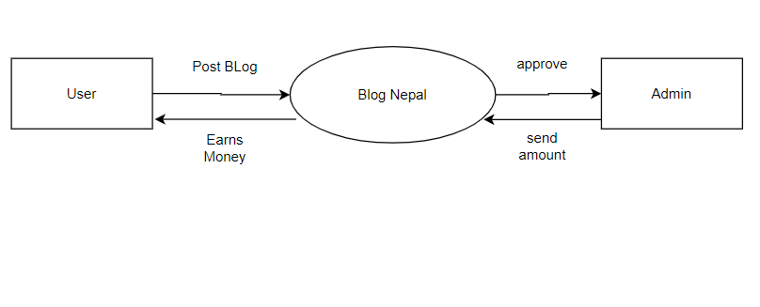
Context diagram

Slide 14
CONCLUSION
A BlogNepal is a web-based and mobile application that allows users to publish, manage, and organize content on the internet
On this system, a user has the ability to write using a text editor that offers customizable design and layout options.
A user has the potential to earn by writing on BlogNepal System.

Slide 15
Any queries ? Thank You!

