Slide 1
Hydro-Smart
Automated Water-Efficient & Odor-Controlled Lavatory System
Presented by: Team TEChBOT
Team Members & Roles
> Gautam saw (team leader)
IoT & Embedded Systems Developer
>Shyamdev Prasad
Mechanical Design & Assembly
Contact Details:
Gautam2020electronic@gmail.com📞 9334053907
Shyamdev9936@gmail.com📞 8340759513

Slide 2
introduction
Water scarcity is a major global challenge Public washrooms waste a large amount of water
Odor and hygiene issues are common Manual systems lack efficiency and monitoring
Hydro-Smart provides a smart and sustainable solution

Slide 3
Problem Statement
Excessive water consumption
Unpleasant odor in washrooms
Poor hygiene due to manual operation
No smart monitoring or maintenance system

Slide 4
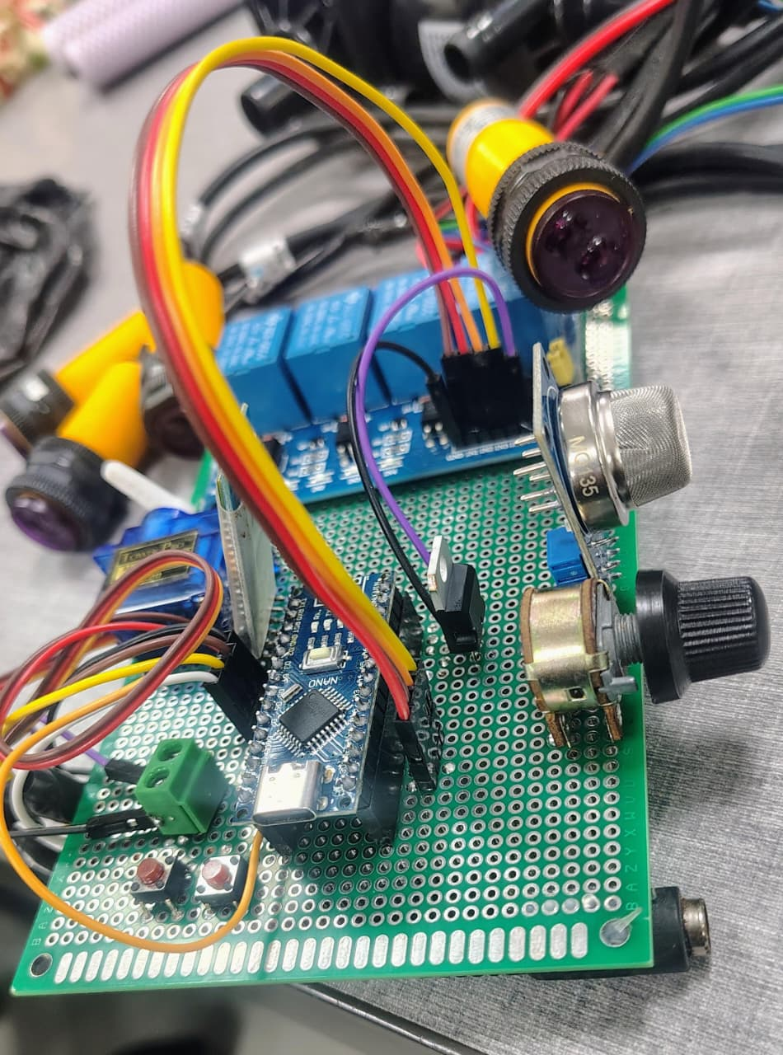
Proposed Solution
Hydro-Smart System
Fully automated lavatory system
Sensor-based water management
Smart odor detection and control
Touch-free and hygienic operation

Slide 5
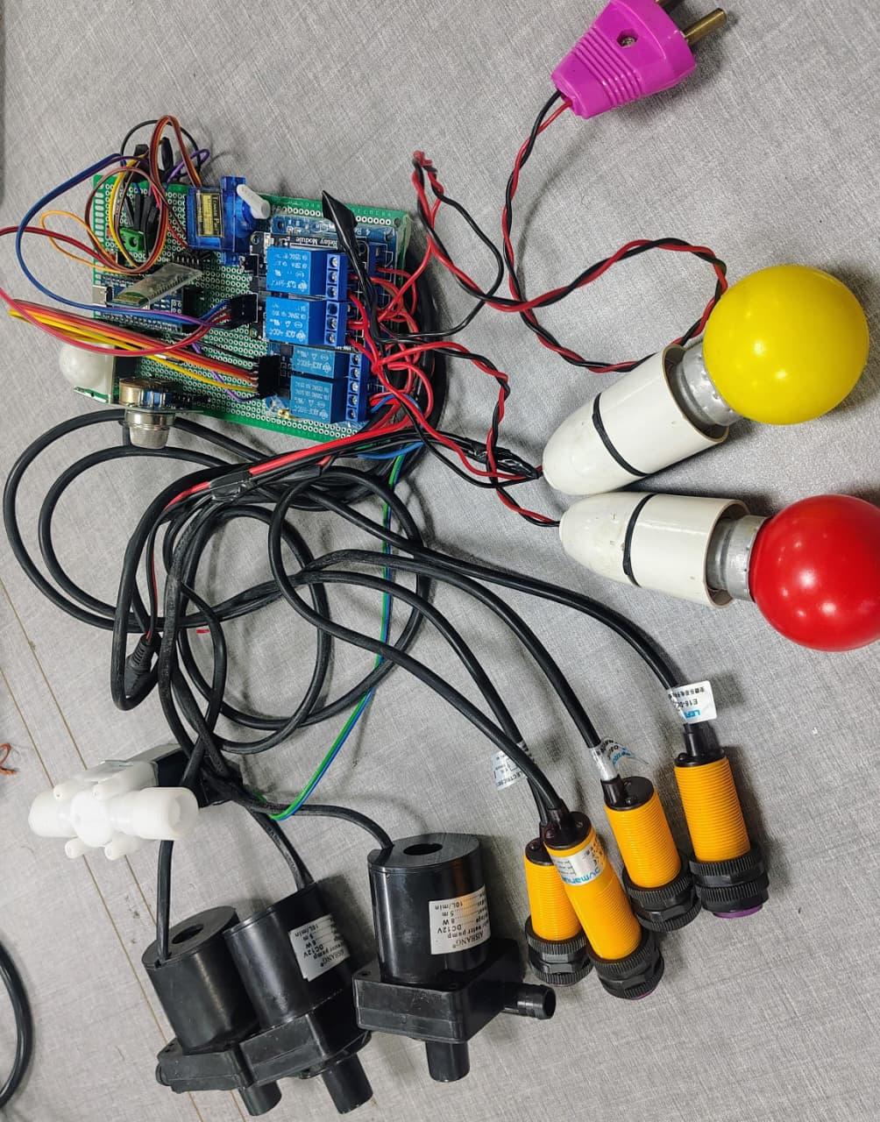
System Architecture
Block Diagram Overview
Motion Sensor → Control Unit → Smart Flush → Water Valve
Odor/Gas Sensor → Control Unit → Exhaust Fan & Deodorizer Control Unit → Mobile App

Slide 6
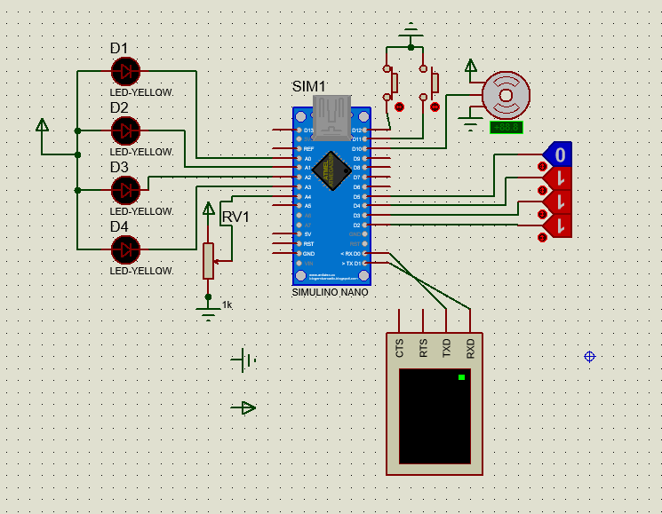
Working Principle
User enters the washroom
Motion sensor detects presence
Control unit activates smart flush
Odor sensor monitors air quality
Exhaust fan turns ON automatically
System resets after use

Slide 7
Key Features & Applications
key Features
Smart water management
Automatic odor control
Touch-free and hygienic operation
IoT-enabled monitoring & Low maintenance
Applications
Schools & Colleges ,Offices & Corporate Buildings
Hospitals ,Shopping Malls Airports & Railway Stations also Public Toilets

Slide 8
Existing Smart Toilets vs Hydro-Smart
Existing smart toilets
Hydro-smart
Limited automation (auto flush, sensor tap)
Fixed water usage per flush
Basic or manual odor control
high cost & complex maintenance
No real-time monitoring
Not suitable for mass public use
Fully automated water & odor control system
Automatic odor detection using gas sensors
Low cost, low maintenance (≈ ₹1 per use)
IoT-enabled monitoring & alerts
Ideal for public toilets & smart cities

Slide 9
Future Scope (Advanced Features)
Integration with government sanitation projects for Swachh Bharat Mission & Smart City initiatives
Hydro-Smart is a smart, sustainable, and cost-effective sanitation system that reduces water wastage, improves hygiene, and enhances user experience in public and private washrooms. Making it suitable for smart cities and public sanitation.
.

