Slide 1

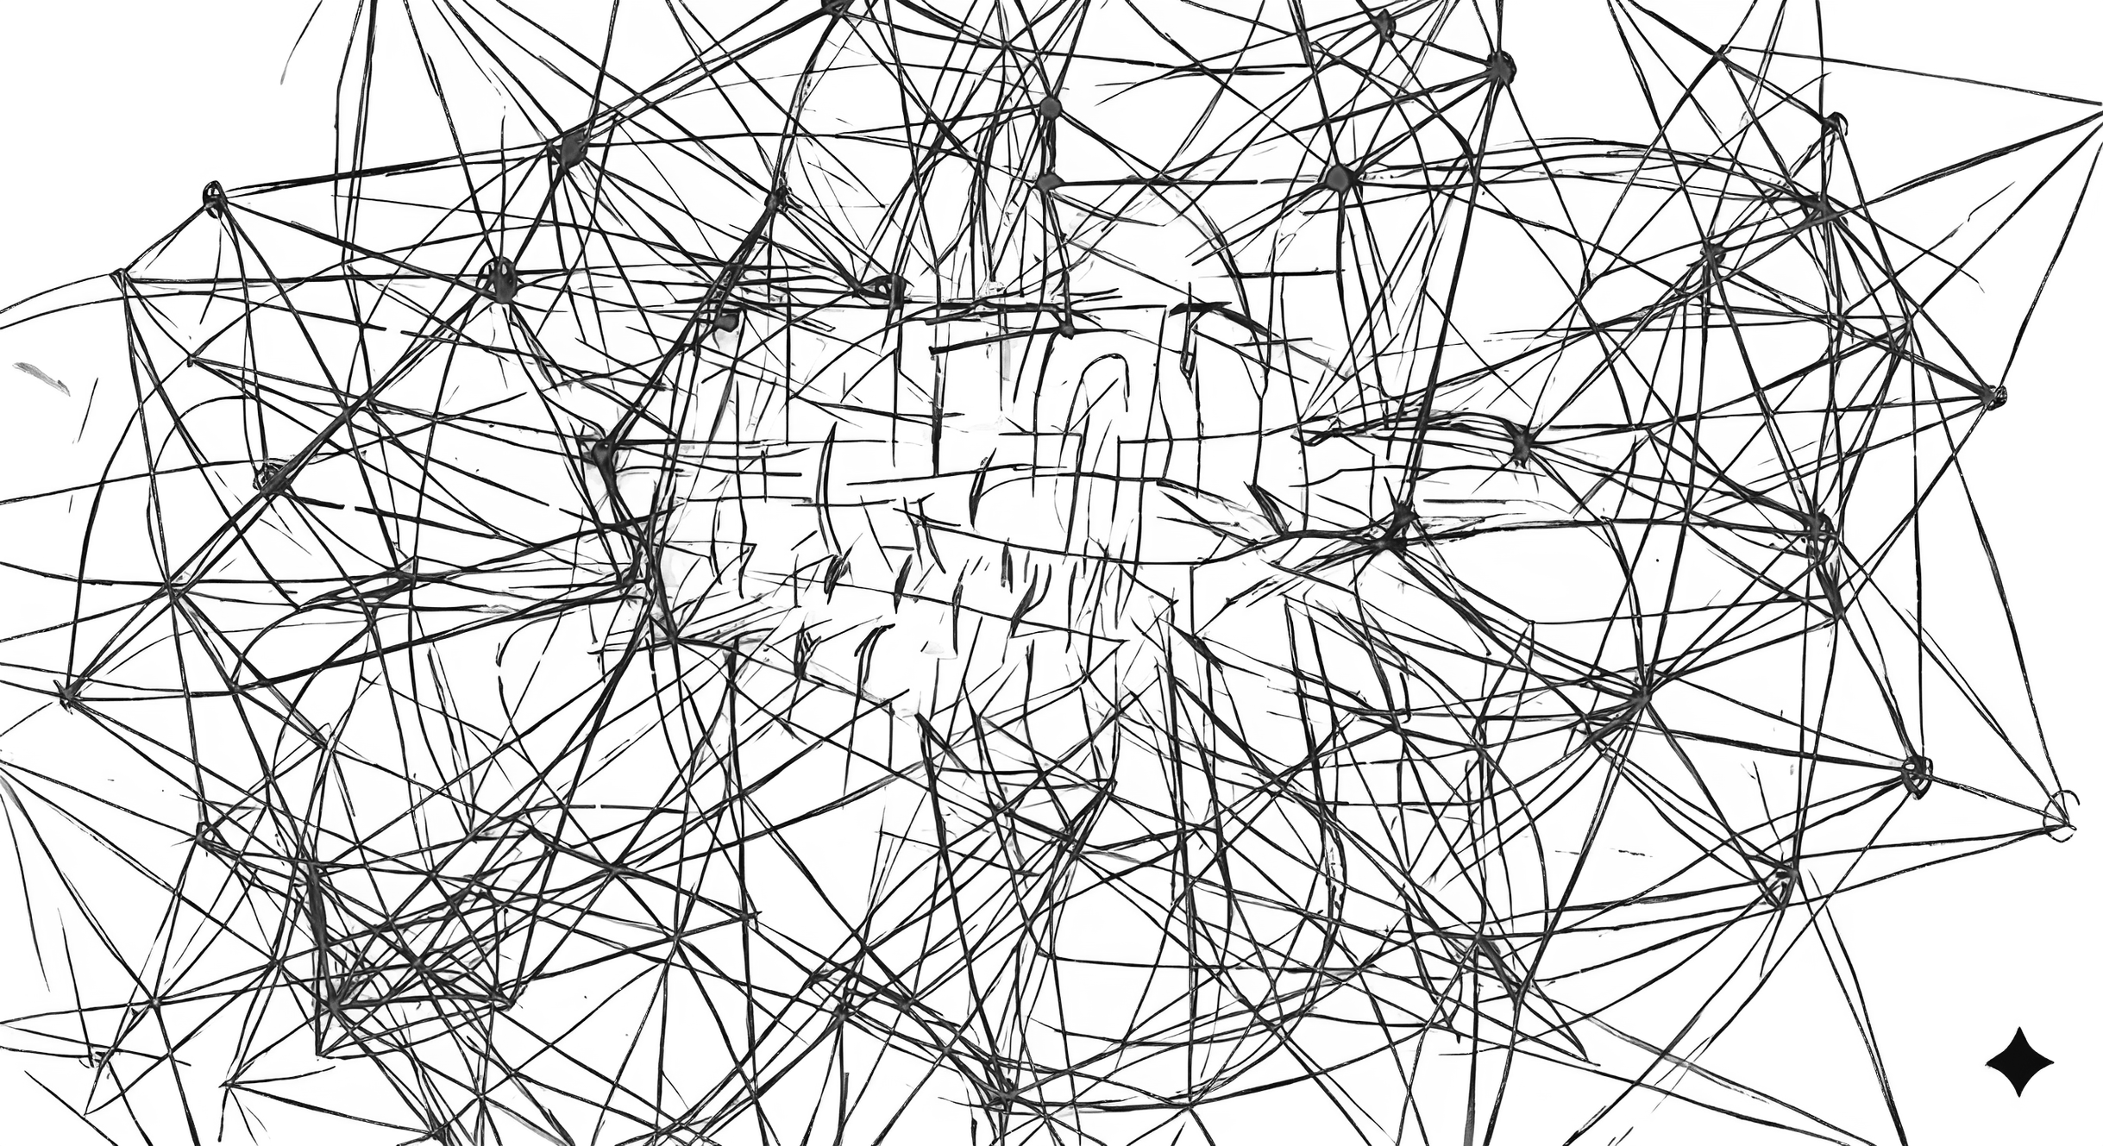

UNTETHER
PRIVATE · PROACTIVE · YOURS
A private chief of staff built on a hand-designed memory system — it recalls your life with receipts, on hardware you own.
Gautam · Harish · [untether.in]

Slide 2

THE PROBLEM?
THE MODERN AI ASSISTANT IS:
  Prompt driven, not experience‑driven
  Operating on short‑term context, not lived experience
  Unable to form long‑term memory, beliefs, or patterns from experience
  Unable to distinguish between temporary context and lasting insight
  Always threatening the privacy of the user, and thus limited in context.

Slide 3
THE TWO WALLS
WHY AI HASN'T FIXED THIS
  THE TRUST WALL — the more valuable your context (Funds, M&A, intimate relations, politics, etc.), the less AI you're allowed to use.
  THE MEMORY WALL — even AI that sees your data doesn't remember it: context windows blur and forget; RAG retrieves lookalikes and confabulates. Kicker: Recall degrades exactly as your history — and your value — grows.

Slide 4
WHY NOW
Three curves just crossed:
  Open-weight models on a $3–5K hardware match 3-months-ago frontier cloud AI.
  Ambient intelligence capture matured.
  Intelligence is commoditizing weekly — memory and trust are not, and that tier is empty.

Slide 5

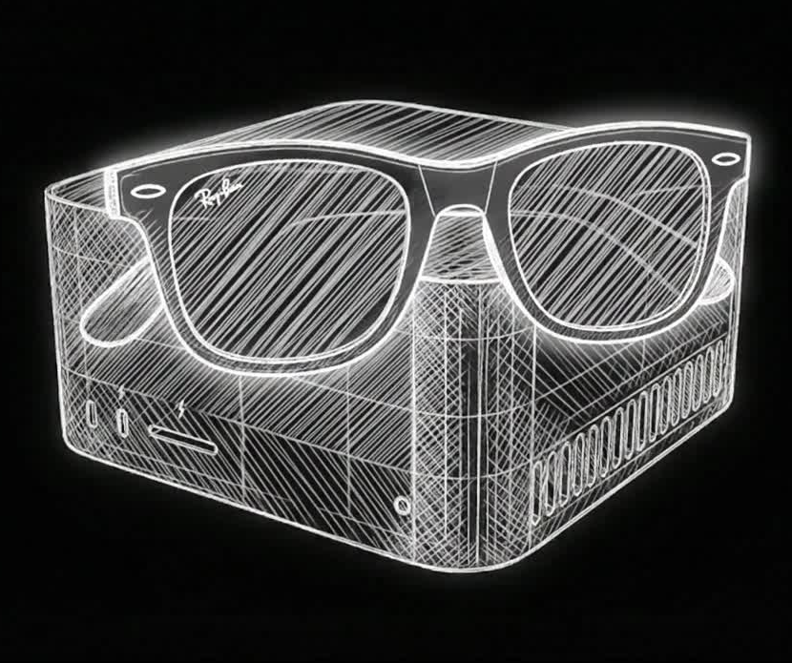
THE SOLUTION:
PERCEPTION
  Visual and audio inputs processed locally, not streamed
  Raw data converted into structured observations, not recordings
  Real‑time insights without cloud exposure
INTELLIGENCE
Memory is structured, queryable, and reasoned over. You don't prompt it. It works.
Hallway: "let's do Thursday" → invite pending before you're at your desk, one tap to confirm. Every promise tracked, nudged, chased in your voice. Inbox to zero, calendar defended, meetings closed in ten minutes.

Slide 6
WHO IT’S FOR
Start where trust is worth the most. End up everywhere.
  Now: Founders & HNWIs — context worth millions, calendars like war zones, already paying $70–120K/yr for EAs; hand-installed Vaults at $4–9K ACV.
  Next: The confidentiality professions — executives, attorneys, physicians, wealth managers; every vertical a compliance story the architecture already satisfies.
  Then: Developers — open schema + self-host turns the internet's most skeptical community into auditors and distribution.
  Everyone: Students & prosumers — a lightweight hosted instance on a cloud VPS: same memory system, no appliance, a fraction of the price.

Slide 7
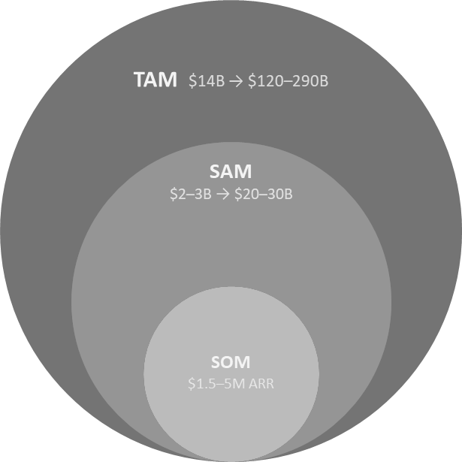
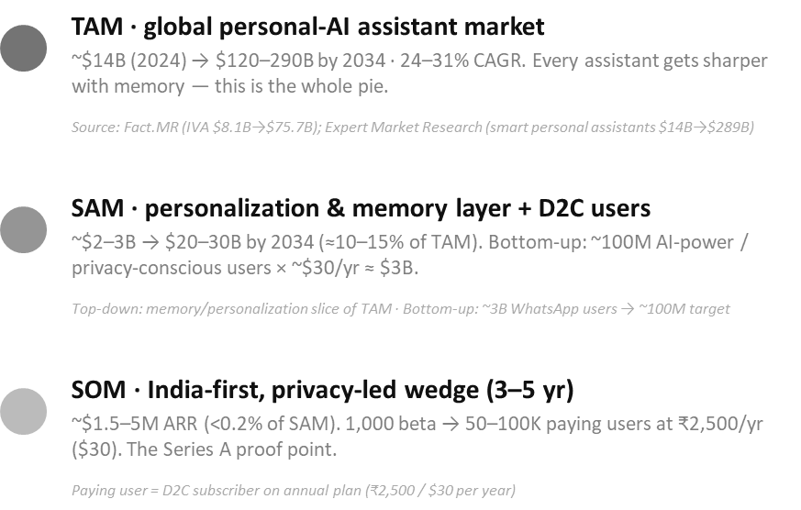
MARKET OPPORTUNITY

Slide 8




COMPETITION:
  Meta Ray Ban glasses desgined for media capture, not understanding
  Google glasses focus on notification,overlays and apps, yet still prompt-driven and short-term
  Even G2 require manual prompting and pose major risks to data privacy.
  Humane AI pin is interaction focused device, but it has limited persistence and learning and no explicit memory or belief model
  Otto is a startup, promising hardware for local AI, however, they lack input methods, and cut corners in terms of speed and privacy by offloading to the cloud.
UNTETHER: proactive · physical world · evidence-gated memory · $3.6-9K/yr
We compete on the two things that don't commoditize: memory and trust.

Slide 9

UVPS

Slide 10






Untether: B.M.C.
A Brief Mapping of the
Company Business Plan
Key Partners | Key Activities | Value Proposition | Customer Relationships | Customer Segments
Server Parts Suppliers: ` Legal Consulting Firm Marketing Agencies / Creative Agencies Delivery Logistics Partner | Marketing/Advertising Continuous Lifetime Support Research & Development Increasing quality of results Optimizing performance/latency Adding features and capability | The product satisfies the need for a PA in everybody’s life. Giving them access to insights, reminders, and information without even asking for it. Privacy/Ownership over all else. Customers either rent a server, a computer hosted by us, but dedicated to them, or buy a server that may reside wherever they deem fit. Cheaper / More effective than hired human PAs Truly autonomous AI assistance, in real time. | High touch on boarding for premium leads Users opting for the premium server purchase receive a lifetime of hand delivered updates, along with extended warranty. Collaboration and technical support for premium technical users. | Power users, researchers, engineers, founders Privacy-conscious professionals handling sensitive data Teams building on-device / edge intelligence systems Unorganized individuals
Server Parts Suppliers: ` Legal Consulting Firm Marketing Agencies / Creative Agencies Delivery Logistics Partner | Key Resources | The product satisfies the need for a PA in everybody’s life. Giving them access to insights, reminders, and information without even asking for it. Privacy/Ownership over all else. Customers either rent a server, a computer hosted by us, but dedicated to them, or buy a server that may reside wherever they deem fit. Cheaper / More effective than hired human PAs Truly autonomous AI assistance, in real time. | Channels | Power users, researchers, engineers, founders Privacy-conscious professionals handling sensitive data Teams building on-device / edge intelligence systems Unorganized individuals
Server Parts Suppliers: ` Legal Consulting Firm Marketing Agencies / Creative Agencies Delivery Logistics Partner | Proprietary (patented) memory layer Unique server architecture Optimized tech stack Optimized glasses hardware Cybersecurity/Reliability R&D | The product satisfies the need for a PA in everybody’s life. Giving them access to insights, reminders, and information without even asking for it. Privacy/Ownership over all else. Customers either rent a server, a computer hosted by us, but dedicated to them, or buy a server that may reside wherever they deem fit. Cheaper / More effective than hired human PAs Truly autonomous AI assistance, in real time. | Paid/Organic Social Media Campaigns High performing written media Security, privacy, and AI infrastructure conferences | Power users, researchers, engineers, founders Privacy-conscious professionals handling sensitive data Teams building on-device / edge intelligence systems Unorganized individuals
Cost Structure | Cost Structure | Cost Structure | Revenue Streams | Revenue Streams
Salaries Assembly Workers Research and Development Employees Marketing Employees Customer Support Staff | Sale Costs Server Parts Shipping, Delivery and Setup Assistance | Periodic Costs Server Maintenance Working Space Maintenance Legal Consultation | Server Sales Monthly Private Server Rental Optional Server Upgrades Defaulting / Cancellation Fees | Server Sales Monthly Private Server Rental Optional Server Upgrades Defaulting / Cancellation Fees

Slide 11

THE ROADMAP

Slide 12
THE TECHNOLOGY:
GLASSES ARE PURE SENSORS
  Audio, video, and GPS stream to a local server. No meaningful onboard compute.
DETERMINISTIC, HALLUCINATION-RESISTANT MEMORY CORE
  Raw observations are never promoted directly; beliefs are gated, auditable, and controllable.
MODEL-AGNOSTIC AND FUTURE-PROOF
  Swap in better perception or reasoning models without losing memory or retraining.
UPGRADABLE, LONG-LIVED INFRASTRUCTURE
  Compute and storage scale over time, prioritizing repairability and lifetime value.
TRANSPARENT AND DEFENSIBLE BY DESIGN
  Built on open source for auditability, with a novel memory system targeted for patenting (where feasible).

Slide 13
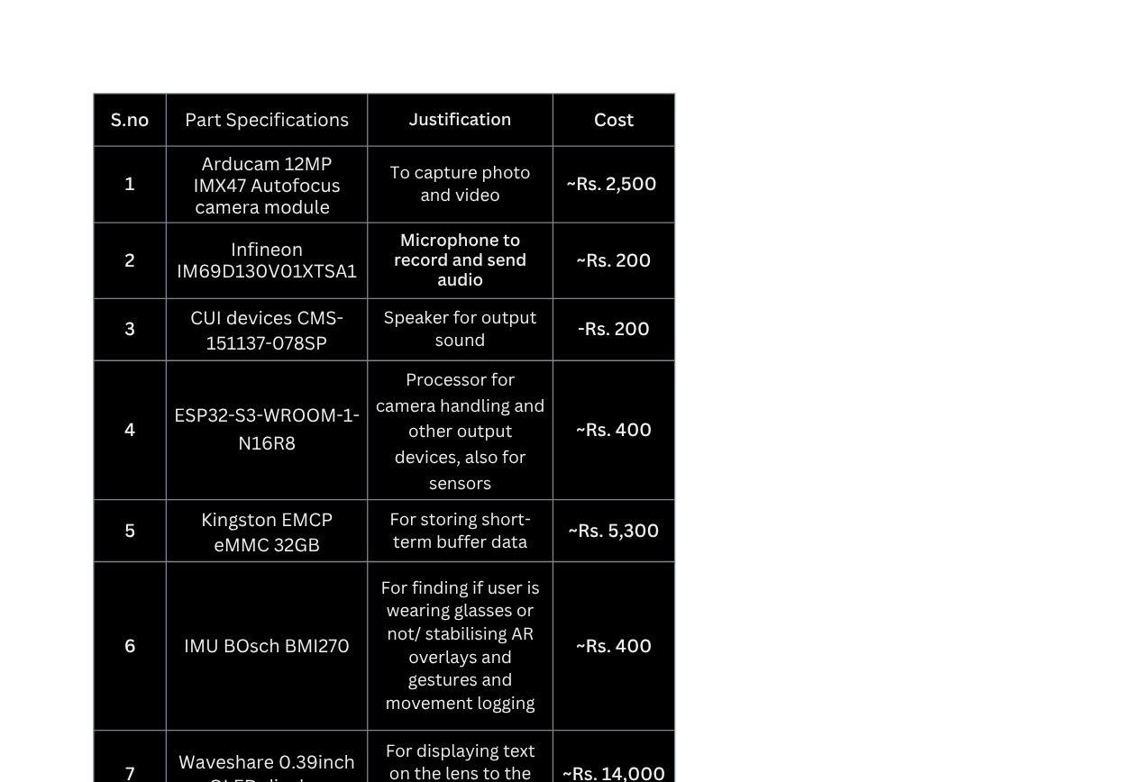
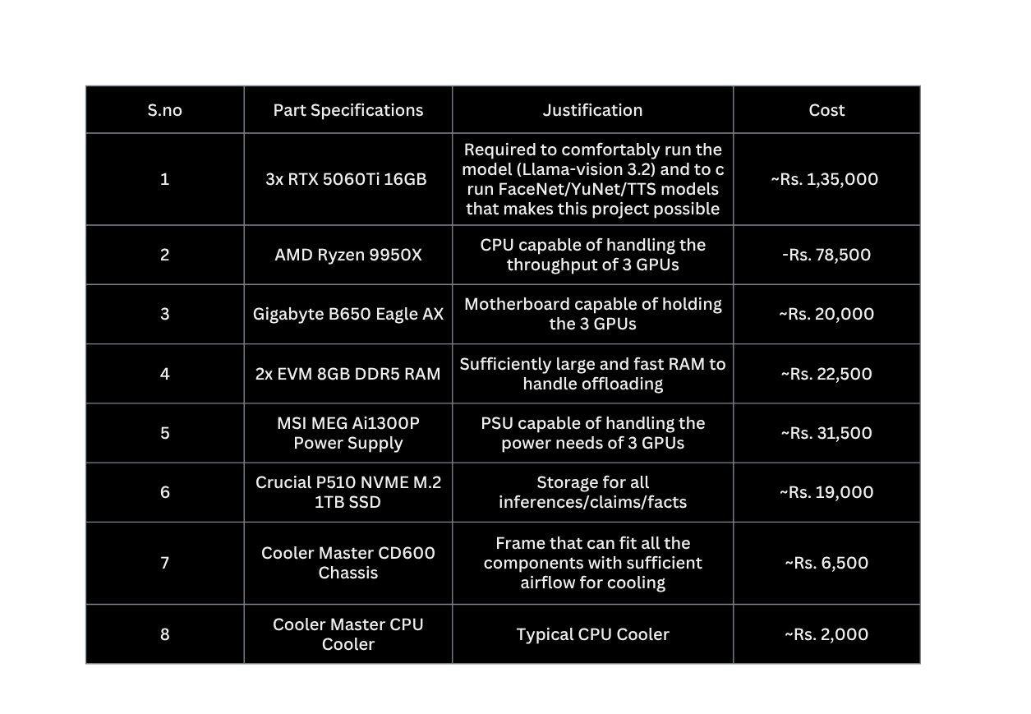
COMPONENTS:

Slide 14
THE MOAT
THREE THINGS THAT DON'T COMMODITIZE
  THE MEMORY. Hand-built from scratch — not a context window, not RAG. It remembers with proof and gets sharper the longer you use it. Six months in, replacing it means lobotomizing your own chief of staff.
  THE MACHINE. It runs on hardware you own, in your office. Big Tech's business model requires your data on their servers; ours forbids it. They can copy features — they cannot copy this sentence: "not one byte leaves."
  THE CONVICTION. Trust isn't a feature we added; it's the rule everything else obeys. Recordings destroyed in seconds, keys we never hold, nothing sent without your tap.
Any one of these is hard. All three together is structural. And the first one is ours alone — here's how it works →

Slide 15
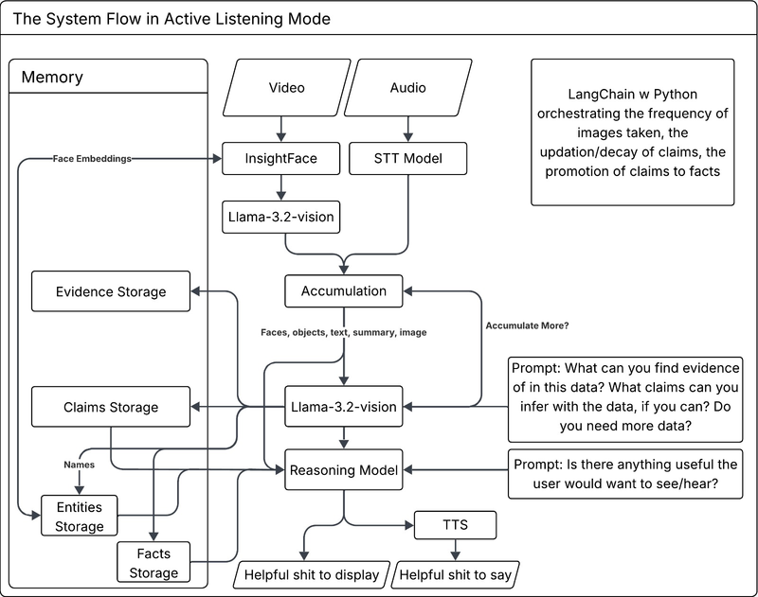
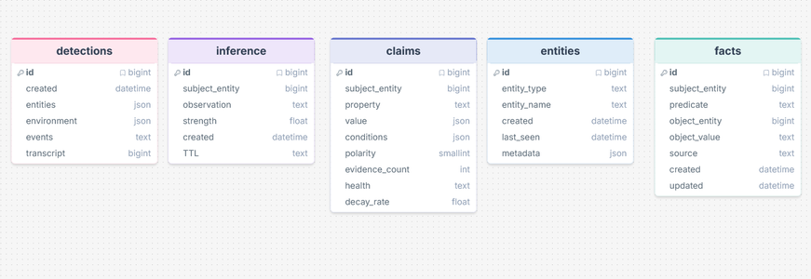
THE MEMORY SYSTEM
The assistant layer? Anyone can build it. Wiring an LLM to an inbox is weekend project. What nobody else has is what it stands on —
MEMORY WITHOUT RECEIPTS
  It never makes up a memory. A fact is only saved when there's proof, and every fact links back to the exact timestamped moment it came from. Ask it anything — it answers with receipts.
  It gets sharper with history, not dumber. Other AIs blur and forget as your data grows; ours stores memories as an organized graph, so a year of your life adds knowledge, not noise.
KNOWS EVERYTHING. LEAKS NOTHING
  Raw audio dies in seconds. We keep the facts — who promised what, when — and destroy the recORDING. THERE IS NO ARCHIVE OF YOUR LIFE TO hack, sell, or subpoena.
  It lives on hardware you own, locked with keys only you hoLD. WE LITERALLY CANNOT READ your data — not to help you, not to train on it, not if a court asks.

Slide 16
PROOF OF CONCEPT:
We fed Untethered our WhatsApp group chat. With zero manual tagging, it built a structured, queryable model of the people in it — every insight backed by real quotes.
  Raw messages → observations → claims → relationships → life episodes → a living identity profile
  Everything is evidence-grounded: each claim links to verbatim, timestamped lines
  Runs locally (private by default) with cloud models only for the final synthesis
(Built on a shoestring. Everything you're about to see was built by a student team on a free API tier and a 4GB consumer laptop GPU — a deliberately primitive proof of concept, constrained only by our current budget. This is the floor, not the ceiling. With funding, better models and full data unlock a dramatically sharper product)

Slide 17
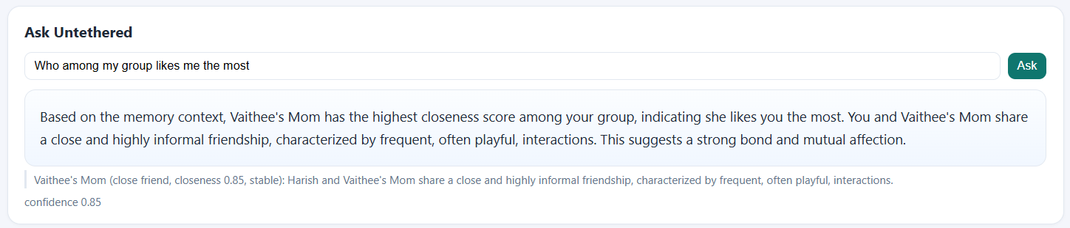
ASK UNTETHER
Ask anything in plain language — it answers from the chat, with quotes as receipts.

Slide 18
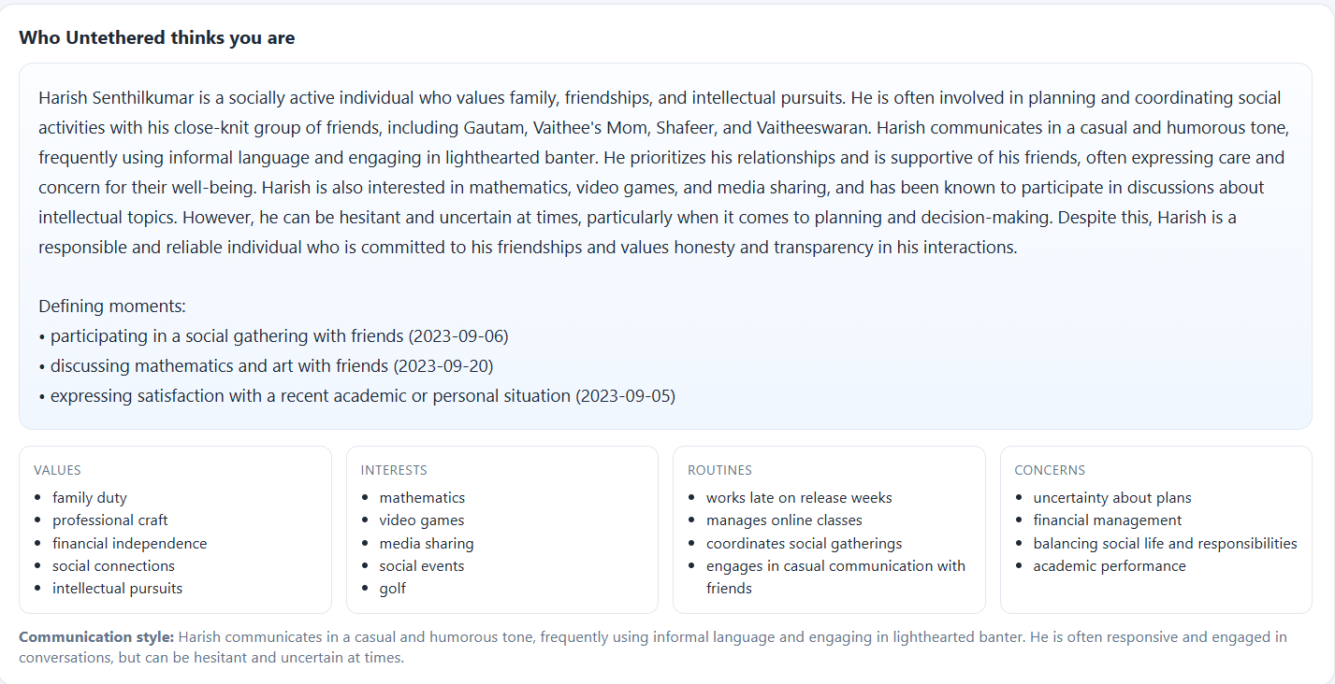
WHO IT THINKS WE ARE
An uncanny, specific portrait generated from the conversation, plus values, interests, routines, and concerns.

Slide 19
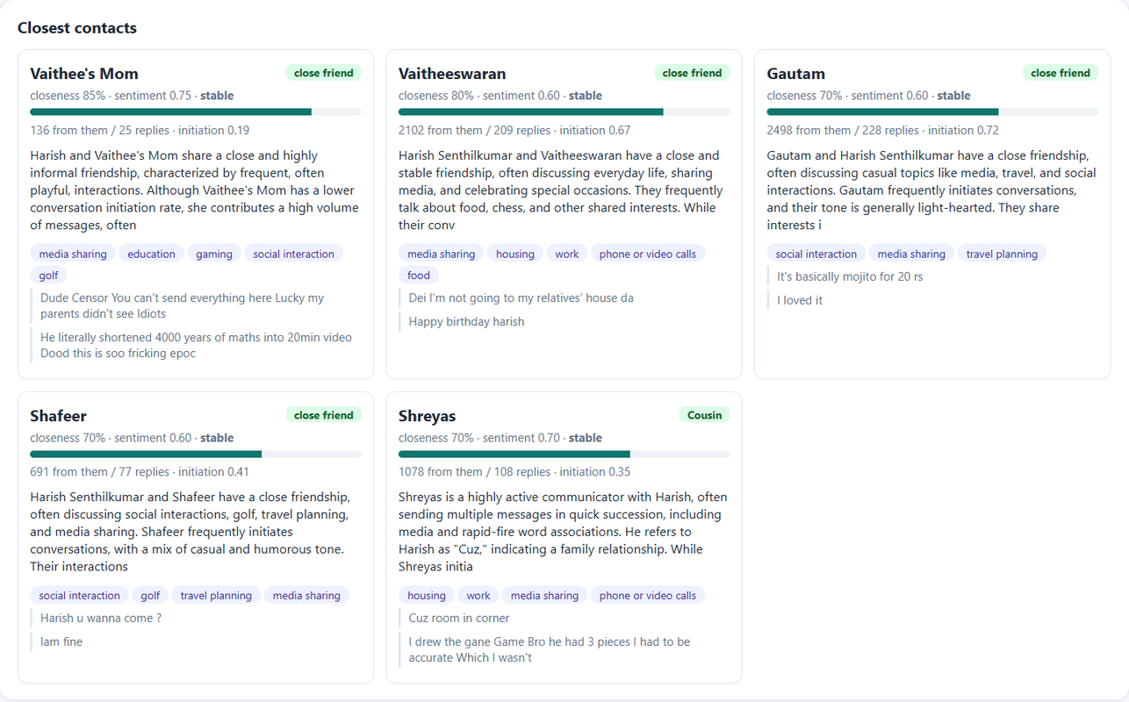
RELATIONSHIPS, QUANTIFIED
Every person scored on closeness, sentiment, and trajectory — with message balance and a real quote each.

Slide 20
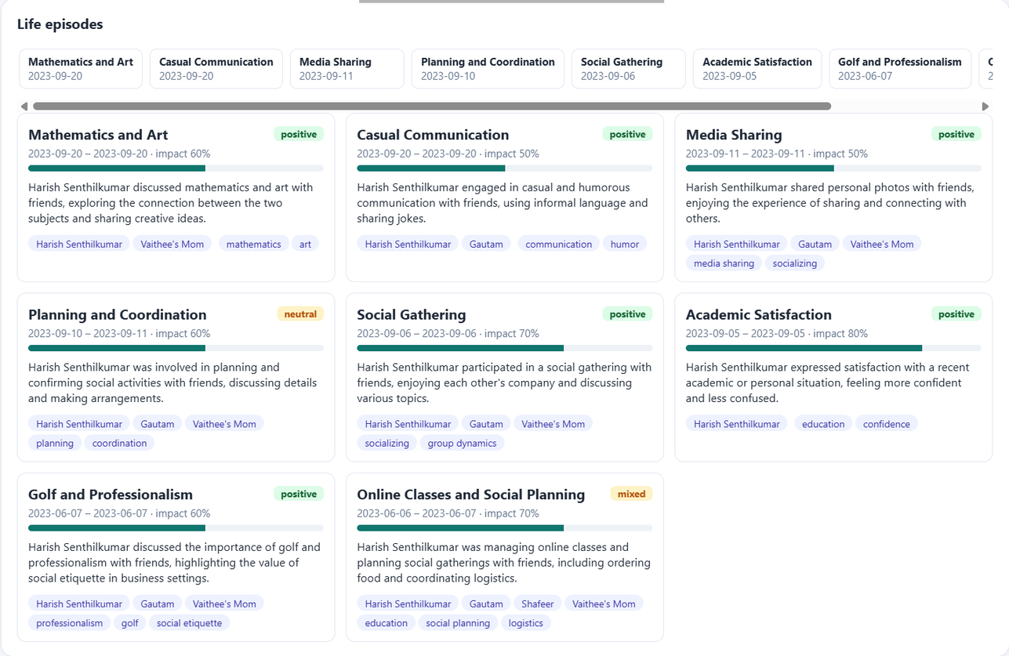
A LIFE, AUTO-CHAPTERED
The chat history organized into meaningful periods, each with a date, emotional tone, and description.

Slide 21
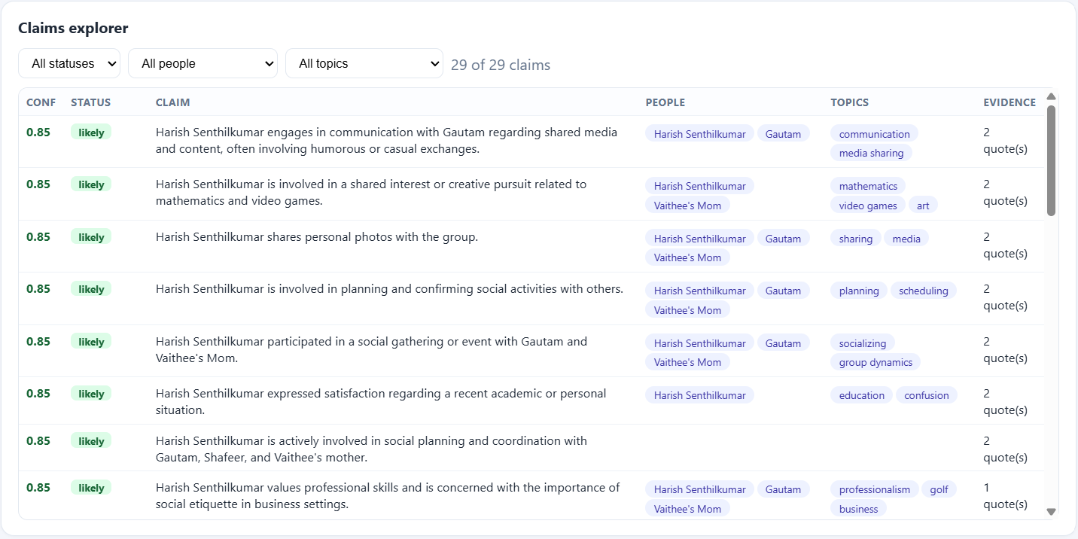
EVERY INSIGHT, WITH RECEIPTS
Filterable claims with a confidence score, status, the people/topics involved, and the exact quotes behind each one.

Slide 22
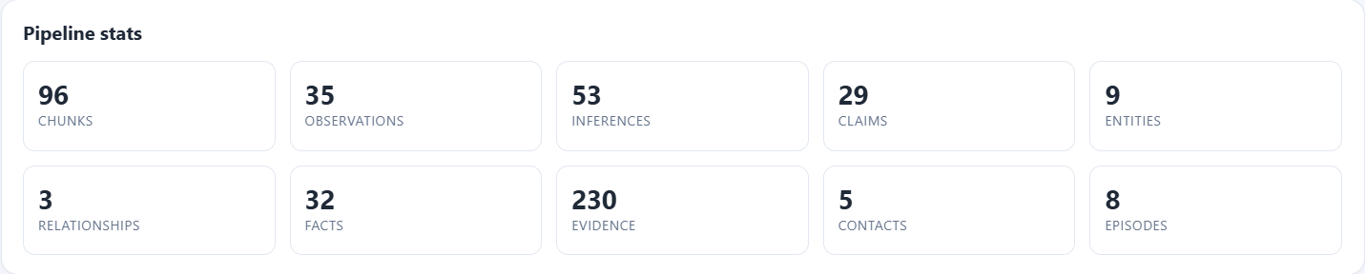
REAL DATA, NOT VIBES
What was actually extracted — chunks, observations, inferences, claims, facts, contacts, episodes.

Slide 23
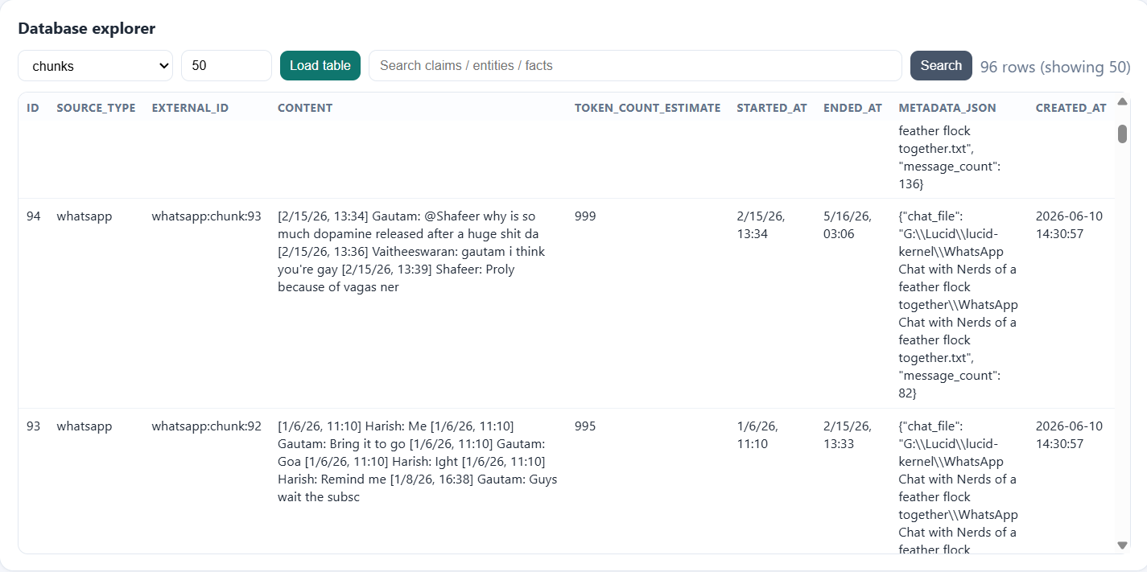
NOTHING HIDDEN
Full access to every underlying table — total auditability of what the system stores.

Slide 24
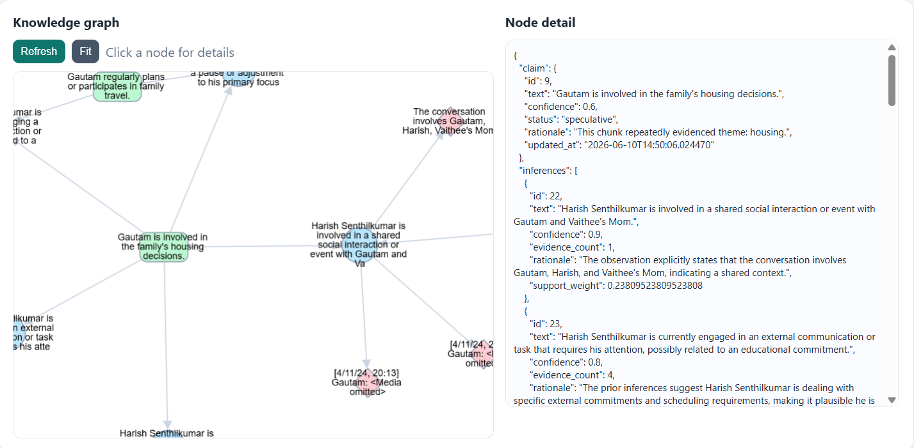
THE MEMORY GRAPH
Claims linked to their supporting inferences and evidence — memory as a connected structure, not a flat list.

Slide 25
THE TEAM
Gautam Krishna
Harish Senthilkumar
  Built the core technology from the ground up
  Leads development, product delivery, and R&D
  Focused on turning ideas into working systems
  Handles operations, finance, and administration
  Oversees planning, execution, and day-to-day management
  Keeps the business running smoothly

Slide 26
THANK YOU
(This is what a free tier and a laptop GPU can do. Imagine what funding does.)
What you just saw (the constrained PoC):
  Two developers, a free Gemini key, a 4GB laptop GPU
  A single chat source, an early slice of the history
  Already producing an uncanny, evidence-grounded profile
What the next stage unlocks:
  Full multi-year history on stronger models — sharper, deeper memory
  Drag-and-drop onboarding (no code) + more sources (email, more chats)
  "Ask Untethered" as a real conversation; first 200 beta users

