Slide 1
Introduction to Flowcharting

Slide 2
What is a Flowchart?
START
Display message “How many hours did you work?”
A flowchart is a diagram that depicts the “flow” of a program.
The figure shown here is a flowchart for the pay-calculating program shown in Program 1-1.
Read Hours
Display message “How much do you get paid per hour?”
Read PayRate
Multiply Hours by PayRate. Store result in GrossPay.
Display GrossPay
END

Slide 3
Basic Flowchart Symbols
START
Terminal
Display message “How many hours did you work?”
Terminals
  represented by rounded rectangles
  indicate a starting or ending point
Read Hours
Display message “How much do you get paid per hour?”
Read PayRate
Multiply Hours by PayRate. Store result in GrossPay.
START
Display GrossPay
END
Terminal
END

Slide 4
Basic Flowchart Symbols
START
Display message “How many hours did you work?”
Input/Output Operations
  represented by parallelograms
  indicate an input or output operation
Read Hours
Display message “How much do you get paid per hour?”
Input/Output Operation
Read PayRate
Multiply Hours by PayRate. Store result in GrossPay.
Display message “How many hours did you work?”
Read Hours
Display GrossPay
END

Slide 5
Basic Flowchart Symbols
START
Display message “How many hours did you work?”
Processes
  represented by rectangles
  indicates a process such as a mathematical computation or variable assignment
Read Hours
Display message “How much do you get paid per hour?”
Read PayRate
Multiply Hours by PayRate. Store result in GrossPay.
Multiply Hours by PayRate. Store result in GrossPay.
Process
Display GrossPay
END

Slide 6
Four Flowchart Structures
Sequence
Decision
Repetition

Slide 7
Sequence Structure
A series of actions are performed in sequence
The pay-calculating example was a sequence flowchart.

Slide 8
Decision Structure
The flowchart segment below shows how a decision structure is expressed in C++ as an if/else statement.
Flowchart
NO
YES
x < y?
Calculate a as x plus y.
Calculate a as x times 2.

Slide 9
Decision Structure
The flowchart segment below shows a decision structure with only one action to perform. It is expressed as an if statement in C++ code.
Flowchart
NO
YES
x < y?
Calculate a as x times 2.

Slide 10
Repetition Structure
The flowchart segment below shows a repetition structure expressed in C++ as a while loop.
Flowchart
YES
x < y?
Add 1 to x

Slide 11
Controlling a Repetition Structure
The action performed by a repetition structure must eventually cause the loop to terminate. Otherwise, an infinite loop is created.
In this flowchart segment, x is never changed. Once the loop starts, it will never end.
QUESTION: How can this
flowchart be modified so
it is no longer an infinite
loop?
YES
x < y?
Display x

Slide 12
Controlling a Repetition Structure
ANSWER: By adding an action within the repetition that changes the value of x.
YES
x < y?
Display x
Add 1 to x

Slide 13
Review
What do each of the following symbols represent?
(Answer on next slide)

Slide 14
Answer
What do each of the following symbols represent?
Decision
Terminal
Input/Output Operation
Connector
Process
Module

Slide 15
Review
Name the four flowchart structures.
(Answer on next slide)

Slide 16
Answer
Sequence
Decision
Repetition
Case

Slide 17
Review
What type of structure is this?
(Answer on next slide)

Slide 18
Answer
Repetition

Slide 19
Review
What type of structure is this?
(Answer on next slide)

Slide 20
Answer
Sequence

Slide 21
Review
What type of structure is this?
(Answer on next slide)

Slide 22
Answer
Decision

Slide 23
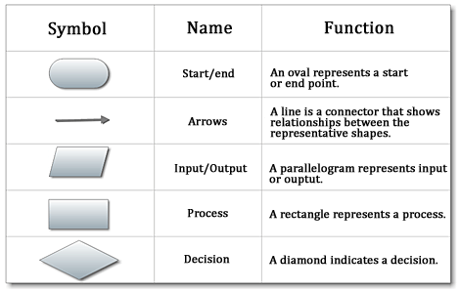

Slide 24
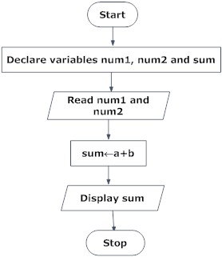

Slide 25
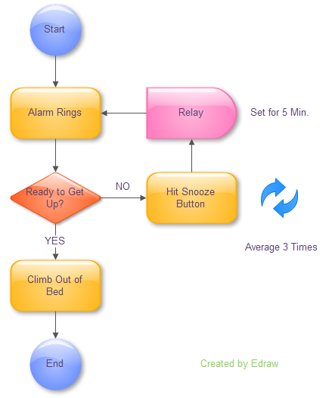

Slide 26
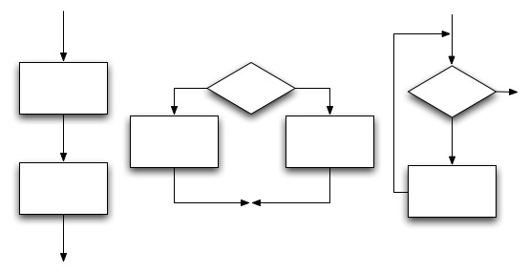
Examples ???

