Slide 1

Customer Shopping Behavior Analysis
Uncovering insights from 3,900 purchases to drive strategic business decisions

Slide 2
Dataset Overview
3,900
18
50
25
Total Purchases
Data Columns
Locations
Products
Transactions analyzed
Features tracked
Geographic coverage
Items purchased
Customer Data
Transaction Details
Demographics & location
Product categories & pricing
Subscription status
Discounts & promotions
Purchase history
Shipping & ratings

Slide 3
Data Preparation in Python
01
02
03
Data Loading & Exploration
Missing Data Handling
Feature Engineering
Imported dataset, checked structure with df.info() and summary statistics
Imputed 37 missing Review Rating values using median by category
Created age_group bins and purchase_frequency_days columns
04
05
Data Consistency
Database Integration
Standardized columns to snake_case, dropped redundant promo_code_used
Connected to PostgreSQL and loaded cleaned data for SQL analysis

Slide 4
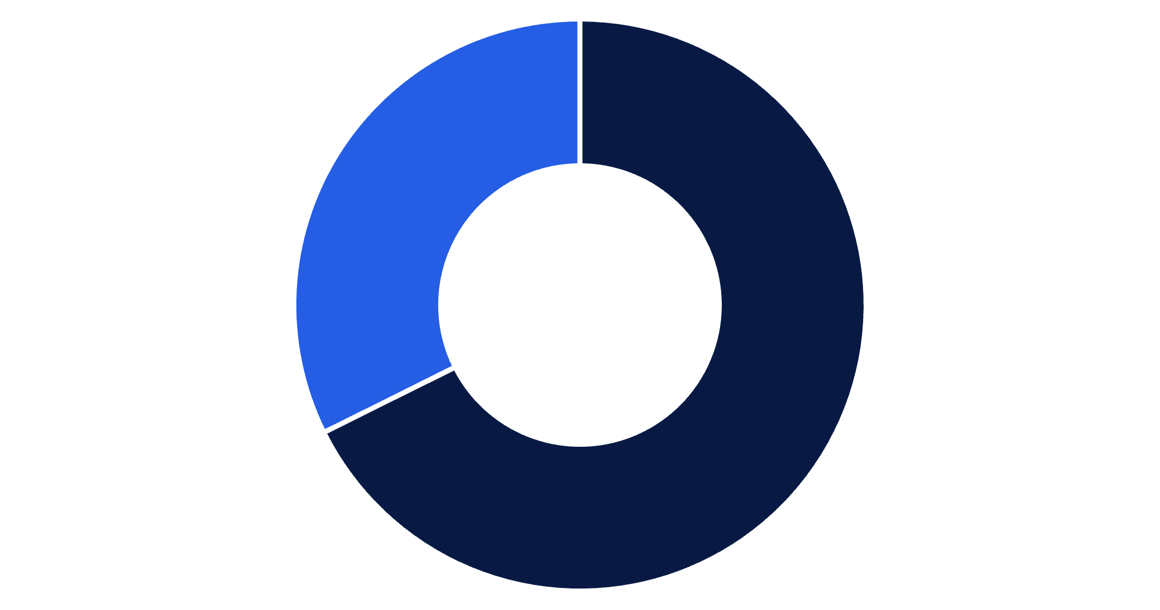
Revenue by Gender
Key Finding
Male customers generate 68% of total revenue, more than double female customer spending
Total revenue: $233,081
Male
Female

Slide 5

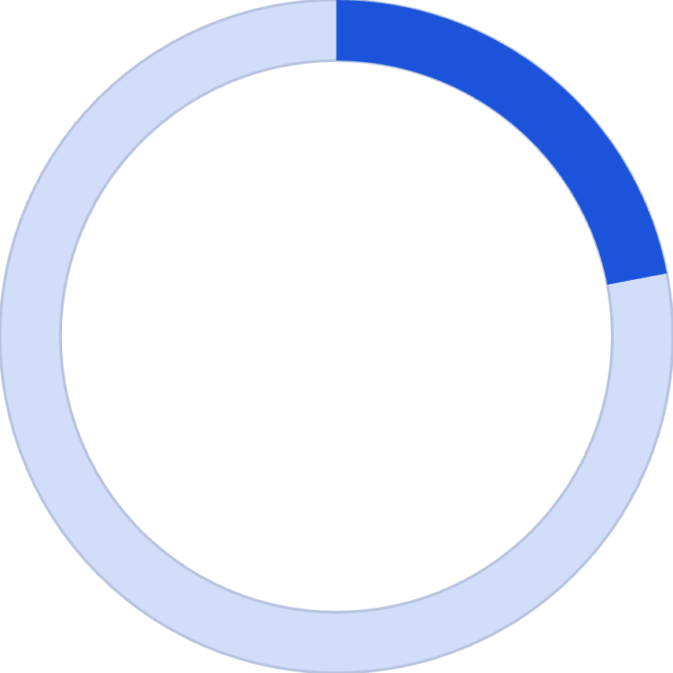


High-Value Discount Users
839
22%
$60
Smart Shoppers
Customer Share
Avg Purchase
Customers using discounts while spending above average
Percentage of total customer base
Above-average spend despite discounts
Insight: Discounts don't necessarily mean lower revenue—strategic promotions attract high-value customers

Slide 6
Product Performance Insights
Top-Rated Products
Discount-Dependent Items
97%
Hat
Gloves
50% discount rate
3.86 avg rating
96%
Sneakers
Sandals
49.66% discount rate
3.84 avg rating
Coat
95%
49.07% discount rate
Boots
3.82 avg rating
Sweater
48.17% discount rate
95%
Hat
Pants
3.80 avg rating
47.37% discount rate
94%
Skirt
3.78 avg rating

Slide 7



Customer Segmentation Analysis
New
1
83 customers
2
Returning
701 customers
3
Loyal
3,116 customers
80% of customers are loyal, representing strong retention and repeat purchase behavior
Repeat Buyers & Subscriptions
Customers with >5 purchases:
958 are subscribers
2,518 are non-subscribers

Slide 8
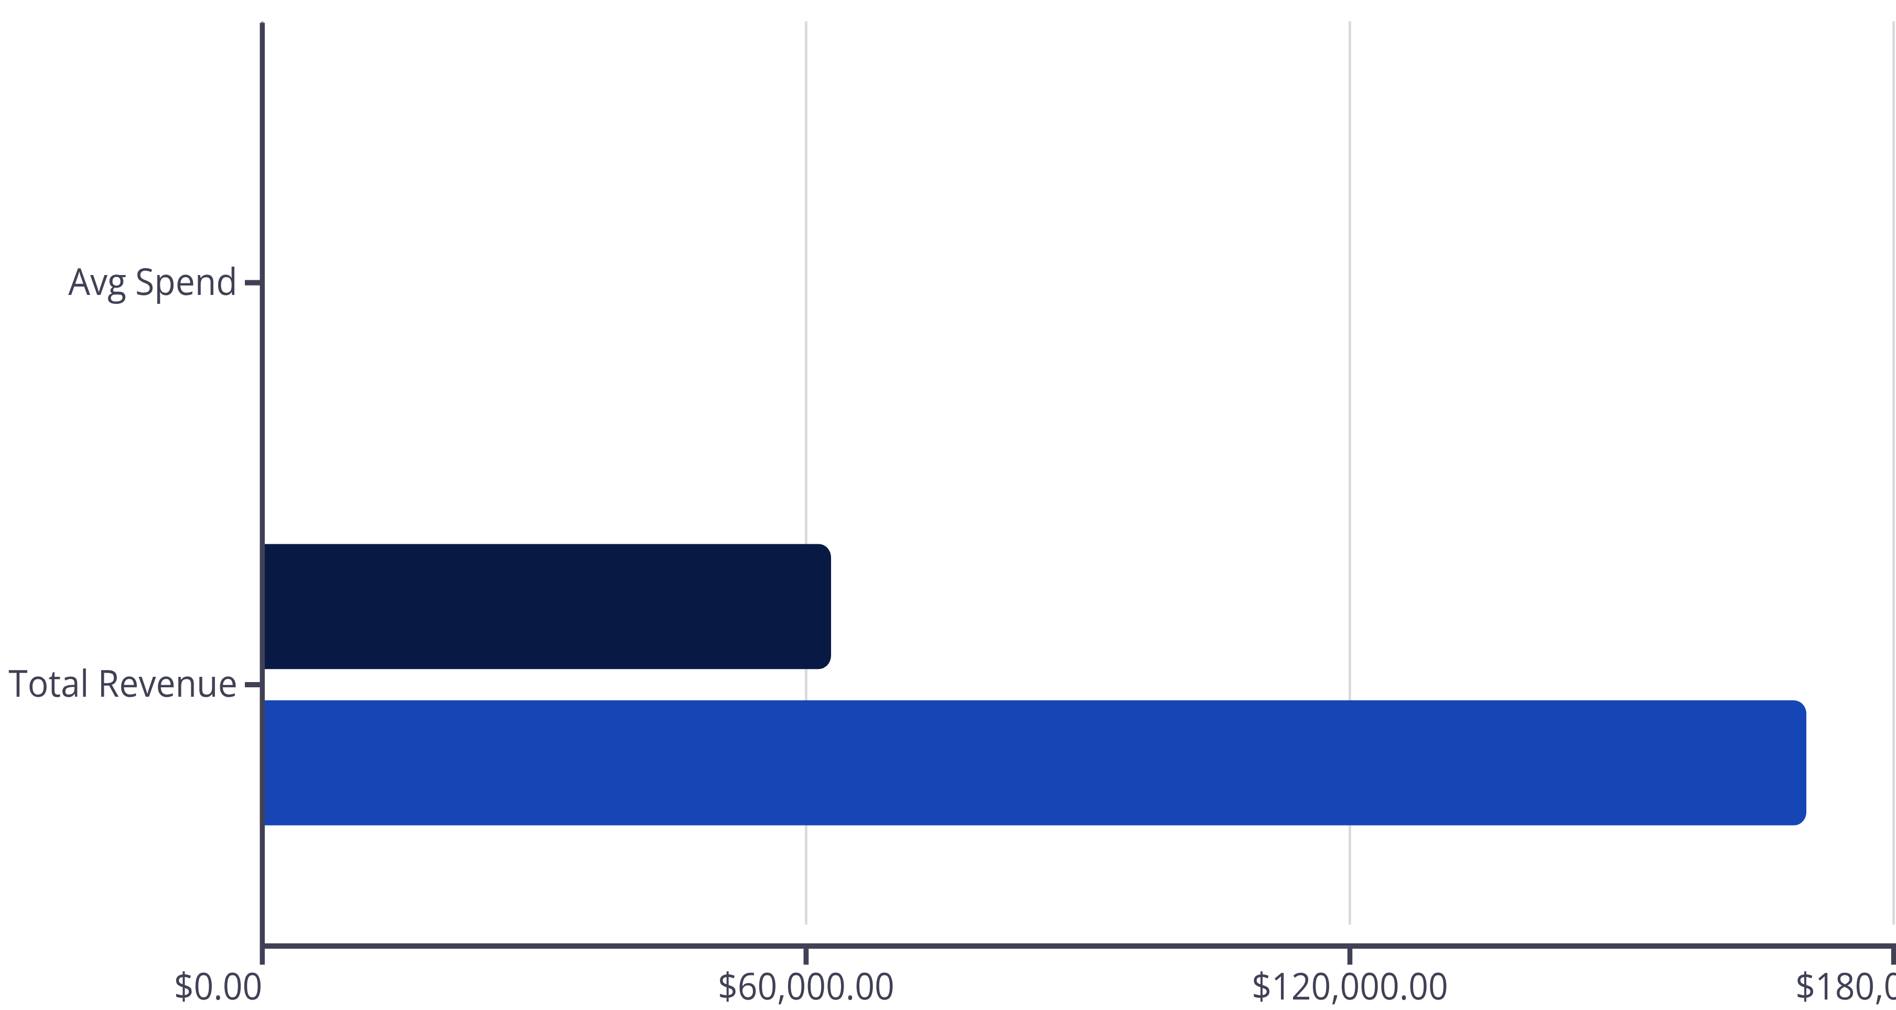

Subscription vs. Non-Subscription
Subscribers
Non-Subscribers
1,053 Subscribers
2,847 Non-Subscribers
Similar Spend
27% of customer base
73% of customer base
Minimal difference in average purchase amount
Opportunity: Non-subscribers generate more total revenue—converting them could significantly boost subscription revenue

Slide 9
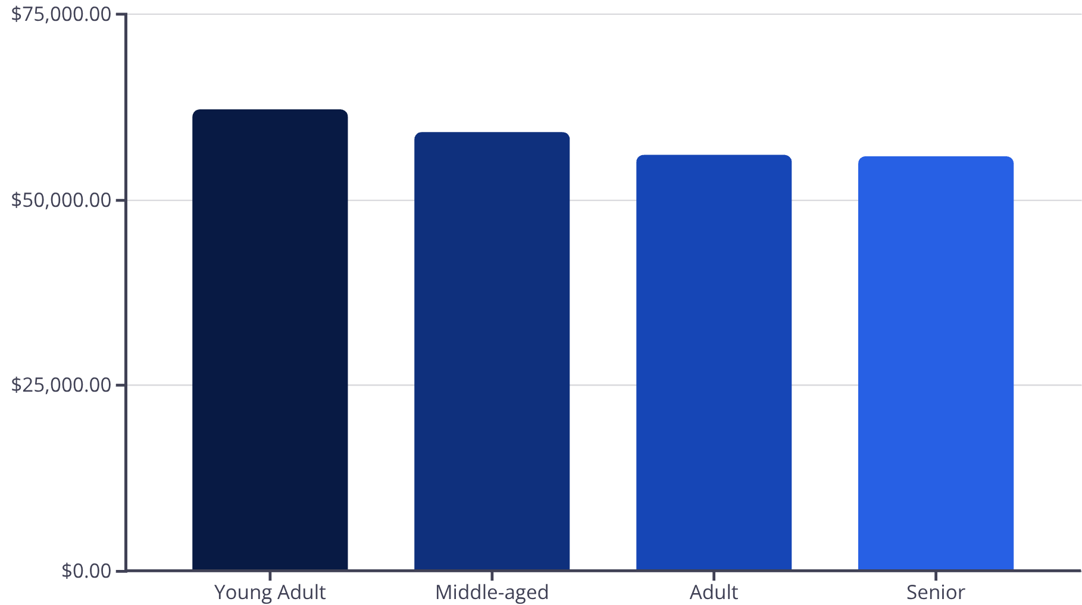
Revenue by Age Group
Shipping Preferences
Standard
$58.46 avg purchase
Express
$60.48 avg purchase
Express shipping users spend 3.5% more on average

Slide 10

Strategic Recommendations
Boost Subscriptions
Loyalty Programs
Review Discount Policy
Promote exclusive benefits to convert high-value non-subscribers
Reward repeat buyers to strengthen the 80% loyal customer base
Balance promotional sales with margin control on discount-dependent products
Product Positioning
Targeted Marketing
Highlight top-rated items like Gloves and Sandals in marketing campaigns
Focus on Young Adults and express-shipping users for maximum ROI

