Slide 1

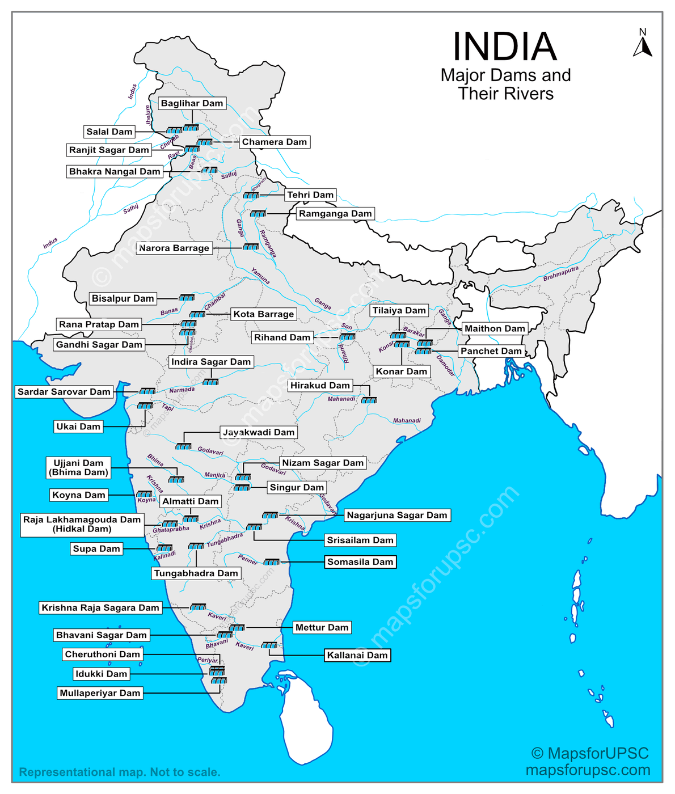




AI-Driven Water Reservoir Analysis and Prediction
Managing water reservoirs efficiently is crucial for agriculture, energy, and sustainability.
Project Goal
Use machine learning to predict reservoir storage levels, efficiency, and risk of depletion based on historical and environmental data.
Motivation
Traditional monitoring is manual and reactive; data science enables proactive water management & forecasting. This system enables data-driven, consistent, and fast decisions.
Core Tools Used
Python, Pandas, Scikit-learn, TensorFlow, and XGBoost.
Name:
PRN:
SEM and SEC:
GAUTAM SUKHANI
22070521059
SEM 7, SEC A
1
Notes:
1

Slide 2

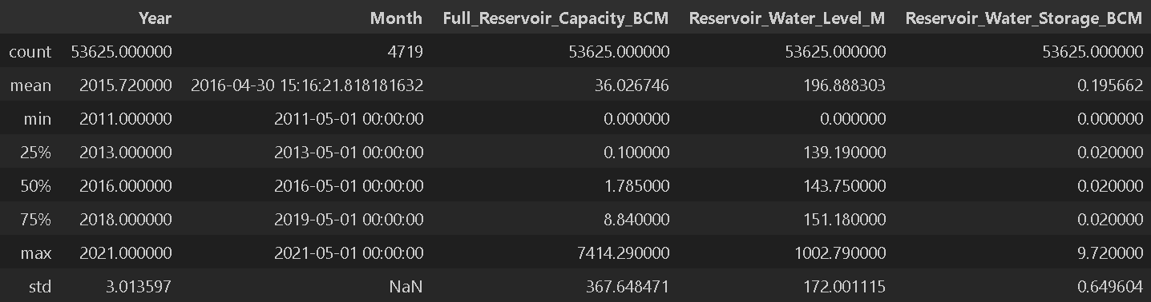

Understanding the Data
The model was trained on Cleaned Water Reservoir—a structured dataset comprising approximately 55,000 records and 10 columns features related to records of multiple reservoirs with hydrological and environmental parameters.
Data Preprocessing Steps
  Missing value treatment and outlier removal
  Feature scaling (MinMaxScaler)
  Encoded categorical fields like Reservoir_Name
Demographics
Target Attributes
  Reservoir_Name, Year, Month, Storage_Capacity, Current_Storage
  Rainfall_mm, Inflow_cusecs
  Outflow_cusecs, Evaporation_mm
  Storage_Efficiency_% (target variable)
2
Notes:
2

Slide 3
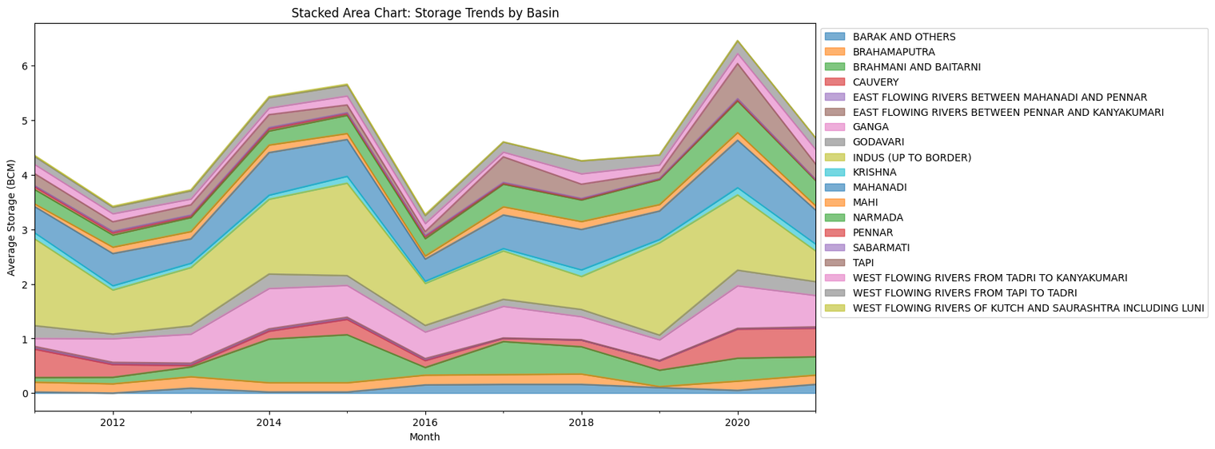
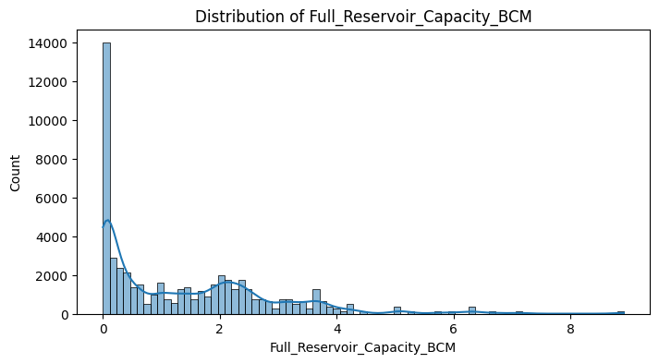
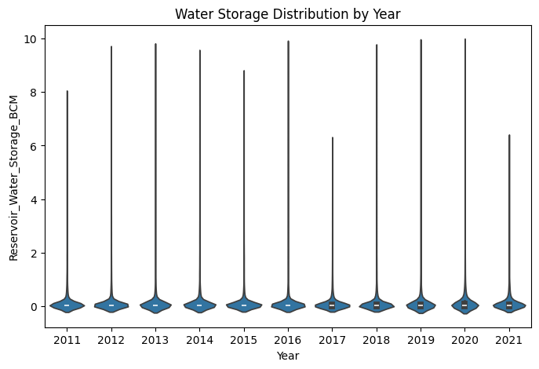
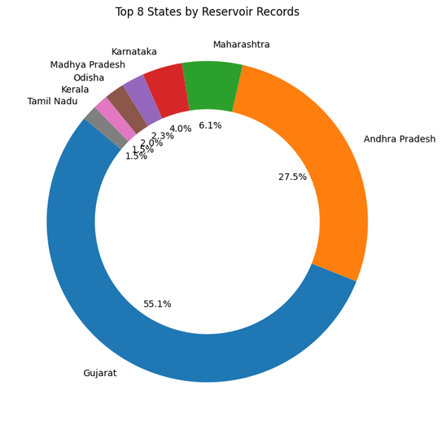
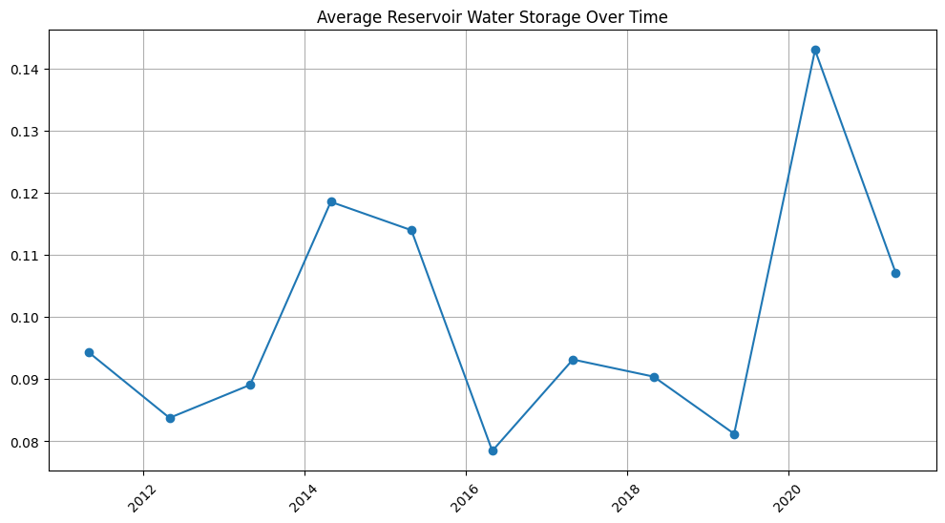
Exploratory Data Analysis
3
Strong Positive
Loss Ratio
Risk Score
Key Findings
Risk Distribution
  Higher income applicants were generally associated with lower claim frequency.
The dataset showed a slight class imbalance: 65% classified as low-risk applicants versus 35% as high-risk applicants.
  Loss Ratio, Claim Count, and Coverage Type emerged as the most significant predictors of overall risk.
Conclusion: EDA insights successfully guided feature engineering and the selection of appropriate classification algorithms.
Notes:
3

Slide 4
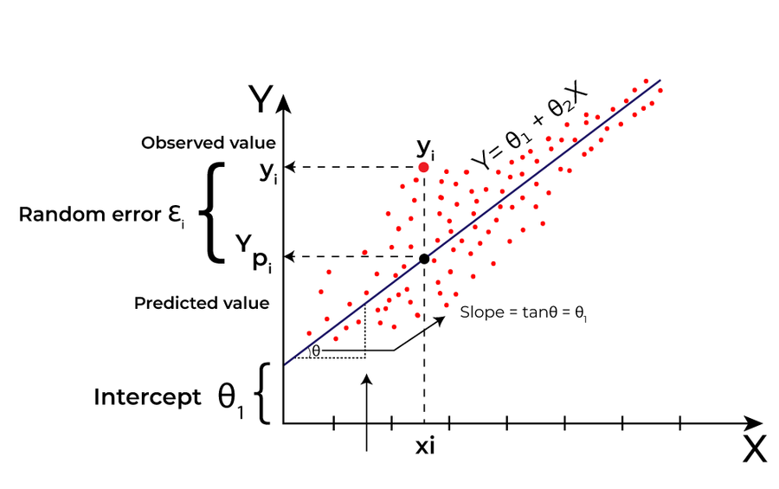
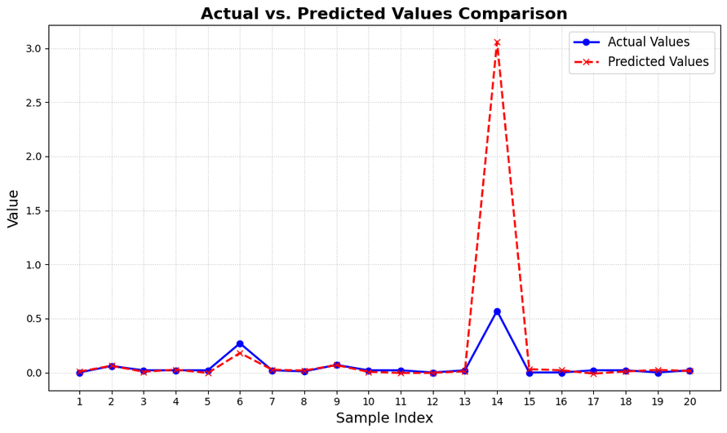
Linear Regression Model: Establishing the Baseline
A Linear Regression model was implemented as the initial baseline to predict the numeric Storage_Efficiency_%
0.74
0.32
R-Squared
RMSE
Explained variance
Root Mean Square Error
Observations
Conclusion
  The model effectively captured the primary linear trends within the data.
While a good baseline, the linear regression is limited in its ability to model the complex, non-linear interactions inherent in risk assessment. Further complexity is required. Struggled with non-linear rainfall-evaporation effects.
  Provided excellent interpretability, clearly showing the captured general trends well (rainfall → efficiency increase).
4
Strong Positive
Notes:
4

Slide 5
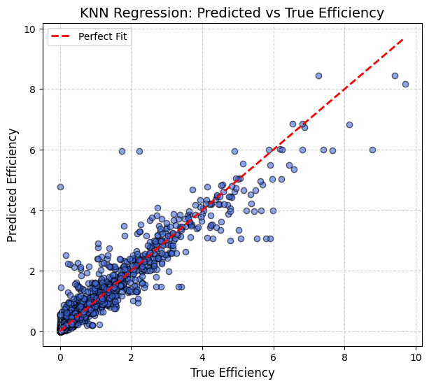



K-Nearest Neighbors (KNN) Classifier
KNN was employed as a classification model to predict efficiency by nearest historical patterns
The optimal value of K = 5 was determined through thorough cross-validation.
92%
0.17
0.393
R2 Score
RMSE Score
MAE Score
Strengths
Limitations
  Performs well and efficiently on structured, moderate-sized datasets.
  Computationally expensive during inference for very large datasets.
  Performs well where reservoir behavior is regionally similar.
  Performance is highly sensitive to the initial scaling and normalization of features.
Conclusion: KNN provides a solid local classifier, effective for pattern matching, but its reliance on proximity limits global generalization and scalability.
5
Strong Positive
Notes:
5

Slide 6
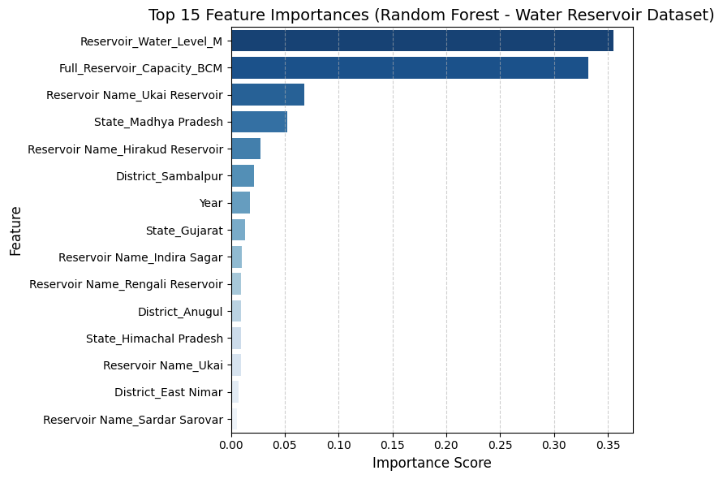
Random Forest Regressor
The Random Forest, an ensemble model utilizing multiple decision trees with bagging, was selected to capture complex feature interactions and mitigate overfitting.
R2 Score
98%
RMSE Score
0.15
Key Advantages
  Provides highly interpretable feature importance rankings.
  Demonstrates robustness against noise, outliers, and class imbalance.
  Strong generalization capabilities due to ensemble averaging.
Conclusion: Achieved high classification accuracy with a balanced generalization, making it the best candidate for stable production environments.
6
Strong Positive
Notes:
6

Slide 7



XGBoost Regressor: Optimized Performance
XGBoost (Extreme Gradient Boosting) was utilized for the continuous prediction of the boosted gradient model optimizing residuals iteratively. The model was rigorously tuned using grid search for hyperparameters like learning rate and max depth.
0.16
93%
RMSE (Lower is Better)
R-Squared (Explained Variance)
Predictive Power
Data Handling
Limitation
Demonstrated excellent predictive performance, surpassing the linear model.
Handles missing values internally, reducing the need for extensive manual imputation.
Requires careful monitoring to mitigate the slight risk of overfitting on small or noisy datasets.
7
Strong Positive
Notes:
7

Slide 8






K-Means Clustering: Applicant Segmentation
K-Means, an unsupervised model, was applied to segment applicants into distinct risk groups, providing underwriters with clear, pre-grouped data.
The optimal number of clusters (k=3: High, Moderate, Low) was determined. Silhouette Score = 0.65
Cluster 1
High-efficiency reservoirs — high inflow and rainfall
Cluster 3
Low-efficiency — low inflow, high evaporation
Cluster 2
Moderate efficiency — seasonal fluctuation
Conclusion: The clustering approach is invaluable for policymakers prioritize low-performing reservoirs..
8
Strong Positive
Notes:
8

Slide 9
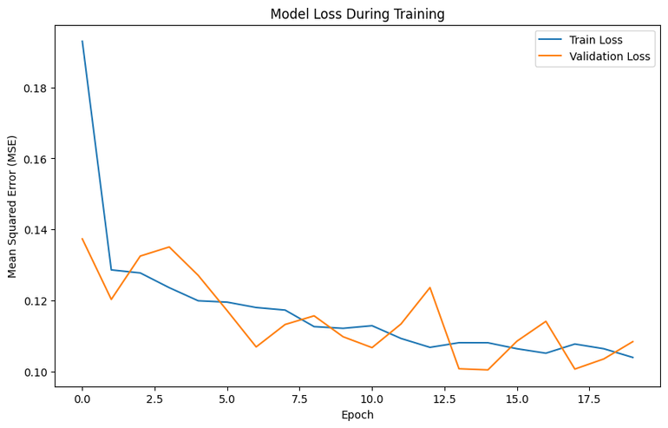

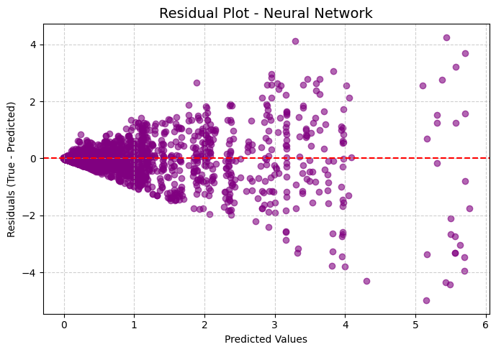

Neural Network: Exploring Deep Learning Potential
A Deep Learning model, built using TensorFlow/Keras with three hidden layers and ReLU activation,128-64-32 neurons. represents our most complex classification architecture.
Optimizer: Adam; Loss: Mean Squared Error.
R2 Score
75%
RMSE Score
0.31
MAE Score
0.09
Core Strengths
Deployment Status
  Exceptional ability to capture complex, non-linear feature relationships.
Achieved the highest overall classification accuracy. While requiring more computational resources for training and careful tuning, this architecture is ideal for high-performance production environments.
  Highly adaptable and scalable to future, massive data volumes.
9
Strong Positive
Notes:
9

Slide 10
Performance Comparison and Key Takeaways
Linear Regression
R² = 74%
Simple, interpretable
Misses non-linearity
KNN
R² = 92%
Easy to implement
Slow for large data
Random Forest
R² = 98%
Best performance
Slower training
XGBoost
R² = 93%
Balanced performance
Slight overfitting risk
K-Means
Silhouette = 0.65
Segmented Reserviors
Needs manual K selection
Neural Network
R² = 72%
Captures complexity
Heavy computation
Model Synthesis
  Random Forest achieved the best predictive accuracy.
  XGBoost provided strong interpretability and balanced performance.
  K-Means added useful grouping insights for management planning.
Efficiency Gains
AI-based models are projected to improve efficiency by 30–40%.
Future Scope:
  Integrate satellite rainfall data.
  Deploy model as web dashboard.
  Add anomaly detection for real-time alerts.
10
Strong Positive
Notes:
10

