Slide 1


Introduction to Machine Learning
Gowtham Abbavaram
September, 2017

Slide 2
Agenda
1
What is Machine Learning
2
From AI perspective
3
Different Kinds of ML
4
A Simple Case Study
5
Linear Regression
6
Gradient Descent
7
Demo
8
End Notes, Q&A
Notes:
2

Slide 3
What is Machine Learning
A way of thinking about Artificial intelligence
Learn different patterns in existing information
Train → optimize → tune → new training data → repeat
Notes:
3

Slide 4
What is Machine Learning
More statistical less logical
ML is the ‘state of the art’ problem solving method
Different approaches to ML
Genetic Algorithms
Probabilistic/Statistical Methods
Artificial Neural Networks(Deep Learning)
Notes:
4

Slide 5
Relation with AI
Learning
Reasoning & Intelligence
ML
DL
AI
Psychology&
Philosophy
Computer Science
Linguistics
Cognitive Science
Neuro science
Mathematics
Notes:
P37 – divide into 2 slides
5

Slide 6
Popular Learning Methods in ML
1
Supervised Learning
e.g. Classification, Regression
Whether prediction, Face recognition, Spam filtering
2
Unsupervised Learning
e.g. Clustering
Recommendation systems, Image segmentation
3
Reinforcement Learning
e.g. Game Theory, Decision Theory
Deep blue, AlphaGo
Notes:
6

Slide 7
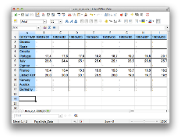


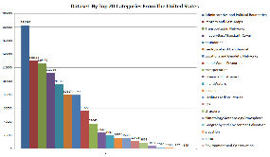

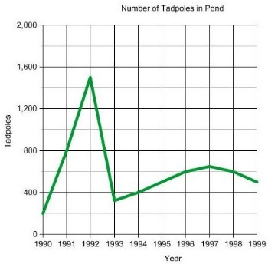
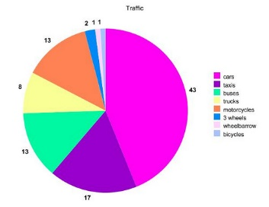
A Simple Example
#bedrooms
#sq. feet
#distance
Knowledge Extraction
Suggestions
Decision making
Notes:
7

Slide 8
Recap..
Equation of a line
Slope of a line / Gradient
Derivative of a function f
Linear function vs non linear function
Sigma Notation for sums

Slide 9
A Simple Example
Input: Square feet
Output: Expected price
Need to come up with a model that predicts the price
Notes:
9

Slide 10
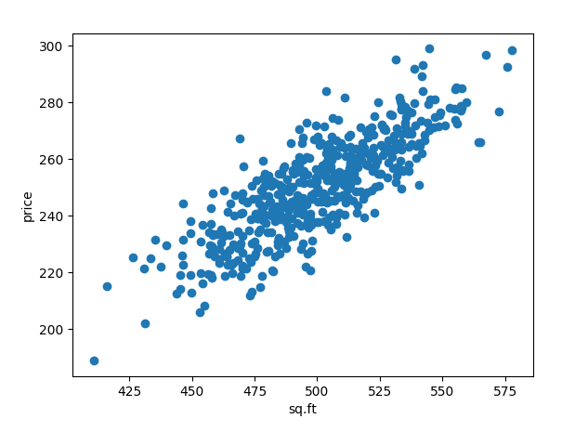
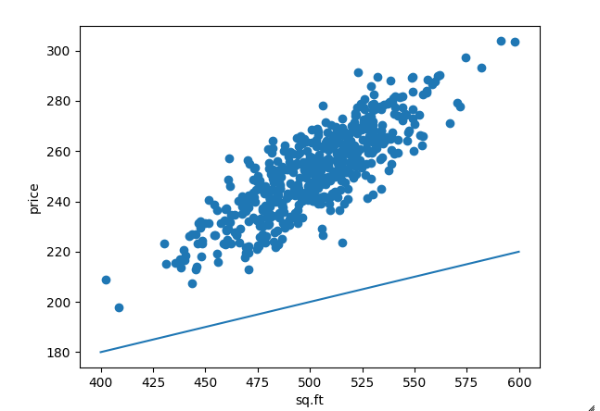
Linear Regression
Lets take the simplest scenario
Assumptions:
Input:
sq. feet of home
Output:
expected price
Existing data shows some linear relationship
Notes:
10

Slide 11
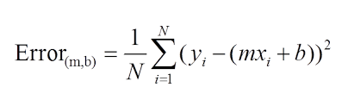

Define an error function
Minimize the error function

Slide 12
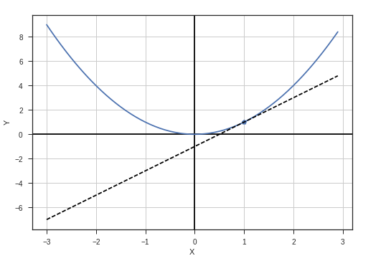
Gradient Descent
Let’s plot cost(C) vs parameters(P)
Change parameter values that minimize cost
Simple setting → convex function
C
P
Notes:
12

Slide 13
Gradient Descent
Minimize convex function → gradient descent
Update rule
P converges to optimal value
Notes:
13

Slide 14
Demo
Demo

Slide 15
End Notes, Q&A
1
More talks and workshops to come on ML
2
Join yammer group “AI Community”

