Slide 1


Introduction to Machine Learning
Gowtham Abbavaram
September 17, 2017

Slide 2
Agenda
1
What is Machine Learning
2
From AI perspective
3
Different Kinds of ML
4
A Simple Case Study
5
Linear Regression
6
Gradient Descent
7
Demo
8
End Notes, Q&A
Notes:
2

Slide 3
What is Machine Learning
A way of thinking about Artificial intelligence
Learn different patterns in existing information
Train → optimize → tune → new training data → repeat
More statistical less logical
ML is the ‘state of the art’ problem solving method
Different approaches → Genetic Algorithms, Probabilistic/Statistical Methods, Artificial Neural Networks(Deep Learning), Rule-based methods and many more
Notes:
3

Slide 4
Relation with AI
Learning
Reasoning & Intelligence
ML
DL
AI
Psychology&
Philosophy
Computer Science
Linguistics
Cognitive Science
Neuro science
Mathematics
Notes:
P37 – divide into 2 slides
4

Slide 5
Popular Learning Methods in ML
1
Supervised Learning
e.g. Classification, Regression
Whether prediction, Face recognition, Spam filtering
2
Unsupervised Learning
e.g. Clustering
Recommendation systems, Image segmentation
3
Reinforcement Learning
e.g. Game Theory, Decision Theory
Deep blue, AlphaGo
Notes:
5

Slide 6
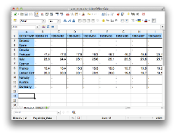


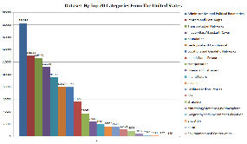

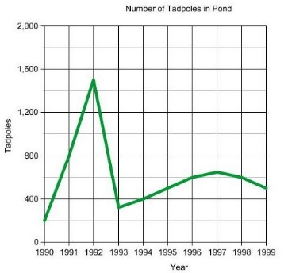
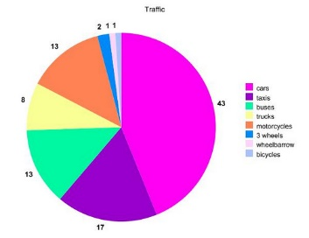
A Simple Example
#bedrooms
#sq. feet
#distance
Knowledge Extraction
Suggestions
Decision making
Notes:
6

Slide 7
Recap..
Equation of a line
Slope of a line / Gradient
Derivative of a function f
Linear function vs non linear function
Sigma Notation for sums

Slide 8
A Simple Example
Input: Square feet
Output: Expected price
Need to come up with a model that predicts the price
How to find such model
Notes:
8

Slide 9
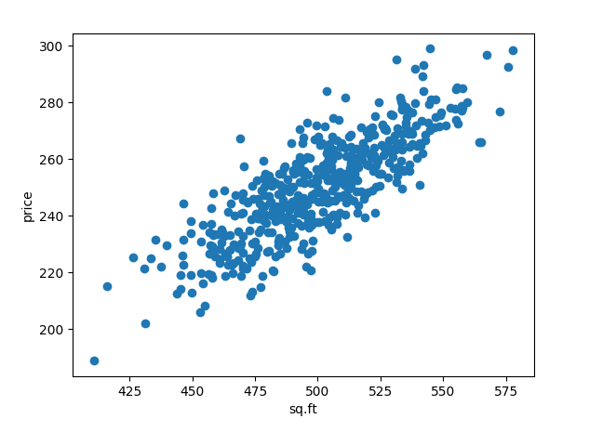
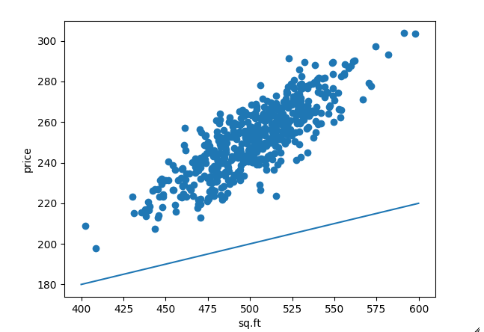
Linear Regression
Lets take the simplest scenario
Assumptions:
Input:
sq. feet of home
Output:
expected price
Existing data shows some linear relationship
Notes:
9

Slide 10
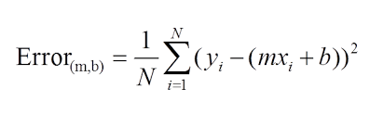

Define an error function
Minimize the error function

Slide 11
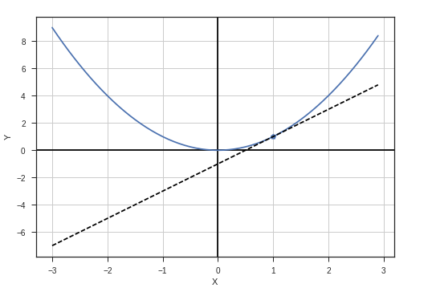
Gradient Descent
Let’s plot cost(C) vs parameters(P)
Change parameter values that minimize cost
Simple setting → convex function
Minimize convex function → gradient descent
Update rule → p = p – k * dc/dp
P converges to optimal value
C
P
Notes:
11

Slide 12
Demo
Demo

Slide 13
End Notes, Q&A
1
More talks and workshops to come on ML
2
Join yammer group “AI Community”

