Slide 1


Introduction to Machine Learning
Linear Regression
Gowtham Abbavaram
September, 2017

Slide 2
Agenda
1
What is Machine Learning
2
From AI perspective
3
Different Kinds of ML Algorithms
4
A Simple Case Study
5
Linear Regression
6
Gradient Descent
7
Summary & Demo
8
End Notes, Q&A
Notes:
2

Slide 3
What is Machine Learning
Learn different patterns in existing information
A way of thinking about Artificial intelligence
Train → tune → predict → get new data → repeat
Notes:
3

Slide 4
What is Machine Learning
More statistical less logical
Different approaches to ML
Genetic Algorithms
Probabilistic/Statistical Methods
Artificial Neural Networks(Deep Learning)
Notes:
4

Slide 5
Relation with AI
Learning
Reasoning & Intelligence
ML
DL
AI
Psychology&
Philosophy
Computer Science
Linguistics
Cognitive Science
Neuro science
Mathematics
Notes:
P37 – divide into 2 slides
5

Slide 6
Popular Learning Methods in ML
1
Supervised Learning
e.g. Classification, Regression
Weather prediction, Face recognition, Spam filtering
2
Unsupervised Learning
e.g. Clustering
Recommendation systems, Image segmentation
3
Reinforcement Learning
e.g. Game Theory, Decision Theory
Deep blue, Alpha Go
Notes:
6

Slide 7
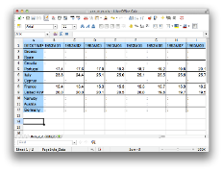


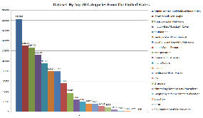

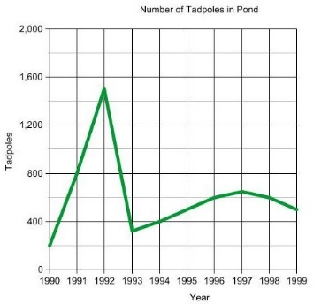
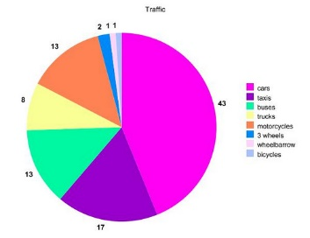
A Simple Example
#bedrooms
#sq. feet
#distance
Knowledge Extraction
Suggestions
Decision making
Notes:
7

Slide 8
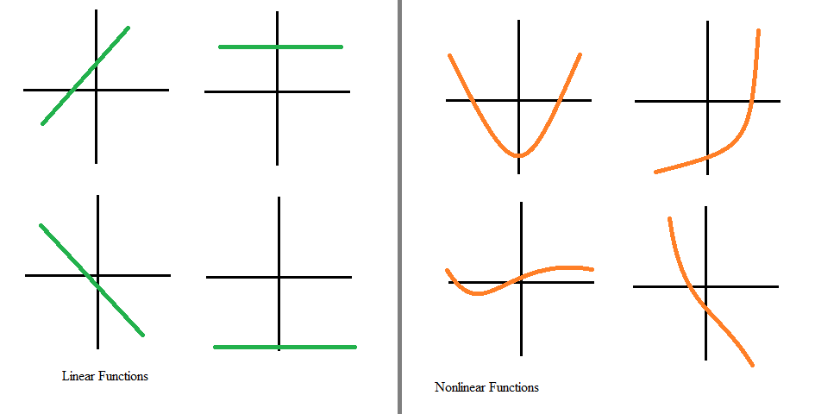

Recap..
Equation of a line
Slope of a line / Gradient
Linear function vs non linear function
Sigma Notation for sums

Slide 9
A Simple Example
Input: Square feet
Output: Expected price
Need to come up with a ‘Model’ that predicts the price
Notes:
9

Slide 10
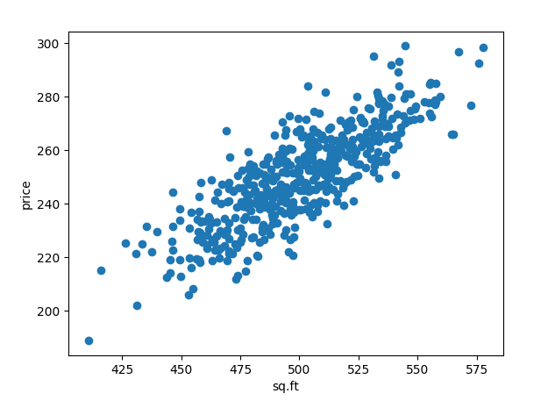
Linear Regression
Assumptions:
Input:
sq. feet of home
Output:
expected price
Existing data shows some linear relationship
Notes:
10

Slide 11
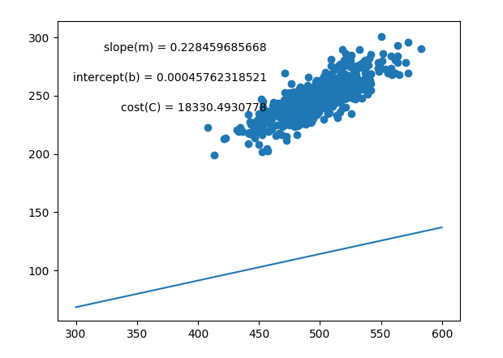
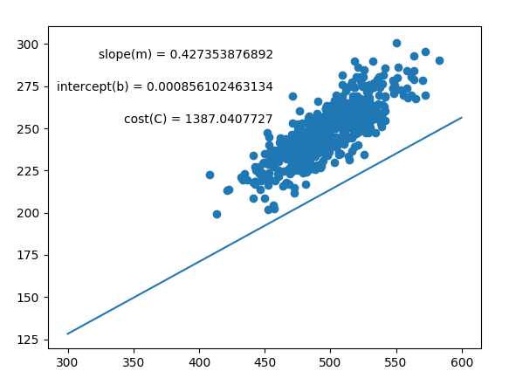
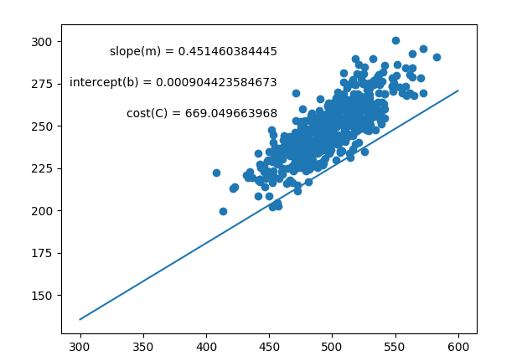
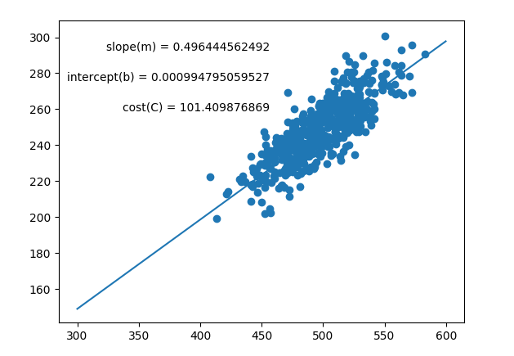
Linear Regression

Slide 12
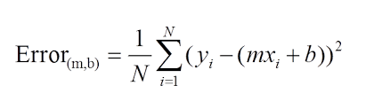
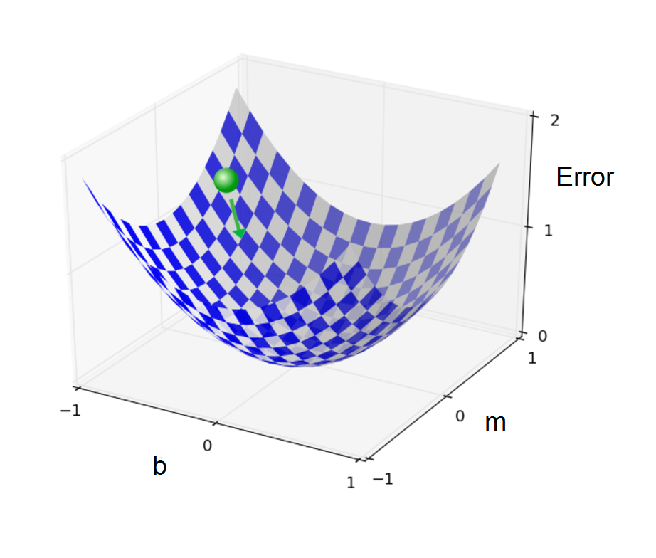
Model and Error
Define an error function
Minimize the error function

Slide 13
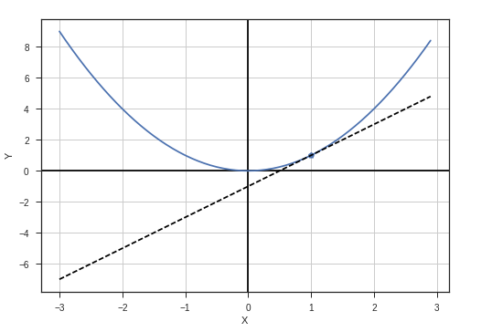
Gradient Descent
Let’s plot Error(E) vs parameter(m)
Change parameter values that minimize cost
Simple setting → convex function
E
m
Notes:
13

Slide 14
Gradient Descent
Minimize convex function → gradient descent
Update rule
m converges to optimal value (i.e. gives minimum Error)
Notes:
14

Slide 15
Demo
Demo

Slide 16
End Notes, Q&A
1
More talks and workshops to come on ML
2
Join yammer group “AI Community”

