Slide 1


Introduction to Machine Learning
Gowtham Abbavaram
September 17, 2017

Slide 2
Agenda
1
What is Machine Learning
2
From AI perspective
3
Different Kinds of ML
4
A Simple Case Study
5
Linear Regression
6
Gradient Descent
7
Demo
8
End Notes, Q&A
Notes:
2

Slide 3
What is Machine Learning
A way of thinking about Artificial intelligence
Learn different patterns in existing information
Train → optimize → tune → new training data → repeat
More statistical less logical
ML is the ‘state of the art’ problem solving method
Different approaches → Genetic Algorithms, Probabilistic/Statistical Methods, Artificial Neural Networks(Deep Learning), Rule-based methods and many more
Notes:
3

Slide 4
Relation with AI
Learning
Reasoning & Intelligence
ML
DL
AI
Psychology&
Philosophy
Computer Science
Linguistics
Cognitive Science
Neuro science
Mathematics
Notes:
P37 – divide into 2 slides
4

Slide 5
Popular Learning Methods in ML
1
Supervised Learning
e.g. Regression, Classification
2
Unsupervised Learning
e.g. Clustering
3
Reinforcement Learning
e.g. Game Theory, Decision Theory
Notes:
5

Slide 6
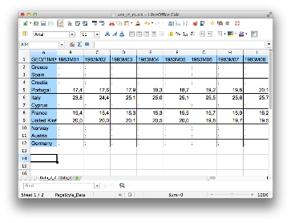


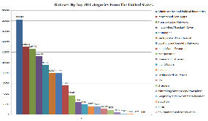

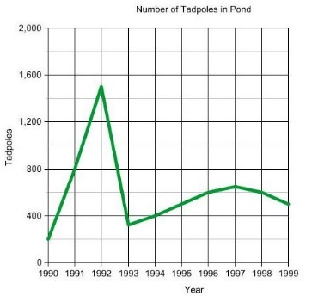
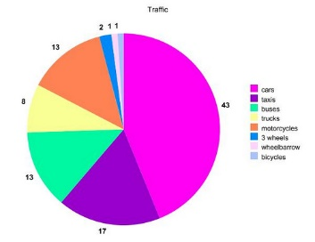
A Simple Example
#bedrooms
#sq. feet
#distance
Knowledge Extraction
Suggestions
Decision making
Notes:
6

Slide 7
A Simple Example
Input: Specifications of a home
Output: Expected price of home
Need to fit a model that best represents our data
How to fit model? How to decide about a model
Lets see this in action in a simple setup
Notes:
7

Slide 8
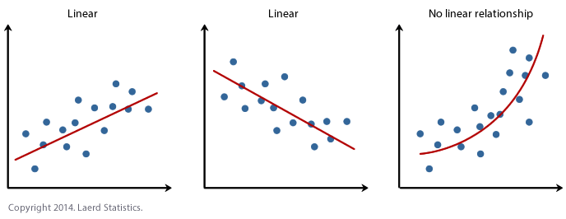
Linear Regression
Lets take the simplest scenario
Assumptions:
Input: sq. feet of home
Output: expected price
Training data shows some linear relationship
Notes:
8

Slide 9
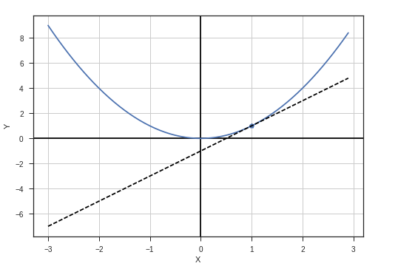
Gradient Descent
Let’s plot cost(C) vs parameters(P)
Change parameter values that minimize cost
Simple setting → convex function
Minimize convex function → gradient descent
Simple update rule
p = p – k * dc/dp
P converges to optimal value
C
P
Notes:
9

Slide 10
Demo
Demo

Slide 11
End Notes, Q&A
1
More talks and workshops to come on ML
2
Join yammer group “AI Community”

