Slide 1
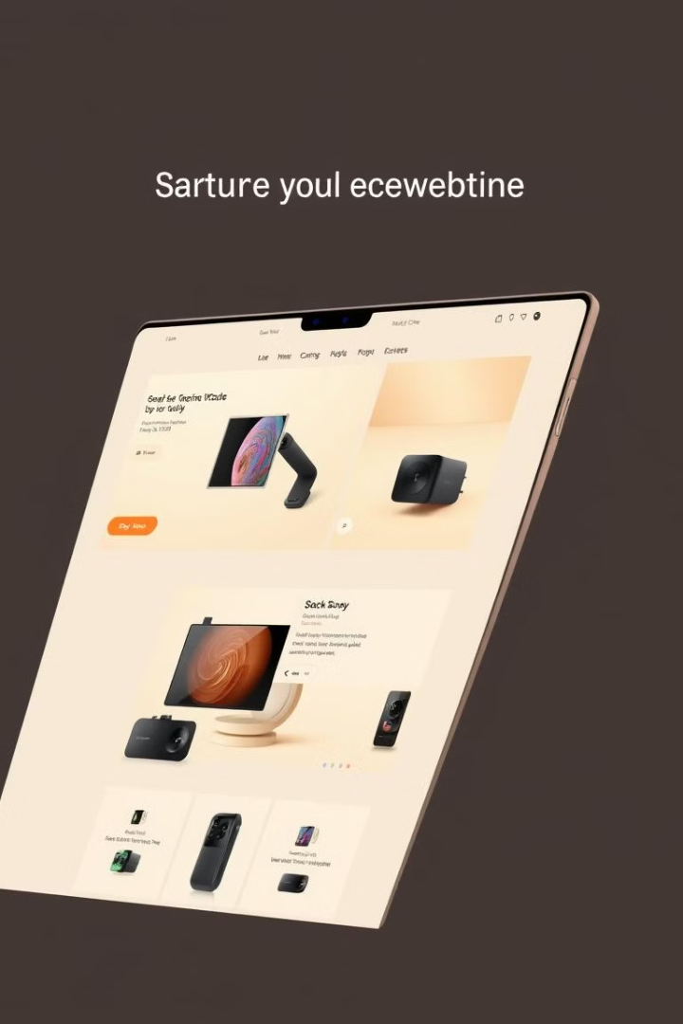

E-Commerce Platform for Electronics Gadgets
This presentation outlines my college project: a fully functional e-commerce platform for electronics. The platform leverages modern web technologies for a seamless user experience. Key features include product browsing, secure authentication, and order management.
by Gautam mukherjee

Slide 2
Project Goals and Objectives
The primary objective was to create a comprehensive e-commerce solution. It targets tech enthusiasts seeking the latest electronic gadgets. The project spanned from the start to end date. Key features were developed to provide a robust and user-friendly platform.
Target Audience
Key Features
Objective
Tech enthusiasts and general consumers.
Product catalog, user authentication, shopping cart.
Implement a fully functional e-commerce platform.

Slide 3




Technology Stack Overview
The platform utilizes a robust technology stack. React.js powers the frontend for interactive UI. Node.js and Express.js handle the backend API. MySQL stores data, managed with Sequelize ORM. Deployment is handled using modern services.
React.js
Node.js
MySQL
Component-based architecture, reusable UI elements.
RESTful API, product data handling.
Data storage, Sequelize ORM.

Slide 4

Database Design with Sequelize
Sequelize ORM defines the database structure. Models include Users, Products, Categories, Orders, and OrderItems. Relationships connect users to orders, orders to items, and products to categories. These models manage the site data efficiently.
1
Users
2
Products
3
Orders
Stores user data and credentials.
Details on each electronic gadget.
Tracks user orders and status.

Slide 5




Key Features Showcase
The platform boasts a product catalog with search. User authentication ensures secure access. A shopping cart enables easy product selection. Order management provides tracking. Payment processing offers simulated transactions. Each feature enhances the user experience.
Product Catalog
Browse and search electronics.
User Authentication
Secure registration and login.
Shopping Cart
Add, update, and remove items.

Slide 6



Frontend Implementation (React.js)
React.js components drive the frontend. Key components include ProductList, ProductDetail, ShoppingCart, Checkout, and UserAuthentication. React Context API manages global state. Axios handles data fetching. These components deliver a seamless user interface.
2
ShoppingCart
1
ProductList
Checkout
3

