Slide 1
Project Based Evaluation – BEE
Semester-5 (Batch-2023)
Multiplayer Gaming Platform
G4-J-PID-18
Team Details:
Bhumika 2310990315
Chetan Bansal 2310990317
Gautam Jain 2310990336
Mr. Rahul
:
Chitkara University Institute of Engineering and Technology,
Chitkara University, Punjab

Slide 2
Table of Contents
Problem Statement
Proposed Solution
Technology Stack
Features and Functionalities
Future Scope
Results
Code Snippets
References

Slide 3
Problem Statement
The current landscape of multiplayer gaming presents several significant hurdles that diminish the user experience and limit accessibility.
Device Incompatibility
Gamers often face frustrating barriers when trying to play across diverse hardware, leading to exclusive ecosystems and limited participation.
Persistent Connection Issues
Lag, high latency, and frequent disconnections disrupt the flow of online sessions, severely impacting immersion and competitive integrity.
Fragmented Cross-Platform Play
Many popular games restrict players to specific platforms, preventing friends from different systems from enjoying a shared gaming experience.
Inconsistent Player Journeys
Moving between devices or platforms often results in fragmented progress, settings, and social networks, creating a disjointed user experience.

Slide 4
Proposed Solution
Device Incompatibility
Universal Web-Based Access
Play from any modern browser, on any device—be it a PC, tablet, or smartphone. Our platform eradicates hardware barriers, inviting a broader audience to join.
Persistent Connection Issues
Real-Time Socket.IO Connectivity
Experience virtually lag-free gameplay with robust, real-time communication powered by Socket.IO. Enjoy stable connections and immediate responses, crucial for competitive and immersive gaming.
Fragmented Cross-Platform Play
Seamless Cross-Device Synchronization
Our architecture ensures that friends can connect and play together effortlessly, regardless of the device they're using. The game world and player actions are perfectly synchronized across all platforms.
Inconsistent Player Journeys
Unified Player Profiles
All your progress, achievements, settings, and social connections are stored securely in a single, cloud-based profile. Transition between devices without losing a beat, ensuring a truly consistent player journey.

Slide 5
Technological Stack
MongoDB
Stores user profiles, match histories, statistics, friend networks, and game data with lightning-fast retrieval and scalability.
Express.js
Powers robust backend APIs and handles complex game logic with efficient routing and middleware management.
React.js
Delivers an interactive, futuristic user interface with dynamic components and smooth state management for optimal gaming experience.
Node.js
Enables real-time communication through Socket.IO, ensuring instant synchronization across all connected players.

Slide 6
Features and Functionalities
Match History
Comprehensive game tracking with detailed statistics, filterable results by game type and outcome, and performance analytics to help you improve your gameplay strategies.
Friends Network
Dynamic friend management system showing online status, pending requests with accept/reject functionality, and detailed friend statistics for competitive comparison.
Global Leaderboards
Competitive ranking system highlighting top performers, global standings across all games, and achievement recognition to fuel your competitive spirit.

Slide 7
Future Scope
UI/UX Excellence
Our design philosophy centres on creating an intuitive yet visually stunning experience. We employ glassmorphism effects, 3D depth perception, and smooth micro-animations to create an immersive environment that feels both familiar and futuristic.
Bold typography with cyberpunk aesthetics
Unique hover interactions and transitions
User-focused navigation and accessibility
Expanding Horizons
Our roadmap includes revolutionary features that will reshape multiplayer gaming:
AI-powered matchmaking and game suggestions
Tournament systems with global championships
Battle Royale mini-games and custom game modes
Advanced analytics and performance insights

Slide 8
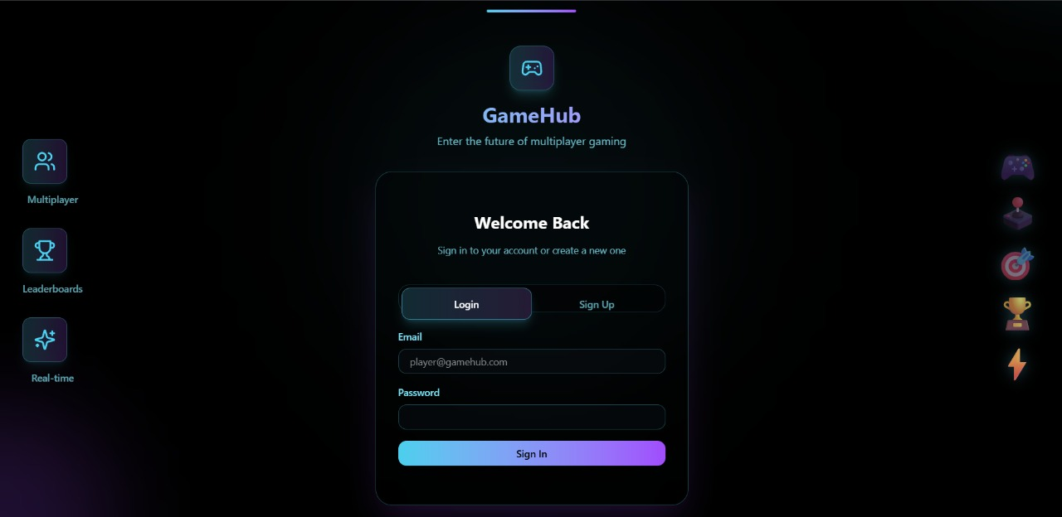
Results

Slide 9
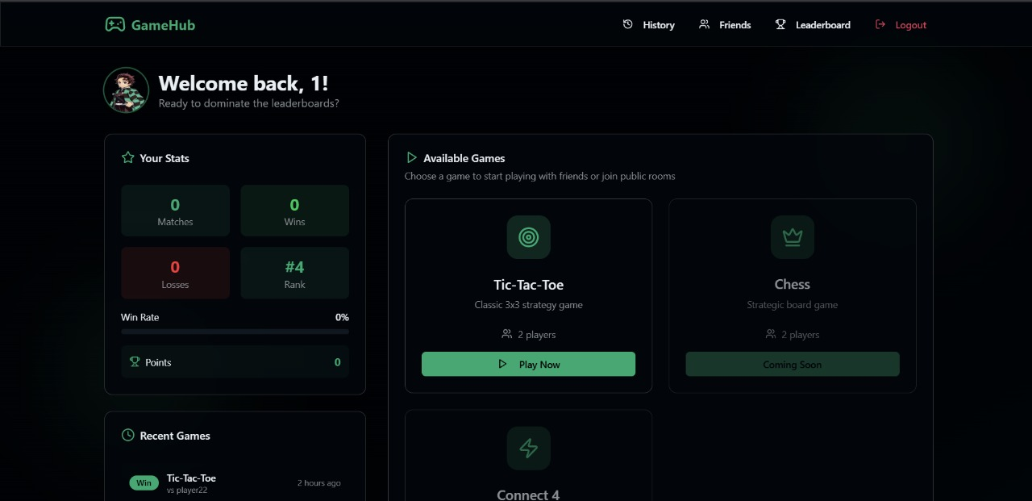
Results

Slide 10
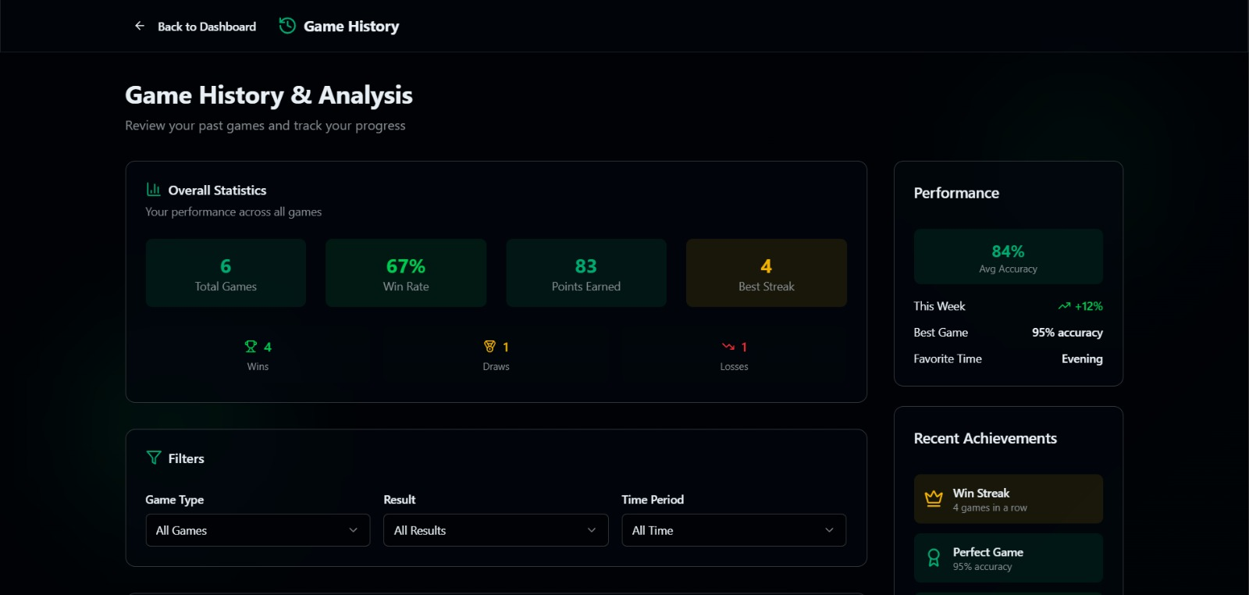
Results

Slide 11
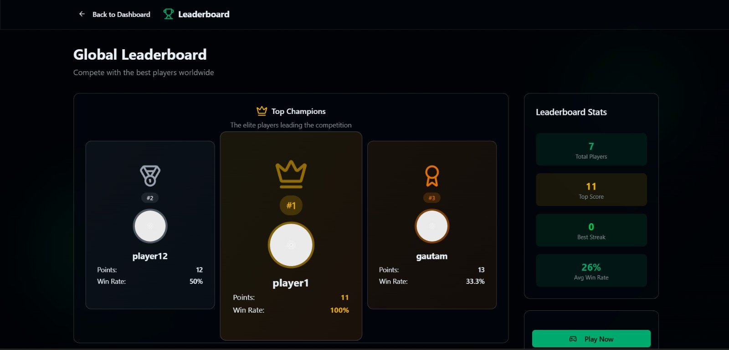
Results

Slide 12
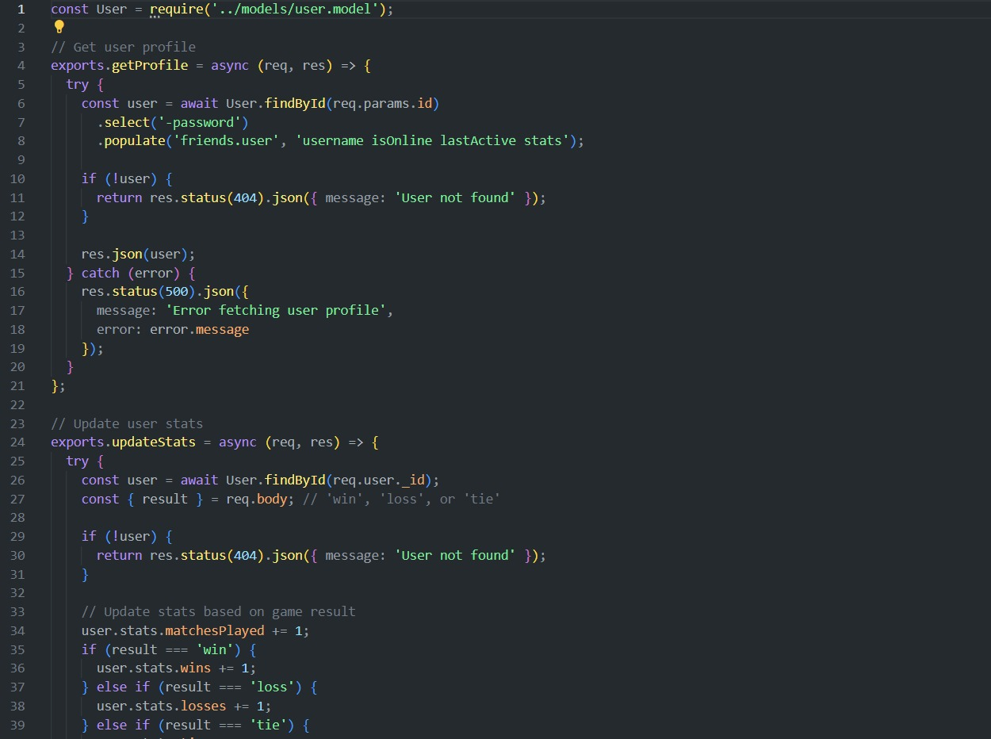
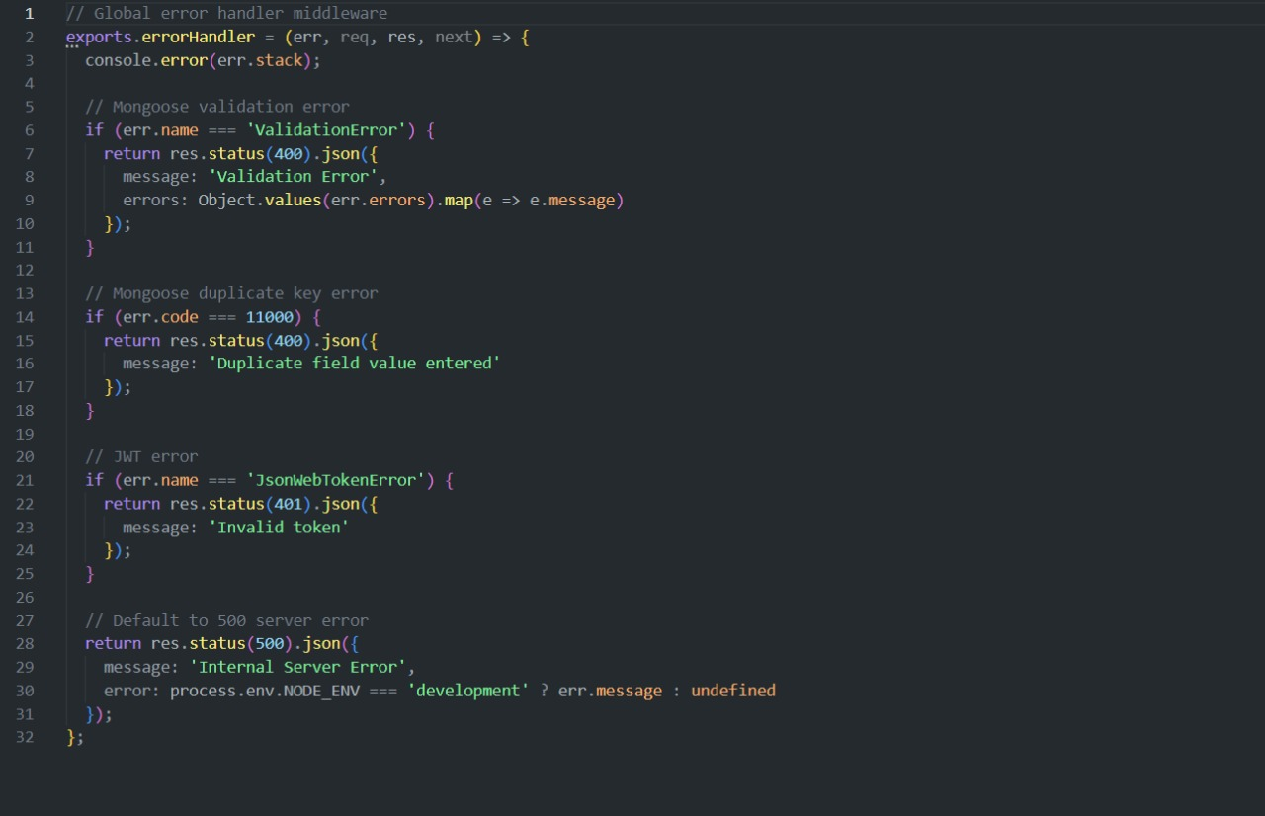
Code Snippets

Slide 13
References
Official Documentation: Documentation for libraries, frameworks, and tools used in the project, as well as APIs or services integrated.
• https://www.google.com/
• Tutorials and Guides: Online tutorials, guides, blog posts, and educational videos that provided assistance or insights during development.
• https://www.geeksforgeeks.org/
• Code Repositories: GitHub repositories or other code repositories where code snippets, examples, or inspiration were found. • https://chat.openai.com/
• Forums and Communities: Online forums, such as Stack Overflow or Reddit, and developer communities where questions were asked, advice was sought, or discussions were participated in. • Personal Communication: Mentors, peers who provided guidance, feedback, or support during development.

Slide 14


