Slide 1
Flight Fare Prediction

Slide 2
Objective:
Travelling through flights has become an integral part of today’s lifestyle as more and more people are opting for faster travelling options. The flight ticket prices increase or decrease every now and then depending on various factors like timing of the flights, destination, duration of flights. various occasions such as vacations or festive season. Therefore, having some basic idea of the flight fares before planning the trip will surely help many people save money and time. In the proposed system a predictive model will be created by applying machine learning algorithms to the collected historical data of flights. This system will give people the idea about the trends that prices follow and also provide a predicted price value which they can refer to before booking their flight tickets to save money. This kind of system or service can be provided to the customers by flight booking companies which will help the customers to book their tickets accordingly.

Slide 3
Introduction:
This project aims to develop an application which will predict the flight prices for various flights using machine learning model.
The user will get the predicted values and with its reference the user can decide to book their tickets accordingly. In the current day scenario flight companies try to manipulate the flight ticket prices to maximize their profits.
There are many people who travel regularly through flights and so they have an idea about the best time to book cheap tickets. But there are also many people who are inexperienced in booking tickets and end up falling in discount traps made by the companies where actually they end up spending more than they should have. The proposed system can help save millions of rupees of customers by proving them the information to book tickets at the right time.

Slide 4
Benefits:
Save money.
Save time.

Slide 5
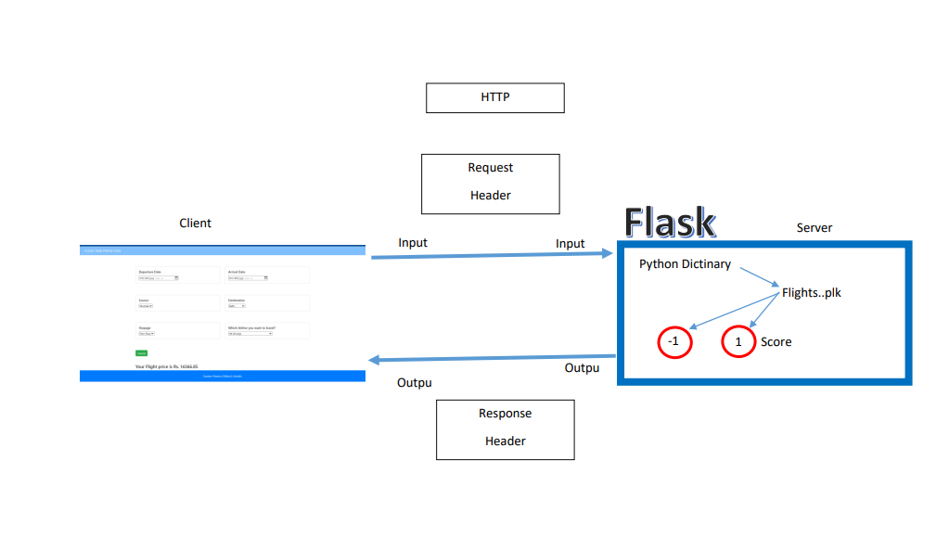
Architecture

Slide 6
Methodology:
Import all required libraries
Import the data
Check the data and verify
Explorartoy Data Analysis
Feature selection
Random forest training

Slide 7
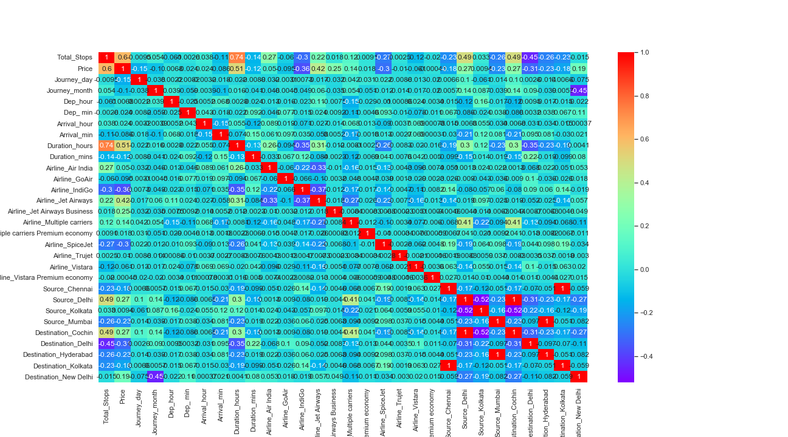
Visualizing the correlation:

Slide 8
Model Training:
Data Export from Kaggle :
Data Preprocessing
Data Validation
Data Training

Slide 9
Model Selection –
By using algorithms “Random Fores”. We calculate the scores for models and select the model with the best score. Similarly, the model is selected for each cluster. All the models for every cluster are saved for use in prediction

Slide 10
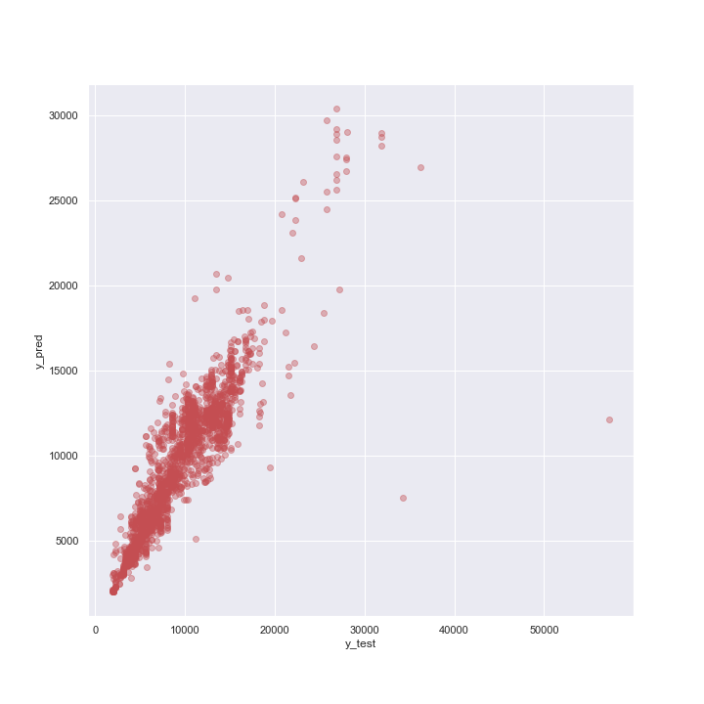
Prediction:
The testing files are shared in the batches and we perform the same Validation operations ,data transformation and data insertion on them.

Slide 11
Q & A:
Q1) What’s the source of data?
The data for training is provided by the client in multiple batches and each batch contain multiple files
Q 2) What was the type of data?
The data was the combination of numerical and Categorical values.
Q 3) After the File validation what you do with incompatible file or files which didn’t pass the validation?
Files like these are moved to the Achieve Folder and a list of these files has been
shared with the client and we removed the bad data folder.

Slide 12
Q 4) How logs are managed?
We are using different logs as per the steps that we follow in validation and
modeling like File validation log , Data Insertion ,Model Training log , prediction log
etc.
Q 5) What techniques were you using for data pre-processing?
Removing unwanted attributes
Visualizing relation of independent variables with each other and output variables
Checking and changing Distribution of continuous values
Removing outliers
Cleaning data and imputing if null values are present.
Converting categorical data into numeric values.
Scaling the data

Slide 13
Q 6) How training was done or what models were used?
Before diving the data in training and validation set we performed clustering over fit to divide the data into clusters.
As per cluster the training and validation data were divided.
The scaling was performed over training and validation data
Algorithms XGBoost were used based on the recall final model was used for each cluster and we saved that model .
Q 7) How Prediction was done?
The testing files are shared by the client .We Perform the same life cycle till the data is clustered .Then on the basis of cluster number model is loaded and perform prediction. In the end we get the accumulated data of predictions.

Slide 14
Q 8) What are the different stages of deployment?
When the model is ready we deploy it in Fire environment .Where SIT and UAT is performed over it.
Once We get Sign off from Fire we deploy in Earth and UAT is performed over it.
After getting the sign off from Earth we deploy in production

