Slide 1
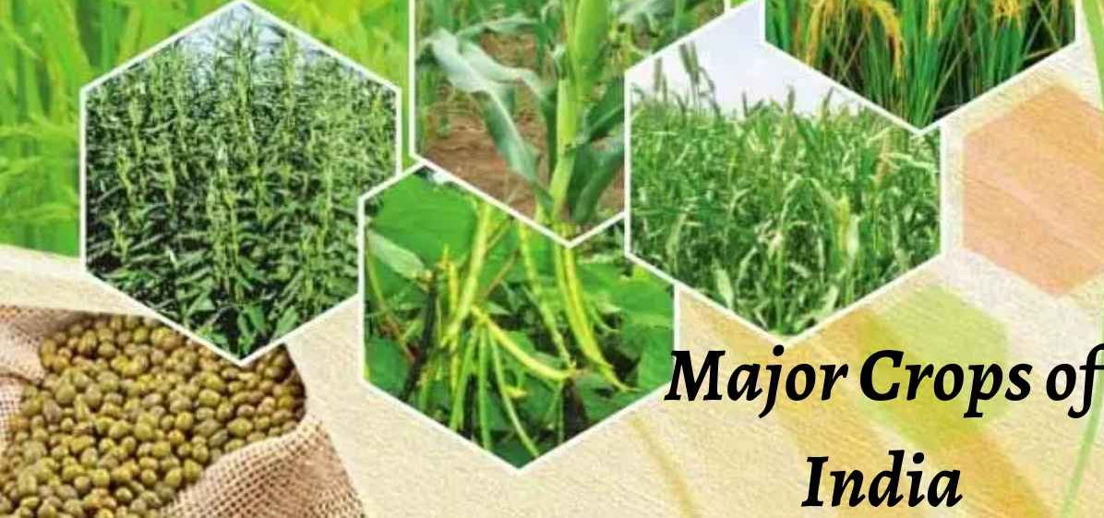
Crop Study: Rice, Wheat, Maize
Prepared by: Gautam Singha

Slide 2
Contents
1. Motivation
2. Packages used
3. Dataset creation
4. Class creation for each crop
5. Calling of class functions
6. Visualisation using matplotlib
7. Observations
8. Future Work

Slide 3
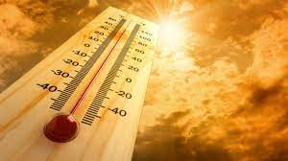


Motivation
How temperature, rainfall, elevation at a particular place can determine crop cultivation at that place

Slide 4



Packages used
Pandas
Numpy
Matplotlib

Slide 5
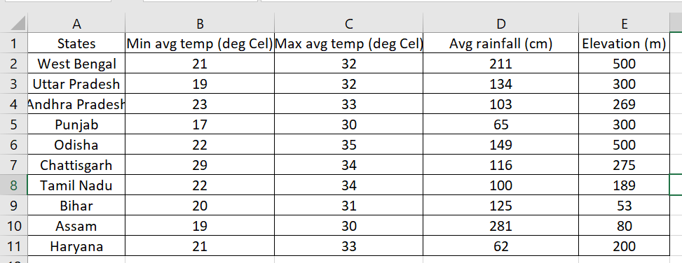
Dataset Creation
Data of rice producing states
Source: 1. https://en.wikipedia.org/wiki/
2. http://www.rainwaterharvesting.org/Urban/Rainfall.htm
3. https://weatherandclimate.com/
4. https://blog.bijak.in/

Slide 6
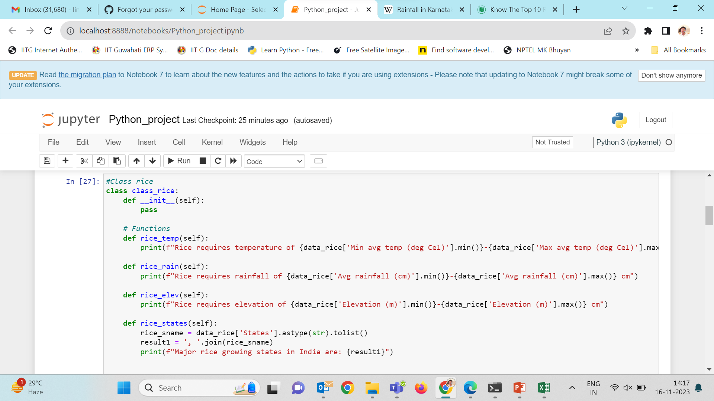
Class creation

Slide 7
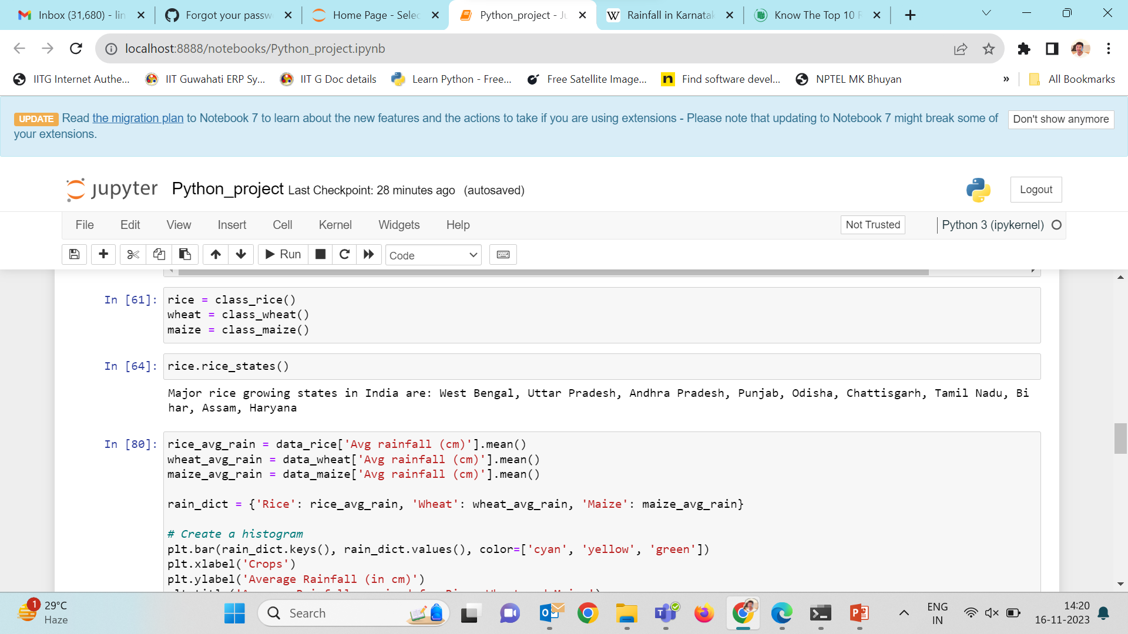
Calling of class functions
3 classes- class_rice, class_wheat, class_maize

Slide 8
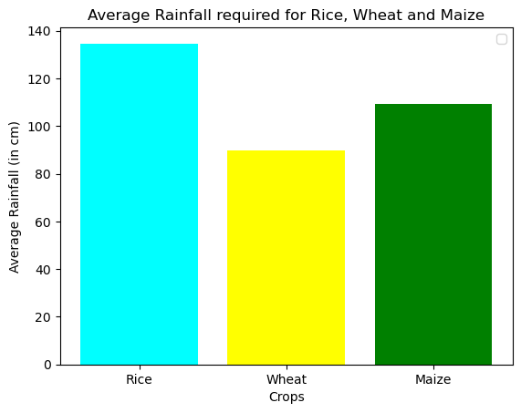
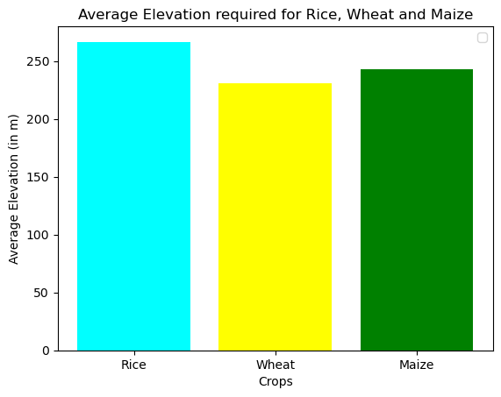
Visualization
Rainfall required by rice is higher as compared to wheat and maize
All the three crops can grow at a wide range of elevation

Slide 9
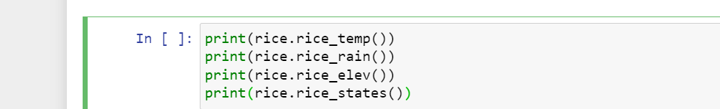
Inferences
Rice requires temperature of 17-35 deg Cel
Rice requires rainfall of 62-281 cm
Rice requires elevation of 53-500 cm
Major rice growing states in India are: West Bengal, Uttar Pradesh, Andhra Pradesh, Punjab, Odisha, Chattisgarh, Tamil Nadu, Bihar, Assam, Haryana None

Slide 10
Future Work
Create a model that can determine the best crop that can be grown at a particular place based on its latitude and longitude

Slide 11
THANK YOU

