Slide 1
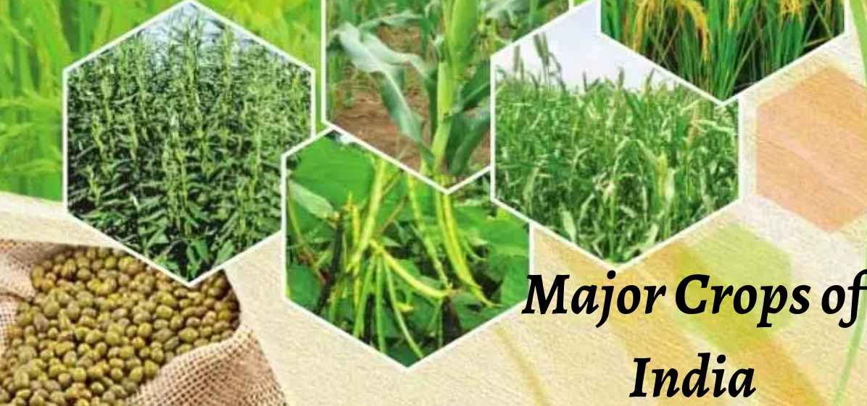
Crop Study: Rice, Wheat, Maize
Prepared by: Gautam Singha

Slide 2
Contents
1. Motivation
2. Packages used
3. Dataset creation
4. Class creation for each crop
5. Calling of class functions
6. Visualisation using matplotlib
7. Observations
8. Future Work

Slide 3
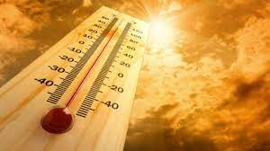


Motivation
How temperature, rainfall, elevation at a particular place can determine crop cultivation at that place

Slide 4



Packages used
Pandas
Numpy
Matplotlib

Slide 5
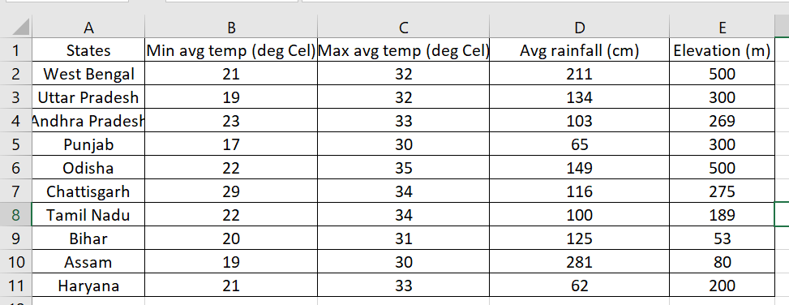
Dataset Creation
Data of rice producing states
Source: 1. https://en.wikipedia.org/wiki/
2. http://www.rainwaterharvesting.org/Urban/Rainfall.htm
3. https://weatherandclimate.com/
4. https://blog.bijak.in/

Slide 6
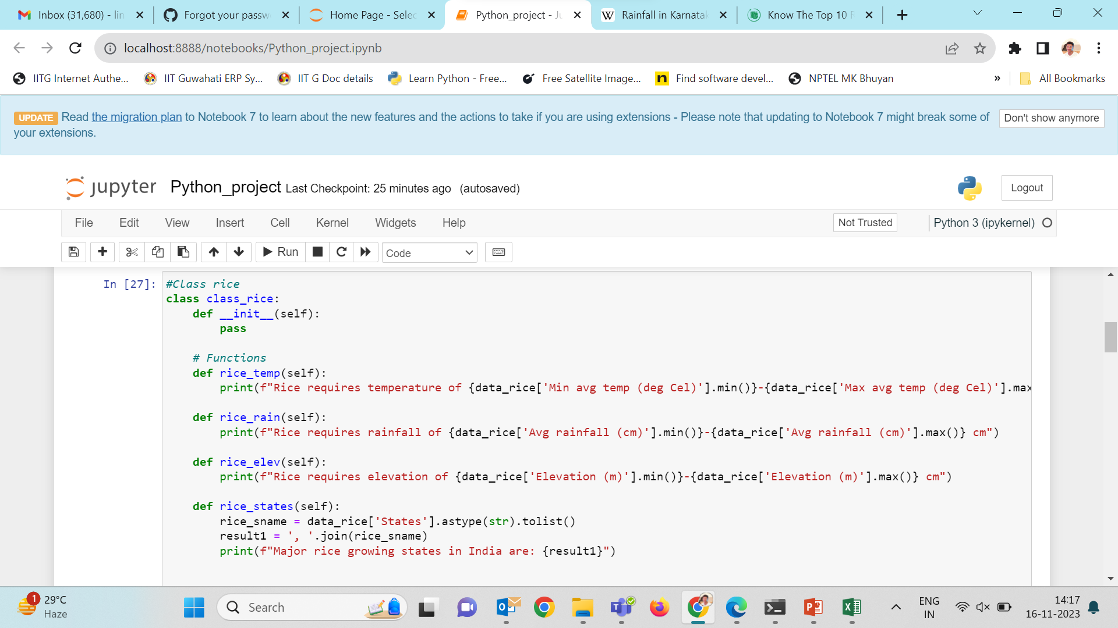
Class creation

Slide 7
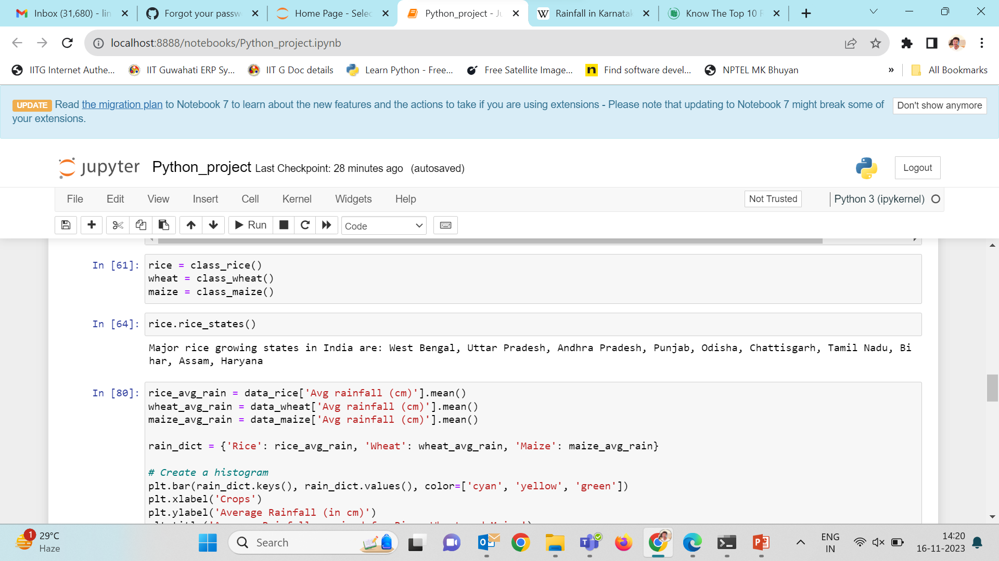
Calling of class functions
3 classes- class_rice, class_wheat, class_maize

Slide 8
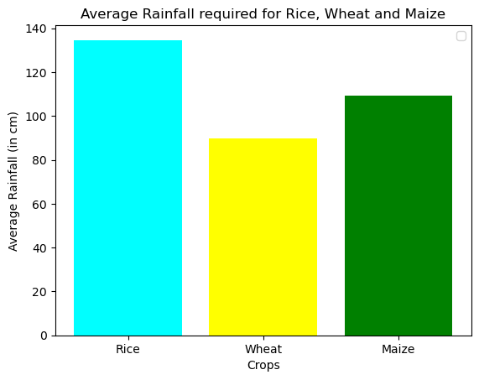
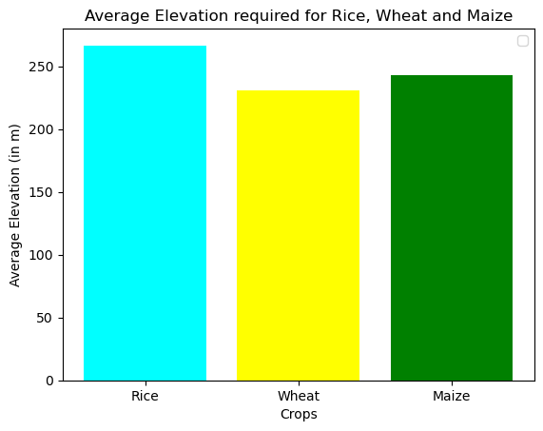
Visualization
Rainfall required by rice is higher as compared to wheat and maize
All the three crops can grow at a wide range of elevation

Slide 9
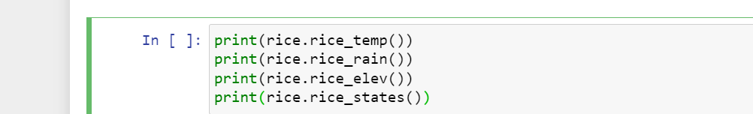
Inferences
Rice requires temperature of 17-35 deg Cel
Rice requires rainfall of 62-281 cm
Rice requires elevation of 53-500 cm
Major rice growing states in India are: West Bengal, Uttar Pradesh, Andhra Pradesh, Punjab, Odisha, Chattisgarh, Tamil Nadu, Bihar, Assam, Haryana None

Slide 10
Future Work
Study other factors that affect crop cultivation such as pollution, forest cover, availability of water resources and so on.
Study other commercially important crops.
Create a model that can determine the best crop that can be grown at a particular place based on its latitude and longitude

Slide 11
THANK YOU

