Slide 1


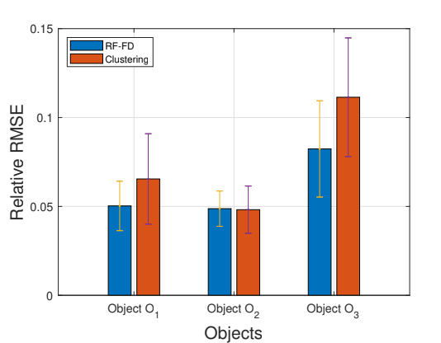

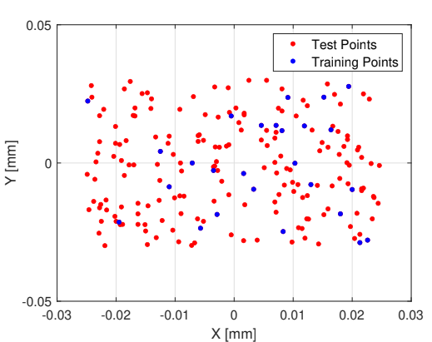
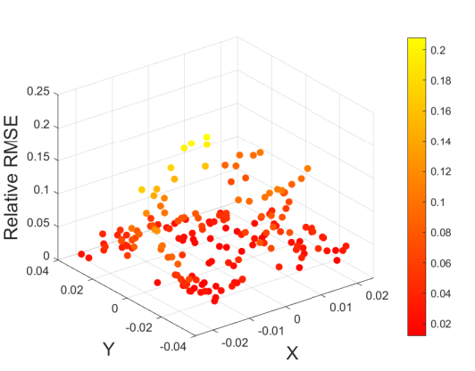
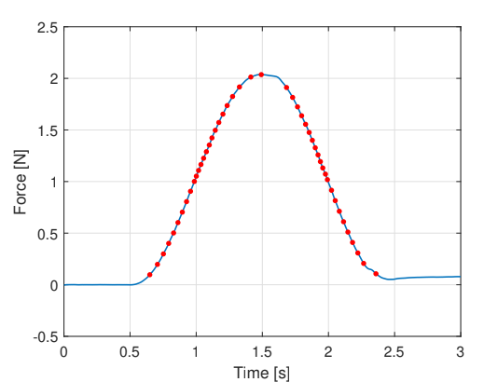
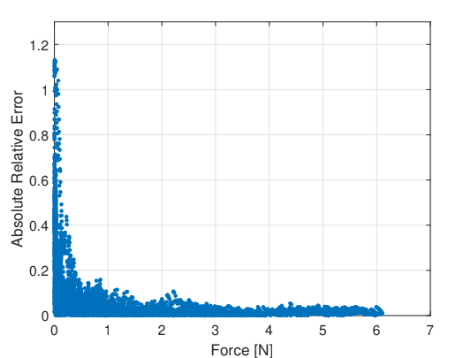
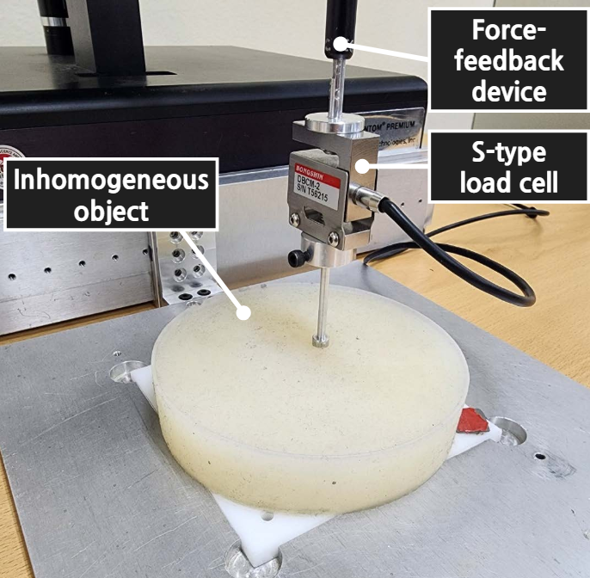
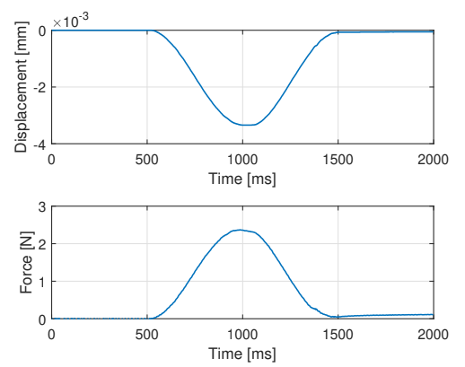

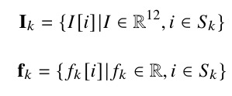
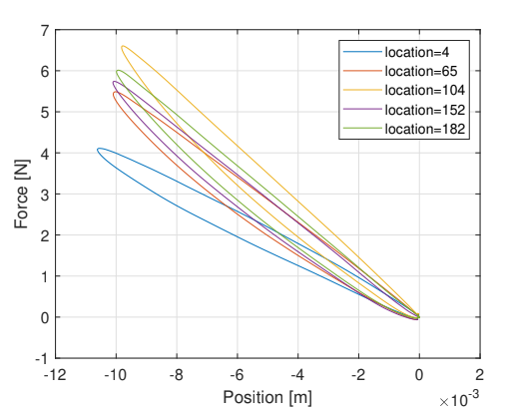
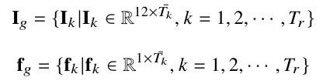
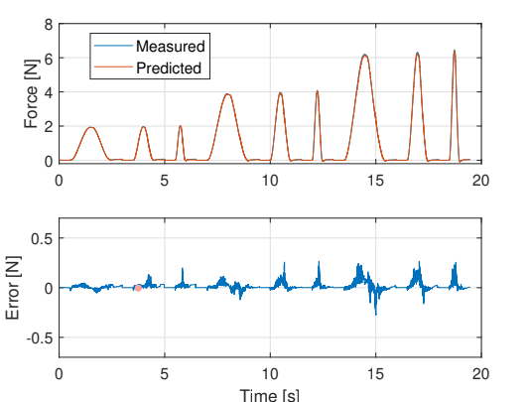
CatBoost
Modelling
CatBoost
Modelling
Haptic Modeling of Inhomogeneous Viscoelastic Objects
Gautam Kumar¹, Shashi Prakash¹, Hojun Cha², Amit Bhardwaj¹ And Seungmoon Choi²
kumar.156@iitj.ac.in prakash.8@iitj.ac.in hersammc@postech.ac.kr amitb@iitj.ac.in choism@postech.ac.kr
¹ Indian Institute of Technology Jodhpur
² Pohang University of Science and Technology
Introduction
Feature-based Learning and Perceptual Sampling
Results
This work provides a new approach for modeling of inhomogeneous viscoelastic deformable objects.
Employs the principles of feature-based learning and perceptual adaptive sampling mechanisms to reduce the dataset.
A single random forest-fractional derivative (RF-FD) based data-driven model is trained on the reduced dataset.
The existing clustering based solution in the literature where one model is trained for each cluster.
Results demonstrate that the proposed approach provides a better prediction accuracy in estimating the responses on inhomogeneous objects as compared to the existing solution in the literature.
Feature-based Learning for Location Selection
Perceptual Sampling for Significant Sample Selection:
Data Collection
Data is collected using a force-feedback device and a load cell, recording position-force measurements with an inverted cosine force control signal.
Three physical mockups made of soft silicone (Ecoflex 0010 from SmoothOn Inc.) are used for the experiments, referred to as Object O₁, Object O₂ and Object O₃.
For each object, data is collected from 200 randomly selected contact locations within a 60 mm by 50 mm modeling area that exhibits a high level of inhomogeneity.
Haptic Modeling: RF-FD
Conclusion
A RF-FD (Random Forest with Fractional Derivatives) data-driven model is used to learn a non-parametric mapping function between input (position) and output (force) samples.
The model's input features include fractional derivatives (FDs) of position information and the X-Y position of the contact location. Ten orders of FDs are used, ranging from 0.05 to 0.50.
The approach required to train just one RF-FD based data-driven model on the reduced dataset for modeling an inhomogeneous deformable object.
Single trained model predicts interactions at unknown locations of the objects with good accuracy.
Requires a much lesser number of trained models as compared to the existing clustering based solution.
Provides better prediction accuracy in terms of the RMSE and maximum error..
Illustration of inhomogeneity
Acknowledgement
This work was supported in part by a grant from i-HUb Drishti, TIH Jodhpur for a project titled as “Haptics based Medical Simulator for Abdomen Palpation and Pulse Behavior” and in part by a grant from IHFC, TIH IIT Delhi for a project titled as “Telepresence and Teleaction System for Robot Assisted Dentistry”
References
Sianov, A., Harders, M.: Exploring feature-based learning for data-driven haptic rendering. IEEE Transactions on Haptics 11(3), 388–399 (2018)
Data-driven haptic modeling of normal interactions on viscoelastic deformable objects using a random forest. IEEE Robotics and Automation Letters 4(2), 1379–1386 (2019)
Breiman, L.: Machine Learning, chap. 1, pp. 5–32. Springer (2001)
Haptic codecs for the tactile internet. Proceedings of the IEEE 107(2), 447–470 (2018)
Notes:
‹#›

