Slide 1

Note: The data and information in this document is reflective of a hypothetical situation and client. This document is to be used for KPMG Virtual Internship purposes only.
Sprocket Central Pty Ltd
Data analytics approach
[Division Name] - [Engagement Manager], [Senior Consultant], [Junior Consultant]

Slide 2
Note: The data and information in this document is reflective of a hypothetical situation and client. This document is to be used for KPMG Virtual Internship purposes only.
Agenda
Introduction
Data Exploration
Model Development
Interpretation

Slide 3
Note: The data and information in this document is reflective of a hypothetical situation and client. This document is to be used for KPMG Virtual Internship purposes only.
Introduction
New Customer analysis
The following factors for new customers needed to be analysed
Age distribution criteria
Bike Purchase in 3 years
Job Industry Category
Car owns by the new customer

Slide 4
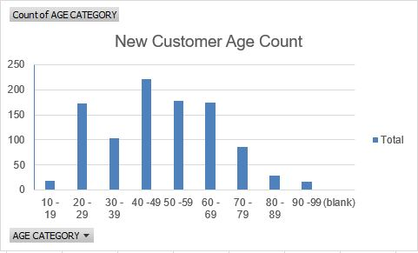
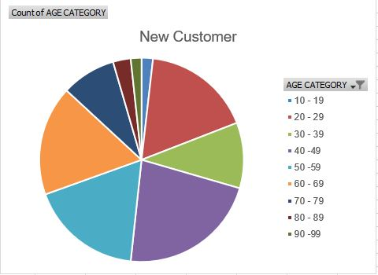
Note: The data and information in this document is reflective of a hypothetical situation and client. This document is to be used for KPMG Virtual Internship purposes only.
Data Exploration
Age Distribution Factor
It is observed that mostly new customers are of age between 40 – 49 as it was noticed in the old customer data sets.
The ratio of new customer age between 60 – 69 has increased.
The age group of 20 – 29 remained same in both the data sets.

Slide 5
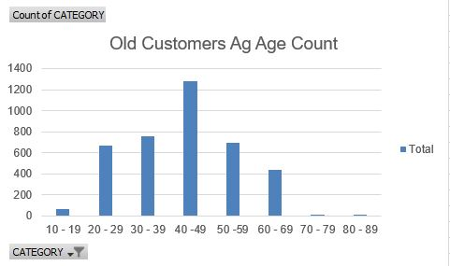
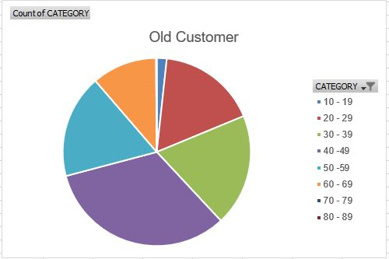
Note: The data and information in this document is reflective of a hypothetical situation and client. This document is to be used for KPMG Virtual Internship purposes only.
Data Exploration

Slide 6
Note: The data and information in this document is reflective of a hypothetical situation and client. This document is to be used for KPMG Virtual Internship purposes only.
Model Development
BIKE PURCHASING
Around 51% females purchased bike in last three years as compare to 47% male purchased.
The target audience for marketing should me for focused on females than males.

Slide 7
Note: The data and information in this document is reflective of a hypothetical situation and client. This document is to be used for KPMG Virtual Internship purposes only.
Model Development
Determine a hypothesis related to the business question that can be answered with the data.
Perform statistical testing to determine if the hypothesis is valid or not.
Create calculated fields based on existing data, for example, convert the D.O.B into an age bracket.
Other fields that may be engineered include ‘High Margin Product’ which may be an indicator of whether the product purchased by the customer is in a high margin category in the past three months based on the fields ‘list_price’ and ‘standard cost’.
Other examples include, calculating the distance from office to home address to as a factor in determining whether customers may purchase a bicycle for transportation purposes.
Additionally, this may include thoughts around determining what the predicted variable actually is.
For example, are results predicted in ordinal buckets, nominal, binary or continuous.
Test the performance of the model using factors relevant for the given model chosen (i.e. residual deviance, AIC, ROC curves, R Squared).
Appropriately document model performance, assumptions and limitations.

Slide 8
Note: The data and information in this document is reflective of a hypothetical situation and client. This document is to be used for KPMG Virtual Internship purposes only.
Interpretation
Job industry
Mostly new customers are on Finance industry and Manufacturing customers are still on top two
The rest industries is still same

