Slide 1
Project Gladiator Presentation
Finance Management System
Chaitanya Gautam(TL)
Nabanita Gharai
Apoorva Wavhal
Sharon Vincent

Slide 2
Problem Statement
To create a no cost EMI portal for buying any product online using EMI option.

Slide 3
Abstract
The project is aimed towards calculating a no-cost EMI for any given product during online shopping through the provided EMI Card.
The user logs in if already registered and after logging in the Dashboard displays the details of the user.
After selecting products from the dashboard, the user is directed towards the products catalog page, where, the EMI is calculated based on the months and amount and user pays the desired installments to the respective vendors.

Slide 4
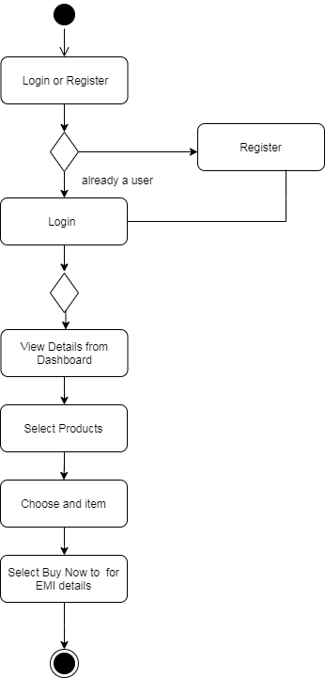
Activity Diagram

Slide 5
Assumptions and Scope of Project
The generic EMI system calculates EMI based on the credit card of the user thus creating an assumption of having the above processing, whereas this project gives the credits to the user based on the EMI card.
The scope of the project paves towards one stop destination for shopping as well as finance management of the user.

Slide 6
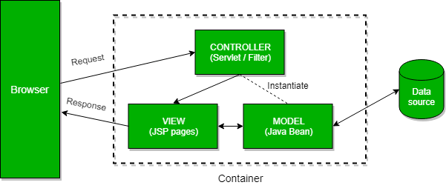
Architecture
Spring MVC application architecture.

Slide 7
Technologies / Tools Used
Eclipse Neon v 4.6
Tomcat v 9.0.29
Java
HTML 5
CSS3
JSP
Git
Spring
Spring MVC
JPA
Oracle 10g

Slide 8
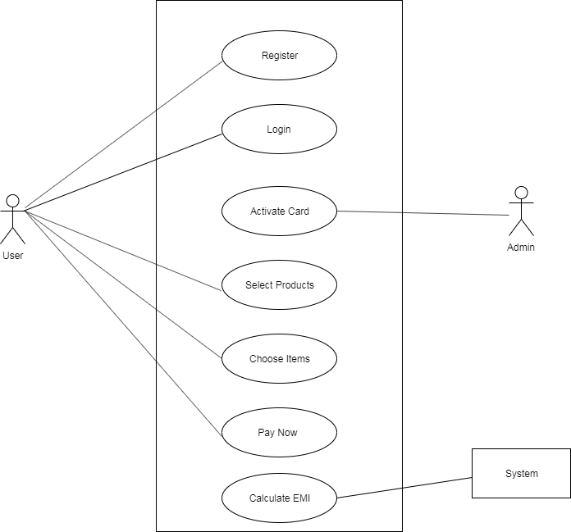
UML – Use Case

Slide 9
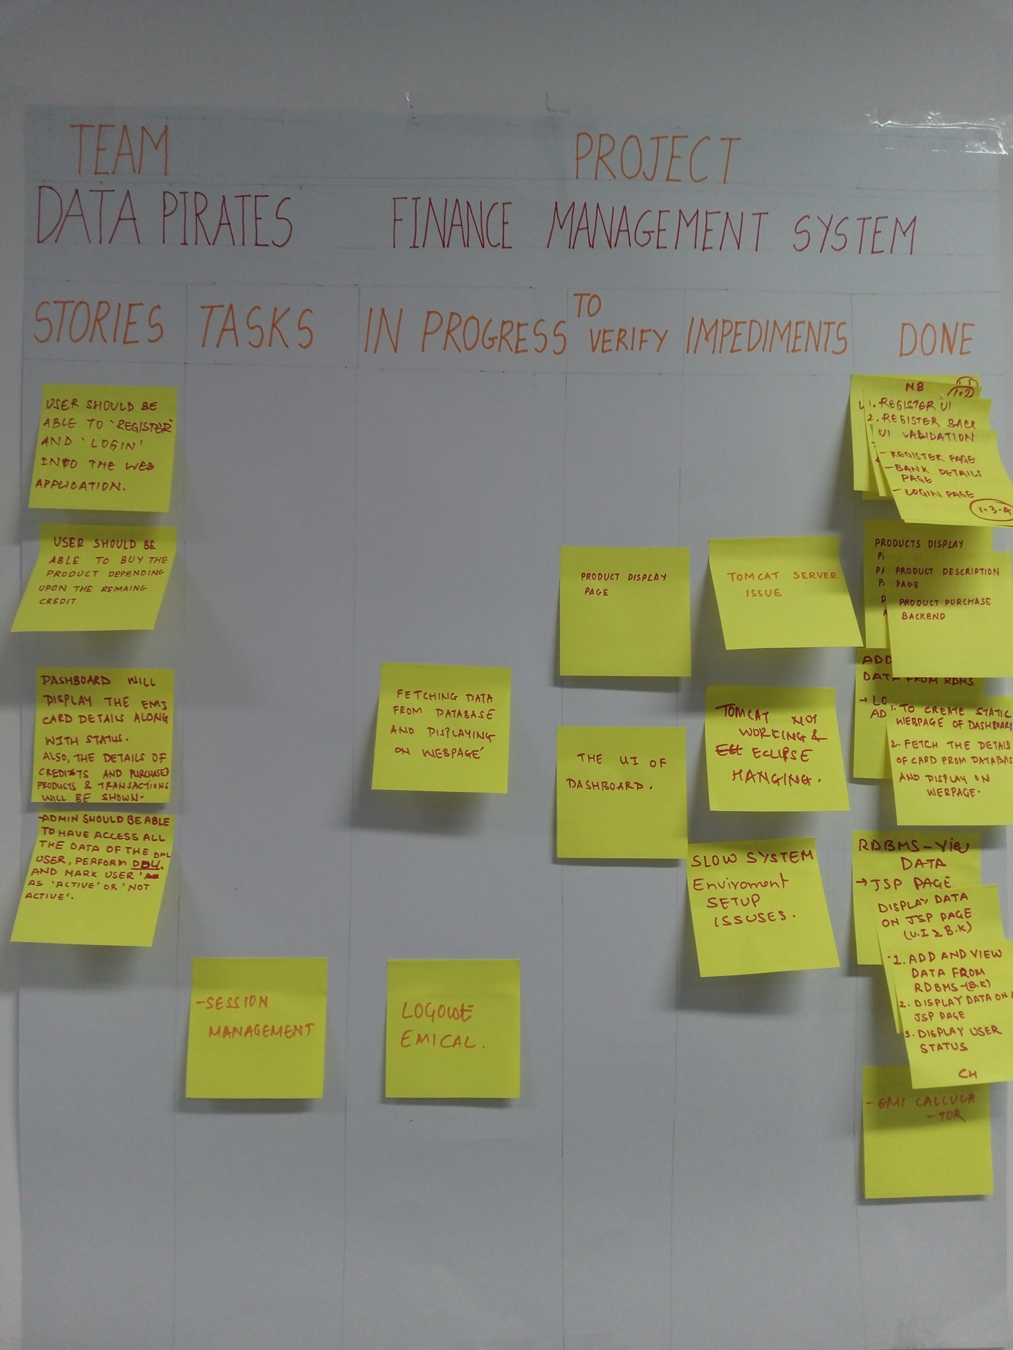
Scrum Board

Slide 10
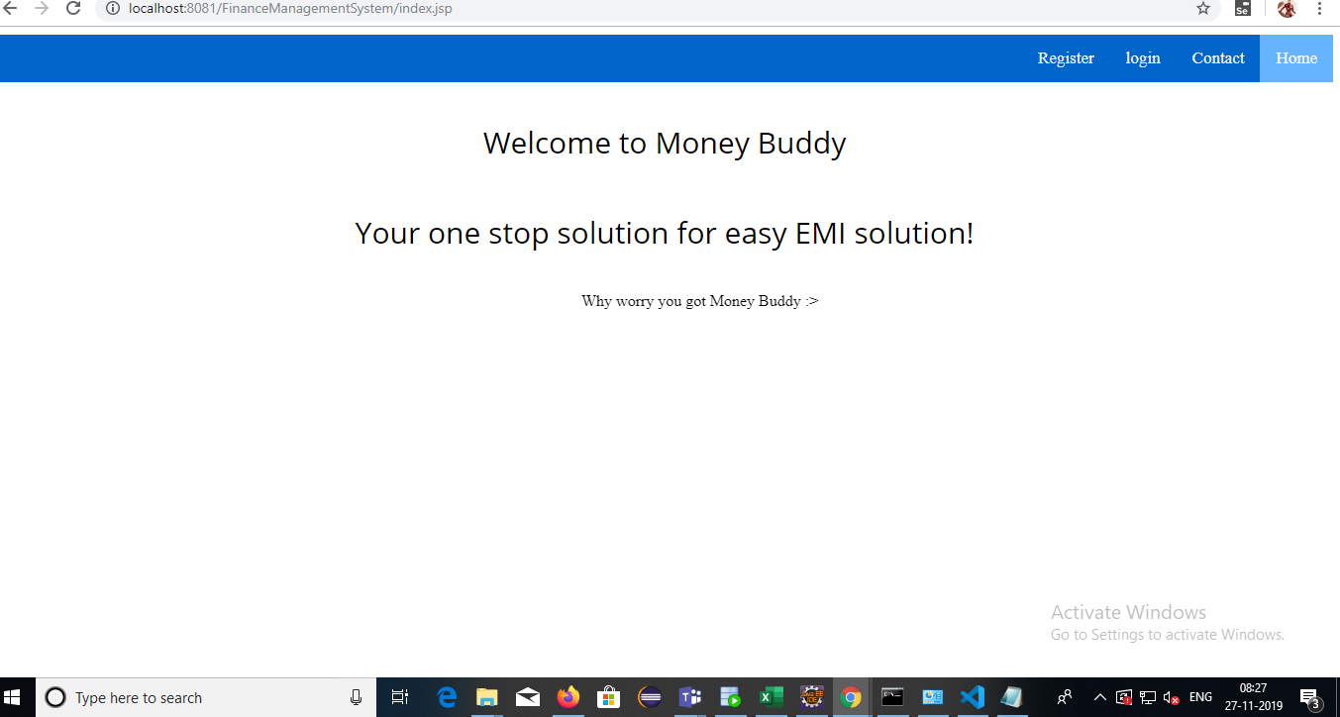
Home Page

Slide 11
A very sincere thanks to the mentors
Mr. Majrul Ansari
Mr. Dinesh Malwade
Mr. Simant Setu
Mr. Gaurav Kulkarni
Mr. Santosh Pande

