Slide 1


Attendance Management System
Database Management System Project — Nepathya College
Department of Computer Science & Information Technology
DBMS Project

Slide 2
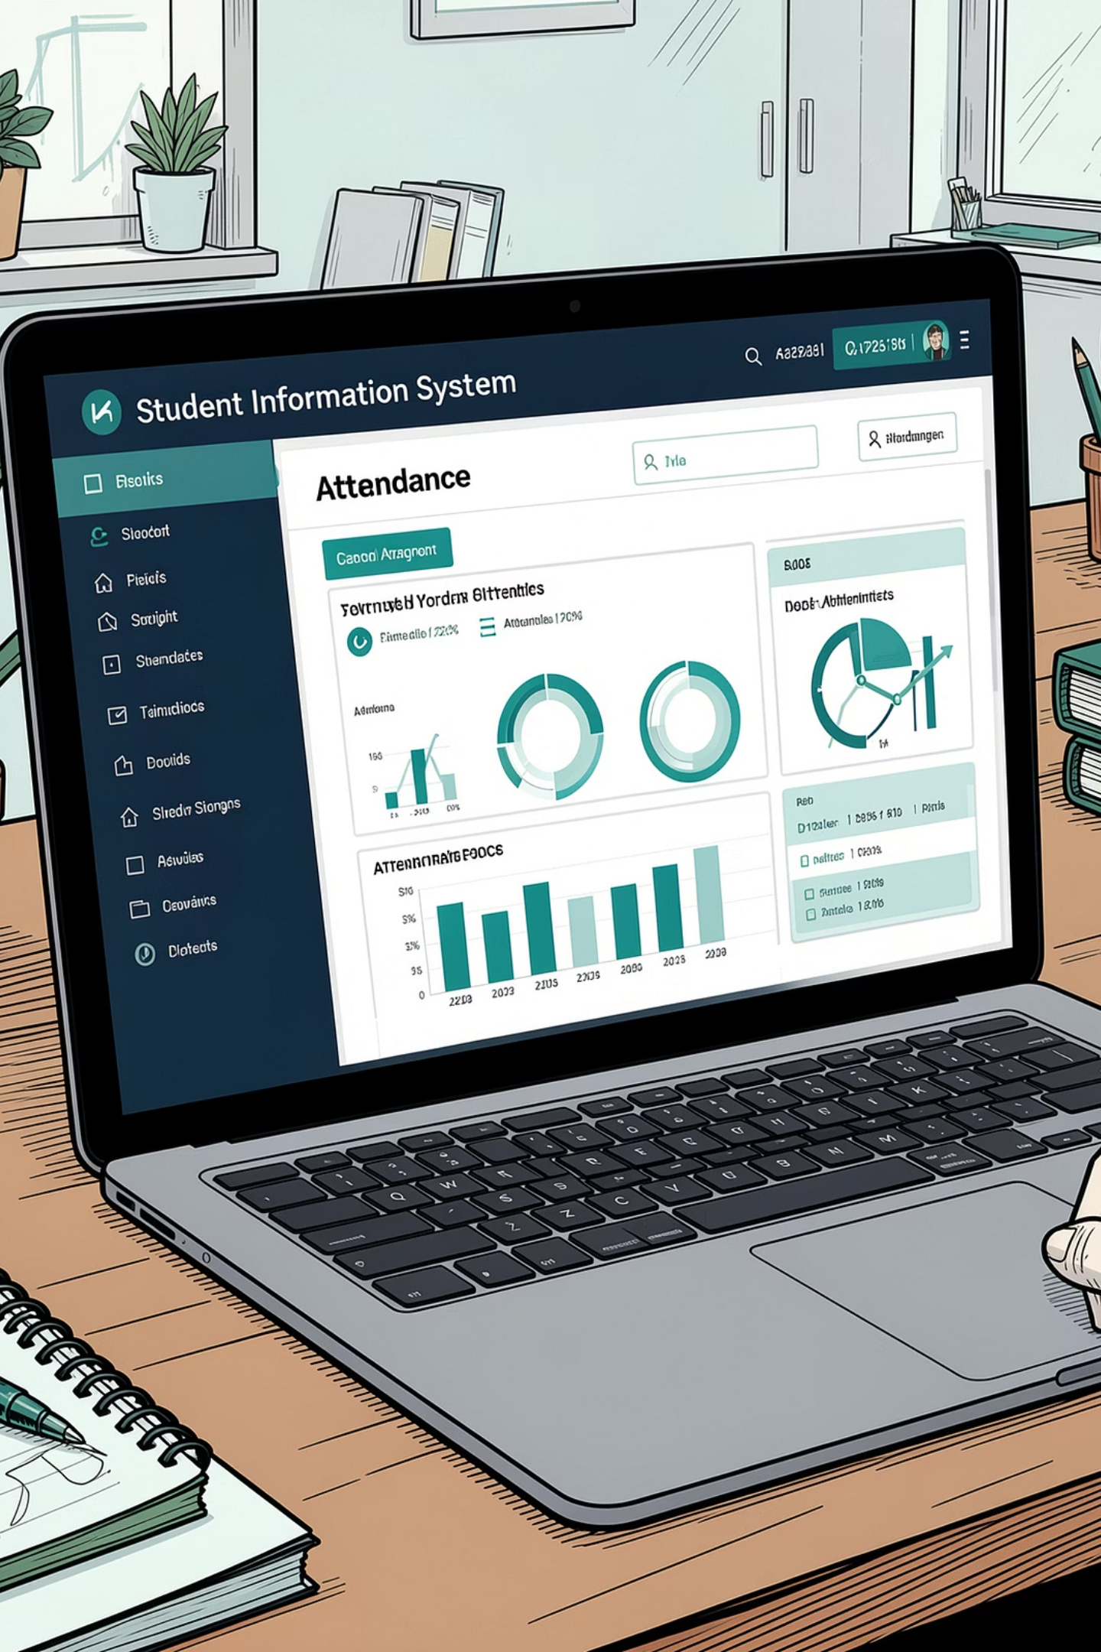
What is an Attendance Management System?
A centralized relational database system to track and manage student attendance across all programs at College. Covers programs: BSc CSIT, BCA, BIM, BBS, BHM etc. Core managed objects: Students, Teachers, Subjects, Semesters, and Class Sessions.
DBMS Principles
Goal
ER modeling, normalization (1NF–3NF), SQL-based implementation
Replace manual/semi-digital attendance with an efficient, accurate database solution

Slide 3
The Problem We Are Solving
Manual Errors
No Central Access
Calculation Difficulties
Manual registers are error-prone and time-consuming.
Admins, teachers, and students lack a unified attendance view.
Hard to compute attendance percentages for exam eligibility.
No Automated Reports
No Audit Trail
Missing subject/semester/course/teacher reports.
Modifications lack traceability, risking data integrity.
"These challenges demand a well-designed, normalized database solution."

Slide 4
Objectives of the System
1
Normalized Database
Design relational DB in 1NF, 2NF, 3NF.
2
Multiple Programs
Support bachelor-level programs and semester structures.
3
Enrollment & Assignment
Enroll students and assign teachers to subjects.
4
Record Attendance
Log class-wise attendance per student, subject, and session.
5
Auto Calculation
Auto-calc attendance percentage per student per subject.
6
Eligibility Rule
Enforce 75% minimum attendance for exam eligibility.
7
Reporting
Generate reports filtered by student, subject, teacher, or semester.
8
Data Integrity
Use primary keys, foreign keys, and constraints.

Slide 5
Database Entities & Key Attributes
Course (course_id)
Semester (semester_id)
Subject (subject_id)
course_name, course_code, duration_years , description
Course_id(FK) , semester_number, semester_name , start_date, end_date
Semester_id(FK), subject_code, subject_name, credit_hours , total_classes
Teacher (teacher_id)
Student (student_id)
Enrollment (enrollment_id)
first_name, last_name, email, phone, department, hire_date
Course_id(FK), first_name, last_name, email, phone, symbol_number, enrollment_year,
student_id (FK), semester_id (FK), entrollment_date, status
Teacher_Subject (ts_id)
Class_Session (session_id)
Attendance (attendance_id)
teacher_id (FK), subject_id (FK), academic_year
subject_id (FK), teacher_id (FK), session_date, start_time, end_time, remarks
session_id (FK), student_id (FK), status (P/A/L), remarks, recorded_at

Slide 6
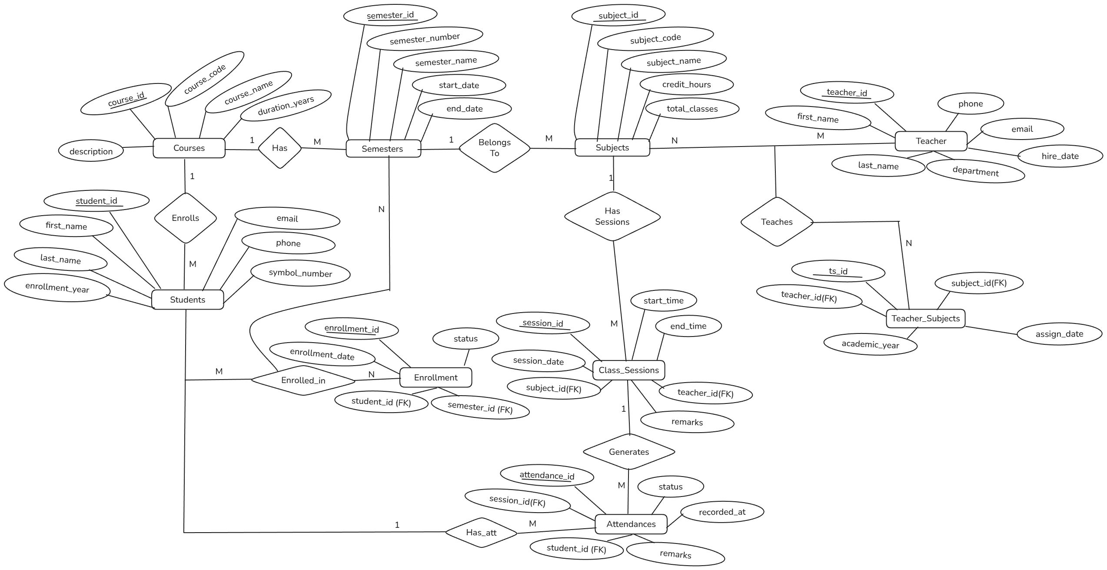
Entity-Relationship Diagram (Chen Notation)

Slide 7
Relationships and Cardinalities
Relationship | Cardinality | Description
Course → Semester | 1 : M | One course has many semesters
Semester → Subject | 1 : M | One semester has many subjects
Course → Student | 1 : M | One course enrolls many students
Student ↔ Semester (via Enrollment) | M : N | Students enroll in multiple semesters
Teacher ↔ Subject (via Teacher_Subject) | M : N | Teachers teach multiple subjects; subjects have multiple teachers over time
Subject → Class_Session | 1 : M | One subject has many class sessions
Teacher → Class_Session | 1 : M | One teacher conducts many sessions
Class_Session → Attendance | 1 : M | One session has attendance for many students
Student → Attendance | 1 : M | One student has many attendance records

Slide 8
Key Benefits
Accuracy
Efficiency
Eliminates manual errors in attendance recording.
Bulk attendance entry per class session in seconds.
Auto Reports
Exam Eligibility
Instant attendance percentage per student per subject.
Automated 75% threshold check for exam eligibility.
Data Integrity
Scalability
FK constraints and UNIQUE rules prevent inconsistencies.
Supports multiple programs, semesters, and campuses.

Slide 9
Next Steps & Implementation Plan
01
02
03
Model
Implement
Develop
Finalize ER model, constraints, and normalization details (1–2 weeks)
Create schema in MySQL/MariaDB, define FKs/UNIQUE/ENUMs, write seed data (2–3 weeks)
Build web UI for Admin/Teacher/Student flows; bulk attendance and reporting modules (4–6 weeks)
04
05
Test & Deploy
Train & Maintain
Unit/integration tests, user acceptance testing, deploy to college server with backup strategy (2 weeks)
Faculty training sessions, documentation, and a maintenance schedule for data audits

Slide 10
Thank You!!

