Slide 1
OUR IDEA
It has now become unsafe to go to the hospital every time we feel unwell, since there is a risk of getting affected by COVID-19. We believe that everyone should have easy access to great health care. Thus, there is a need to connect patients virtually with doctor. So, we are planning to build a web-application that will help the people to know about the disease they are likely to be infected with based on their symptoms, then they can take the precautions accordingly. In case of high risk they can directly consult a doctor in an effective manner using the video calling feature of the application.
OUR SOLUTION: APNA DOCTOR

Slide 2
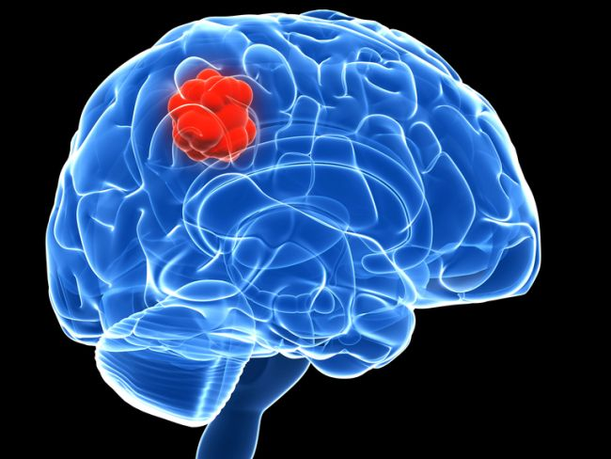

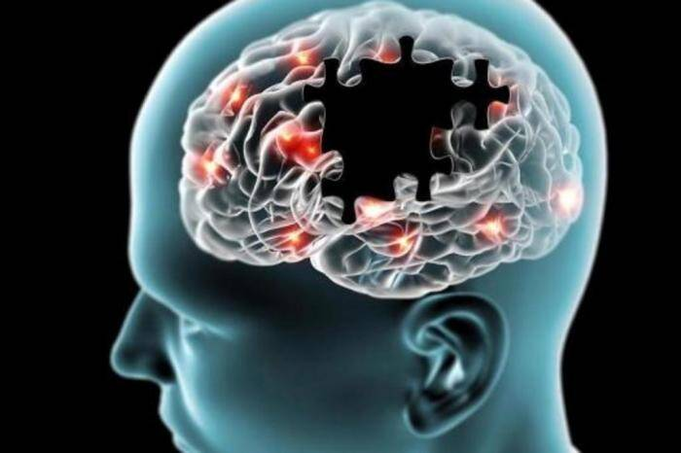
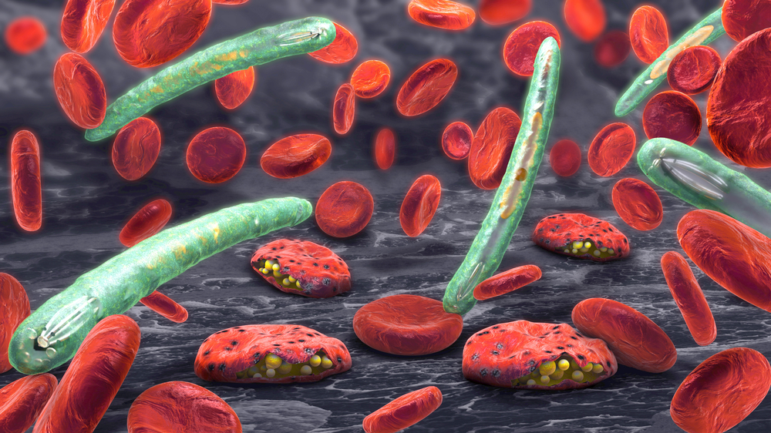
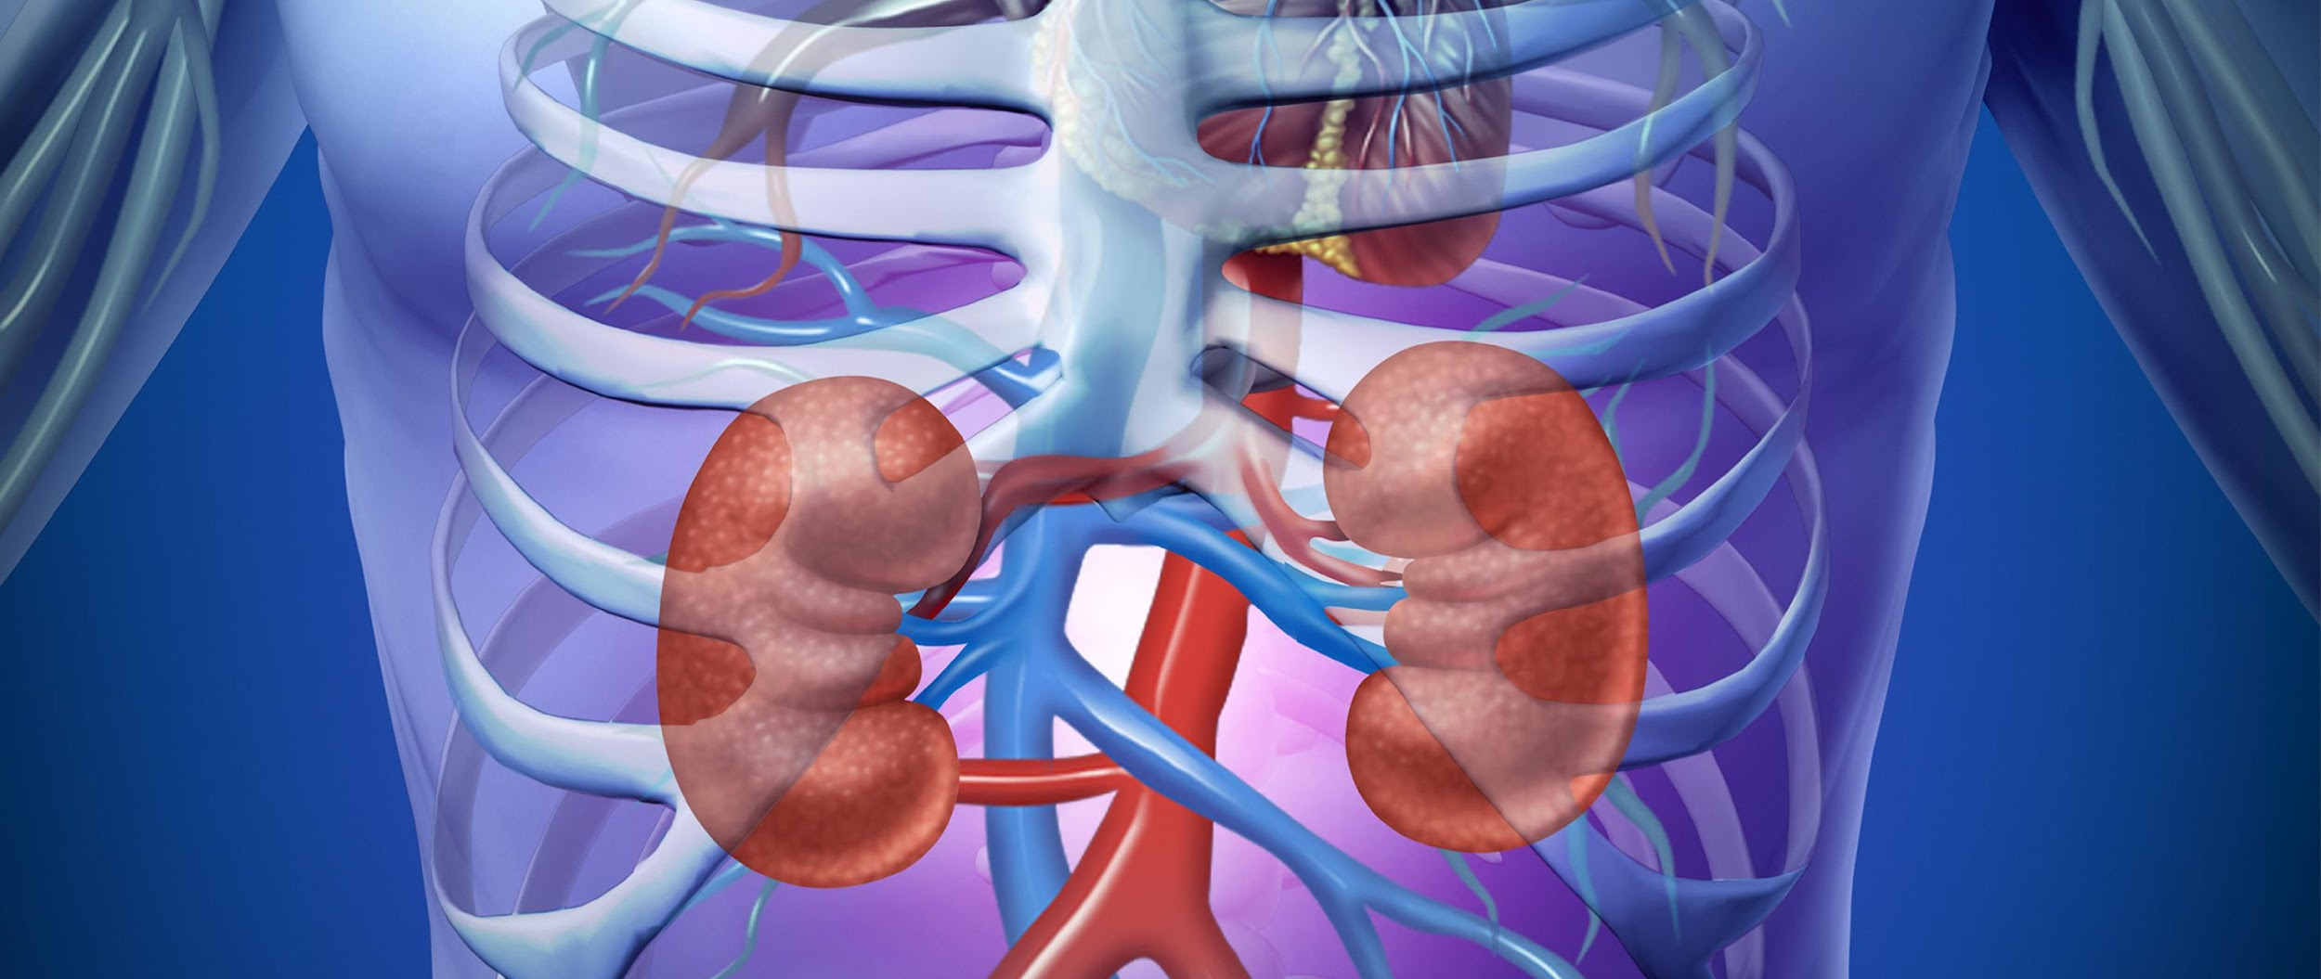
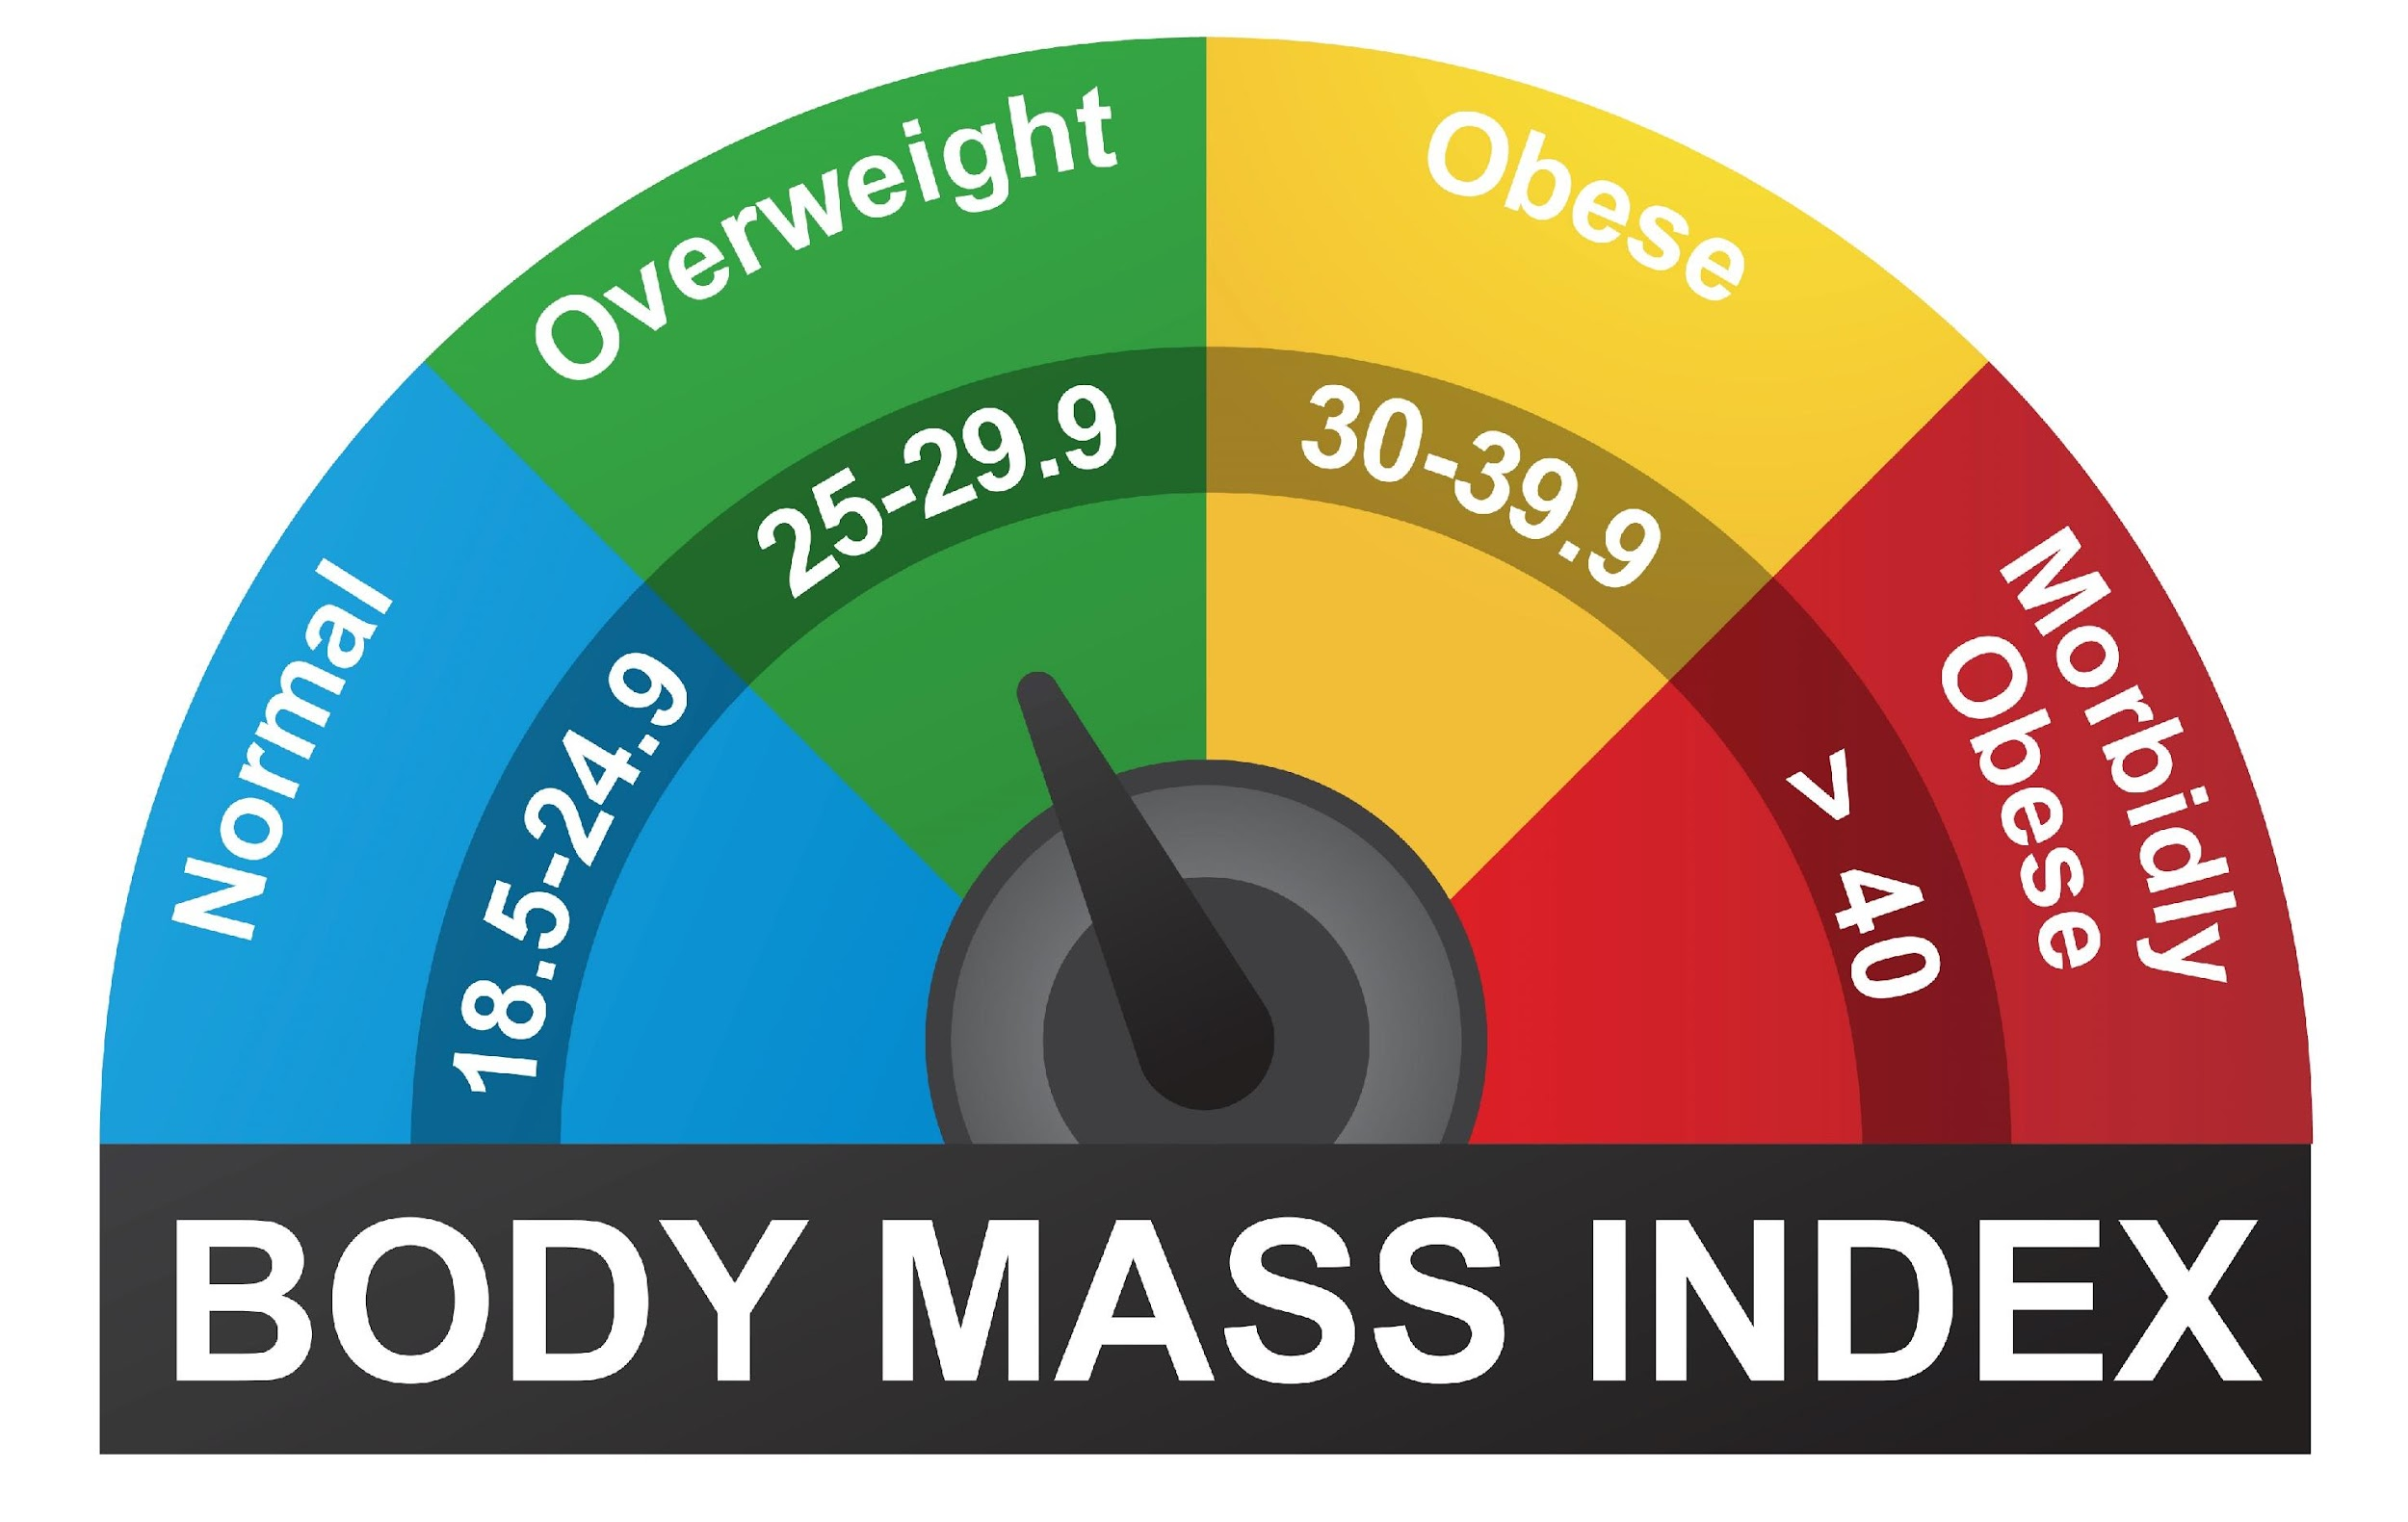
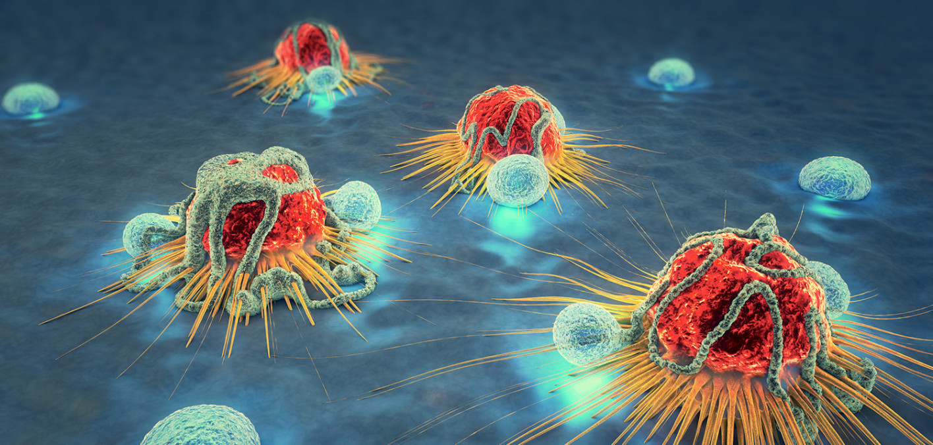
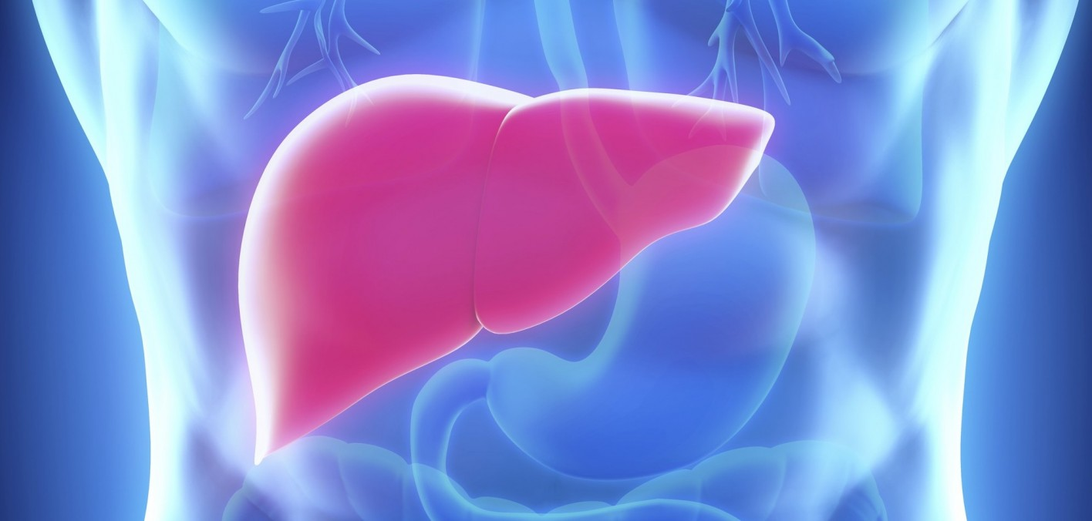
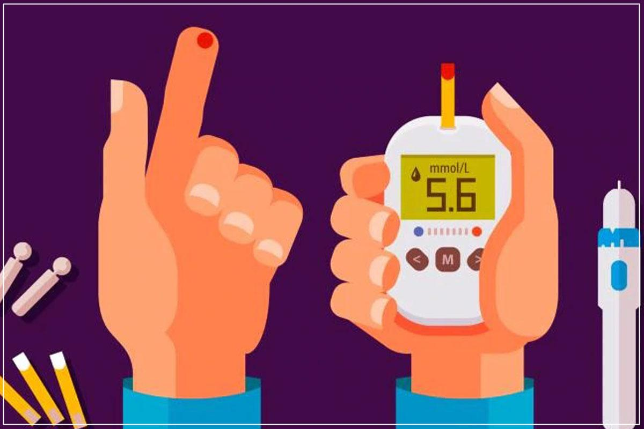
APNA CHECKUP
Home
About
Diseases
KNOW YOUR DISEASE
TAKE TEST
BRAIN TUMOR
COVID 19 PREDICTION
ALZHEIMER
TAKE TEST
TAKE TEST
TAKE TEST
MALARIA
KIDNEY TUMOR
BMI
TAKE TEST
TAKE TEST
TAKE TEST
CANCER
LIVER
DIABETES
TAKE TEST
TAKE TEST
TAKE TEST

Slide 3
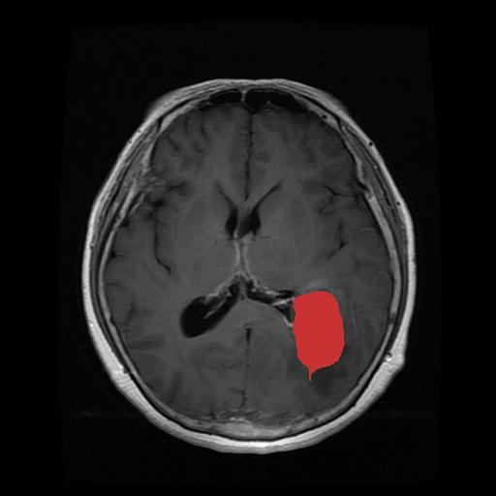
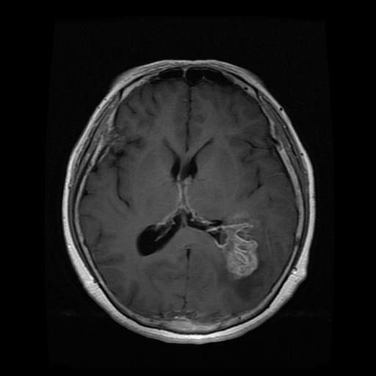
BRAIN TUMOR DIAGNOSIS
INPUT BRAIN MRI
TUMOR LOCALIZATION
LOAD INPUT IMAGE
TUMOR CLASSIFICATION
TUMOR LOCALIZATION
RESET

Slide 4
CANCER DIAGNOSIS
Radius
Texture
Perimeter
Area
Smoothness
Compactness
Concavity Points
Concave points
Symmetry
Submit

Slide 5
WORK-FLOW
Enter your symptoms
Know your disease based on symptoms
Doctor’s Appointment

Slide 6
KNOW YOUR DISEASE
WRITE
PREDICTED DISEASE AND PRECAUTIONS
TOO WORRIED ABOUT SYMPTOMS AND DISEASE?
BOOK AN APPOINTMENT
PREDICTION OF DISEASE
OR
RECORD
AWS CLOUD
TEXT CLEANING
NLP MODEL
PREDICTION OF DISEASE

Slide 7
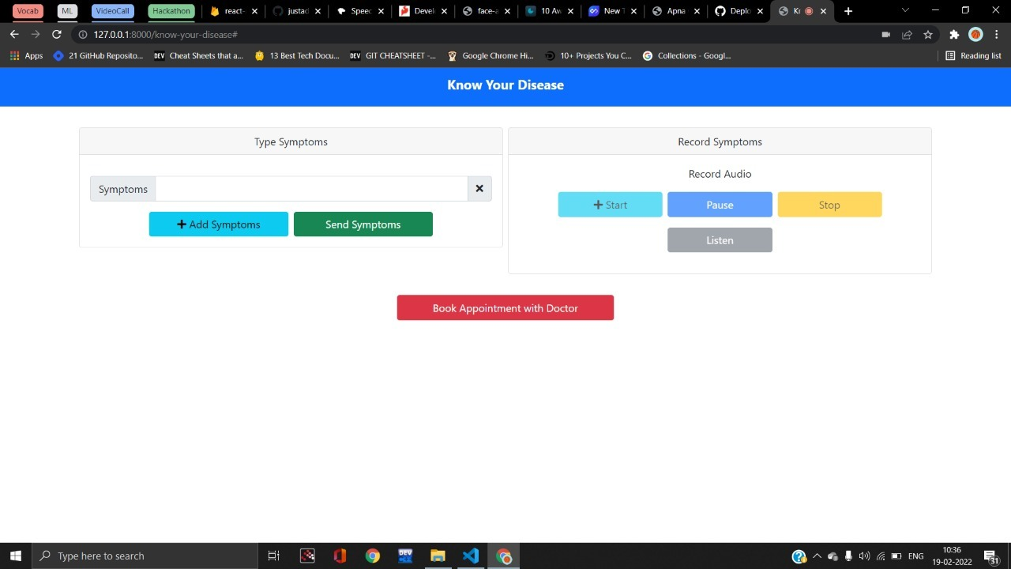

Slide 8
Appointment with Doctor
Top 5 doctors added to database
Filter doctors based on location and specialization
Book appointment and call them directly

Slide 9
