Slide 1

Basic Details of the Team and Problem Statement
Ministry/Organization Name/Student Innovation: University Grants Commission (UGC)
PS Code: VS933
Problem Statement Title: Development of Integrated dashboard for sharing of innovation and startups with success stories across Higher Educational Institutions and relevant stakeholders
Team Name: Bleed Blue
Team Leader Name: Gautam Chutani
Institute Code (AISHE): U-0078
Institute Name: UIET, Panjab University
Theme Name: Miscellaneous

Slide 2
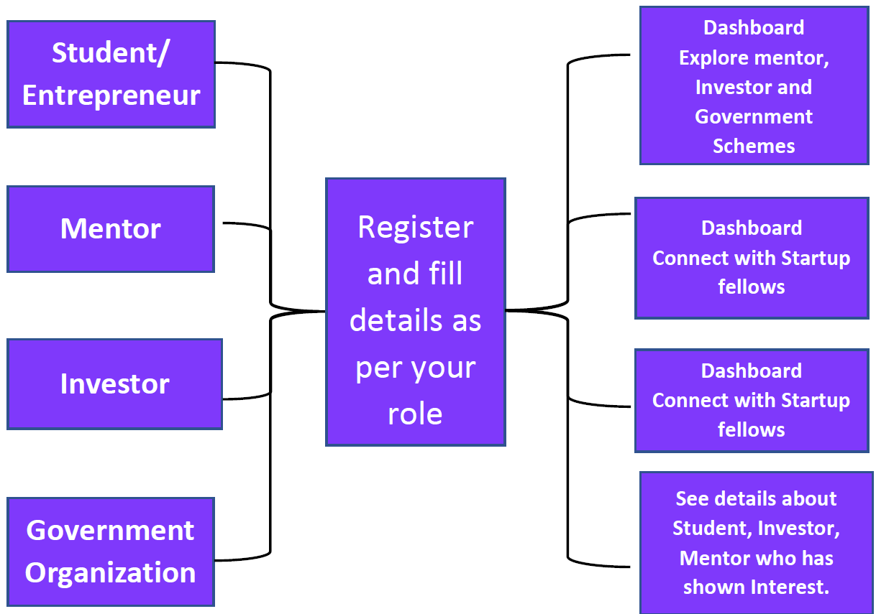
Idea/Approach Details
Describe your idea/Solution/Prototype here:
A platform where students/startup fellows can submit their ideas, prototypes or business models
Facilitate various agencies to submit their problem statements post their verification using block-chain technology
A platform that enables capitalists/investors to invest funds in the projects of their interests/expertise
Quality interaction of startup fellows with mentors so that they can pitch their ideas via mail, video call or AI based chatbot
Quantitative ML model that enables an objective and fact-based approach for startup success prediction and analysis
AI powered web-portal to generate concise insights about the entrepreneur and his/her solution to the investors/mentors
Interactive dashboards to display startup trends in different parts of India
Free courses, guided learning resources and services by various organizations for the students to accelerate their startup growth
Describe your Technology stack here:
HTML
JavaScript/React JS
Django
SQLite/PostgreSQL Database
AWS/Google Cloud
Machine/Deep Learning
Block-chain

Slide 3
Idea/Approach Details
Describe your Use Cases here
Describe your Dependencies / Show stopper here
AI powered interactive and integrated portal that connects students, entrepreneurs, venture capitalists, mentors and government bodies
Make the process of “doing a business” an ease so as to promote entrepreneurship
Provide incentives and fundings to young entrepreneurs to achieve their goals
To catalyse a startup, innovation and entrepreneurial culture in India
Generate employment and wealth creation
An initiative towards “Make in India” campaign to facilitate investments, foster innovations and boost Indian economy
Development of business and technology skills by providing free resources and guided paths
Ensure qualitative interactions between entrepreneurs and mentors/investors
Requirement of proper business model and strategy to register as a startup on our portal
Lack of domain specific business knowledge among young startup fellows
Reachability of our web platform to quality investors and mentors of different domains
Verification of organizations upon registration

Slide 4
Team Member Details
Team Leader Name: Gautam Chutani
Branch : B.E Stream : ECE Year : III
Team Member 1 Name: Hemant Garg
Branch : B.E Stream : ECE Year : III
Team Member 2 Name: Sakshi Gandhi
Branch : B.E Stream : ECE Year : III
Team Member 3 Name: Aakanksha Bharti
Branch : B.E Stream : ECE Year : III
Team Member 4 Name: Harshvardhan Singh
Branch : B.E Stream : ECE Year : III
Team Member 5 Name: Himanshu Bohra
Branch : B.E Stream : ECE Year : III

