Slide 1
Kou Model and Delta Hedging
By Gautam Hegde

Slide 2
Project Overview
This project implements a pricing, calibration and hedging framework based on the Kou Model.
One of the goals is to assess whether the idea of “Delta-Hedging” works in the context of the Kou Model.
The motivation behind this project is to study a model that captures the real-world market better than the Black-Scholes or Merton Model.

Slide 3
What is the Kou Model
The Kou model generalizes the Black-Scholes model to allow for sudden jumps in stock price, similar to the Merton Model.
Where it differs from the Merton Model, is that the jumps are drawn from an asymmetric exponential distribution, as opposed to a Normal Distribution.

Slide 4
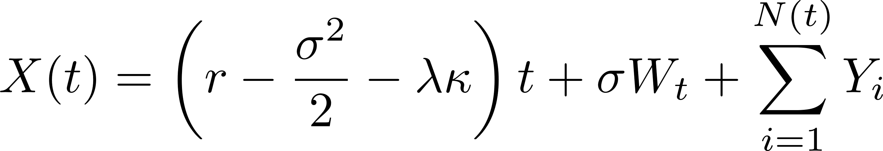
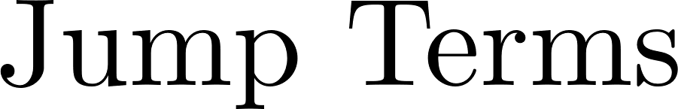


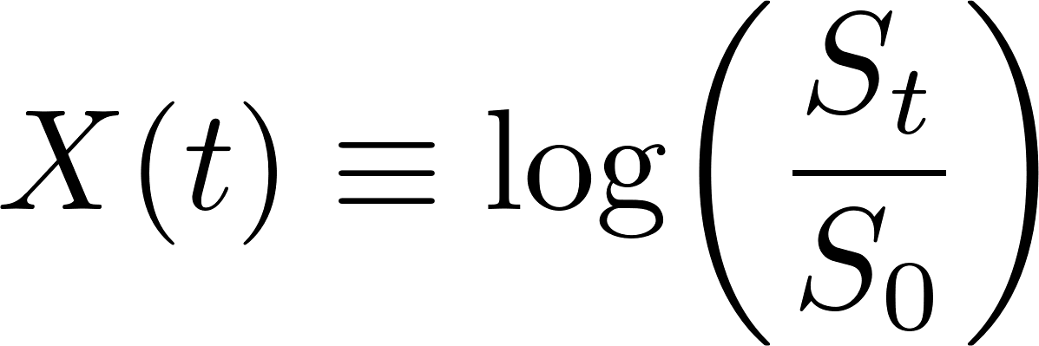
Kou Model

Slide 5
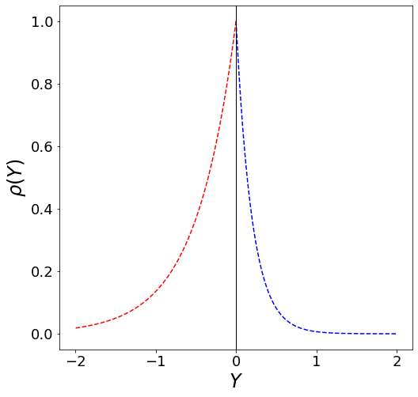
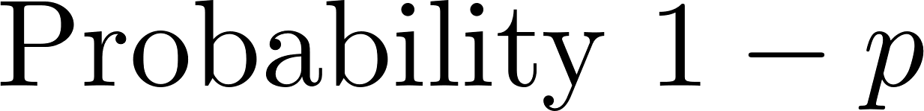
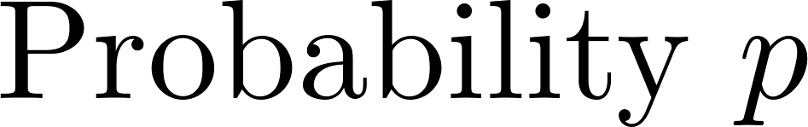
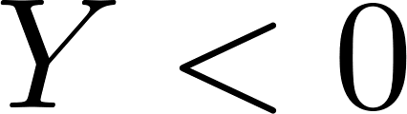
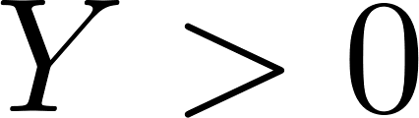
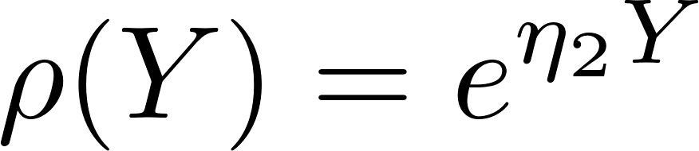
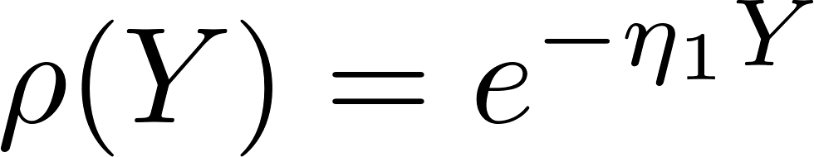
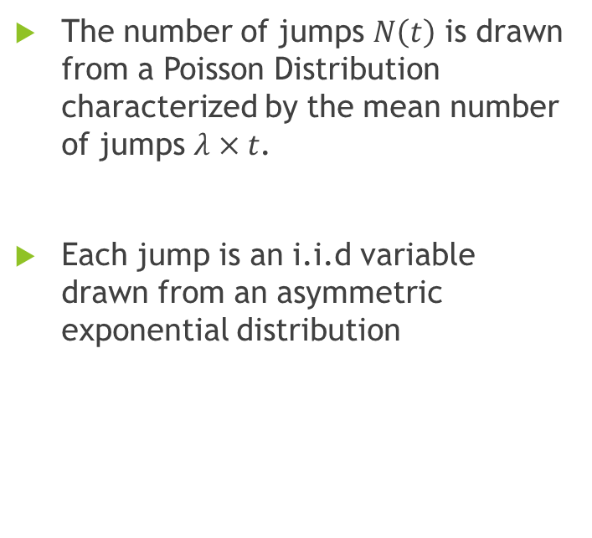
Jump Terms
The number of jumps $N\left(t\right)$ is drawn from a Poisson Distribution characterized by the mean number of jumps $λ×t$.
Each jump is an i.i.d variable drawn from an asymmetric exponential distribution

Slide 6
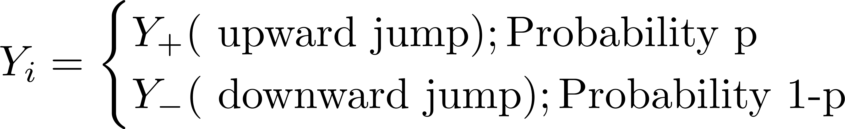
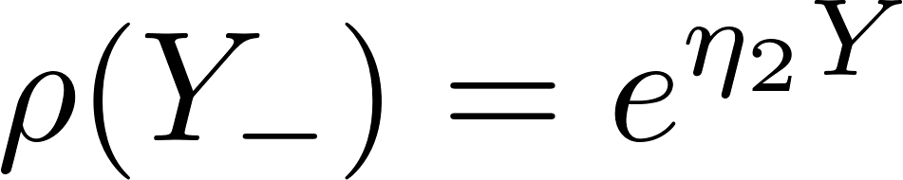
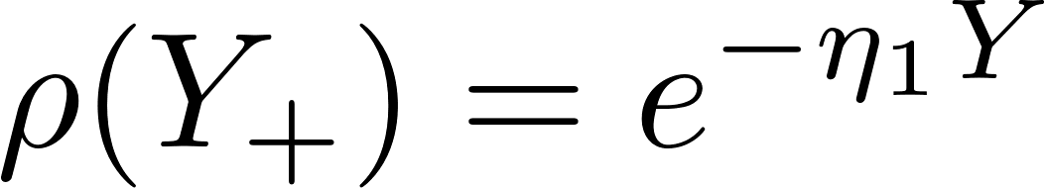
Jump Terms

Slide 7
Why the Kou-model instead of the Merton-model?
Humans don’t view good and bad news the same. Very often bad news leads to large downwards jump in stock value, and good news leads to relatively modest jumps. Hence, more extreme downward jumps are more likely.
Furthermore, the Kou-model’s choice of an exponential distribution allows for more extreme jumps than the Merton models normal distribution, matching real life stock data better, and providing a better fit to volatility smiles.

Slide 8
Evaluating Call Option Prices : Carr-Madan Method
Unlike the Merton-Model, the closed form solutions to the Kou-Model aren’t as simple to numerically evaluate, since the distribution of jumps is exponential not normal.
Hence, we use the Carr-Madan method¹ which has the algorithm outlined below. The details behind this method is provided in the accompanying pdf titled “Project-Report”.
The Carr-Madan method involves an F.F.T and is hence a lightning-fast method to compute option prices for a wide array of strike prices and expiry times.
Analytically evaluate the Characteristic function (log -moment generating function) of the Kou Process
Find the Carr-Madan function in terms of the characteristic function
Numerically Inverse Fourier transform (F.F.T) the Carr-Madan Function to obtain the expected payoff for a Call-Option
1 - Carr, P., & Madan, D. (1999) Journal of computational finance, 2(4), 61-73.

Slide 9
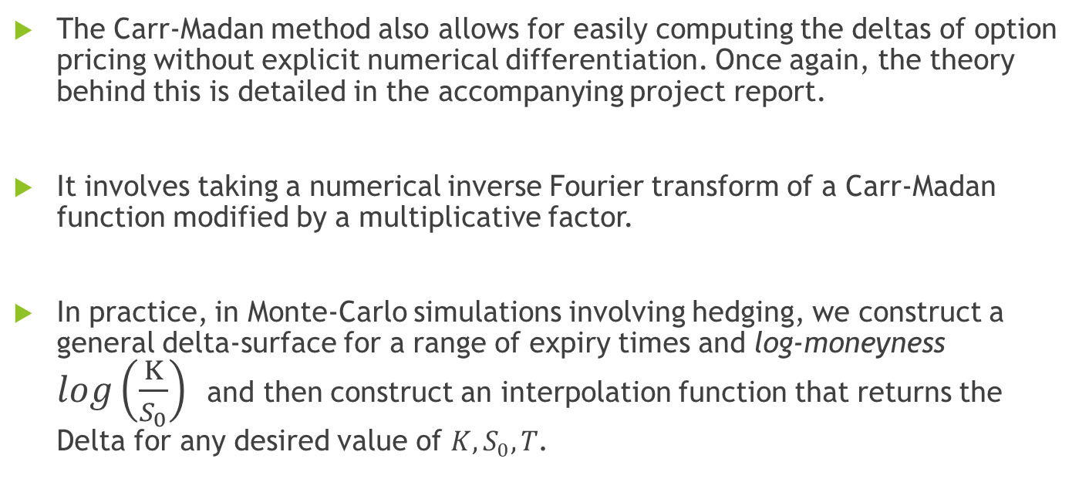
Evaluating Delta of option prices
The Carr-Madan method also allows for easily computing the deltas of option pricing without explicit numerical differentiation. Once again, the theory behind this is detailed in the accompanying project report.
It involves taking a numerical inverse Fourier transform of a Carr-Madan function modified by a multiplicative factor.
In practice, in Monte-Carlo simulations involving hedging, we construct a general delta-surface for a range of expiry times and log-moneyness $log\left(\frac{K}{S_{0}}\right)$ and then construct an interpolation function that returns the Delta for any desired value of $K,S_{0},T$.

Slide 10
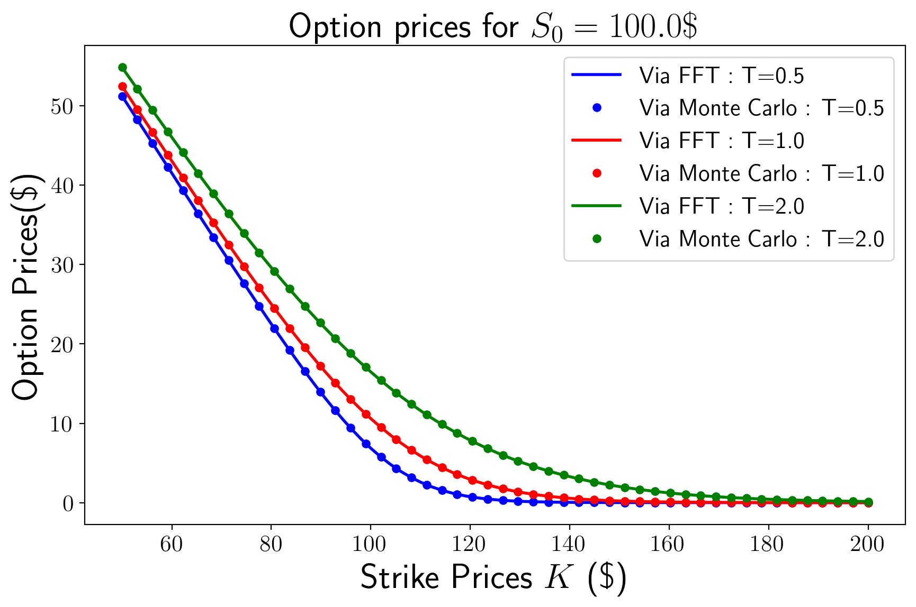
Comparing the Carr-Madan F.F.T method with Monte Carlo Simulations

Slide 11
Calibration
Market data acquisition — Live option chain data for the target stock is retrieved via the yfinance library, covering a range of strikes and maturities.
Data cleaning — Illiquid contracts are filtered out to ensure calibration is not distorted by unreliable quotes.
Parameter calibration — The Kou model parameters are recovered by minimizing the distance between model-implied and market-implied volatilities, fitting the observed volatility smile. For this, we use the L-BFGS-B method.

Slide 12
Delta Hedging in the Kou Model
Usually, for the Black-Scholes model delta-hedging allows for reducing the directional variation of a portfolio containing a call/put option by shorting/buying the same stock, and adjusting the number such that the number of stocks is equal to the delta of the call/put option.
This changes the distribution of the portfolio value to minimize the tails, and centers it around the expected payoff. In the mathematically ideal case (continuous hedging), the portfolio value would match the expected payoff perfectly.

Slide 13
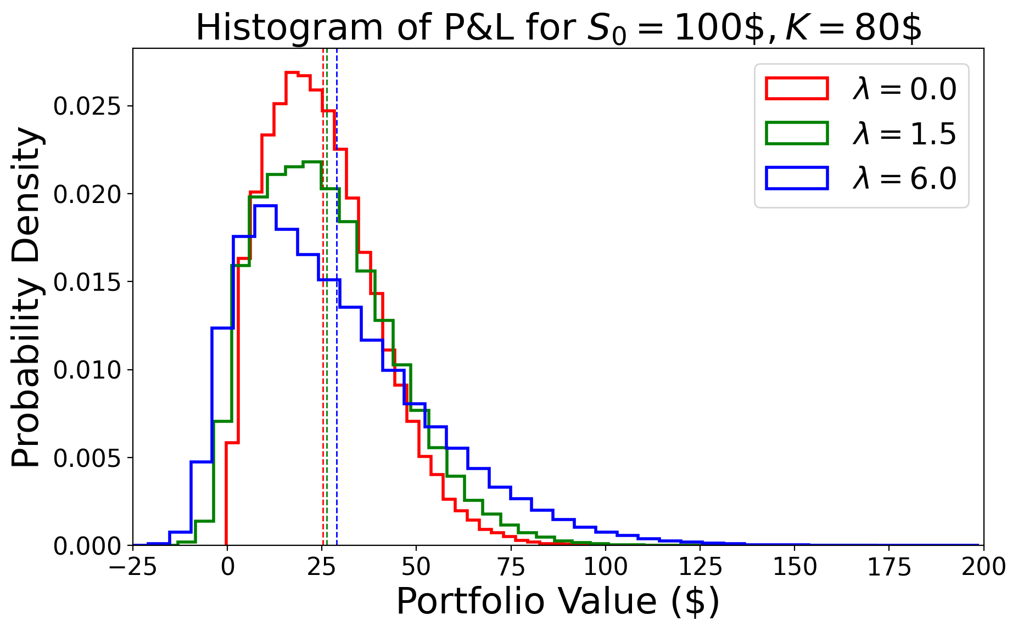
Monte Carlo with Delta Hedging

Slide 14
Delta Hedging in the Kou Model
As we saw from the histograms of the Monte-Carlo simulations, when applied to the Kou-Model Delta-Hedging does not completely remove the extremal cases, and in fact even allows for a non-trivial probability for the portfolio value to become negative.
This is because while Delta-Hedging protects against infinitesimal changes, it is less effective against sudden large jumps, which the Kou-Model allows for.
Hence, one needs more appropriate hedging techniques, such as combining Delta-Hedging with appropriately weighed static hedges.

