Slide 1
TEAMVIEWER ASSIGNMENT
By Gautami Pande

Slide 2
Contents
My Introduction
Problem Statement #1
Solution for #1
Problem Statement #2
Solution for #2
Problem Statement #3
Solution for #3
Brief introduction about Airflow
Brief introduction about DBT

Slide 3
HELLO !
I am Gautami Pande.
I am from India.
Used to work at Michelin Tyres as Data Engineer.
I have around 9 years of experience in IT domain.
Majorly worked as Data Engineer and Data Analysts in past organizations.

Slide 4
PROBLEM STATEMENT #1
A table `products` exists in a data warehouse that has a schema like this:
id integer
productName varchar(10)
productPrice numeric(4,2)
updatedAt timestamp
This table contains latest available data about every product, which is extracted from an external API. The API only allows us to query limited amount records every day, which is much lower than total size of our table. Fortunately, we get an initial data dump to populate the table and the API allows us to run a query which returns only the records updated in certain time interval. Only a handful of records are updated every day and we can easily read those from the API. A query like this would produce a JSONL output like this:
{"id": 1, "product_name": "milk", product_price: 0.99}
{"id": 6, "product_name": "bread", product_price: 1.80}
{"id": 7, "product_name": "eggs", product_price: 2.40}...
We store the output of these API calls in an immutable cloud storage location and make them available in a database table called `products_raw` with the same schema as above.
- How would you write an SQL query or queries that would update the `products` table with the `products_raw` table in such a way that the `products` table would contain the latest information about every product in the end?
- How would you write an SQL query that would create table `products_history` table from the `products_raw` table that would allow us to easily find data about every product at arbitrary time in the past. Which columns would be in the `product_history` table?
- How would you update it?

Slide 5
Assumptions
‘products_raw’ table has the same schema as the JSON file extracted from the API, with three columns id, product_name, product_price.
‘Id’ column is the primary key and is of Integer datatype.

Slide 6

SOLUTION #1
Here are some cases from the ‘products_raw’ table, that are considered while designing the SQL query for data updation.
Existing Data update: The data that is already present in the ‘products’ table gets changed and the changed values are captured in the ‘products_raw’ table. These changed values should be updated in ‘products’ table.
New record entry: New products get added in the ‘products_raw’ table and we need to include them in the ‘products’ table.
Unchanged data: Sometimes the data/record that is present in the ‘product_raw’ table, which is exactly the same as the products table, should not be considered and those rows in the ‘products’ table should not get impacted/overwritten.
Below are the SQL query scripts attached. (Scripts for updation of records in the ‘products’ table and then maintaining the ‘history’ table for it.)
Products Update Query Products History Update Query

Slide 7
PROBLEM STATEMENT #2
Debugging of SQL script:
You inherited the following piece of SQL from a former colleague of yours who left the company some time ago.
A manager who looks at some reports wrote you an email that says that there "may be a problem with the value of the edition" in the reports.
No further information has been provided and the manager cannot be reached for further comments.
Without knowing much about the business process or the data, try to go over the code and understand how the edition value is created.
Theorize, what could be the problem with it and how you would fix it.
Think aloud - show us your SQL skills while you think.

Slide 8

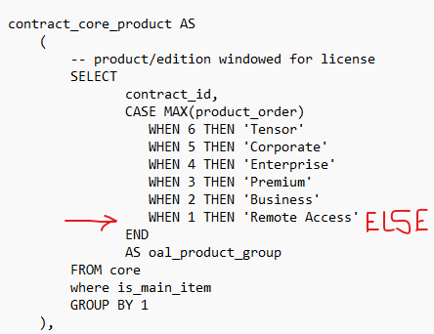
SOLUTION #2
Here are some findings about the ‘edition’ value calculation in the SQL script:
~ ‘frontline’ – The symbol ‘~’ is not a recognised operator in Snowflake SQL or DBT. I believe we should use the comparison operator if we wish to compare ‘oal_product_group’ value with the text ‘frontline’.
While creating the CTE ‘contract_core_product’, the ELSE condition is not considered. We should put ELSE ‘Others’ as the value, if we wish to capture the ‘oal_product_groups’ which are other than the mentioned 6 values in CASE statement.

Slide 9
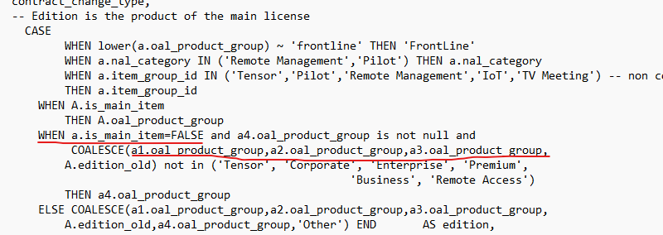
SOLUTION #2 (continues)
In ‘Edition’ value calculation, there is some unnecessary code written in the CASE statement-
In the underlined WHEN condition, inside the third condition i.e the COALESCE, ‘a1.oal_product_group and a2.oal_product_group and a3.oal_product_group’ will always return NULL (as these 3 values are derived from 3 CTEs which holds lines for ‘is_main_item = TRUE’). So, including these 3 columns here can be skipped. Instead, we can directly check the A.edition_old value here.

Slide 10
PROBLEM STATEMENT #3
Freshdesk is a customer service software that another team in the company is using to interact with their customers.
They would like to evaluate efficiency of their support agents.
In order to do that, they asked you to import data about the tickets they resolve into the data warehouse.
You can find the details about the Freshdesk API here: https://developers.freshdesk.com/v2/docs/data-api/#
Tell us how you would create a data ingestion that would accomplish the task of getting complete data about the tickets.
- which technologies would you use?
- how would the process be deployed and updated?
- where would you store the sensitive information such as access credentials?
- how would you structure the data?
- how would you report on it?

Slide 11
SOLUTION #3

Slide 12

What Is Airflow?
"Airflow is an open-source workflow management platform designed to programmatically schedule, monitor, and manage complex workflows for data engineering and data science.“
A sequence of Tasks, defined as DAG(Directed Acyclic Graph) is created to run the job as per schedule.
The code is written with Python programming language.

Slide 13

What Is DBT?
DBT is a tool that provides a development framework.
It combines modular SQL with software engineering best practices to make data transformation reliable, fast, and fun.
We can write custom business logic using SQL, automate data quality testing, deploy the code, and deliver trusted data with data documentation side-by-side with the code.

