Slide 1

IOT PROJECT
IOT BASED HOME AUTOMATION PROJECT
JAGMOHAN GAUTAM
AYUSHMAN SINGH
UPDESH KUMAR

Slide 2
Topics covered in this internship
C Programming
C++ Programming
Introduction to IOT
Introduction to Embedded systems
Arduino Uno
LED, CLCD, ADC, LM35, PWM
Arduino Based Home Automation Project

Slide 3
Simulation Tools Used For The Project Implementation
Arduino IDE
Picsimlab
Null emulator
Blynk cloud
Blynk IOT mobile application

Slide 4
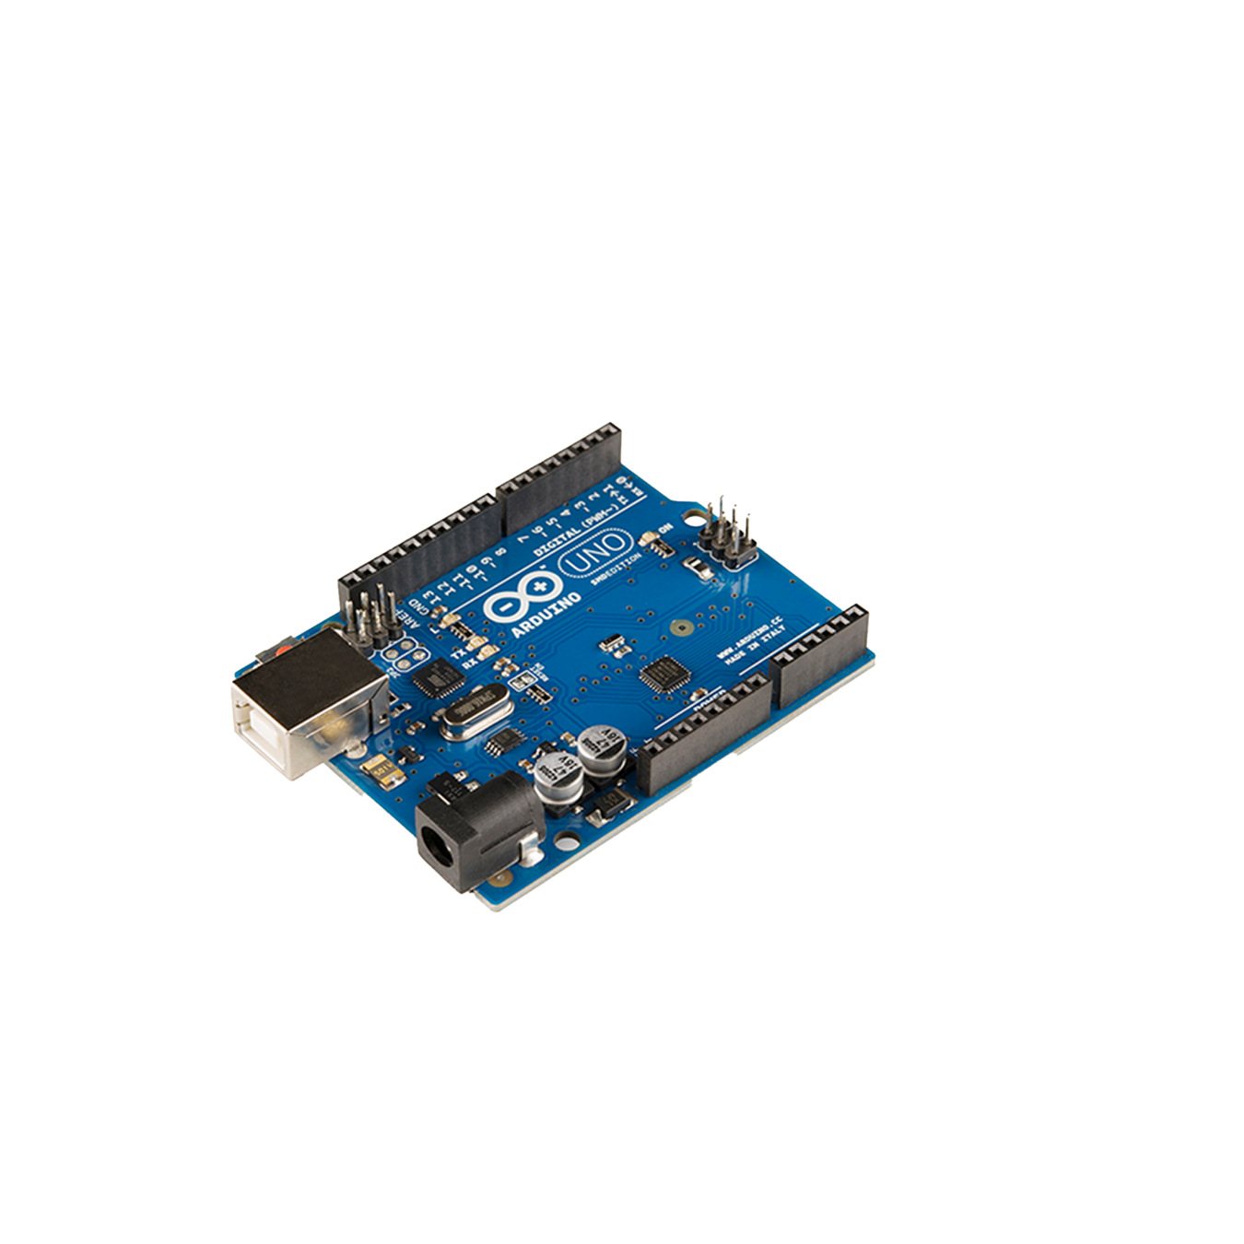
Arduino Uno
Arduino Uno is a microcontroller board on the ATmega328.
It has 14 input/output pins, of which 6 are Analog input pins and 6 can be used as PWM outputs. The pins operate at 5v.
It has 16mhz ceramic resonator, and USB connection, a power jack, an ISCP header, a reset button, and USB to serial converter.
There is a built in LED connected to digital pin 13. when the pin is high, the LED is on, when the pin is low , the LED is off.

Slide 5
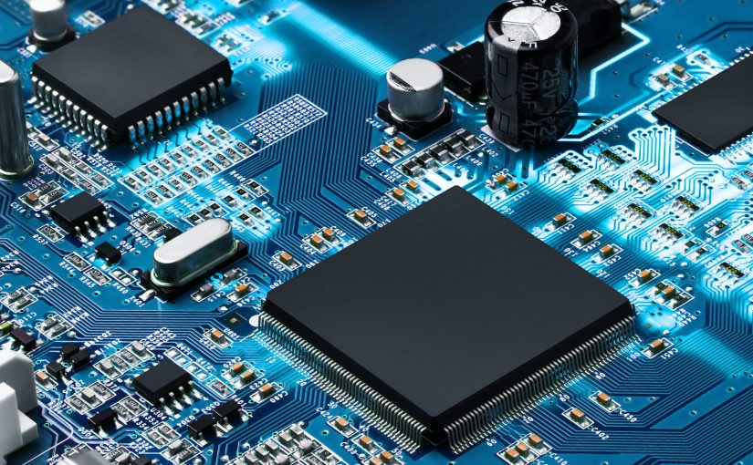
Embedded Systems
Any combination of Hardware and Software which is intended to do a Specific task can be called as an Embedded Systems
Types of Embedded systems
Stand alone
Real time
Networked
Mobile
GPS

Slide 6

IOT
The network of physical objects that contain embedded technology to communicate and interact with their internal stated or the external environment.
Internet of things is it connects to unique objects to internet. It is bidirectional communication. It is large and can share complex data flows.
It can be used in utilities, insurance, agriculture, factory, automobiles, transport, consumer and in many sectors.

Slide 7
Project Introduction
Home Automation is a technological solution that enables automating the bulk of electronic, electrical and technology-based tasks within a home.
In this project we will automate 3 things in the smart home -
GARDEN LIGHTS CONTROL
TEMPERATURE CONTROL
WATER TANK CONTROL

Slide 8
Project Introduction
Garden Lights Control
We have to turn on the garden lights at night and turn off when in the morning sunlight automatically.
Temperature Control System
Read the temperature from sensor and displaying the temperature on Gauge widget in Blynk IOT app and on the CLCD. If the temperature is more than 35 degrees and the heater is on then turn off the heater and send notification to Blynk IOT app and displaying it on the CLCD.
Water Tank Control
Read the volume of water in the tank and display it on the Gauge widget in Blynk IOT app and on CLCD. We have to control the inlet and outlet valves of the tank using buttons of Blynk IOT app. If the volume for the water in the tank is less than 2000 litres turn on the inlet valve and send notification to Blynk IOT app and display it on the CLCD.

Slide 9
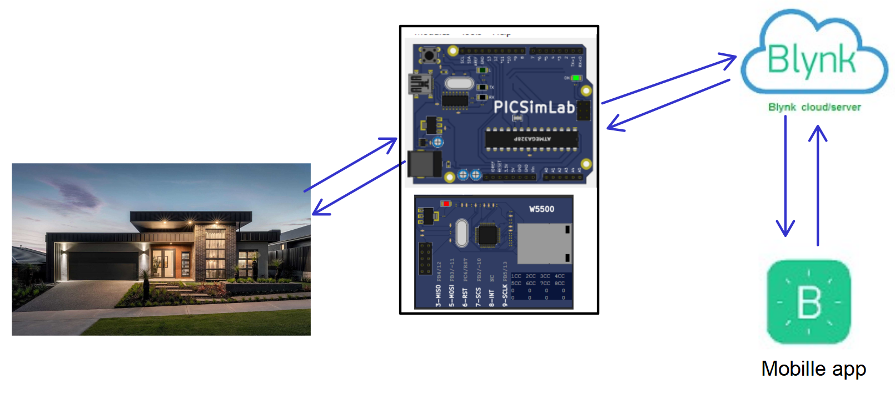
Mapping

Slide 10
Components
LED
LDR
Light emitting diode is a semiconductor light source that emits light when current flows through it. In the project the LED is used as garden lights. It tells us whether it is day or night. If night it glows.
It is called as light dependent resistor. It is used to indicate the presence or absence of light or to measure the light intensity.

Slide 11
Components
CLCD
Temperature system
Liquid crystal displays are flat panel displays that use light modulating properties of liquid crystals to produce images. We can display 2 or 4 lines by 16 or 20 columns.
It consists of heater, cooler, LM35(temperature sensor). We can read the temperature from the temperature sensor

Slide 12
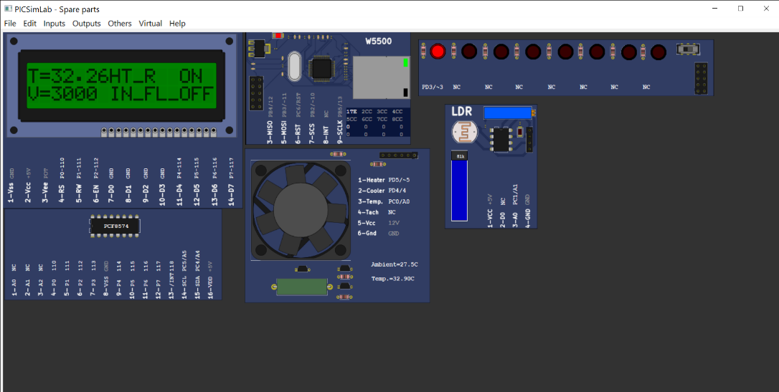
Output Screenshots
When the heater is on notification is shown on CLCD and it displays current temperature.

Slide 13
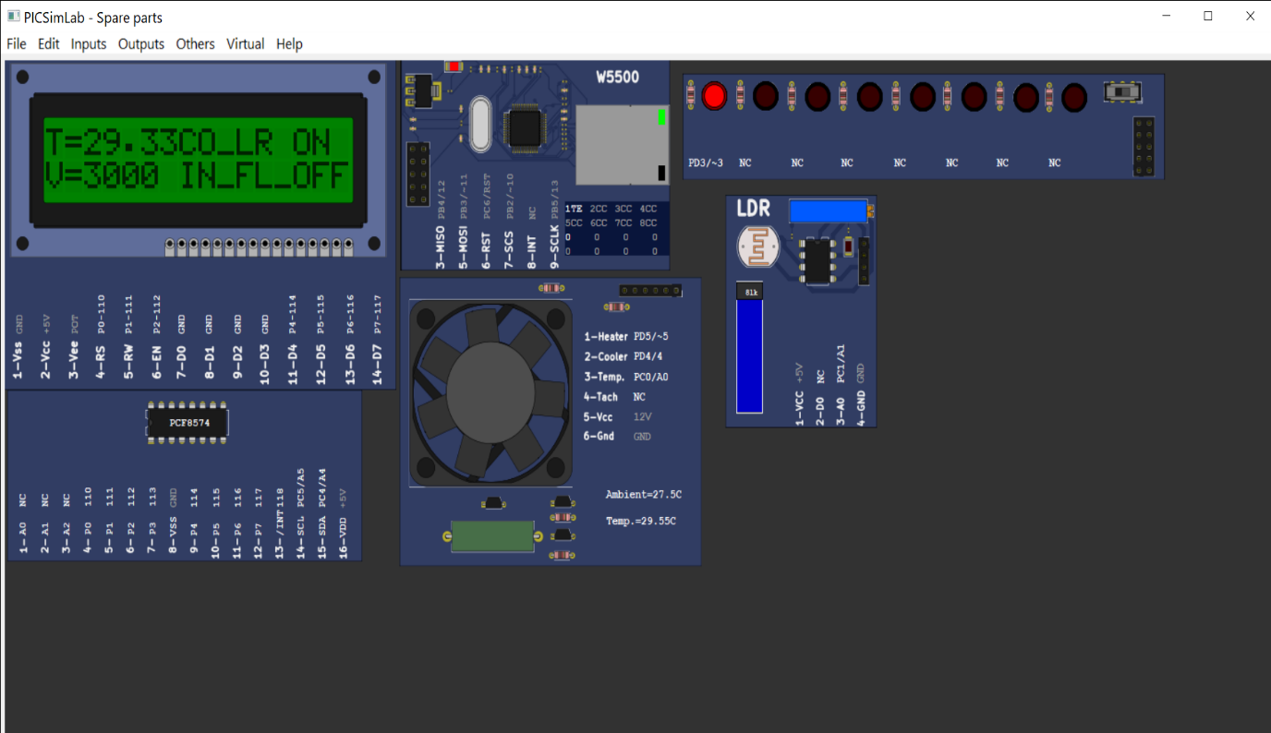
Output Screenshots
When the Cooler is on, the notification is shown on the CLCD and displaying the temperature.

Slide 14
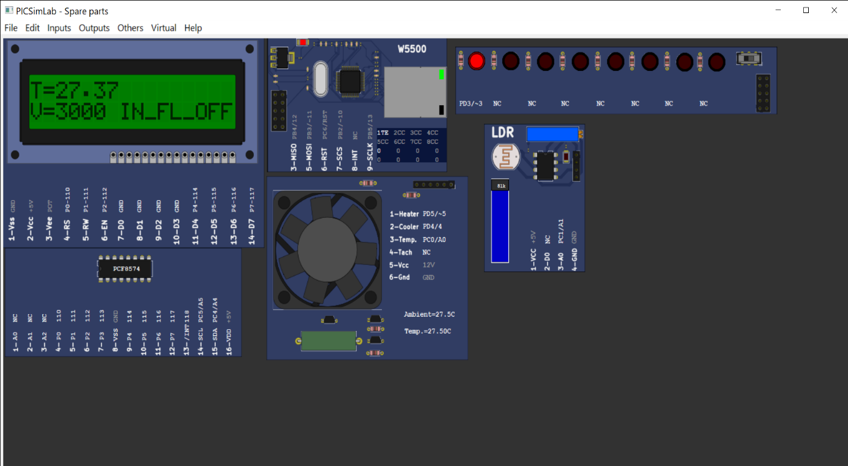
Output Screenshots
When we turn off the Cooler, the notification is shown on the CLCD and displays the temperature.

Slide 15

Output Screenshots
When we turnoff the Cooler, the notification is shown on the CLCD and displays the temperature.

Slide 16
Conclusion
We have learnt basic c++ programming skills.
We have learnt various function which are used in Arduino IDE.
We have got better understanding in connection of components to Arduino board.
We have learnt basic IOT programming in this internship and worked on the IOT based Home automation solution project, and simulated in Picsimlab and I used Arduino IDE to do the programming.

Slide 17
THANK YOU

