Slide 1

CUSTOMER ANALYTICS
Customer
Shopping
Behavior
Analysis
From transactions to targeting, merchandising, and retention.

Slide 2
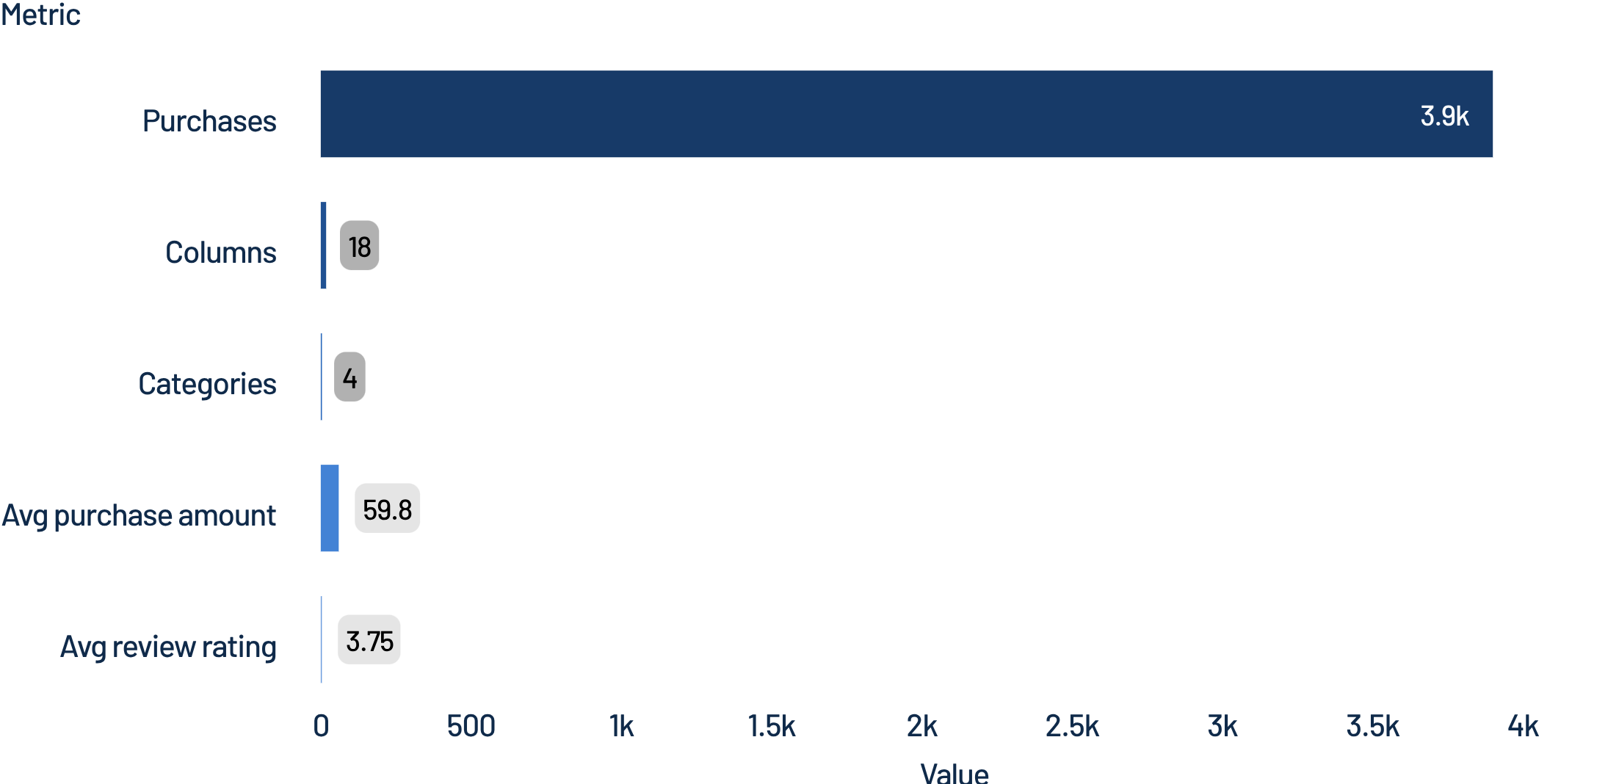
DATASET SNAPSHOT
What the dataset reveals at a glance
3,900 purchases across 18 columns and 4 product categories support a focused customer-behavior story.
Average purchase: $59.76
Average review rating: 3.75
Core question: how do customer segments, products, discounts, and subscriptions shape revenue?
2

Slide 3
ANALYSIS PIPELINE
From raw transactions to business insight
Five steps moved the dataset from inspection to SQL-ready analysis.
01
02
03
04
05
Loaded and profiled
Handled missing ratings
Engineered features
Checked redundancy
Loaded into PostgreSQL
Loaded and profiled the dataset with pandas.
Handled 37 missing review ratings using category medians.
Standardized columns and engineered age and purchase-frequency features.
Checked redundant discount and promo fields.
Loaded the cleaned data into PostgreSQL for SQL analysis.
3

Slide 4
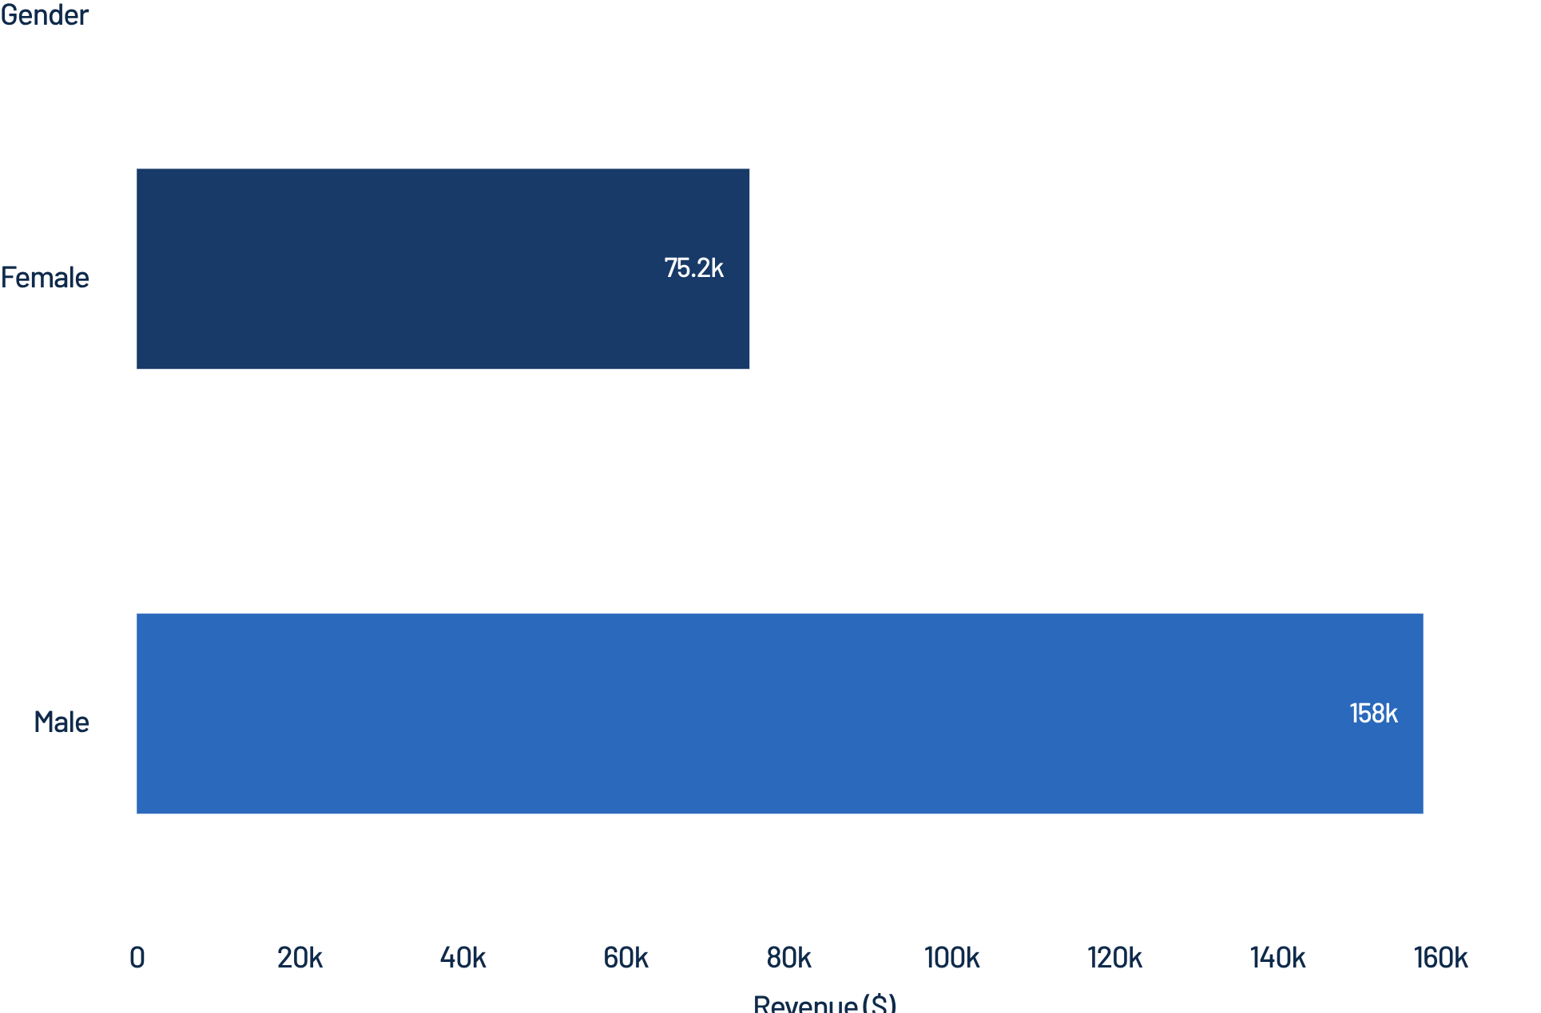
REVENUE MIX
Revenue is concentrated among male customers
$233,081
Observed revenue across male and female customers.
The observed revenue mix is roughly two-to-one, creating a clear targeting question for the business.
$157,890
$75,191
MALE CUSTOMERS
FEMALE CUSTOMERS
4

Slide 5
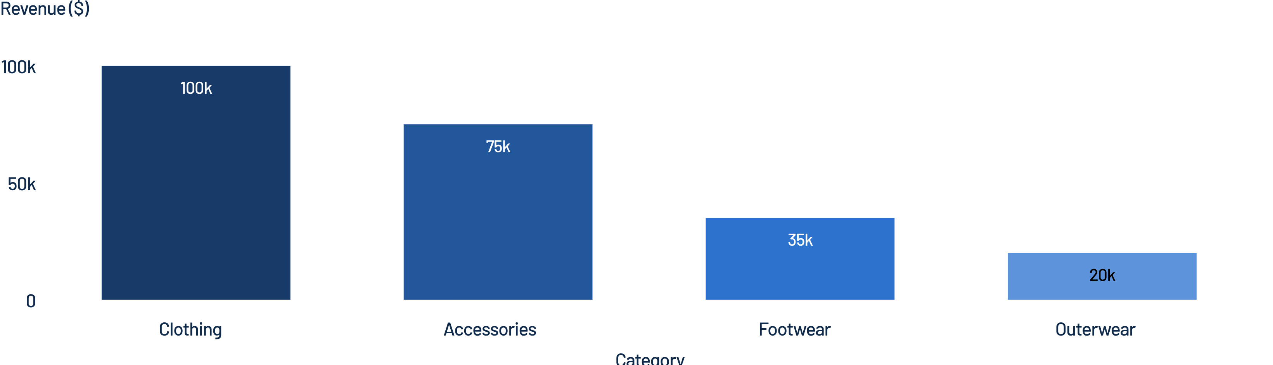
CATEGORY ECONOMY
Clothing leads the category economy
Clothing contributes approximately $100K revenue and 1,700 sales. Accessories follows with approximately $75K revenue and 1,250 sales.
Footwear and outerwear are smaller contributors in the dashboard view.
Top category products: Jewelry, Blouse, Sandals, and Jacket lead their respective categories.
5

Slide 6
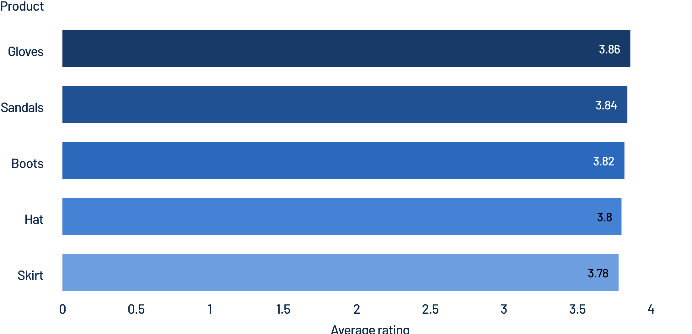
PRODUCT SIGNAL
Ratings point to a strong product shortlist
Five products lead on average customer rating and can anchor campaigns, bundles, and review-led merchandising.
The shortlist spans Gloves, Sandals, Boots, Hat, and Skirt.
6

Slide 7

DISCOUNT BEHAVIOR
Discounts attract high-value shoppers, but may train dependency
839
customers used discounts while still spending above the average purchase amount.
Discount-heavy products include Hat at 50.00%, Sneakers at 49.66%, and Coat at 49.07% of purchases.
Business tension
Discounts can lift conversion while putting pressure on margin and full-price behavior.
7

Slide 8
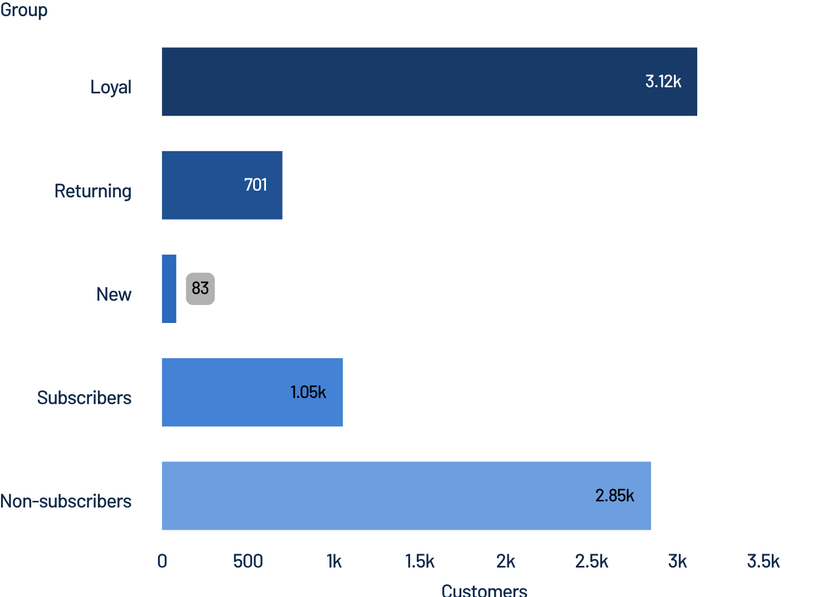
LOYALTY & SUBSCRIPTIONS
Loyalty is strong; subscription adoption is the gap
Most customers are already loyal, but subscription penetration remains limited.
3,116
701
83
LOYAL
RETURNING
NEW
Subscription status: 27% subscribed and 73% not subscribed.
Average spend is nearly flat: subscribers $59.49 versus non-subscribers $59.87.
8

Slide 9
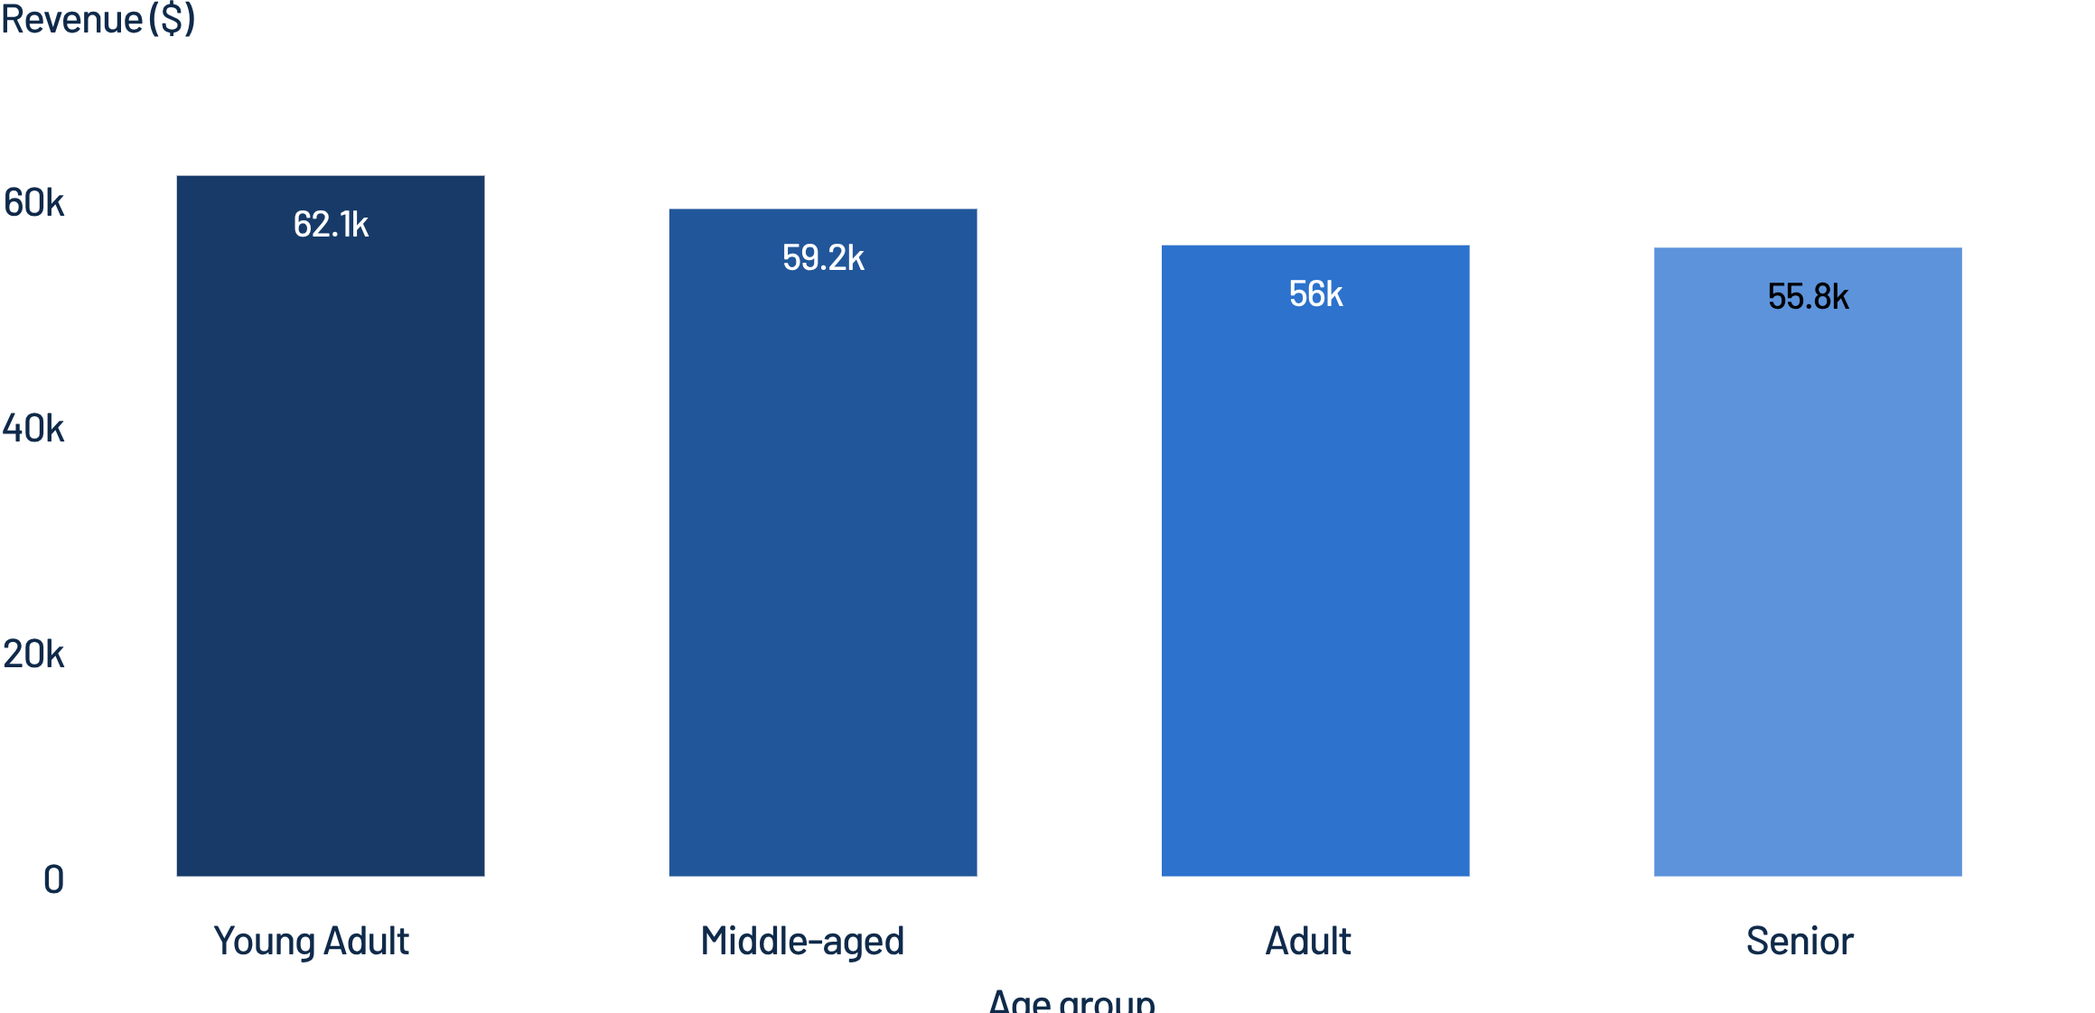
VALUE BY CUSTOMER CONTEXT
Young adults lead revenue, while shipping creates a small upsell signal
Young adults contribute the highest observed revenue, with fairly balanced age-group performance.
$60.48
$58.46
EXPRESS SHIPPING
STANDARD SHIPPING
Express shipping averages $60.48 per purchase versus $58.46 for Standard.
The difference is modest, but express-shipping users may be a useful audience for convenience-oriented offers.
9

Slide 10

ACTION PLAN
Recommendations: turn analysis into action
Grow subscriptions: test exclusive benefits, early access, or shipping perks
Reward repeat behavior: move returning customers toward the loyal segment with tiered loyalty rewards
Protect margin: target discounts to high-potential shoppers and monitor discount-dependent products
Merchandise the winners: feature top-rated and best-selling products in campaigns and bundles
Target by value: prioritize young adults, high-spending discount users, and express-shipping audiences

