Slide 1


Azure Fundamentals
Mr.Gautam Singh, Assistant Professor, CSE

Slide 2
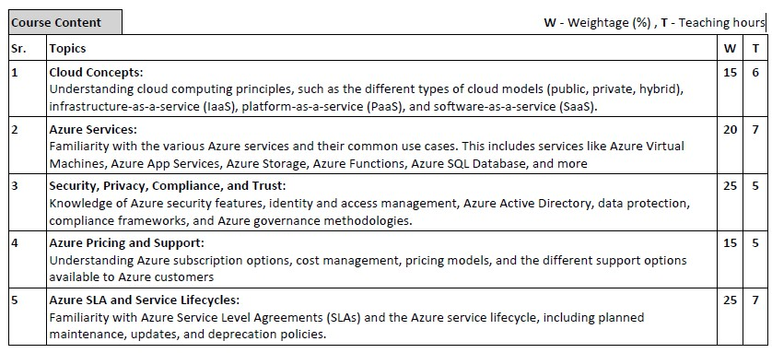

Slide 3
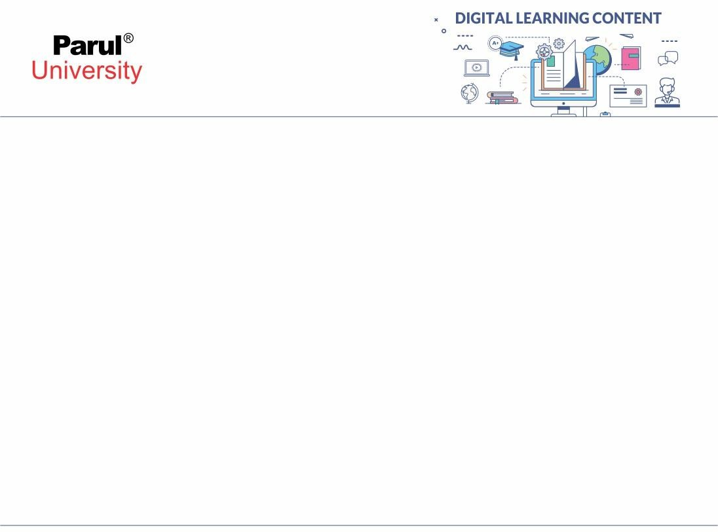

Module-1
Cloud Concepts

Slide 4
What is the cloud?
The term cloud is usually used to represent the internet but it is not just
restricted to the Internet.
It is virtual storage where the data is stored in third-party data centers.
Storing, managing, and accessing data present in the cloud is typically
referred to as cloud computing.

Slide 5
What is Cloud Computing?
The National Institute of Standards and Technology (NIST) said:
Cloud computing provides worldwide and on-demand access to computing resources that can be configured based on customer demand.
Unlimited Computing and storage
It is a process of renting computing power and memory when needed and
giving them back when done.
Compute, Storage, Networking components + Speech recognition and other cognitive services + Analytical Services

Slide 6
Cloud computing differs from traditional IT hosting services in that the consumer (whether that’s a business, organization, or individual user) generally doesn’t own the infrastructure needed to support the programs or applications they use.
Instead, those elements are owned and operated by a third party, and the end- user pays only for the services they use. In other words, cloud computing is an on-demand, utility-based model of computing.
In short, the cloud is the Internet, and cloud computing is that describes software and services that run through the Internet (or an intranet) rather than on private servers and hard drives.

Slide 7
Characteristics of cloud computing
On-demand self-service
Users can access computing services via the cloud when they need to without interaction from the service provider. The computing services should be fully on- demand so that users have control and agility to meet their evolving needs.
Broad network access
Cloud computing services are widely available via the network through users’ preferred tools (e.g., laptops, desktops, smartphones, etc.).
Resource pooling
One of the most attractive elements of cloud computing is the pooling of resources to deliver computing services at scale. Resources, such as storage, memory, processing, and network bandwidth, are pooled and assigned to multiple consumers based on demand.

Slide 8
Rapid elasticity
Successful resource allocation requires elasticity. Resources must be assigned accurately and quickly with the ability to absorb significant increases and decreases in demand without service interruption or quality degradation.
Measured service
Following the utility model, cloud computing services are measured and metered. This measurement allows the service provider (and consumer) to track usage and gauge costs according to their demand on resources.

Slide 9
What is a Cloud Deployment Model?
Cloud Deployment Model functions as a virtual computing environment with a
deployment architecture that varies depending on the amount of data you want to store and who has access to the infrastructure.
A cloud deployment model essentially defines where the infrastructure for your
deployment resides and determines who has ownership and control over that infrastructure. It also determines the cloud’s nature and purpose

Slide 10
Cloud deployment models can be divided into five types
Public Cloud
Private Cloud
Hybrid Cloud
Community cloud
Multi-Cloud

Slide 11
Public Cloud
The public cloud makes it possible for anybody to access systems and services.
The public cloud may be less secure as it is open to everyone. The public cloud is one in which cloud infrastructure services are provided over the internet to the general people or major industry groups.
The infrastructure in this cloud model is owned by the entity that delivers the
cloud services, not by the consumer.
This form of cloud computing is an excellent example of cloud hosting, in which service providers supply services to a variety of customers.

Slide 12
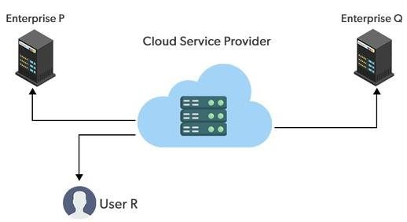
In this arrangement, storage backup and retrieval services are given for free, as a subscription, or on a per-user basis. For example, Google App Engine etc.

Slide 13
Advantages of the Public Cloud Model
Minimal Investment: Because it is a pay-per-use service, substantial upfront fee.
there is no
No setup cost: The entire infrastructure is fully subsidized by the cloud service
providers, thus there is no need to set up any hardware.
Infrastructure Management is not required: It does not necessitate infrastructure management.
No maintenance: The maintenance work is done by the service provider (not
users).
Dynamic Scalability: To fulfill your company’s needs, on-demand resources are accessible.

Slide 14
Disadvantages of the Public Cloud Model
Less secure: Public cloud is less secure as resources are public so there is no guarantee of high-level security.
Low customization: It is accessed by many public so it can’t be customized according to personal requirements.

Slide 15
Private Cloud
The private cloud deployment model is the exact opposite of the public
cloud deployment model.
It’s a one-on-one environment for a single user (customer). There is no
need to share your hardware with anyone else.
The distinction between private and public clouds is in how you handle all of the hardware.

Slide 16
It is also called the “internal cloud” & it refers to the ability to access
systems and services within a given border or organization.
The cloud platform is implemented in a cloud-based secure environment
that is protected by powerful firewalls and under the supervision of an
organization’s IT department.
The private cloud gives greater flexibility of control over cloud resources.

Slide 17
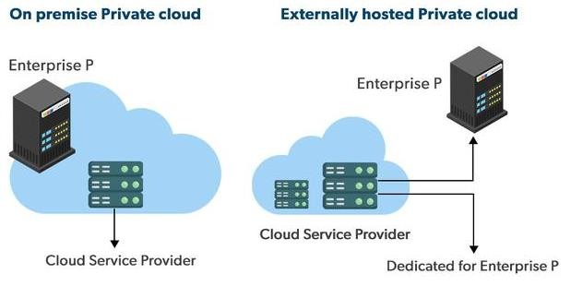

Slide 18
Advantages of Private Cloud
Better Control: You are the sole owner of the property. You gain complete command over service integration, IT operations, policies, and user behavior.
Data Security and Privacy: It’s suitable for storing corporate information to which only authorized staff have access. By segmenting resources within the same infrastructure, improved access and security can be achieved.
Supports Legacy Systems: This approach is designed to work with legacy systems that are unable to access the public cloud.
Customization: Unlike a public cloud deployment, a private cloud allows a company to tailor its solution to meet its specific needs.

Slide 19
Disadvantages of Private Cloud
Less scalable: Private clouds are scaled within a certain range as there is less
number of clients.
Costly: Private clouds are more costly as they provide personalized facilities

Slide 20
Hybrid Cloud
By bridging the public and private worlds with a layer of proprietary software,
hybrid cloud computing gives the best of both worlds. With a hybrid solution, you may host the app in a safe environment while taking advantage of the public cloud’s cost savings.
Organizations can move data and applications between different clouds using a combination of two or more cloud deployment methods, depending on their needs.

Slide 21
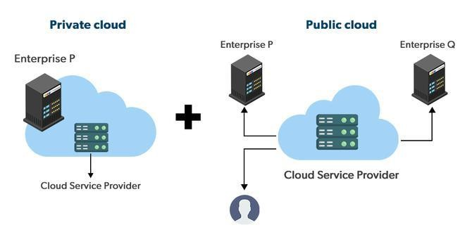

Slide 22
Advantages of the Hybrid Cloud Model
Flexibility and control: Businesses with more flexibility can design
personalized solutions that meet their particular needs.
Cost: Because public clouds provide scalability, you’ll
responsible for paying for the extra capacity if you require it.
only be
Security: Because data is properly separated, the chances of data theft
by attackers are considerably reduced.

Slide 23
Disadvantages of the Hybrid Cloud Model
Difficult to manage: Hybrid clouds are difficult to manage as it is a
combination of both public and private cloud. So, it is complex.
Slow data transmission: Data transmission in the hybrid cloud takes
place through the public cloud so latency occurs.

Slide 24
Community Cloud
It allows systems and services to be accessible by a group of organizations. It is
a distributed system that is created by integrating the services of different clouds to address the specific needs of a community, industry, or business.
The infrastructure of the community could be shared between the organization
which has shared concerns or tasks. It is generally managed by a third party or by the combination of one or more organizations in the community.

Slide 25
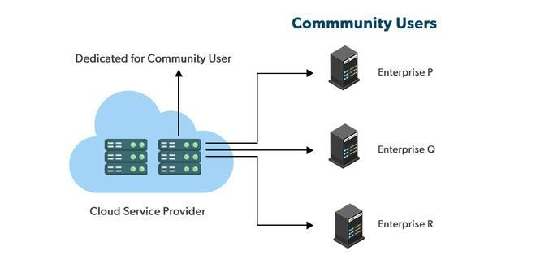

Slide 26
Advantages of the Community Cloud Model
Cost Effective: It is cost-effective because the cloud is shared by multiple organizations or communities.
Security: Community cloud provides better security.
Shared resources: It allows you to share resources, infrastructure, etc. with
multiple organizations.
Collaboration and data sharing: It is suitable for both collaboration and data sharing.

Slide 27
Disadvantages of the Community Cloud Model
Limited Scalability: Community cloud is relatively less scalable as many organizations share the same resources according to their collaborative interests.
Rigid in customization: As the data and resources are shared among different
organizations according to their mutual interests if an organization wants some
changes according to their needs they cannot do so because it will have an impact on other organizations.

Slide 28
Multi-Cloud
We’re talking about employing multiple cloud providers at the same time under this paradigm, as the name implies.
It’s similar to the hybrid cloud deployment approach, which combines public and private cloud resources. Instead of merging private and public clouds, multi- cloud uses many public clouds.
Although public cloud providers provide numerous tools to improve the reliability of their services, mishaps still occur. It’s quite rare that two distinct clouds would have an incident at the same moment.

Slide 29
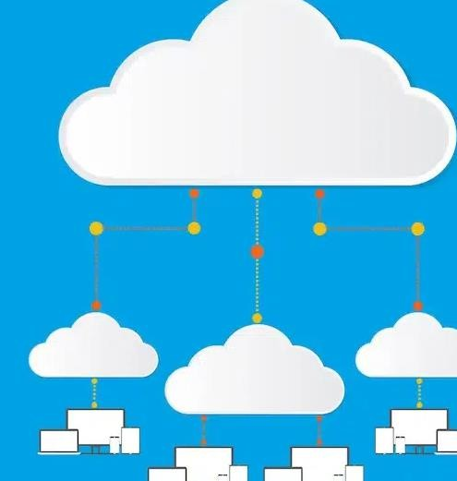
As a result, multi-cloud deployment improves the high availability of your
services even more.

Slide 30
Advantages of the Multi-Cloud Model
You can mix and match the best features of each cloud provider’s services to suit the demands of your apps, workloads, and business by choosing different cloud providers.
Reduced Latency: To reduce latency and improve user experience, you can
choose cloud regions and zones that are close to your clients.
High availability of service: It’s quite rare that two distinct clouds would have an incident at the same moment. So, the multi-cloud deployment improves the high availability of your services.

Slide 31
Disadvantages of the Multi-Cloud Model
Complex: The combination of many clouds makes the system complex and bottlenecks may occur.
Security issue: Due to the complex structure, there may be loopholes to which a hacker can take advantage hence, makes the data insecure.

Slide 32
Comparison
Factors | Public Cloud | Private Cloud | Community Cloud | Hybrid Cloud
Initial Setup | Easy | Complex, requires a professional team to setup | Complex, requires a professional team to setup | Complex, requires a professional team to setup
Scalability and Flexibility | Highest | Low | Fixed | High
Cost-Comparison | Cost-Effective | Costly | Distributed cost among members | Between public and private cloud
Reliability | Low | Low | High | High
Data Security | Low | High | High | High
Data Privacy | Low | High | High | High

Slide 33
Cloud Computing Models
There are three main models for cloud computing
Infrastructure as a service (IaaS)
Platform as a service (PaaS)
Software as a service (SaaS)
Note: There are other two types of models:
Anything/Everything as a service (XaaS)
Function as a Service (FaaS)

Slide 34
These are sometimes called the cloud computing stack because they are built
on top of one another. Knowing what they are and how they are different, makes it easier to accomplish your goals.
These abstraction layers can also be viewed as a layered architecture where
services of a higher layer can be composed of services of the underlying layer i.e, SaaS can provide Infrastructure.

Slide 35
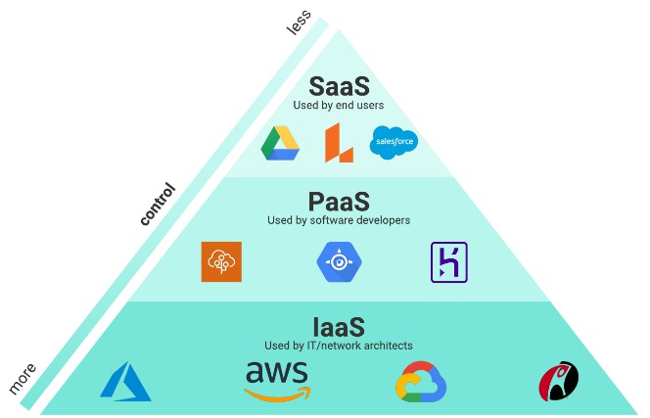

Slide 36
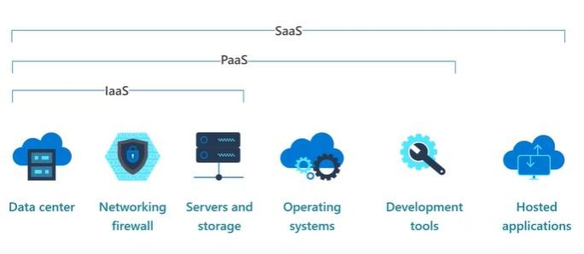

Slide 37
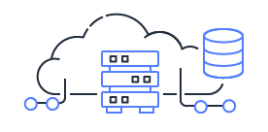
1. Infrastructure as a service (IaaS)
IaaS is also known as Hardware as a Service (HaaS). It is a computing infrastructure managed over the internet.
Features:
Resources are available as a service
Services are highly scalable
Dynamic and flexible
Graphical User Intgerface (GUI) and Application Programming Interface (API)-based access
Automated administrative tasks

Slide 38
IaaS, contains the basic building blocks for cloud IT and typically provide access to networking features, computers (virtual or on dedicated hardware), and data storage space.
IaaS provides you with the highest level of flexibility and management control
over your IT resources and is most similar to existing IT resources that many IT
departments and developers are familiar with today.
Example: DigitalOcean, Linode, Amazon Web Services (AWS), Microsoft Azure, Google Compute Engine (GCE), Rackspace, and Cisco Metacloud.

Slide 39
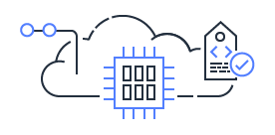
2. Platform as a Service (PaaS)
PaaS cloud computing platform is created for the programmer to develop, test, run, and manage the applications.
characteristics of PaaS –
Accessible to various users via the same development application.
Integrates with web services and databases.
Builds on virtualization technology, so resources can easily be scaled up or down as per the organization's need.
Support multiple languages and frameworks.
Provides an ability to "Auto-scale"

Slide 40
Platforms as a service remove the need for organizations to manage the underlying infrastructure (usually hardware and operating systems) and allow you to focus on the deployment and management of your applications.
This helps you be more efficient as you don’t need to worry about resource
procurement, capacity planning, software maintenance, patching, or any of the
other undifferentiated heavy lifting involved in running your application.
Example: AWS Elastic Beanstalk, Windows Azure, Heroku, Force.com, Google App Engine, Apache Stratos, Magento Commerce Cloud, and OpenShift.

Slide 41
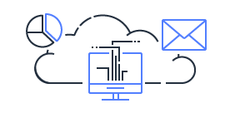
3. Software as a Service (SaaS)
SaaS is also known as "on-demand software". It is a software in which the applications are hosted by a cloud service provider. Users can access these applications with the help of internet connection and web browser.
Characteristics:
Managed from a central location
Hosted on a remote server
Accessible over the internet
Users are not responsible for hardware and software updates. Updates are applied automatically.
The services are purchased on the pay-as-per-use basis

Slide 42
Software as a Service provides you with a completed product that is run and managed by the service provider. In most cases, people referring to Software as a Service are referring to end-user applications. With a SaaS offering you do not have to think about how the service is maintained or how the underlying infrastructure is managed; you only need to think about how you will use that particular piece of software.
A common example of a SaaS application is web-based email where you can send and receive email without having to manage feature additions to the email product or maintaining the servers and operating systems that the email program is running on.
Example: BigCommerce, Google Apps, Salesforce, Dropbox, ZenDesk, Cisco WebEx, ZenDesk, Slack, and GoToMeeting.

Slide 43
What is serverless computing?
Like PaaS, serverless computing enables developers to build applications faster by eliminating the need for them to manage infrastructure.
With serverless applications, the cloud service provider automatically provisions, scales, and manages the infrastructure required to run the code.
Serverless architectures are highly scalable and event-driven, only using
resources when a specific function or trigger occurs.
It's important to note that servers are still running the code. The "serverless" name comes from the fact that the tasks associated with infrastructure provisioning and management are invisible to the developer.
This approach enables developers to increase their focus on the business logic,
and deliver more value to the core of the business.
Serverless computing helps teams increase their productivity and bring products to market faster, and it allows organizations to better optimize resources and stay focused on innovation.

Slide 44
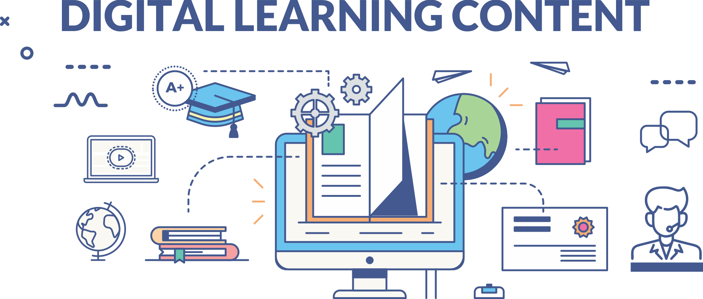


Slide 45
Azure Fundamentals
Mr.Gautam Singh, Assistant Professor, CSE

Slide 46


Slide 47

Module-2
Azure Services

Slide 48
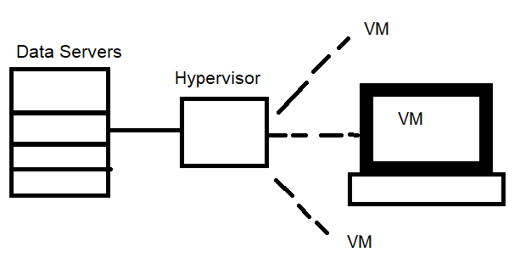
What is Azure?
It’s a cloud computing service from Microsoft
Azure is a continually expanding set of cloud services that help you meet current and future business challenges.
Azure gives you the freedom to build, manage, and deploy applications on a massive global network using your favorite tools and frameworks.
Azure uses the technique of Virtualization.
A hypervisor can run
multiple Virtual Machines (VMs) at a time

Slide 49
What does Azure offer?
Build intelligent apps and solutions with advanced technology, tools, and services to take your business to the next level. Seamlessly unify your technology to simplify platform management and to deliver innovations efficiently and securely on a trusted cloud.
Bring ideas to life: Build on a trusted platform to advance your organization with industry-leading AI and cloud services.
Seamlessly unify: Efficiently manage all your infrastructure, data, analytics, and AI solutions across an integrated platform.
Innovate on trust: Rely on trusted technology from a partner who's dedicated to security and responsibility.

Slide 50
Azure provides more than 100 services that enable you to do everything from running your existing applications on virtual machines to exploring new software paradigms, such as intelligent bots and mixed reality.
For example, Azure provides artificial intelligence (AI) and machine-learning
(ML) services that can naturally communicate with your users through vision,
hearing, and speech.
It also provides storage solutions that dynamically grow to accommodate massive amounts of data. Azure services enable solutions that aren't feasible without the power of the cloud.

Slide 51
Many teams start exploring the cloud by moving their existing applications to virtual machines (VMs) that run in Azure. Migrating your existing apps to VMs is a good start, but the cloud is much more than a different place to run your VMs.
Launched in 2010, Microsoft Azure is one of the leading cloud providers in the
market.
It is now being used by 85% of Fortune 500 companies.
Approximately 56% of global organizations utilize Microsoft Azure as their preferred cloud service provider.

Slide 52
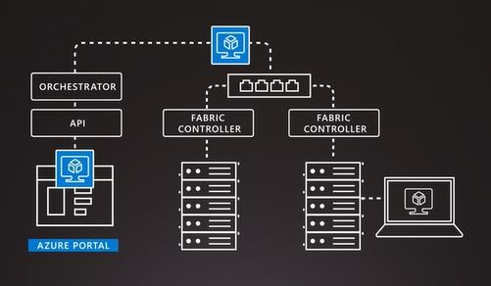
How does Azure works?
Switching
Network
Virtual Machine through which user can Access server
Request by user
Server

Slide 53
API- Application Programming Interface
Orchestrator- It manages everything happening in the Azure
The user puts on a request, it reaches the orchestrator. Orchestrator choses the best server available and sends request to it.
Fabric controller creates a virtual machine for the user.
The VM accesses the server

Slide 54

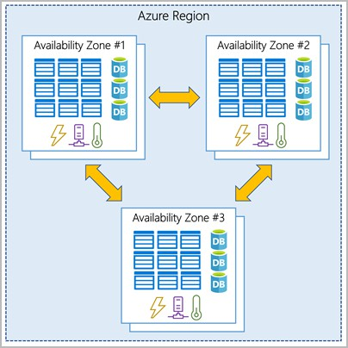
What is an Azure Region
A geographical area on the planet that contains one or multiple data centers together with a low latency network.

Slide 55
What are Availability Zones?
They are physically separate data centers within Az. Region
Each Zone is made of one or more data centers with independent cooling, power, and networking.
It acts like isolation boundary
If one Zone goes down, the others continues to provide service
The Zones are connected with high speed fiber optics.
Zones can be used to run critical operations, where your resources, VMs, data, etc are copied into other zones (Duplicating might cost you extra).

Slide 56
What are Azure Services?
Based on cloud computing service models
IaaS
PaaS
SaaS
Based on types of services
Foundational
Mainstream
Strategic

Slide 57
1. Platform as a Service (PaaS)
PaaS is a cloud-based service model that offers the necessary resources to develop and deploy software applications.
It supports the entire software application development lifecycle, eliminating the need to manage infrastructure.
PaaS operates on a pay-as-you-go model, enabling users to purchase Azure resources and access them securely over the Internet.
Following are some of the core Azure PaaS cloud services.
Development - App Configuration, Azure Chaos Studio, DevTest Labs, Load
Testing, Microsoft Dev Box
Databases - SQL database, Apache Cassandra MI, Database for MariaDB
Compute - App service, Azure batch, Azure functions, Cloud services, container apps
Integration - API management, Logic apps, service bus.

Slide 58
2. Software as a Service (SaaS)
Azure SaaS is a service model that allows users to access and utilize cloud-based applications like mail, calendars, and office tools.
It allows organizations to deploy applications quickly with minimal costs.
Azure manages the hardware and software, such as infrastructure and middleware on your behalf.
Therefore, it ensures the high availability and security of those apps.
Following are the SaaS services Azure currently provides:
Analytics - Data Catalog, PowerBI Embedded
Development - Azure DevOps, Visual Studio App Center
Identity and Security - Defend for cloud, Information Protection, Microsoft Sentinel
IoT - IoT central
Management and Governance - Azure Advisor, Azure Arc, Azure Backup
Migration - Azure Migrate, DB Migration Service, Site Recovery
Networking - Azure Orbital, Internet Analyzer
Storage - Data Share

Slide 59
3. Infrastructure as a Service (IaaS)
IaaS is a cloud service model that provides cloud resources like compute and storage on demand.
It also uses a pay-as-you-go model, offering the flexibility to scale resources based on your varying workloads and traffic.
It enables organizations to quickly adapt to changing user needs and improve the reliability of their infrastructure.
Following are the IaaS services that Azure currently provides.
Compute - Azure VMware Solution, Dedicated Host, Virtual Desktop, Virtual
Machines, VM Scale Sets
Storage - Azure Storage, HPC Cache, Managed Disks
Networking - Azure Firewall, ExpressRoute, Load Balancer, Network Watcher, Private Link, Traffic Manager, Virtual Network, Virtual WAN, VPN Gateway.

Slide 60
1. Foundational services
These are essential or core services provided by the Azure platform.
The foundational services are available in all regions recommended for use and
in any alternate regions when they become generally available.
Additionally, if a new foundational service is introduced, it will be made available in all recommended and alternate regions within 90 days of its general availability.
Some examples of foundational services include:
Azure Application Gateway
Azure Backup
Azure Cosmos
Azure Event Hubs
Azure Virtual Machines
Azure VPN Gateway

Slide 61
2. Mainstream services
These services are accessible in all the recommended regions for deployment
They will be made accessible within 90 days from when the recommended
region becomes generally available.
Additionally, the availability of these services in alternate regions is determined by customer demand within those specific regions.
Those services have already been launched and implemented in many alternate regions.
Some examples of mainstream services include:
Azure API Management
Azure Container Registry
Azure Functions
Azure Private Link
Azure Virtual WAN

Slide 62
3.Strategic services
Strategic services were previously known as ‘specialized services.’
They are designed to meet the specific requirements of a particular industry and are
developed with a deep understanding of that specific industry.
These services leverage customized hardware to enhance performance or enable unique functionality. They are also made available in regions based on customer demand, and many services have already been launched and implemented in many of the recommended regions.
Some examples of strategic services include:
Azure API for FHIR
Azure Lab Services
Azure VMware Solution
Azure Applied AI Services
Azure Machine Learning
Azure Red Hat OpenShift
Azure Kubernetes

Slide 63
Types of Azure Services (Core Services)
Compute Services
Cloud Storage
Networking
AI
IoT
Application Hosting
Databases
Integrity and Security
https://azure.microsoft.com/en-us/products

Slide 64
1. Azure compute services
Azure compute services enable organizations to deploy, manage, and scale applications and workloads in the cloud. Here are some of the core compute services provided by Azure.
Compute services are often one of the primary reasons why companies move to the Azure platform. Azure provides a range of options for hosting applications and services. Here are some examples of compute services in Azure.

Slide 65
Service name | Service function
Azure Virtual Machines | Windows or Linux virtual machines (VMs) hosted in Azure
Azure Virtual Machine Scale Sets | Scaling for Windows or Linux VMs hosted in Azure
Azure Kubernetes Service | Cluster management for VMs that run containerized services
Azure Service Fabric | Distributed systems platform that runs in Azure or on- premises
Azure Batch | Managed service for parallel and high-performance computing applications
Azure Container Instances | Containerized apps run on Azure without provisioning servers or VMs
Azure Functions | An event-driven, serverless compute service

Slide 66
NoSQL databases use a variety of data models for accessing and managing data.
2. Azure storage services
Azure provides four main types of storage services.
Service name | Service function
Azure Blob storage | Storage service for very large objects, such as video files or bitmaps
Azure File storage | File shares that can be accessed and managed like a file server
Azure Queue storage | A data store for queuing and reliably delivering messages between applications
Azure Table storage | A NoSQL store that hosts unstructured data independent of any schema

Slide 67
3.Azure Networking Services
Linking compute resources and providing access to applications is the key
function of Azure networking.
Networking functionality in Azure includes a range of options to connect the outside world to services and features in the global Azure datacenters.

Slide 68
Domain Name System (DNS) is a protocol that allows us to use human readable names to communicate over networks, rather than having to manage and memorize IP addresses.
Service name | Service function
Azure Virtual Network | Connects VMs to incoming virtual private network (VPN) connections
Azure Load Balancer | Balances inbound and outbound connections to applications or service endpoints
Azure Application Gateway | Optimizes app server farm delivery while increasing application security
Azure VPN Gateway | Accesses Azure Virtual Networks through high- performance VPN gateways
Azure DNS | Provides ultra-fast DNS responses and ultra-high domain availability
Azure Content Delivery Network | Delivers high-bandwidth content to customers globally

Slide 69
Service name | Service function
Azure DDoS Protection | Protects Azure-hosted applications from distributed denial of service (DDOS) attacks
Azure Traffic Manager | Distributes network traffic across Azure regions worldwide
Azure ExpressRoute | Connects to Azure over high-bandwidth dedicated secure connections
Azure Network Watcher | Monitors and diagnoses network issues by using scenario- based analysis
Azure Firewall | Implements high-security, high-availability firewall with unlimited scalability
Azure Virtual WAN | Creates a unified wide area network (WAN) that connects local and remote sites

Slide 70
4. Azure AI Services
AI, in the context of cloud computing, is based around a broad range of
services, the core of which is machine learning.
Machine learning is a data science technique that allows computers to use existing data to forecast future behaviors, outcomes, and trends.
Using machine learning, computers learn without being explicitly programmed.
Forecasts or predictions from machine learning can make apps and devices smarter. For example, when you shop online, machine learning helps recommend other products you might like based on what you've purchased. Or when your credit card is swiped, machine learning compares the transaction to a database of transactions and helps detect fraud. And when your robot vacuum cleaner vacuums a room, machine learning helps it decide whether the job is done.

Slide 71
Service name | Description
Azure Machine Learning Service | Cloud-based environment you can use to develop, train, test, deploy, manage, and track machine learning models. It can auto-generate a model and auto-tune it for you. It will let you start training on your local machine, and then scale out to the cloud.
Azure Machine Learning Studio | Collaborative visual workspace where you can build, test, and deploy machine learning solutions by using prebuilt machine learning algorithms and data-handling modules.

Slide 72
A closely related set of products are the cognitive services. You can use these prebuilt APIs in your applications to solve complex problems.
Service name | Description
Vision | Use image-processing algorithms to smartly identify, caption, index, and moderate your pictures and videos.
Speech | Convert spoken audio into text, use voice for verification, or add speaker recognition to your app.
Knowledge mapping | Map complex information and data to solve tasks such as intelligent recommendations and semantic search.
Bing Search | Add Bing Search APIs to your apps and harness the ability to comb billions of webpages, images, videos, and news with a single API call.
Natural Language processing | Allow your apps to process natural language with pre-built scripts, evaluate sentiment, and learn how to recognize what users want.

Slide 73
5. Azure IoT Services
People are able to access more information than ever before. Personal digital assistants led to smartphones, and now there are smart watches, smart thermostats, and even smart refrigerators.
Personal computers used to be the norm. Now the internet allows any item that's online-capable to access valuable information.
This ability for devices to garner and then relay information for data analysis is referred to as IoT.

Slide 74
Service name | Description
IoT Central | Fully managed global IoT software as a service (SaaS) solution that makes it easy to connect, monitor, and manage IoT assets at scale
Azure IoT Hub | Messaging hub that provides secure communications between and monitoring of millions of IoT devices
IoT Edge | Fully managed service that allows data analysis models to be pushed directly onto IoT devices, which allows them to react quickly to state changes without needing to consult cloud-based AI models

Slide 75
6. Azure App Hosting
Azure App Service is an HTTP-based service for hosting web applications, REST APIs, and mobile back ends. You can develop in your favorite language, be it .NET, .NET Core, Java, Node.js, PHP, and Python. Applications run and scale with ease on both Windows and Linux-based environments.
App Service adds the power of Microsoft Azure to your application, such as
security, load balancing, autoscaling, and automated management.
Additionally, you can take advantage of its DevOps capabilities, such as continuous deployment from Azure DevOps, GitHub, Docker Hub, and other sources, package management, staging environments, custom domain, and TLS/SSL certificates.
With App Service, you pay for the Azure compute resources you use. The compute resources you use are determined by the App Service plan that you run your apps on.
https://learn.microsoft.com/en-us/azure/app-service/overview

Slide 76
7. Database Services
Service name | Service function
Azure Cosmos DB | Globally distributed database that supports NoSQL options
Azure SQL Database | Fully managed relational database with auto-scale, integral intelligence, and robust security
Azure Database for MySQL | Fully managed and scalable MySQL relational database with high availability and security
Azure Database for PostgreSQL | Fully managed and scalable PostgreSQL relational database with high availability and security
SQL Server on Azure Virtual Machines | Service that hosts enterprise SQL Server apps in the cloud

Slide 77
Service name | Service function
Azure Synapse Analytics | Fully managed data warehouse with integral security at every level of scale at no extra cost
Azure Database Migration Service | Service that migrates databases to the cloud with no application code changes
Azure Cache for Redis | Fully managed service caches frequently used and static data to reduce data and application latency
Azure Database for MariaDB | Fully managed and scalable MariaDB relational database with high availability and security

Slide 78
Azure Virtual Machines
Azure virtual machines are one of several types of on-demand, scalable computing resources that Azure offers. Typically, you choose a virtual machine when you need more control over the computing environment than the other choices offer. This article gives you information about what you should consider before you create a virtual machine, how you create it, and how you manage it.
An Azure virtual machine gives you the flexibility of virtualization without having to buy and maintain the physical hardware that runs it. However, you still need to maintain the virtual machine by performing tasks, such as configuring, patching, and installing the software that runs on it.

Slide 79
Azure virtual machines can be used in various ways. Some examples are:
Development and test – Azure virtual machines offer a quick and easy way to create a computer with specific configurations required to code and test an application.
Applications in the cloud – Because demand for your application can fluctuate, it might make economic sense to run it on a virtual machine in Azure. You pay for extra virtual machines when you need them and shut them down when you don’t.
Extended datacenter – virtual machines in an Azure virtual network can easily be connected to your organization’s network.
The number of virtual machines that your application uses can scale up and out to whatever is required to meet your needs.
https://learn.microsoft.com/en-us/azure/virtual-machines/overview

Slide 80
Azure SQL
Azure SQL is a family of managed, secure, and intelligent products that use the SQL Server database engine in the Azure cloud. Azure SQL is built upon the familiar SQL Server engine, so you can migrate applications with ease and continue to use the tools, languages, and resources you're familiar with. Your skills and experience transfer to the cloud, so you can do even more with what you already have.
https://learn.microsoft.com/en-us/azure/azure-sql/azure-sql-iaas-vs-paas-what-is- overview?view=azuresql

Slide 81
The three products in the Azure SQL family are:
Azure SQL Database: Support modern cloud applications on an intelligent, managed database service that includes serverless compute.
Azure SQL Managed Instance: Modernize your existing SQL Server
applications at scale with an intelligent fully managed instance as a service,
with almost 100% feature parity with the SQL Server database engine. Best for most migrations to the cloud.
SQL Server on Azure VMs: Lift-and-shift your SQL Server workloads with
ease and maintain 100% SQL Server compatibility and operating system- level access.

Slide 82
Azure Functions
Azure Functions is a serverless solution that allows you to write less code, maintain less infrastructure, and save on costs. Instead of worrying about deploying and maintaining servers, the cloud infrastructure provides all the up- to-date resources needed to keep your applications running.
You focus on the code that matters most to you, in the most productive language
for you, and Azure Functions handles the rest.

Slide 83
For the best experience with the Functions documentation, choose your preferred development language from the list of native Functions languages at the top of the article.
Functions provides a comprehensive set of event-driven triggers and
bindings that connect your functions to other services without having to write
extra code.
The following are a common, but by no means exhaustive, set of integrated scenarios that feature Functions.
https://learn.microsoft.com/en-us/azure/azure-functions/functions-overview?pivots=programming-language-csharp

Slide 84
www.paruluniversity.ac.in

Slide 85
Azure Fundamentals
Mr.Gautam Singh, Assistant Professor, CSE

Slide 87

Module-3
Security, Privacy, Compliance, and Trust

Slide 88
Azure security
Microsoft Azure is one of the safest and most flexible cloud platforms on the market. Azure contains a range of configurable security tools and supports numerous types of security services and features.
This enables one to expand Azure’s monitoring and remediation capabilities and
achieve an advanced level of cybersecurity proficiency.

Slide 89
Azure’s top native cloud security tools and features
Azure contains an extensive list of built-in security offerings that you can use to
strengthen your cloud environment.
Sentinel
Microsoft Sentinel is a cloud-native solution for security information and event monitoring (SIEM.)
Sentinel offers threat intelligence and security analytics and empowers security teams to act with greater speed and responsiveness using a single dashboard.
https://learn.microsoft.com/en-us/azure/security/fundamentals/overview

Slide 90
Defender for Cloud
Defender for Cloud is a powerful cloud security posture management (CSPM) tool. Its main purpose is to identify cloud vulnerabilities and help businesses handle evolving threats.
This tool also lets you remediate security issues from a central location, which saves time and effort for team members.
Application Insights
Application Insights is an extensible application performance management (APM) solution.
Using this tool, you can monitor live web applications and discover
anomaly
performance issues. It also provides analytics and performance detection.

Slide 91
Resource Manager
Resource Manager is a system deployment and management service that you can use to create and manage Azure assets.
Resource Manager also offers template-based deployments, which can replace
manual deployments and reduce configuration errors.
Azure Monitor
Azure Monitor provides ongoing security alerts for events that arise from Azure and activity logs. This tool supports data querying, routing, and visualization.
Web Application Firewall (WAF)
Microsoft provides a secure WAF component in the Azure Application Gateway. WAF helps protect applications from threats like session hijacking and SQL injection.

Slide 92
Identity and Access Management (IAM)
Identity and access management ensures that the right people, machines, and software components get access to the right resources at the right time.
First, the person, machine, or software component proves they're who or what they claim to be. Then, the person, machine, or software component is allowed or denied access to or use of certain resources.

Slide 93
IAM System core functionality:
Identity management
The process of creating, storing, and managing identity information.
Identity providers (IdP) are software solutions that are used to track and manage user identities, as well as the permissions and access levels associated with those identities.
Identity federation
You can allow users who already have passwords elsewhere (for example, in
your enterprise network or with an internet or social identity provider) to get access to your system.

Slide 94
Provisioning and deprovisioning of users
The process of creating and managing user accounts, which includes specifying which users have access to which resources, and assigning permissions and access levels.
Authentication of users
Authenticate a user, machine, or software component by confirming that they're who or what they say they are.
You can add multi-factor authentication (MFA) for individual users for extra
security or single sign-on (SSO) to allow users to authenticate their identity with one portal instead of many different resources.

Slide 95
Authorization of users
Authorization ensures a user is granted the exact level and type of access to a tool that they're entitled to.
Users can also be portioned into groups or roles so large cohorts of users can be granted the same privileges.
Access control
The process of determining who or what has access to which resources. This
includes defining user roles and permissions, authentication and authorization mechanisms.
Access controls regulate access to systems and data.
as well as setting up

Slide 96
Reports and monitoring
Generate reports after actions taken on the platform (like sign-in time, systems accessed, and type of authentication) to ensure compliance and assess security risks.
Gain insights into the security and usage patterns of your environment.

Slide 97
Working of IAM (Authenticating, authorizing, and accessing resources)
Let's say you have an application that signs in a user and then accesses a protected
resource. Steps:
The user (resource owner) initiates an authentication request with the identity provider/authorization server from the client application.
If the credentials are valid, the identity provider/authorization server first sends an ID token containing information about the user back to the client application.

Slide 98
The identity provider/authorization server also obtains end-user consent and grants the client application authorization to access the protected resource. Authorization is provided in an access token, which is also sent back to the client application.
The access token is attached to subsequent requests made to the protected
resource server from the client application.
The identity provider/authorization server validates the access token. If successful the request for protected resources is granted, and a response is sent back to the client application.

Slide 99
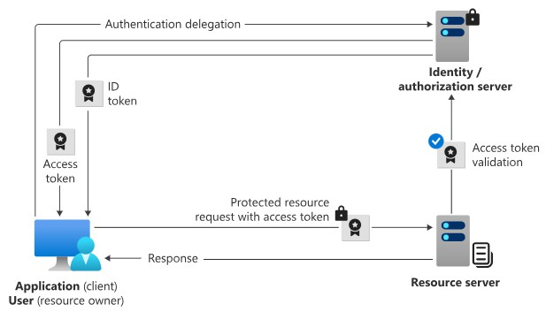
https://learn.microsoft.com/en-us/entra/fundamentals/introduction-identity-access-management

Slide 100
Azure Active Directory (Azure AD)
Azure Active Directory (Azure AD) is Microsoft’s enterprise cloud-based identity and access management (IAM) solution.
Azure AD is the backbone of the Office 365 system, and it can sync with on- premise Active Directory and provide authentication to other cloud-based systems via OAuth.
During the 2020 pandemic, Microsoft Teams saw a drastic 70% increase in daily Teams users in a single month. While it is unclear how many of those users are net new to Azure AD, we can assume that the 2020 pandemic jump-started both adoption and implementation of Azure AD to meet the demands of a remote workforce.

Slide 101
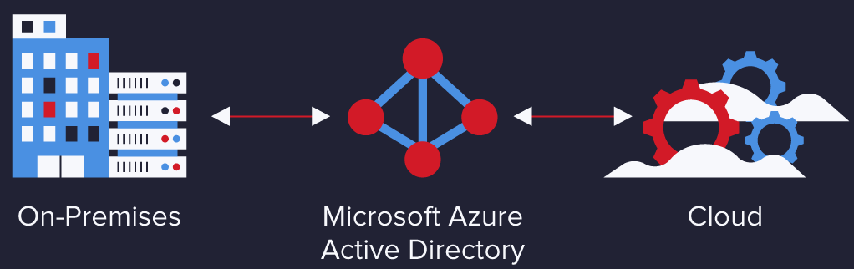
https://www.varonis.com/blog/azure-active-directory

Slide 102
Azure Active Directory is Microsoft’s multi-tenant, cloud-based directory and identity management service. For an organization, Azure AD helps employees sign up to multiple services and access them anywhere over the cloud with a single set of login credentials.
Windows Active Directory (AD) is Microsoft’s predecessor to Azure AD.
Microsoft released Active Directory in Windows 2000 server, and it became a standard for enterprise identity management.

Slide 103
Example: All employees in an organization need access to some Azure services to perform their tasks. They can access services like SQL database, machine learning, or Azure container services when the administrator assigns them separate user id and password for each service. Employees, as well as administrators, often find it hard to manage multiple user logins at the same time. It creates more of a hassle for administrators working in an organization that involves more than 1000 employees.
Thisis is where Azure Active Directory (AD) comes into the picture. With Azure AD, the administrators can handle multiple user logins without any issue. Administrators need to assign a single username and password to access all the services they want.

Slide 104
Windows AD vs. Azure AD
Windows Active Directory (AD) was the previous version of Azure AD.
Active Directory (AD) is an OS directory service that facilitates working with interconnected, complex, and different network resources in a unified manner.
The biggest drawback of Windows AD was that it had many layers that
performed various bits of work.

Slide 105
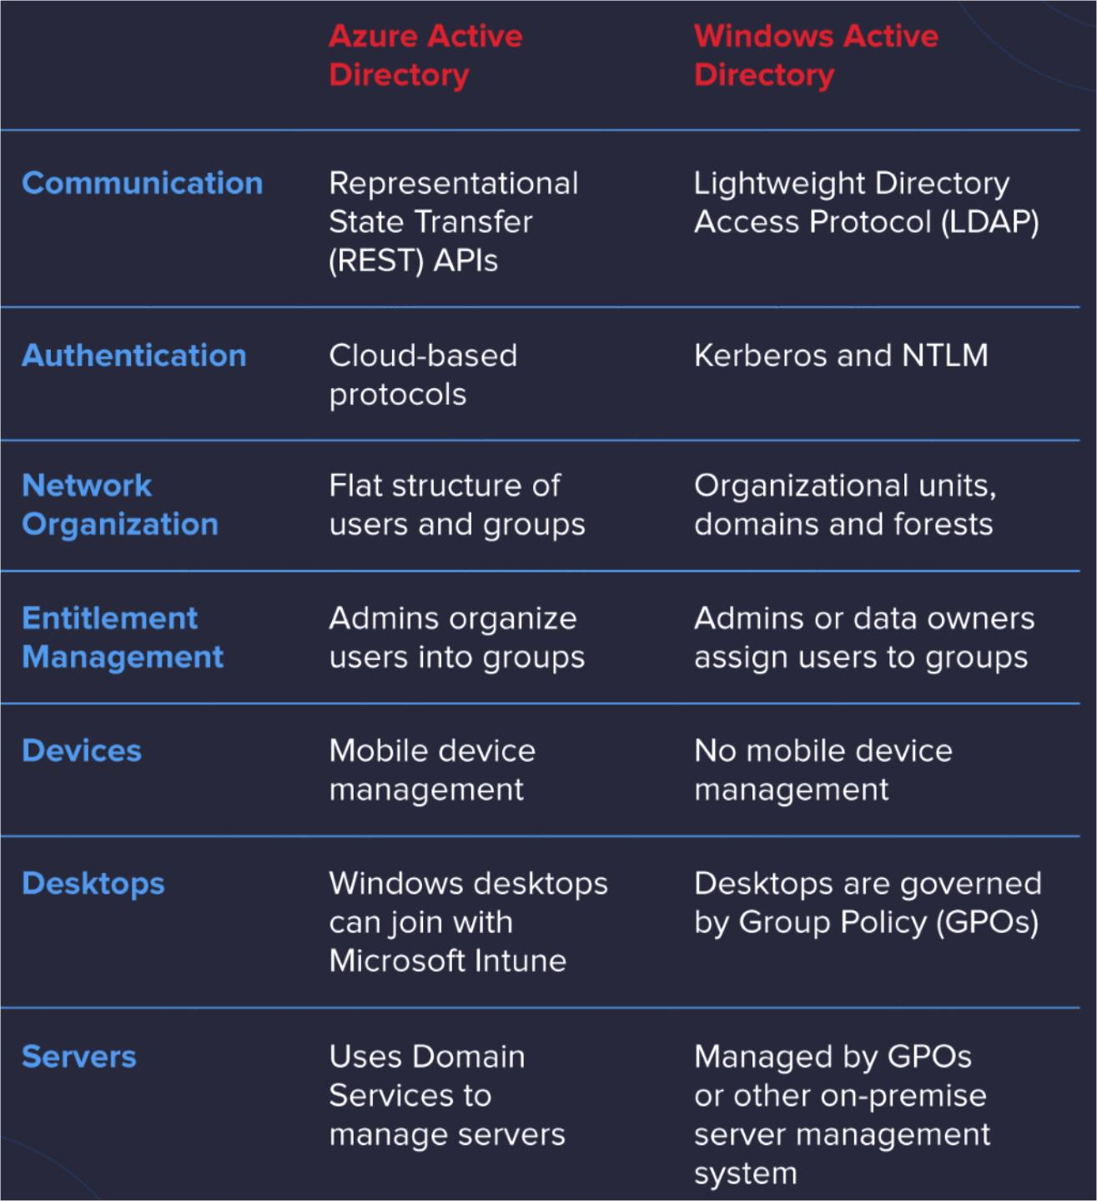

Slide 106
Azure Security
The most common question CIOs and CTOs ask before moving to Azure is, “Is Azure Secure?“. We understand that the ‘job one’ in the cloud is security. And one of the best reasons to migrate to Azure is taking advantage of its wide array of security tools and capabilities.
These tools make it possible for you to build secure solutions on the Azure platform.
Azure public cloud service provides a highly secure infrastructure which is a
trustworthy foundation upon which companies can meet their security
requirements.
https://medium.com/@AlexanderObregon/exploring-azure-compliance-and-security-standards-66d8942d7816

Slide 107
Security Features and Capabilities in Azure:
Identity and Access Management with Azure Active Directory
AAD provides a range of identity services, including single sign-on (SSO), multi-factor authentication (MFA), and conditional access policies, which form the first line of defense against unauthorized access.
By ensuring that only authenticated users can access resources, AAD
significantly reduces the risk of security breaches.

Slide 108
Advanced Threat Protection with Azure Security Center
It offers a centralized view of security alerts and incidents, enabling rapid response and mitigation to potential threats, thus minimizing the impact of security breaches.
This tool continuously assesses the security posture of Azure resources,
providing recommendations to improve security settings and practices.
Security Center’s advanced threat protection capabilities leverage machine learning and behavioral analytics to detect and respond to threats in real- time.

Slide 109
Network Security with Azure Firewall and NSGs
Azure Firewall is a managed, cloud-native network security service that provides
stateful packet inspection, ensuring secure network traffic to and from Azure resources.
It allows users to centrally manage and log all their network traffic flows.
Complementing Azure Firewall, Network Security Groups (NSGs) are used to filter
network traffic to and from Azure resources in an Azure Virtual Network.
NSGs act as a virtual firewall for your VMs, defining what traffic is allowed or denied to and from network interfaces (NIC), VMs, and subnets, providing an additional layer of security.

Slide 110
Data Protection through Encryption and Azure Key Vault
Azure places a strong emphasis on data protection, offering encryption for
data in transit and at rest.
Azure provides a range of encryption capabilities, including Azure Storage Service Encryption for data stored in Azure Blob Storage, File Storage, and
Queue Storage.
Azure Disk Encryption helps secure disk data against theft and unauthorized access.

Slide 111
Compliance and Security Integration
Azure’s security features are not standalone; they are integrated with the platform’s compliance capabilities, ensuring that security measures also contribute to meeting regulatory and compliance requirements.
For example, Azure’s compliance documentation often references specific
security features as part of the compliance controls, demonstrating the synergy between Azure’s security and compliance efforts.

Slide 112
Continuous Innovation and User Empowerment
Azure continuously innovates and updates its security features to address emerging threats and vulnerabilities.
This commitment to innovation ensures that Azure remains at the forefront of cloud security, offering the latest in security technologies and practices.

Slide 113
Understanding Compliance in the Cloud
Compliance in the cloud refers to the adherence of cloud services to various laws, regulations, and standards that govern data protection, privacy, and security.
These regulations are often complex and vary significantly across different
industries and regions.
For example: healthcare organizations must comply with the Health Insurance Portability and Accountability Act (HIPAA) to protect sensitive patient data.

Slide 114
Azure Compliance Framework
Microsoft Azure’s approach to compliance is built on a comprehensive framework designed to meet the diverse and evolving regulatory requirements faced by businesses across different industries and regions.
This framework is a testament to Azure’s commitment to providing a cloud
platform that not only enhances operational efficiency and innovation but also
ensures that users’ data is handled with the utmost integrity and in accordance with global compliance standards.

Slide 115
Following are the elements of Azure Compliance policy:
Meeting Global and Industry-Specific Standards
Azure Compliance Documentation Center
Third-Party Audits and Certifications
Leveraging Compliance for Cloud Governance
Continuous Evolution and Adaptation
https://medium.com/@AlexanderObregon/exploring-azure-compliance-and- security-standards-66d8942d7816

Slide 116
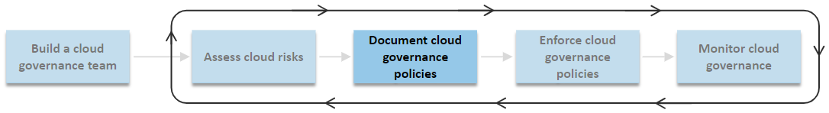
Azure governance policies
Cloud governance policies specify what should or shouldn't happen in the cloud.
The cloud governance team should create one or more cloud governance policies for each risk identified in the risk assessment.
Cloud governance policies define the guardrails for interacting with and in the
cloud.

Slide 117
Governance Policies establish an approach for creating, maintaining, and updating the rules and guidelines that govern the use of cloud services.
Cloud governance policies shouldn't be unique to a specific workload.
The goal is to produce cloud governance policies that don’t require frequent
updates and that consider the effects of cloud governance policies across the
cloud environment.

Slide 118
To define a policy documentation approach, follow these recommendations:
Define standard governance language.
Develop a standard structure and format for documenting cloud governance policies.
The policies must be a clear and authoritative reference for stakeholders.
2. Recognize the different scopes of governance.
Define and assign specific governance responsibilities tailored to the unique roles within
your organization.
For example, a developer governs application code. A workload team is responsible for a single workload, and the platform team is responsible for governance that workloads inherit.

Slide 119
3. Evaluate the broad effects of cloud governance.
Cloud governance creates friction. Find a balance between friction and freedom.
Consider the effects of governance on workload architecture, software development practices, and other areas as you develop cloud governance policies.
For example, what you allow or disallow determines workload architecture and affects software development practices.
https://learn.microsoft.com/en-us/azure/cloud-adoption-framework/govern/document-cloud-governance-policies

Slide 120
www.paruluniversity.ac.in

Slide 121
Azure Fundamentals
Mr.Gautam Singh, Assistant Professor, CSE

Slide 123
Module-4
Azure Pricing and Support

Slide 124
Azure Subscription:
Microsoft’s public cloud service Azure is the perfect solution for most
businesses that require modern computing solutions. There are different ways to subscribe to Azure Cloud resources.
Understanding Azure subscriptions will save businesses money and hassles.
Businesses need to know how Azure subscriptions are designed and work.
https://www.apps4rent.com/blog/understanding-azure- subscriptions/

Slide 125
Subscription Hierarchy:
Azure Tenant
A tenant is at the highest level of the Azure subscription hierarchy.
Not only is a tenant created by default with the first subscription, but also an identity is created on the Azure cloud with a new Azure Active Directory instance.

Slide 126
Azure Subscriptions
Each tenant can have multiple Azure subscriptions.
Subscription is at the level at which the customer is billed based on usage. It also provides a logical segmentation for simplifying administration.
Typically, a company can have a single tenant and each of its departments using cloud services can have subscriptions for their respective Azure environments.
Azure Resource Groups
Resource groups help in creating logical and billing segregations for resources.
Each resource group can have different administrators to track billing.
The billing data for several resource groups are collated and sent as a single invoice and can be managed much more easily at the subscription level.

Slide 127
Types of Azure Subscription
Sponsored or Trial Subscription
Microsoft provides access to certain resources for either a limited period or provides a certain amount of credit or a combination of the two factors.
Pay-as-you-go Azure Subscription
Most affordable form of paid subscriptions but also the most widely used method
Enterprise Agreement (EA) Azure Subscriptions
These are high volume licenses that require businesses to commit a certain amount of resources for a certain duration.
Lacks Flexibility
Often given on significant discounts
Azure Windows Virtual Machines Desktop Reserved Instances
This is a special category of subscription for individual users and small and medium businesses who can reserve their Azure Virtual Machines for one-year or three-year terms.

Slide 128
Azure Cost Management
Azure Cost Management
Azure provides clear billing data and usage data to it’s subscribers.
Go to azure portal
At the top search bar, Search for Cost
Under services click on:“Cost management- Billing” at very top.
In this portal all your subscription and bills for each are available.
Select on the particular service and all billing data will be visible
https://www.youtube.com/watch?v=7w88KBVesPI

Slide 129
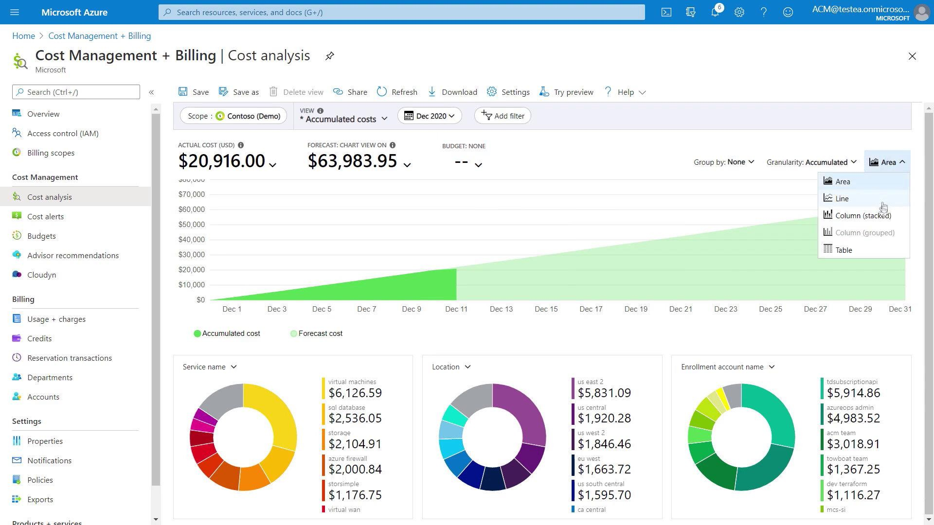

Slide 130
Azure Pricing Models
Microsoft offers three main ways to pay for Azure VMs and other cloud resources:
Pay as You Go
You can pay for services on Azure according to actual usage, billed per
second, with no long-term commitment or upfront payments.
This provides complete flexibility to increase or decrease resources as needed.

Slide 131
Reserved Instances
Azure provides Reserved Virtual Machine Instances (RVMI)—virtual machines that are pre-purchased for one or three years in a specific region.
It also allows users to cancel reserved instances before the end of the term,
but this incurs an early termination fee.
This pricing model is suitable for applications with stable ongoing usage, organizations who have a fixed budget

Slide 132
3. Spot Pricing
Azure lets you buy unused computing power at a discount of up to 90%
compared to pay as you go prices.
However, spot instances can be interrupted on short notice, so they are
considered to be suitable only for workloads that can tolerate disruptions.
Spot instances are mainly suitable for distributed, fault tolerant applications, stateless applications, workloads that are not urgent.

Slide 133
Azure Support Options:
Microsoft offers four support plans that can provide you with technical support:
Basic: Available to all Microsoft Azure accounts, this is the only free plan and does not have any active support from Azure, the user has access to community forums, self-help documentation, etc, and can raise as many support tickets as required.
Developer: Best suggested for trial and non-production environments, This plan has active support from Azure in the form of access to support engineers via email during standard Business hours. The response time from Microsoft for this plan is within eight hours.

Slide 134
Standard: Best suggested for production workload environments, this plan is an upgrade of the developer plan and provides support in the form of 24×7 access to support engineers via email and phone. The response time from Microsoft for this plan is within one hour.
Professional Direct: Absolutely necessary for business-critical environments,
this plan also offers 24/7 technical support with one-hour response time but also includes operational support, training, and proactive guidance from a ProDirect delivery manager.

Slide 135
www.paruluniversity.ac.in

Slide 136
Azure Fundamentals
Mr.Gautam Singh, Assistant Professor, CSE

Slide 138
Module-5
Azure SLA and Service Lifecycles

Slide 139
Service-level agreement (SLA)
A service-level agreement (SLA) is a formal agreement between a service company and the customer. For Azure, this agreement defines the performance standards that Microsoft commits to for you, the customer.
The Azure Service Level Agreement (SLA) describes Microsoft’s commitments for uptime and connectivity for individual Azure Services.
Each Azure service has its own SLA with associated terms, limitations, and
service credits. Some (free) services don’t have an SLA, for example, Azure
DevTest Labs. Other services require a specific configuration such as Virtual Machines.
https://azurecharts.com/sla

Slide 140
The SLA starts at a lowly 95% on Single Instance Virtual Machines using Standard HDD Disks to 99,99% for multi-instance Virtual Machines deployed across two or more Availability Zones in the same Azure region.
Here’s a table to give you a sense of how total downtime decreases as the SLA
percentage increases from 99 percent to 99.999 percent:
SLA percentage | Downtime per week | Downtime per month | Downtime per year
99 | 1.68 hours | 7.2 hours | 3.65 days
99.9 | 10.1 minutes | 43.2 minutes | 8.76 hours
99.95 | 5 minutes | 21.6 minutes | 4.38 hours
99.99 | 1.01 minutes | 4.32 minutes | 52.56 minutes
99.999 | 6 seconds | 25.9 seconds | 5.26 minutes
https://intercept.cloud/knowledge-base/blogs/demystifying-the-azure-sla/

Slide 141
What are service credits?
A service credit is the percentage of the fees you paid that are credited back to
you according to the claim approval process.
An SLA describes how Microsoft responds when an Azure service fails to
perform to its specification.
For example, you might receive a discount on your Azure bill as compensation when a service fails to perform according to its SLA.

Slide 142
Azure service life cycle
The service life cycle defines how each Azure service that's introduced is released and made available.
New Azure services are introduced through preview services; these preview
services are not provided with an SLA or support during the preview (unless
there's an explicit service exception).
The service life cycle and the services you can access are as follows:
Development: Not available to the public
Private preview: Available only to a selected audience
Public preview: Available to all customers
General availability (GA): Available to all customers
https://www.linkedin.com/pulse/stages-azure-service-life-cycle-abhay-velankar-dxhjf/

Slide 143
Service Lifecycle
The service lifecycle defines how every Azure service is released for public use.
Every Azure service starts in the development phase. In this phase, the Azure team collects and defines its requirements, and begins to build the service.
Microsoft invites select participants to test and provide feedback on new
features or services before a wider release. This is Private Review Phase.

Slide 144
Next, the service is released to the public preview phase. During this phase, the public can access and experiment with it so that it can provide feedback. Your feedback helps Microsoft improve services. More importantly, providing feedback gives you the opportunity to request new or different capabilities so that services better meet your needs.
After a new Azure service is validated and tested, it’s released to all customers as a production-ready service. This is known as general availability (GA).

Slide 145
Maintenance and Updates for virtual machines in Azure
Azure periodically updates its platform to improve the reliability, performance, and security of the host infrastructure for virtual machines.
The purpose of these updates ranges from patching software components in the hosting environment to upgrading networking components or decommissioning hardware.
https://learn.microsoft.com/en-us/azure/virtual-machines/maintenance-and-updates

Slide 146
Updates rarely affect the hosted VMs. When updates do have an effect, Azure chooses the least impactful method for updates:
If the update doesn't require a reboot, the VM is paused while the host is updated, or the VM is live-migrated to an already updated host.
If maintenance requires a reboot, you're notified of the planned maintenance. Azure
also provides a time window in which you can start the maintenance yourself, at a time that works for you. The self-maintenance window is typically 35 days (for Host machines) unless the maintenance is urgent. Azure is investing in technologies to reduce the number of cases in which planned platform maintenance requires the VMs to be rebooted.

Slide 147
Planned maintenance
Microsoft Azure periodically performs updates across the globe to improve the reliability, performance, and security of the host infrastructure that underlies virtual machines. Many of these updates are performed without any impact to your virtual machines or Cloud Services, including memory-preserving updates.
However, some updates do require a reboot to your virtual machines to apply the required updates to the infrastructure. The virtual machines are shut down while we patch the infrastructure, and then the virtual machines are restarted.
Please note that there are two types of maintenance that can impact the availability of your virtual machines: planned and unplanned.

Slide 148
Planned maintenance events | Unplanned maintenance events
These are periodic updates made by Microsoft to | These occur when the hardware or physical
the underlying Azure platform to improve overall reliability, performance, and security of the platform infrastructure that your virtual machines run on. The majority of these updates are performed without any impact upon your virtual machines or cloud services. However, there are instances where these updates require a reboot of your virtual machine to apply the required updates to the platform infrastructure. | infrastructure underlying your virtual machine has faulted in some way. This may include local network failures, local disk failures, or other rack level failures. When such a failure is detected, the Azure platform will automatically migrate your virtual machine from the unhealthy physical machine hosting your virtual machine to a healthy physical machine. Such events are rare, but may also cause your virtual machine to reboot.
https://github.com/Huachao/azure-content/blob/master/articles/virtual-machines/virtual-machines-planned-maintenance.md

Slide 149
Updates In Azure
There are mainly four types of updates:
Memory-preserving updates
Virtual machine configurations
Multi-instance configuration updates
Single-instance configuration updates

Slide 150
1. Memory-preserving updates
For a class of updates in Microsoft Azure, customers will not see any impact to their running virtual machines. Many of these updates are to components or services that can be updated without interfering with the running instance.
Some of these updates are platform infrastructure updates on the host operating
system that can be applied without requiring a full reboot of the virtual
machines.
Not all updates can be deployed by using this mechanism, but given the short pause period, deploying updates in this way greatly reduces impact to virtual machines.

Slide 151
These updates are accomplished with technology that enables live migration (a “memory-preserving” update). When updating, the virtual machine is placed into a “paused” state, preserving the memory in RAM, while the underlying host operating system receives the necessary updates and patches. The virtual machine is resumed within 30 seconds of being paused. After resuming, the clock of the virtual machine is automatically synchronized.
Multi-instance updates (for virtual machines in an availability set) are applied one update domain at a time.

Slide 152
2. Multi-instance configuration updates
During planned maintenance, the Azure platform first updates the set of virtual machines that are hosted in a multi-instance configuration. This causes a reboot to these virtual machines.
In a multi-instance configuration update, virtual machines are updated in way that preserves availability throughout the process, assuming that each virtual machine serves a similar function as the others in the set.
Each virtual machine in your availability set is assigned an update domain and a fault domain by the underlying Azure platform. Each update domain is a group of virtual machines that will be rebooted in the same time window. Each fault domain is a group of virtual machines that share a common power source and network switch.

Slide 153
3. Single-instance configuration updates
After the multi-instance configuration updates are complete, Azure will perform single-instance configuration updates. This update also causes a reboot to your virtual machines that are not running in availability sets.
Please note that even if you have only one instance running in an availability set, the Azure platform treats it as a multi-instance configuration update.
For virtual machines in a single-instance configuration, virtual machines are updated by shutting down the virtual machines, applying the update to the host machine, and restarting the virtual machines. These updates are run across all virtual machines in a region in a single maintenance window.
This planned maintenance event will impact the availability of your application for this type of virtual machine configuration. Azure offers a 1-week advanced notification for planned maintenance of virtual machines in the single-instance configuration.

Slide 154
4. Virtual machine configurations
There are two kinds of virtual machine configurations: multi-instance and single-instance. In a multi-instance configuration, similar virtual machines are placed in an availability set.
The multi-instance configuration provides redundancy, and it is recommended to ensure the availability of your application. All virtual machines in the availability set should be nearly identical and serve the same purpose to your application.
By contrast, a single-instance configuration is used for standalone virtual machines that are not placed in an availability set. These virtual machines do not qualify for the service level agreement (SLA), which requires that two or more virtual machines are deployed under the same availability set.
https://github.com/Huachao/azure-content/blob/master/articles/virtual-machines/virtual- machines-planned-maintenance.md#virtual-machine-configurations

Slide 155
Preview and deprecated policies
Policies can be in preview because a property (alias) referenced in the policy definition is in preview, or the policy is newly introduced and would like additional customer feedback. A policy may get deprecated when the property (alias) becomes deprecated & not supported in the resource type's latest API version, or when there is manual migration needed by customers due to a breaking change in a resource type's latest API version.
When a policy gets deprecated or gets out of preview, there is no impact on existing
assignments. Existing assignments continue to work as-is. The policy is still evaluated & enforced like normal and continues to produce compliance results.
https://github.com/Azure/azure-policy/blob/master/built-in-policies/README.md#preview-and-deprecated-policies

Slide 156
Here are the changes that occur when a policy gets deprecated:
Display name is appended with ‘[Deprecated]:’ prefix, so that customers have awareness to migrate or delete the policy.
Description gets updated to provide additional information regarding the
deprecation.
The version number is updated with ‘-deprecated’ suffix.
To deter customers from making any new assignments, deprecated definitions are hidden in the definition list view in Azure Portal. Here are the changes that occur when a policy gets out of preview:
Display name is no longer appended with ‘[Preview]:’ prefix.
The version number is updated to remove the ‘-preview’ suffix.

