Slide 1
IBM University Engagement Project Submission
“Exploring the Power of Agentic AI with IBM Granite ”

Slide 2

Project Tile – Travel Planner Agent
Domain of Project – Travel & Tourism
Student Name | Recent Passport Photo | Email ID | Mobile number [WhatsApp]
Gautam kapoor |  | gautam9872793374@gmail.com | 9872793374

Slide 3
Problem Statement -
Problem Statement : Travel Planner Agent
The Challenge
Planning a trip can be time-consuming and complicated because travelers need to compare destinations, transportation, accommodation, attractions, weather conditions, and travel costs across multiple sources. Finding suitable options that match individual preferences, budgets, and schedules can be challenging.
Traditional travel planning often requires users to visit multiple websites and manually organize their travel details. Additionally, changing weather conditions, travel disruptions, and unexpected expenses can make it difficult to maintain an efficient itinerary.
A Travel Planner Agent is an AI-powered assistant that simplifies this process by providing personalized travel recommendations, generating itineraries, suggesting transportation and accommodation options, and assisting users throughout their journey.
The Objective
To develop an AI-powered Travel Planner Agent using IBM Granite and IBM Cloud Lite services that simplifies and personalizes the travel planning process.
The solution aims to:
1. Personalized Travel Planning – Generate customized travel itineraries based on users' destinations, travel dates, budgets, interests, and preferences.
2. Smart Destination Recommendations – Suggest suitable destinations, tourist attractions, and local experiences based on user requirements.
3. Transportation and Accommodation – Recommend suitable transportation and accommodation options based on budget, availability, and convenience.
4. Budget Optimization – Estimate travel expenses and suggest cost-effective alternatives to help users stay within their budgets.
5. Real-Time Travel Assistance – Integrate maps, weather updates, and travel information to support informed decisions and itinerary adjustments.
6. Agentic AI Integration – Use IBM Granite to understand user requests, coordinate travel planning tasks, and generate relevant recommendations.
7. Seamless Travel Experience – Reduce the time and effort required for trip planning by providing a centralized, intelligent travel assistance system.

Slide 4
Proposed Solution -
Proposed Solution: AI-Powered Travel Planner Agent
The proposed solution is an AI-powered Travel Planner Agent built using IBM Granite, IBM watsonx.ai, and IBM Cloud Lite services to provide personalized, intelligent, and efficient travel planning assistance.
The system uses Agentic AI to understand user preferences, retrieve relevant travel information, generate customized itineraries, and recommend suitable transportation and accommodation options. It helps travelers make informed decisions while considering their budgets, schedules, and personal interests.
The solution consists of the following key components:
1. Travel Preference Agent: Understands user requirements such as destination, travel dates, budget, group size, interests, and travel preferences.
2. Destination Research Agent: Retrieves relevant information about tourist destinations, attractions, local experiences, and travel facilities using a travel knowledge base and external data sources.
3. Itinerary Planning Agent: Generates personalized day-wise travel itineraries, organizing activities and attractions based on the user's schedule and preferences.
4. Budget and Booking Agent: Estimates travel expenses and recommends suitable transportation and accommodation options based on the user's budget and requirements.
5. Travel Assistance Agent: Provides weather updates, travel information, and itinerary adjustments to help users respond to changing travel conditions.
The system uses Retrieval-Augmented Generation (RAG) to retrieve relevant travel information before generating recommendations, helping improve the relevance and reliability of responses.
IBM watsonx.ai provides access to IBM Granite models for natural language understanding, reasoning, and personalized itinerary generation. IBM Cloud Lite services provide the cloud environment for developing and demonstrating the solution.
A user-friendly interface built using Streamlit allows travelers to enter their requirements and receive personalized travel plans, estimated budgets, and travel recommendations.

Slide 5
Technology Used
1. IBM Granite Model – Used for natural language understanding, reasoning, and generating personalized travel recommendations and itineraries.
2. IBM watsonx.ai – Provides access to IBM Granite models for AI-powered travel planning and response generation.
3. IBM Cloud Lite Services – Provides the cloud environment for developing, testing, and demonstrating the Travel Planner Agent.
4. Python – Used for application development, data processing, and implementing the travel planning logic.
5. IBM Bob – Used as an AI-powered coding assistant to help develop the application, generate code, debug errors, and implement the travel planning functionality.

Slide 6
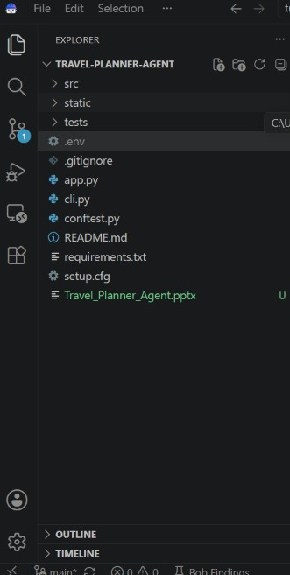
IBM BOB File Structure:

Slide 7
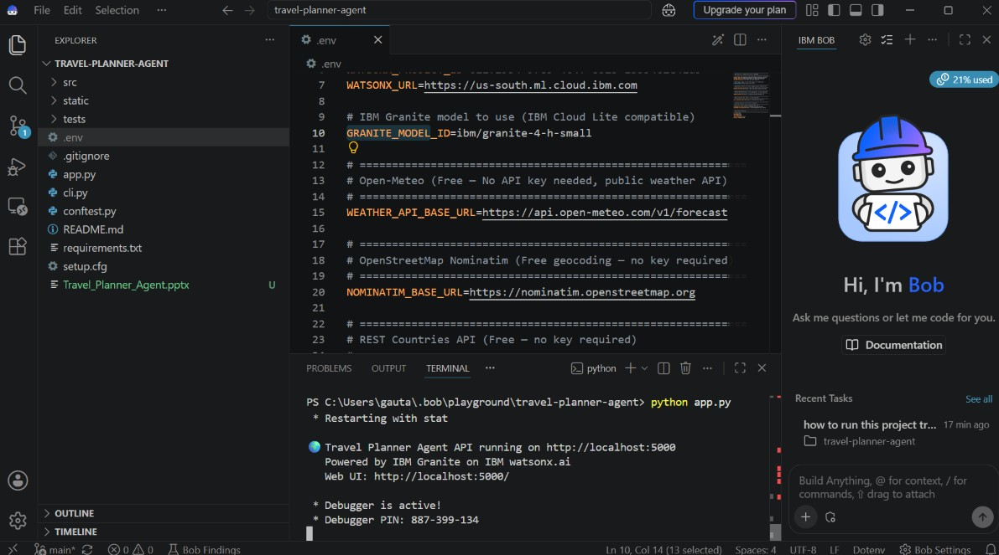
IBM BOB Screenshots:

Slide 8
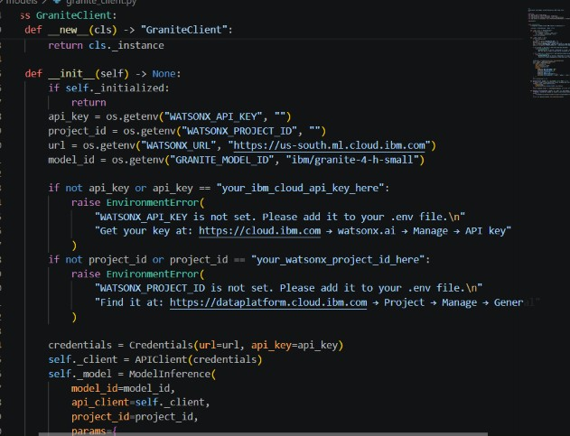
IBM BOB Screenshots:

Slide 9
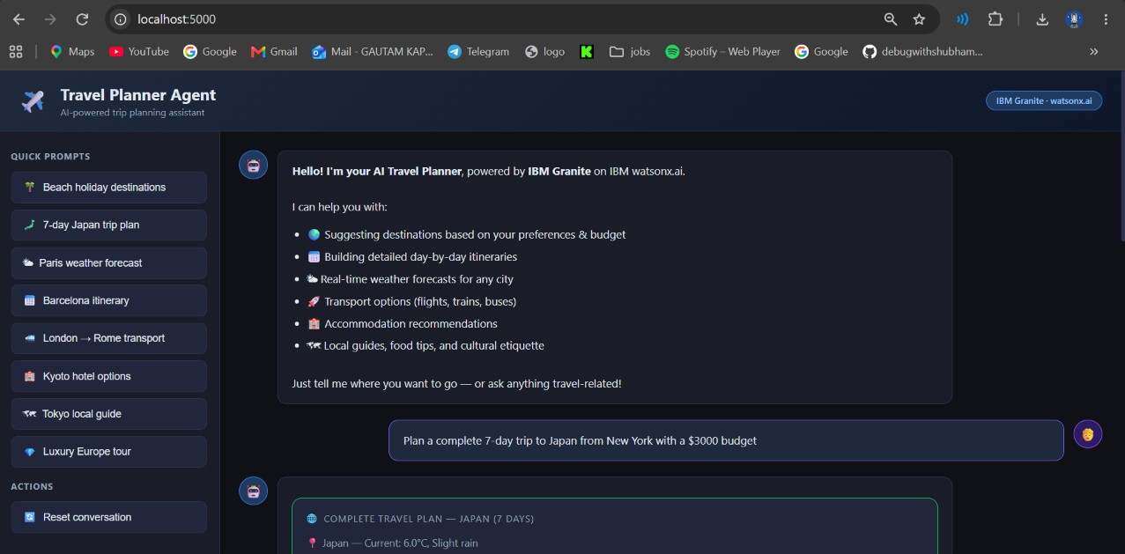
Output Screenshots:

Slide 10
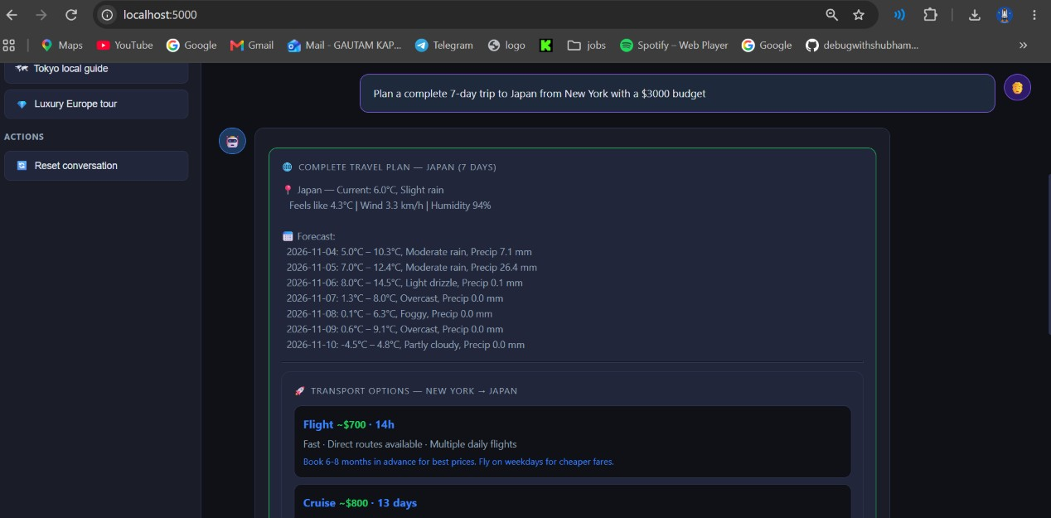
Output Screenshots:

Slide 11
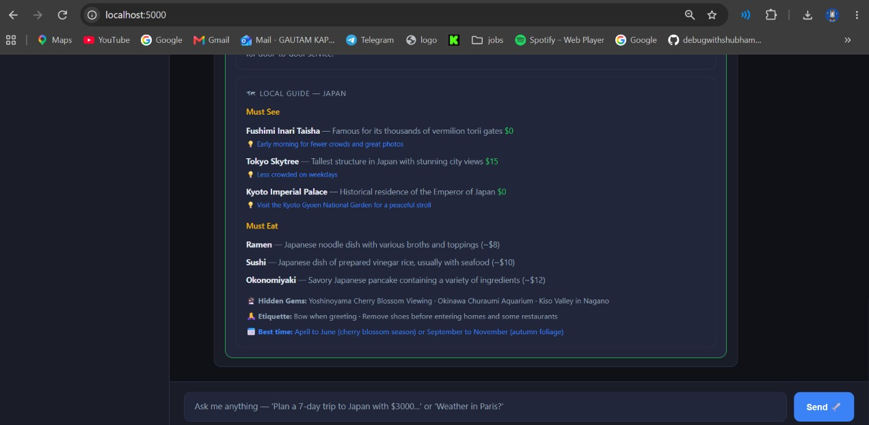
Output Screenshots:

Slide 12
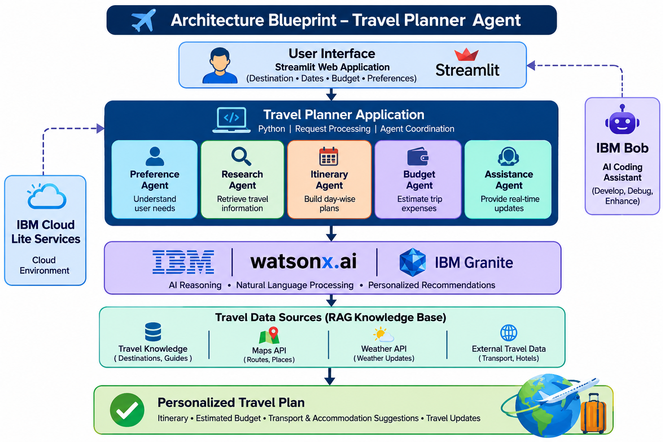
Architecture blueprint

Slide 13

Role of Agentic AI in the solution
Role of Agentic AI in Travel Planner Agent
Agentic AI enables the Travel Planner Agent to function as an intelligent, goal-oriented system rather than a simple chatbot. Using IBM Granite and IBM watsonx.ai, it coordinates specialized agents to provide personalized and efficient travel planning assistance.
Intelligent Task Coordination: Coordinates specialized agents for destination research, itinerary planning, budget estimation, and travel assistance.
Context Awareness: Understands user preferences, travel dates, budget, group size, and interests to generate personalized recommendations.
Autonomous Planning: Generates day-wise itineraries, organizes activities, and suggests suitable transportation and accommodation options.
Real-Time Adaptation: Uses connected travel information, weather updates, and route data to help revise itineraries when conditions change.
Budget Optimization: Evaluates estimated travel expenses and recommends alternatives that align with the user's budget.
Continuous Assistance: Allows users to modify their preferences and receive updated travel plans throughout the planning process.

Slide 14
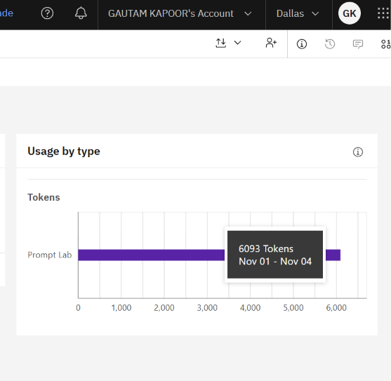
Token Usage
6093 token are used
·
·
·

Slide 15
Novelty and Uniqueness
The proposed Travel Planner Agent stands out by combining Agentic AI, personalized recommendations, and intelligent itinerary planning into a single travel assistance system.
Multi-Agent Intelligence: Uses specialized agents for destination research, itinerary planning, budget estimation, and travel assistance to handle different aspects of trip planning collaboratively.
Personalized Travel Planning: Generates customized itineraries based on user preferences, travel dates, budget, interests, and constraints.
Budget-Aware Recommendations: Estimates travel expenses and suggests cost-effective alternatives to help users plan trips within their budgets.
Intelligent Itinerary Optimization: Organizes attractions and activities into day-wise schedules while considering travel time, user preferences, and available time.
Real-Time Travel Assistance: Integrates maps, weather updates, and travel information to support itinerary adjustments when conditions change.
IBM Granite-Powered Intelligence: Uses IBM Granite through IBM watsonx.ai for natural language understanding, reasoning, and personalized travel recommendations.
Adaptive Travel Experience: Allows users to modify their requirements and receive updated travel plans without restarting the entire planning process.

Slide 16
Git Hub Link
https://github.com/gautamkapoor0/travel-planner-agent
·
·
·

Slide 17
Future Scope
Integration with Live Booking Services – Integrate with authorized transportation and accommodation platforms to retrieve real-time availability, compare prices, and enable users to complete bookings through secure booking links.
Real-Time Travel Monitoring – Integrate live weather, traffic, and travel disruption data to provide timely alerts and automatically suggest alternative routes or activities.
AI-Powered Voice Assistant and Multilingual Support – Enable voice-based interactions and support multiple languages to make travel planning more accessible and convenient for users.
·
·
·

Slide 18
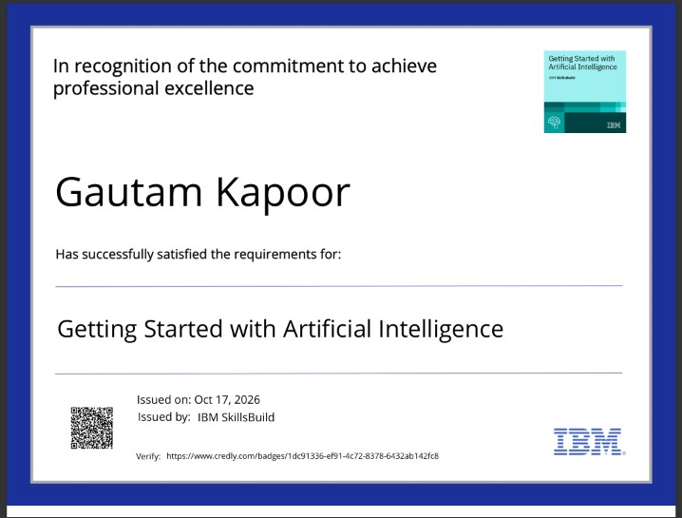
Certificates Earned:

Slide 19
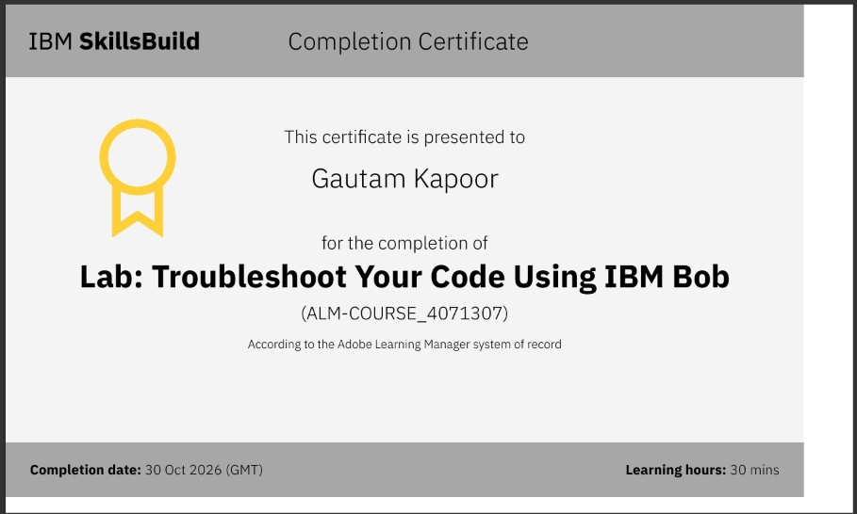
Certificates Earned:​

Slide 20


