Slide 1

Arduino Based Sensing System for
Air Quality Monitoring

Slide 2
Problem Statement

Slide 3
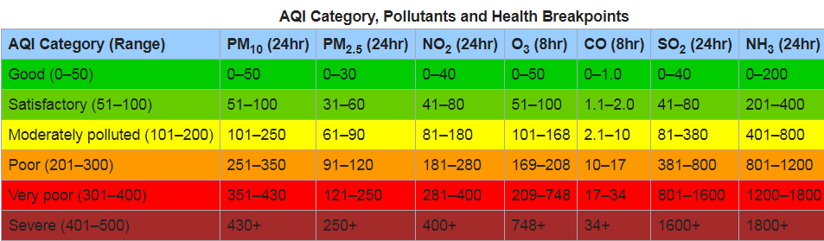
Air Quality Index
The air quality index (AQI) is used determine how polluted the air currently is or how polluted it is forecast to become.
The National Air Quality Index (AQI) in India was launched on 17 September 2014 in New Delhi under the Swachh Bharat Abhiyan.
The air quality index is composed of 8 pollutants (PM₁₀, PM_{2.5}, NO₂, SO₂, CO, O₃, NH₃, and Pb).

Slide 4
Air Quality Index and Associated Health Impacts
Air Quality Index | Associated Health Impacts
Good (0–50) | Minimal Impact
Satisfactory (51–100) | May cause minor breathing discomfort to sensitive people.
Moderately polluted (101–200) | May cause breathing discomfort to people with lung disease such as asthma, and discomfort to people with heart disease, children and older adults.
Poor (201–300) | May cause breathing discomfort to people on prolonged inhaling, and problems to people with heart disease.
Very Poor (301–400) | May cause respiratory illness to the people on prolonged inhaling. Effect may be more severe in people who are living with lung and heart diseases
Severe (401-500) | May cause respiratory impact even on healthy people, and serious health impacts on people with lung/heart disease. The health impacts may be experienced even during normal walk also.

Slide 5
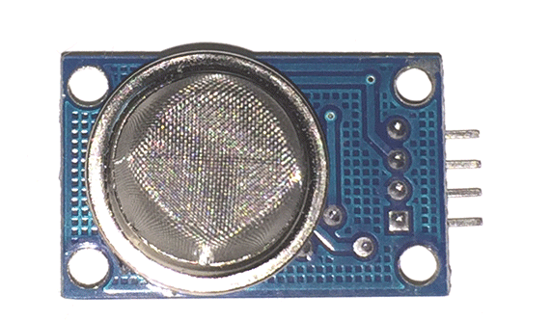
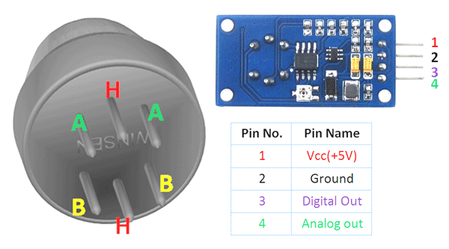
MQ-135 Gas Sensor

Slide 6
Bibliography
https://www.olimex.com/Products/Components/Sensors/Gas/SNS-MQ135/resources/SNS-MQ135.pdf

