Slide 1

Basic Details of the Team and Problem Statement
Ministry/Organization Name/Student Innovation:
Government of Kerala
PS Code: 1326
Problem Statement Title: Ideate and implement a system to enhance the quality of education in rural areas.
Team Name: Code Conqueror
Team Leader Name: Gautam Kumar Mahar
Institute Code (AISHE): U-0907
Institute Name: Indian Institute of Technology Goa
Theme Name: Smart Education

Slide 2
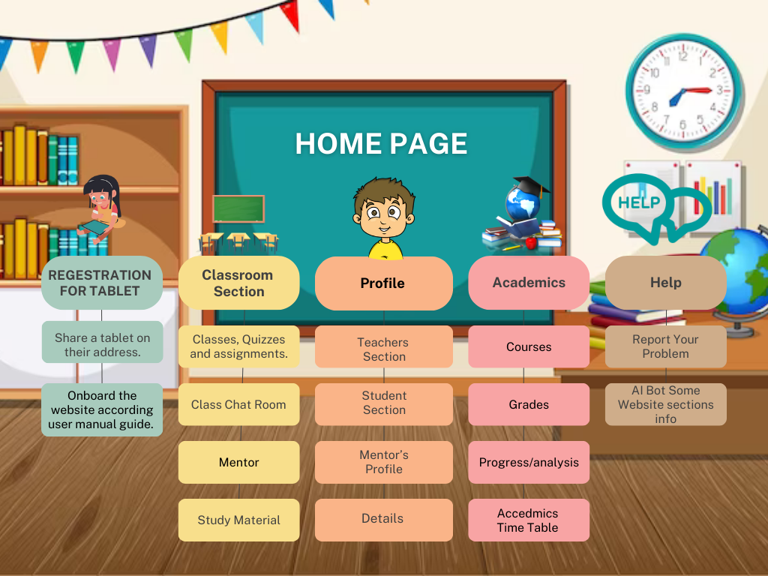
Idea/Approach Details
Describe your idea/Solution/Prototype here:
Voice assistant would make learning fun and effortless, thus endeavoring high participation.
Translation of local languages into English and confident communication speaking skills.
Track attendance using automatic agents and awarding the outstanding performers would incentivise towards increased class participation.
Literacy maps for each listed region would aid in easy visualisation of the current status.
Wi-fi locator is just the right tool to develop and hence mitigate internet connectivity issues.
Content compression and data saver mode would make data charges affordable for the commoners.
Resource recommendation engine, with reviews and ratings would help to find the right match for dueling up the learning experience.
Commodity forums and discussions in a simulated classroom environment makes doubt clearance effective.
Virtual labs and experimentation would enable in depth understanding.
Monitoring and assessment via learning heatmaps lets the student self evaluate themselves and improve at their pace.
Describe your Technology stack here:
MERN STACK
HTML, CSS, JS, REACT JS, NODE JS,Express JS, MONGO DB/FIREBASE and some other Databases like IndexedDB and use AI POWER.
SOME USEFUL API - Google translator API, Google Maps API.

Slide 3
Idea/Approach Details
Describe your Dependencies / Show stopper here
Describe your Use Cases here
Chatbot Assistance to navigate our web app easily!
In class chat room, fostering peer discussion in a classroom environment
Offline mode provides seamless learning experience even amidst limited connectivity
Access to material resources via centralized repository of learning resources
Monitoring skill progress
Bridge the digital divide by creating a mobile version of the application
Financially disadvantaged patrons are supported through subsidies and education loans
Job assistance for various roles in schools
Research and development
Color Blindness feature makes the application extra convenient for the needful.
Awareness of good farming practices among the rural people, thus provides an excellent co curricular welfare programme.
Special concentration on targeted communities, thus segregating them into various groups represented by nominated leaders.
Providing counselling to the children encourages them to streamline with the education system.

Slide 4
Team Member Details
Team Leader Name: Gautam Kumar Mahar
Branch (Btech/Mtech/PhD etc): Btech Stream (ECE, CSE etc): CSE Year (I,II,III,IV): III
Team Member 1 Name: Ponnekanti Pranathi
Branch (Btech/Mtech/PhD etc): Btech Stream (ECE, CSE etc): CSE Year (I,II,III,IV): III
Team Member 2 Name: Harsh Choudhary
Branch (Btech/Mtech/PhD etc): Btech Stream (ECE, CSE etc): CSE Year (I,II,III,IV): III
Team Member 3 Name: Harsh
Branch (Btech/Mtech/PhD etc): Btech Stream (ECE, CSE etc): CSE Year (I,II,III,IV): III
Team Member 4 Name: Akansha Madavi
Branch (Btech/Mtech/PhD etc): Btech Stream (ECE, CSE etc): CSE Year (I,II,III,IV): III
Team Member 5 Name: Atul Mehta
Branch (Btech/Mtech/PhD etc): Btech Stream (ECE, CSE etc): Mechanical Year (I,II,III,IV): III
Team Mentor 1 Name: Type Your Name Here
Category (Academic/Industry): Expertise (AI/ML/Blockchain etc): Domain Experience (in years):
Team Mentor 2 Name: Type Your Name Here
Category (Academic/Industry): Expertise (AI/ML/Blockchain etc): Domain Experience (in years):

