Slide 1
Deep Loop-Closure from Feature Bank WS:2021-22
Pawnesh Kumar
pawneshg@rhrk.uni-kl.de
Supervisor: Mr. SK Aziz Ali

Slide 2
Outline
LCDNet : Deep Loop Closure detection for LiDAR
Overview
Experiment Setup
Approach
Evaluation

Slide 3
LCDNet¹: Overview
Problem: Loop closure detection.
Idea: To use LCDNet & estimate relative transformation.
Method Evaluation: On multiple real-world autonomous driving datasets (KITTI, KITTI-360).
Why it is better :
Outperforms state-of-the-art methods especially in reverse loops.
Doesn‘t requirs an ad-hoc functions, fast query processing
¹[2103.05056] LCDNet: Deep Loop Closure Detection and Point Cloud Registration for LiDAR SLAM (arxiv.org)

Slide 4
LCDNet¹ : Experiment Setup
Dataset:
Training Dataset: KITTI (05, 06, 07, 09), KITTI-360.
Evaluation Dataset: KITTI(00, 08), KITTI-360(sequence:02 & 09)
Test Dataset:KITTI-360, KITTI
Training:
Optimizer: Adam
Batch size: 24
Epochs: 150
Learning Rate: 0.004 which is halved after epoch 40 & 80
Weight decay: 5.10⁻⁶
¹[2103.05056] LCDNet: Deep Loop Closure Detection and Point Cloud Registration for LiDAR SLAM (arxiv.org)

Slide 5
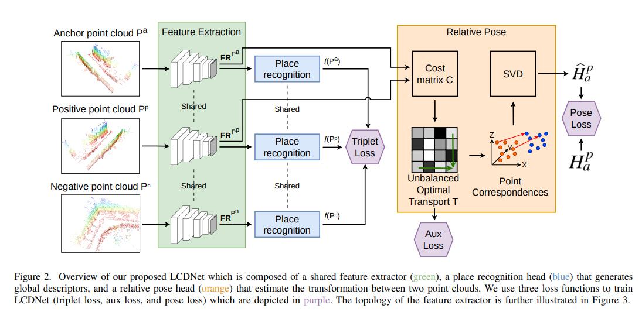
LCDNet¹ : Approach-Overview
¹[2103.05056] LCDNet: Deep Loop Closure Detection and Point Cloud Registration for LiDAR SLAM (arxiv.org)

Slide 6
LCDNet¹ : Approach-Feature Extraction
Adapted PV-RCNN²:
3D-Voxel CNN,
Voxel Set Abstraction(VSA) Module
¹[2103.05056] LCDNet: Deep Loop Closure Detection and Point Cloud Registration for LiDAR SLAM (arxiv.org)
²[1912.13192] PV-RCNN: Point-Voxel Feature Set Abstraction for 3D Object Detection (arxiv.org)

Slide 7
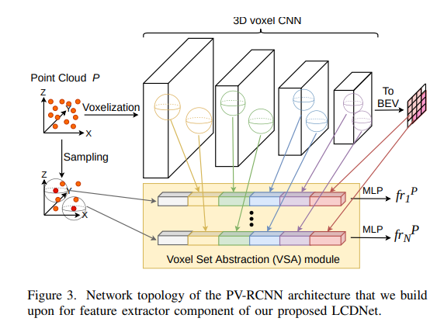
LCDNet¹ : Approach-Feature Extraction
²
¹[2103.05056] LCDNet: Deep Loop Closure Detection and Point Cloud Registration for LiDAR SLAM (arxiv.org)
²[1912.13192] PV-RCNN: Point-Voxel Feature Set Abstraction for 3D Object Detection (arxiv.org)

Slide 8
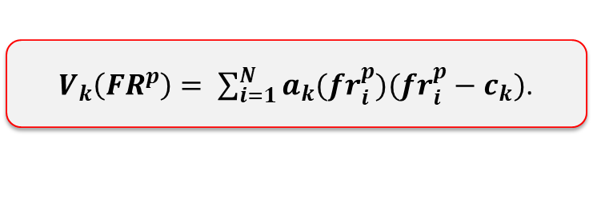
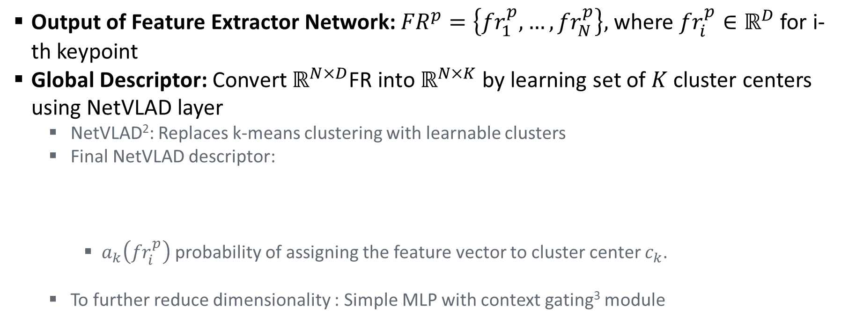
LCDNet¹ : Approach-Global Descriptor
Output of Feature Extractor Network: ${FR}^{p}=\left\{{fr}_{1}^{p}, …,{fr}_{N}^{p}\right\},$ where ${fr}_{i}^{p}∈ℝ^{D}$ for i-th keypoint
Global Descriptor: Convert $ℝ^{N×D}$FR into $ℝ^{N×K}$ by learning set of $K$cluster centers using NetVLAD layer
NetVLAD²: Replaces k-means clustering with learnable clusters
Final NetVLAD descriptor:
$a_{k}\left({fr}_{i}^{p}\right)$ probability of assigning the feature vector to cluster center $c_{k}$.
To further reduce dimensionality : Simple MLP with context gating³ module
$V_{k}\left({FR}^{p}\right)= \sum_{i=1}^{N}{a_{k}({fr}_{i}^{p})({fr}_{i}^{p}−c_{k})}$.
¹[2103.05056] LCDNet: Deep Loop Closure Detection and Point Cloud Registration for LiDAR SLAM (arxiv.org)
²NetVLAD: CNN Architecture for Weakly Supervised Place Recognition | IEEE Conference Publication | IEEE Xplore
³ Learnable pooling with Context Gating for video classification (arxiv.org)

Slide 9

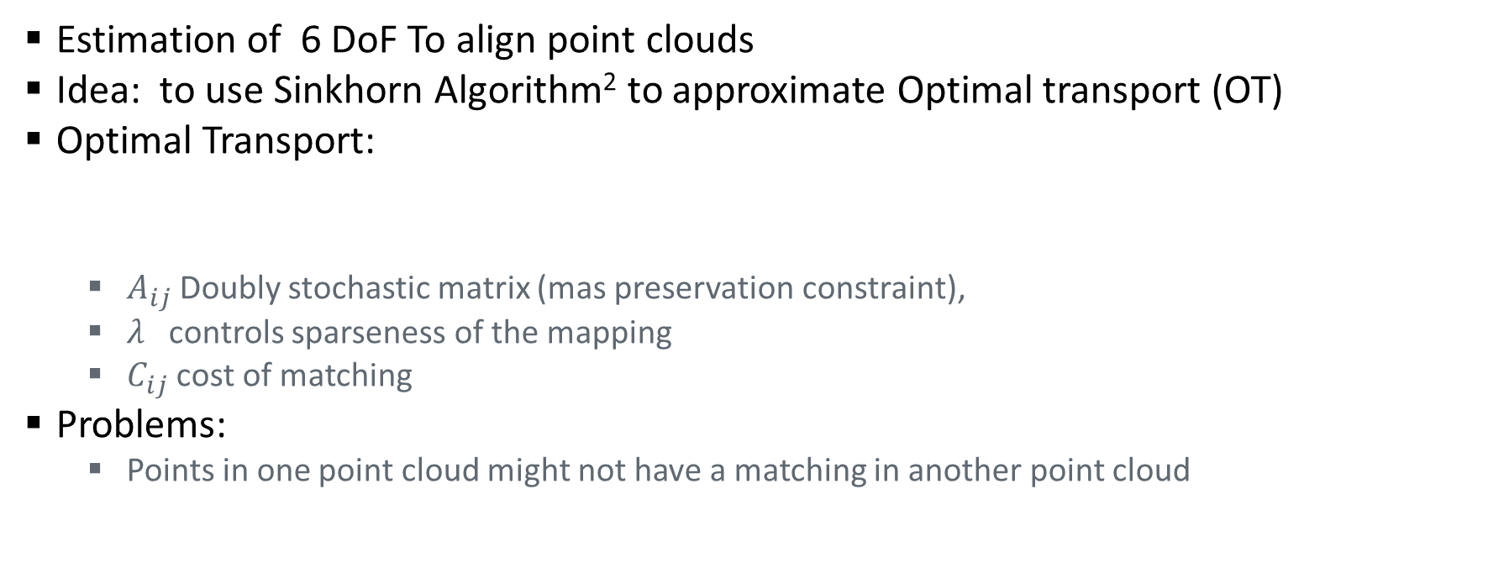
LCDNet¹ : Approach-Relative Pose Estimation
Estimation of 6 DoF To align point clouds
Idea: to use Sinkhorn Algorithm² to approximate Optimal transport (OT)
Optimal Transport:
$A_{ij}$Doubly stochastic matrix (mas preservation constraint),
$λ$controls sparseness of the mapping
$C_{ij}$ cost of matching
Problems:
Points in one point cloud might not have a matching in another point cloud
¹[2103.05056] LCDNet: Deep Loop Closure Detection and Point Cloud Registration for LiDAR SLAM (arxiv.org)
²A Relationship Between Arbitrary Positive Matrices and Doubly Stochastic Matrices (projecteuclid.org)

Slide 10
LCDNet¹ : Approach-Relative Pose Estimation
Train relative pose head by comparing predicted transformation with groudtruth
Training
Formulate the problem as unbalanced optimal transport (UOT)²
Estimated UOT represents set of soft correspondences
Estimate tranformation b/w point cloud P and its projection in S
RANSAC-based registration method by exploiting features from network
Inference
¹[2103.05056] LCDNet: Deep Loop Closure Detection and Point Cloud Registration for LiDAR SLAM (arxiv.org)
²AMS :: Mathematics of Computation

Slide 11
LCDNet¹ : Approach-Loss functions
Triplet Loss: enforces distance between positive samples to be smaller than distance between negative samples descriptors.
Auxiliary Loss: On the matches estimated by UOT.
Pose Loss: by comparing anchor point cloud transformed using predicted transformation and the groundtruth transformation.
¹[2103.05056] LCDNet: Deep Loop Closure Detection and Point Cloud Registration for LiDAR SLAM (arxiv.org)

Slide 12
LCDNet¹ : Evaluation
Precision-recall curves
Average Precision Metric
Protocol 1: By computing similarity between global descriptor and descriptor of all previous scans. And select high similarity candidates then checks their distance from the groundtruth poses.
Protocol 2: Include all pairs, whose similarity is higher than threshold. These pairs are compared against groundtruth to compute precision and recall.
¹[2103.05056] LCDNet: Deep Loop Closure Detection and Point Cloud Registration for LiDAR SLAM (arxiv.org)

