Slide 1
Hierarchical Approaches
Pawnesh Gautam, 07-05-2022

Slide 2
Referenced Papers:

Slide 3
1. Training of Convolutional Networks on Multiple Heterogeneous Datasets for Street Scene Semantic Segmentation
Meletis and Dubbelman: https://arxiv.org/pdf/1803.05675.pdf
Datasets:
Training:
Cityscapes
GTSDB (traffic signs) non-pixel annotation
Mapillary Vistas

Slide 4
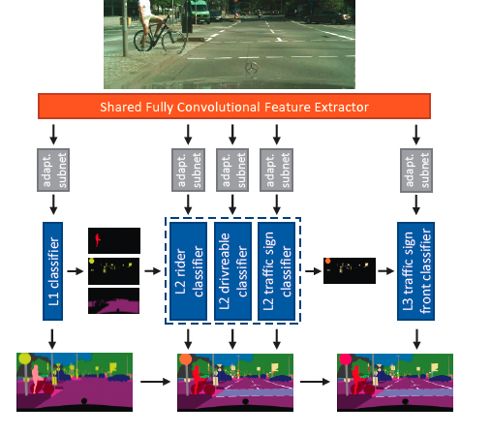
1. Training of Convolutional Networks on Multiple Heterogeneous Datasets for Street Scene Semantic Segmentation
Meletis and Dubbelman: https://arxiv.org/pdf/1803.05675.pdf
Backbone: ResNet-50
Same adaptation subnetworks
Hybrid upsampling
(2x2 learnable fractional strides convolutional layer, bilinear upsampling)
Batch: 4 Cityscapes:Vistas:GTSDB = 1:2:1
Input: 512x706
Inference Time: 58 ms per frame
Loss: Hierarchical loss

Slide 5
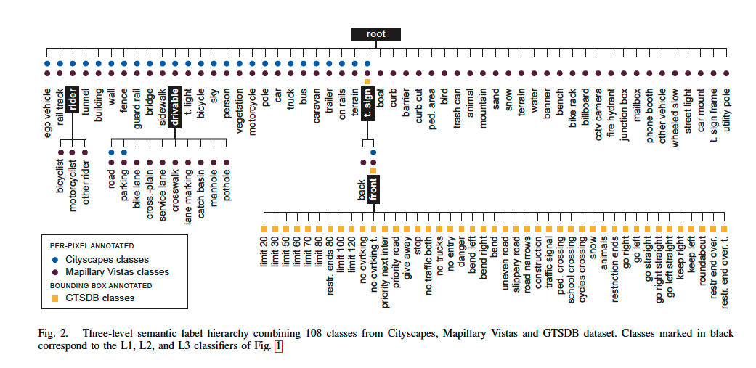
1. Training of Convolutional Networks on Multiple Heterogeneous Datasets for Street Scene Semantic Segmentation
Meletis and Dubbelman: https://arxiv.org/pdf/1803.05675.pdf

Slide 6
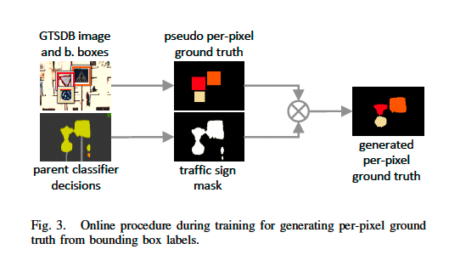
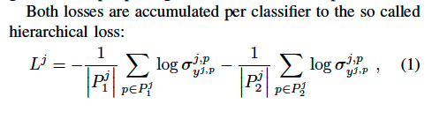

1. Training of Convolutional Networks on Multiple Heterogeneous Datasets for Street Scene Semantic Segmentation
Meletis and Dubbelman: https://arxiv.org/pdf/1803.05675.pdf

Slide 7
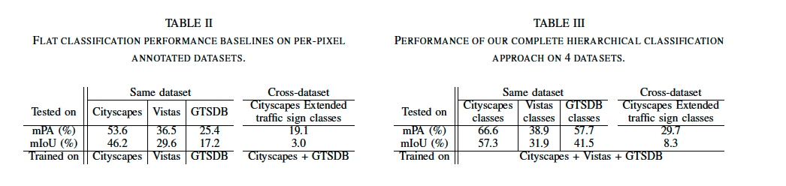
1. Training of Convolutional Networks on Multiple Heterogeneous Datasets for Street Scene Semantic Segmentation
Meletis and Dubbelman: https://arxiv.org/pdf/1803.05675.pdf

Slide 8
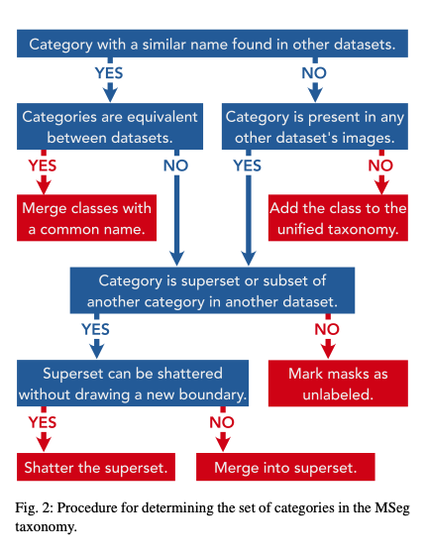
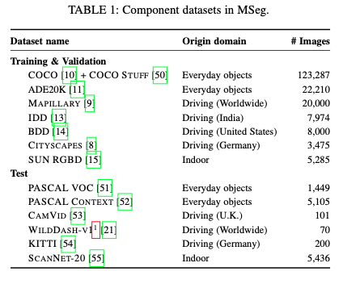
2. MSeg: A composite Dataset for Multi-domain Semantic Segmentation
Lambert and Liu: https://arxiv.org/pdf/2112.13762.pdf

Slide 9
2. MSeg: A composite Dataset for Multi-domain Semantic Segmentation
Lambert and Liu: https://arxiv.org/pdf/2112.13762.pdf

Slide 10
3. Autonomous driving datasets
Cityscapes
nuImages
CamVid
Mapillary
IDD
A2D2
GTA-5

Slide 11
3. Autonomous driving datasets: CityScape+CamVid+GTA5+nuScene+Mapillary+IDD+A2D2

Slide 12
Multi Domain Heterogeneous Dataset Hierarchical Semantic Segmentation Methods

Slide 13
Flat Network with hierarchical loss
Loss function:
Loss of superclass (level 1)
Loss of level 2 classes
Loss of level 3 classes
Total loss = loss_level_1 + loss_level2 + loss_level3

Slide 14
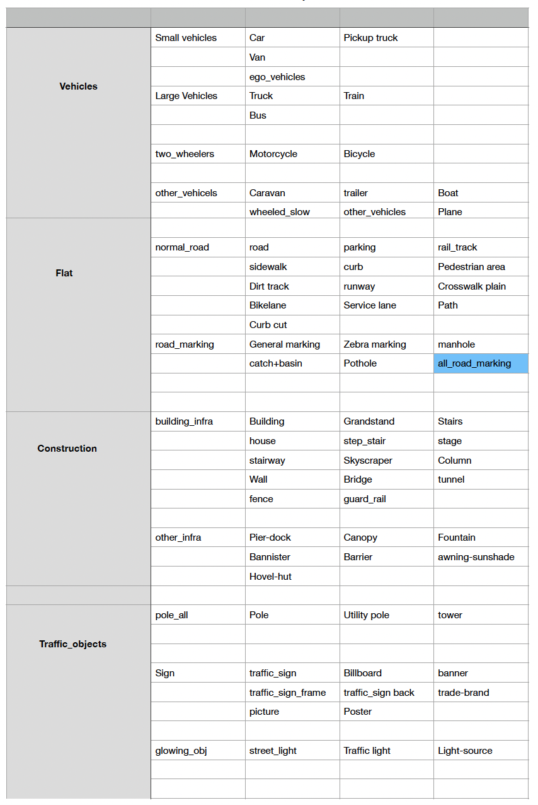
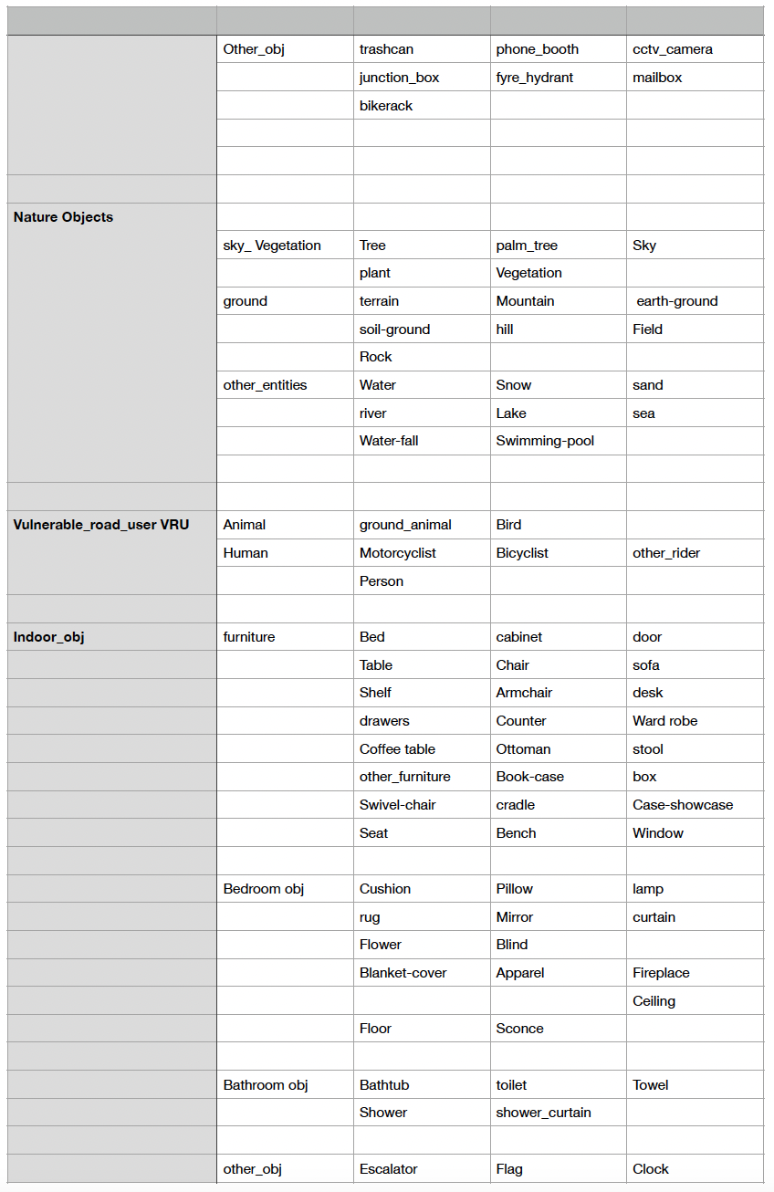
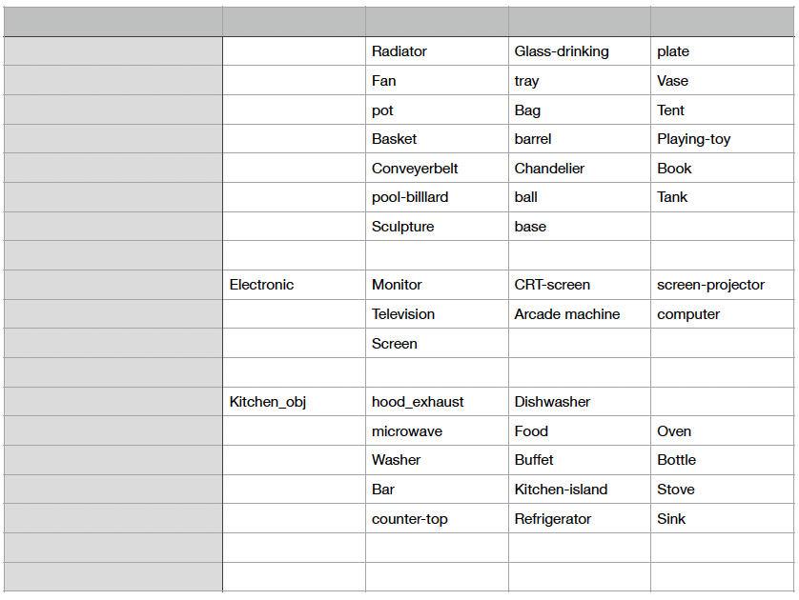
Class Hierarchy
Level 1 super classes
Fine grained classes
Level 1 super classes
Fine grained classes
Level 1 super classes
Fine grained classes

Slide 15

Multi Heads Architecture: example
Level 1 Head
Level 2 Head: Vehicles
Level 3 Head: Small Vehicles
Ignore
Ignore
Ignore
Vehicles
Small vehicles
Car
Flat
Large vehicles
pickup_truck
Construction
Two wheelers vehicles
Van
Traffic objects
Other vehicles
ego_vehicle
Nature objects
VRU objects
Indoor objects

Slide 16



Hierarchical Network
Backbone
Overview
Level 1 head
Vehicle head
Small vehicle head
L 1
L2
L3
Example for level 1 vehicle class
Prediction ->
…Vehicles …
Small vehicles
Car, ego vehicle

Slide 17
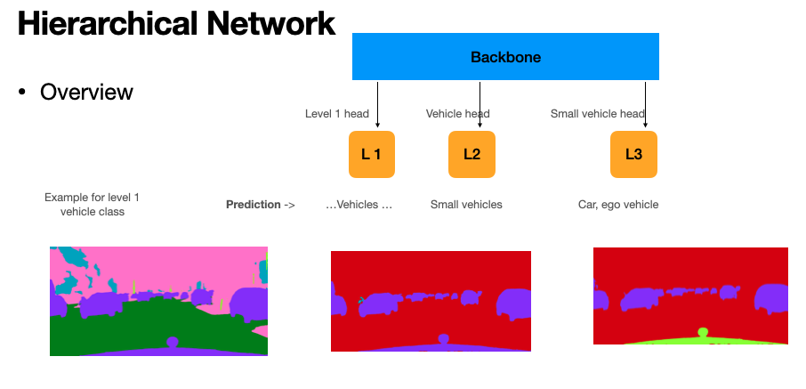
Hierarchical N/W
Loss function: total loss
c1 * L1_loss + c2 * L2_loss + c3 * L3loss
Discussion:
Everything relies on L1_head
solution: to improve mIOU -> class weights at L1 head
Loss function : other possibilites to connect all heads through loss function !!!
If L1 predicted negative: output is negative
.
.

Slide 18




Hierarchical N/w v2
Backbone
Inverse Hierarchy
Advantage:
Dependency over L1 head is reduced
Level 1 head
Vehicle head
Small Vehicle head
Earlier
Lowest level head
New —>

Slide 19
Hierarchical N/w v3
Backbone
Inverse Hierarchy
Advantage:
Level 1 is enriched with features!!
Level 1 head
Vehicle head
Small Vehicle head
Earlier
Level 1 head
New —>

Slide 20
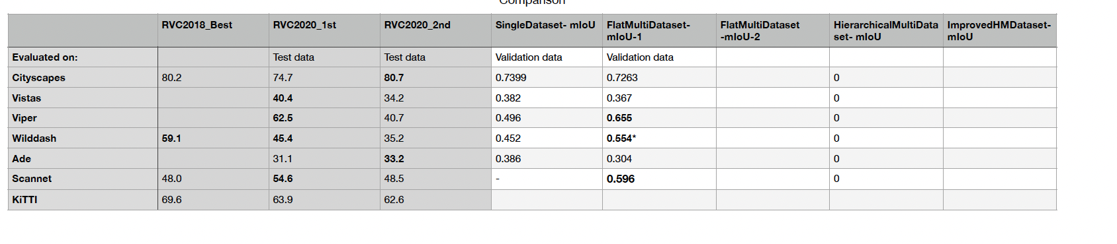
Results:

