Slide 1
SnapIt.ml
Gautam Rizwani MT2022142
Hansal Dhandha MT2022166

Slide 2
SnapIt
Data Exploration and Preprocessing

Slide 3
Dataset
PRODUCT_ID - id of the product
PRODUCT_NAME - this is the name of the product provided by the seller
PRODUCT_CONDITION - a number signifying the condition of the product
CATEGORY - product category
PRODUCT_BRAND - brand the product belongs to
SHIPPING_AVAILABILITY - if the product is paid by the seller to be shipped or not (0 if not paid 1 otherwise)
PRODUCT_DESCRIPTION - the description of the product provided by the seller
PRODUCT_PRICE - this is the label; The value which is to be predicted

Slide 4
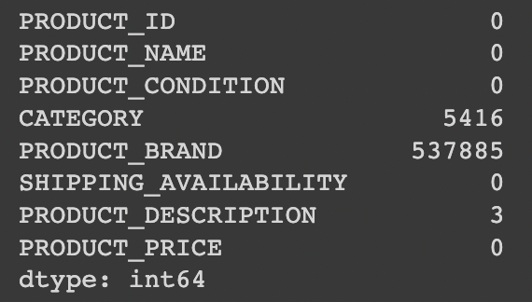
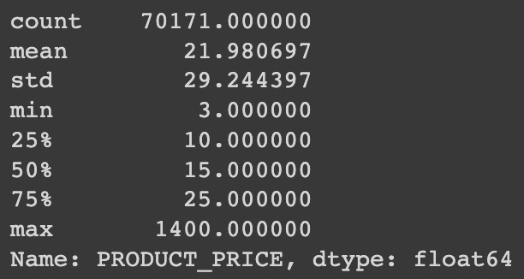
Missing Values:
Close to 45% of PRODUCT_BRAND is null.
Around 5k Categories are null.
3 PRODUCT_DESCRIPTION are null. But, there is a catch, there are around 70k rows which says ‘No Description yet’.

Slide 5
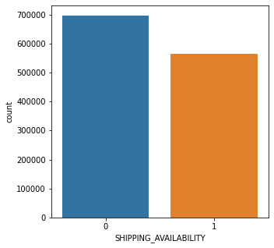
Data Analysis- Shipping
There are more products whose shipping charges are paid by the buyers

Slide 6
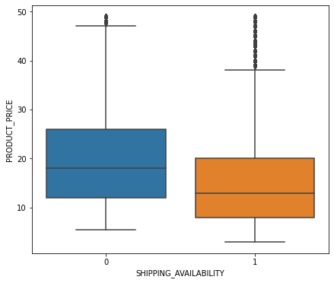
Data Analysis- Shipping
The median price of products whose shipping charges are paid by buyers is more as compared to the other case.
The reason might be, the product must be in so much demand that the buyers are even willing to pay the shipping charges along with the base price.

Slide 7
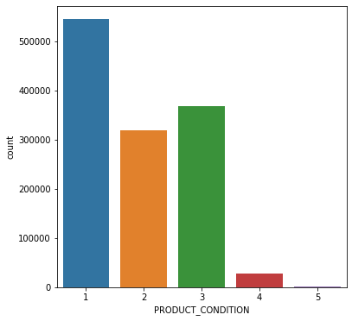
Data Analysis- Product Condition
There are more number of Products of PRODUCT_CONDITION = 1 as compared to other Conditions.

Slide 8
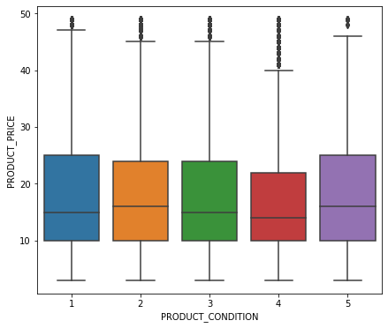
Data Analysis- Product Condition
Also The price must follow the pattern of Better condition -> High price Which seems to follow here with exception of PRODUCT_CONDITION = 5 (Maybe because amount of data of Condition_5 is very less)

Slide 9
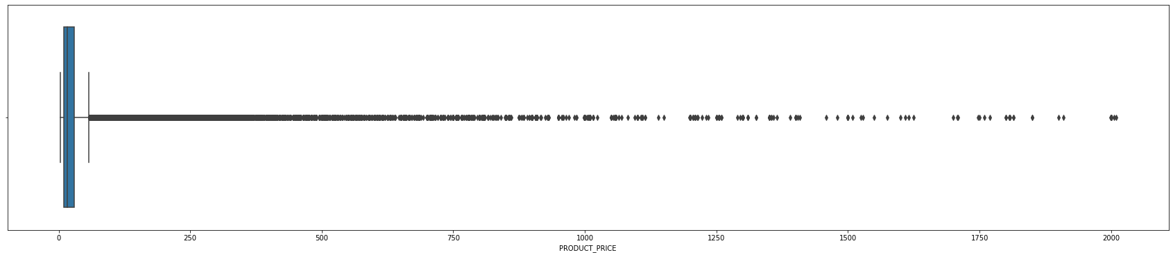
Data Analysis- Product Price
Here upper limit for outliers are 57.5
The number of data points having price > Upper Limit (p75 + 1.5 * iqr) is around 100k

Slide 10
Data Analysis- Product Categories
(df['CATEGORY'].str.count('/')).max()
The above Operation shows 'The maximum occurence of / in column CATEGORY'.
Thus Maximum number of Categories can be 5.
df[['CATEGORY_1','CATEGORY_2','CATEGORY_3','CATEGORY_4','CATEGORY_5']]=df.CATEGORY.str.split("/",expand=True).loc[:,:4]
The above code is for Splitting Categories with /
Here, We can see that around 99% data in Category_4 and Category_5 is null So we removed it
And we also dropped CATEGORY column

Slide 11
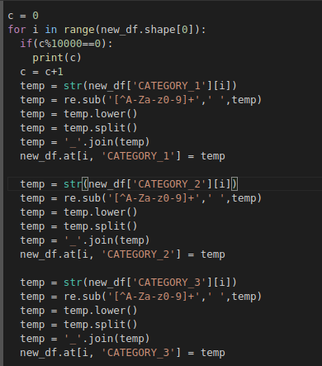
Data Analysis- Product Categories
We structured the CATEGORY columns as:
We replaced the special characters with Blank space.
Converted it to lower alphabet.
Splitted it on the basis of blank spaces and joined them by ‘-’
We did this for all the 3 categories.

Slide 12
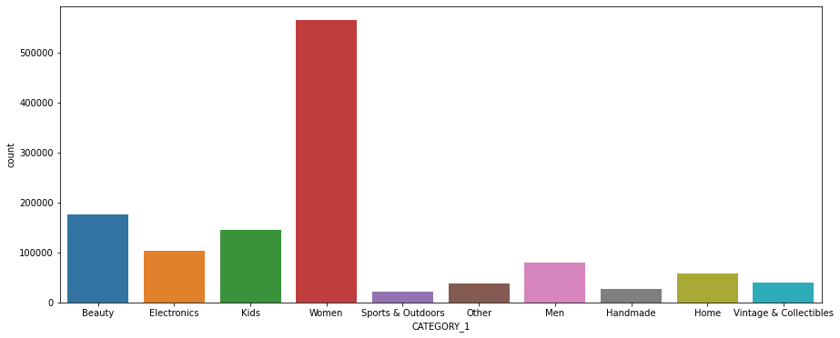
Data Analysis- Product Categories
There are almost half of the number of products of Category 'Women'

Slide 13
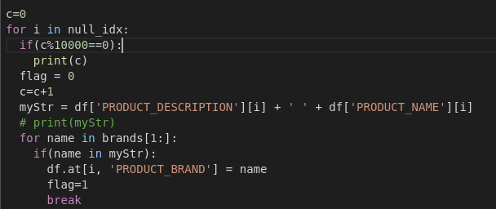
Data Analysis- Product Brand
There are many ways to impute Brand names: Listing few of them:
Imputing based on the current ratio of available brands.
Training a Classification model to classify the value of Brands.
Searching values of PRODUCT_BRAND from PRODUCT_DESCRIPTION/PRODUCT_NAME.

Slide 14
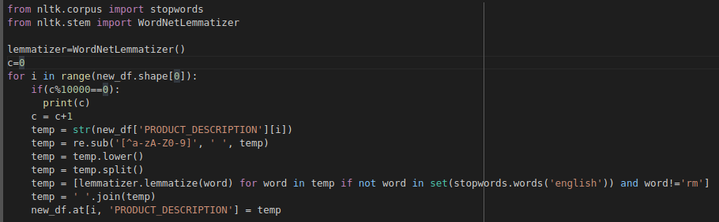
Lemmatization
Here we have used lemmatization on product description and product name
There were several rows where product description and product name column had “rm”
This process took a lot of time, so we saved the output data frame as csv file in the google drive

Slide 15
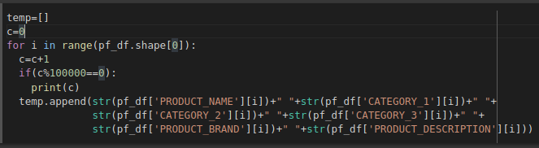

Merging columns
We tried to merge all text columns in to a single column and applied bag of words technique on it but due to running out of RAM , colab notebook crashed.
Then we also tried to apply the same on single column but there was a same problem

Slide 16
References:
NLP playlist
Outlier Detection
Handling missing data
Deploying Machine Learning Application

