Slide 1
SnapIt.ml
Gautam Rizwani MT2022142
Hansal Dhandha MT2022166

Slide 2
SnapIt
Final Evaluation

Slide 3

Hurdle 1:
Insufficient Memory
It turned out that we were using the to_array() method to convert the sparse matrix obtained by CountVectorizer which is not the appropriate way.
Instead we then converted our existing array and stacked it with the output of CountVectorizer using the hstack() function.

Slide 4
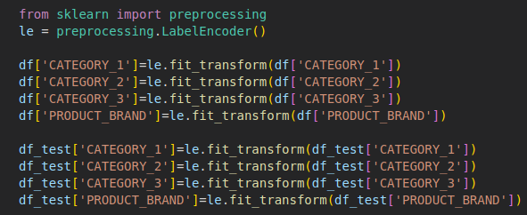
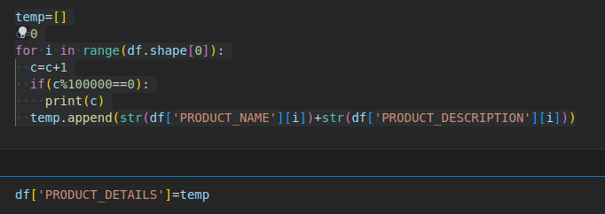
Label Encoding:
We then converted the remaining categorical columns to numerical values by Label Encoder (PRODUCT_BRAND, CATEGORY’s).
Combined the columns PRODUCT_DESCRIPTION and PRODUCT_NAME as PROFUCT_DETAILS..

Slide 5
Observations:
Number | Model | RMLSE | Remarks
1. | Linear Regression | 0.825 | Used Max Features in Countvectorizer. Label Encoded categorical columns.
2. | Linear Regression | 0.709 | Used 20k Features. Label Encoded categorical columns. Shifted min price to 3.
3. | Linear Regression | 0.735 | Increased the features to 100K, in the previous model which gave a negative effect.
4. | Linear Regression | 0.647 | Used One-Hot encoding on categorical columns. With 20K Features.
5. | Linear Regression | 0.633 | Used Tf-Idf instead of Count Vectorizer.
We applied Linear Regression and with some tweaks (Shown in table), we were able to get 0.633 RMLSE, then there was no significant improvement in this particular model.
So, we then explored different models, explained ahead.

Slide 6
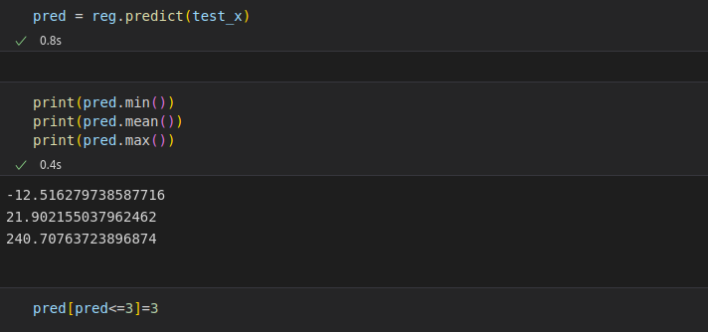
Negative values
On applying Linear Regression we got negative prices as output in a few rows, which we resolved by adding bias of minimum to all the rows.
Don’t know if it is an appropriate solution but had no choice at that time.
We tried taking log-antilog, but it was shooting prices to 10^18.
Can you suggest a better option?

Slide 7
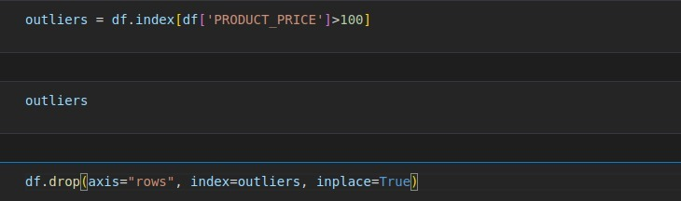
Outliers
We know that outliers can be a blessing or a curse, here we had some products (~100K) which had a price ~1300$ . We removed those outliers to check if it impacts the rmlse, It did but negatively, it increased the rmlse.

Slide 8

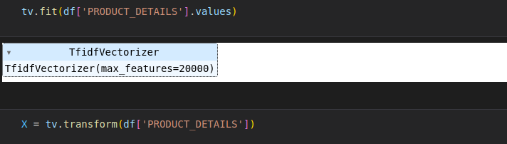
Tf-Idf
We used Tf-Idf instead of Countvectorizer on the PRODUCT_DETAILS column which is combination of PRODUCT_NAME and PRODUCT_DESCRIPTION.
Tf-Idf gave better results than Countvectorizer.

Slide 9
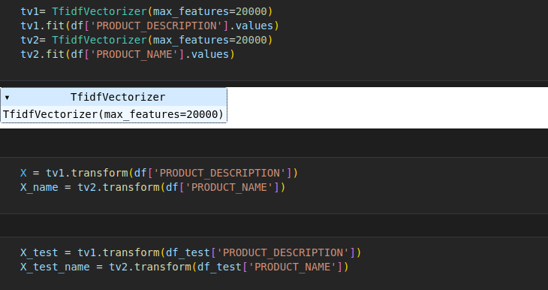
Experiment
We tried to apply TFIDF on PRODUCT_DESCRIPTION and PRODUCT_NAME individually and it gave better results.

Slide 10
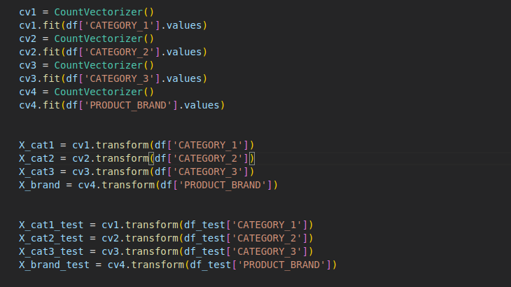
One-Hot Encoding
We have tried label encoding and one hot encoding for categorical columns like CATEGORY and PRODUCT_BRAND columns in which we got better results with one hot encoding.
Here we’ve done one hot encoding using countvectorizer because in each category there is only one word so countvectorizer on this column will behave like one hot encoding and also countvectorizer gives csr matrix which consumes less memory.
This made us thinking, Is there any difference b/w One-Hot encoding and CountVectorizer?

Slide 11
Non-LR Models
1. | Ridge Regression | 0.629 | Used Tf-Idf instead of Count Vectorizer with 20k features. Used one-hot encoding
2. | LightGBM | 0.612 | No change.
3. | XGBoost Regressor | 0.543 | Used Random Search CV to get the best params.
4. | LinearSVR | 0.522 | No change.
5. | LinearSVR | 0.511 | Splitted PRODUCT_DETAILS which was merged previously.
6. | XGBoost Regressor | 0.512 | Used Random Search CV to get the best params.
We tried various other models than Linear Regression as listed in the table.
We used RandomSearchCV to get the optimum parameters, because of the obvious reasons.
At last we settled with the results from LinearSVR with the RMLSE of 0.511. (We were standing 2nd on the leaderboard at this point).
Then we moved to Deployment.

Slide 12
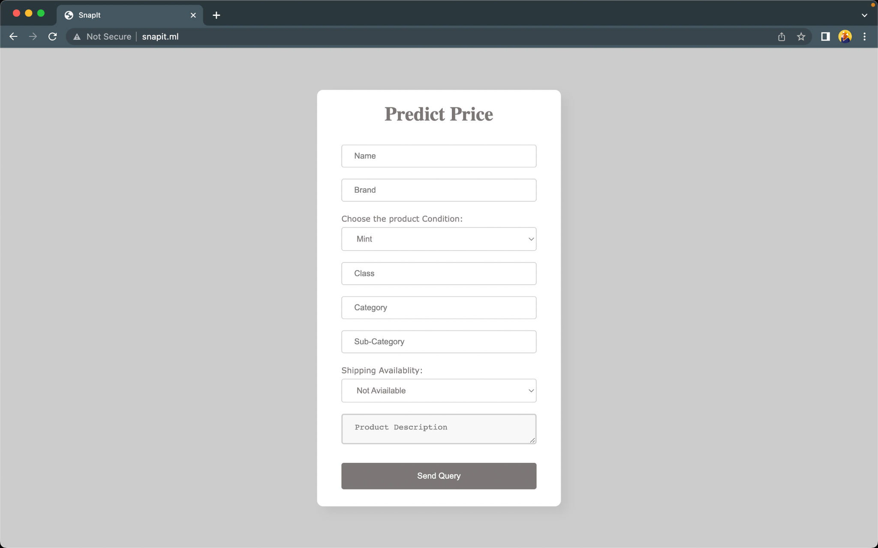
Deployment
We used:
Flask framework to support the backend.
HTML, CSS for the frontend.
The model used is LinearSVR (RMLSE 0.511).
The model was stored offline using pickle library.
AWS EC2 to make it available online at snapit.ml.

Slide 13
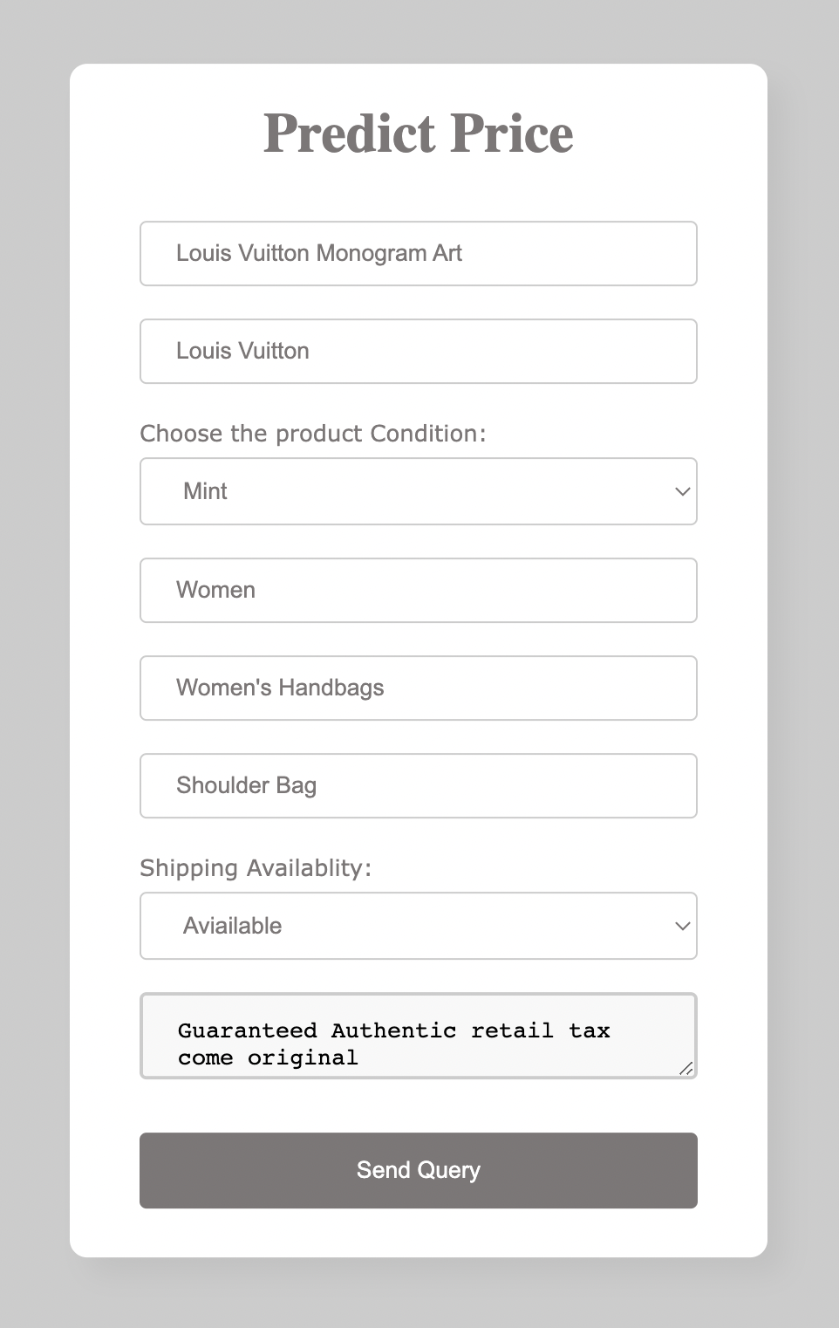
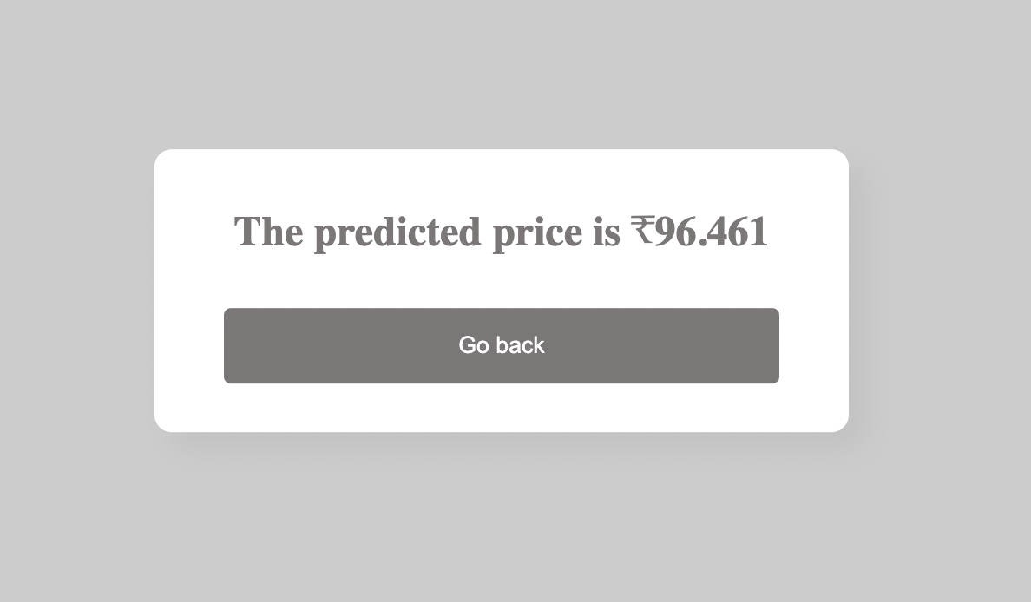
Screenshots

Slide 14
Thankyou

