Slide 1
Ark Robotics
Pitch Deck 11.11.2025

Slide 2
~/Ark_Robotics/
/Team
/Motivation
/Market_Research
/System_Overview
/Technical_Contributions

Slide 3
/Team
Gidon Gautel
Skanda Nadig
Yunhao Cao
Gourav Mohanan

Slide 4
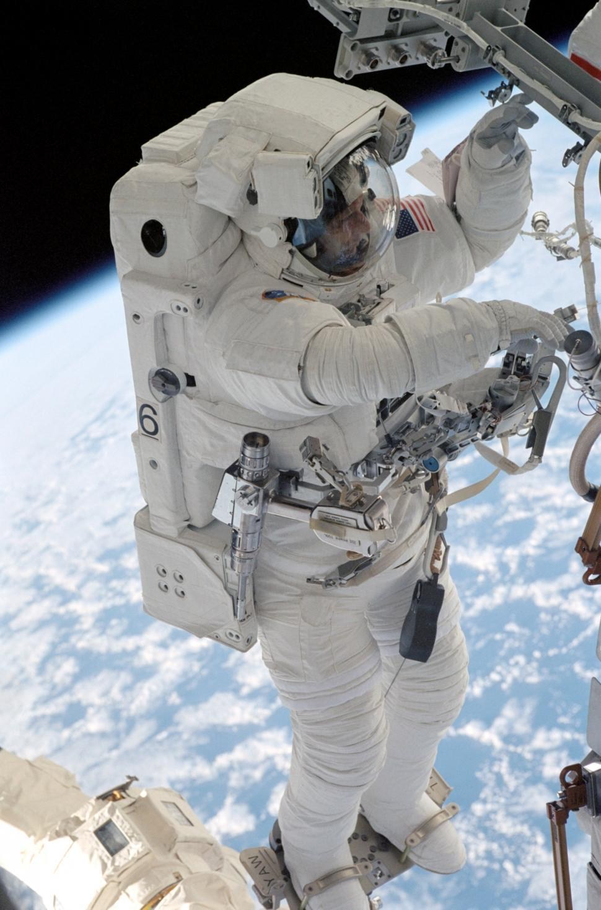
Motivation
Problem:
140 hours / year inspecting and repairing
Hours not spent on value-added activities
$28M in direct cost lost per year
Add opportunity cost: $50M+ / year
Solution:
Automate external inspection with free-floating platform
Free astronaut time, reduce operation risk
Support next gen. commercial stations

Slide 5
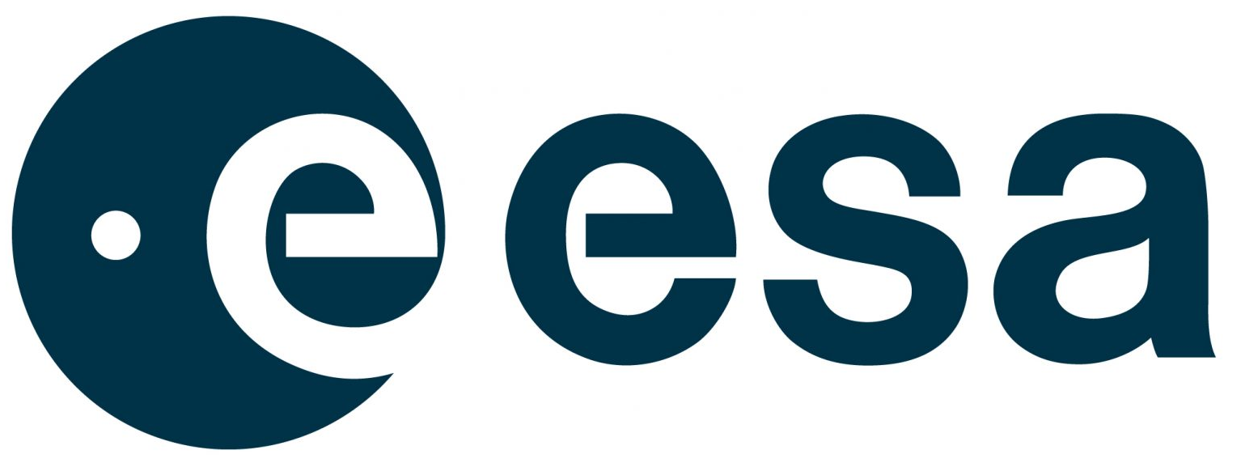


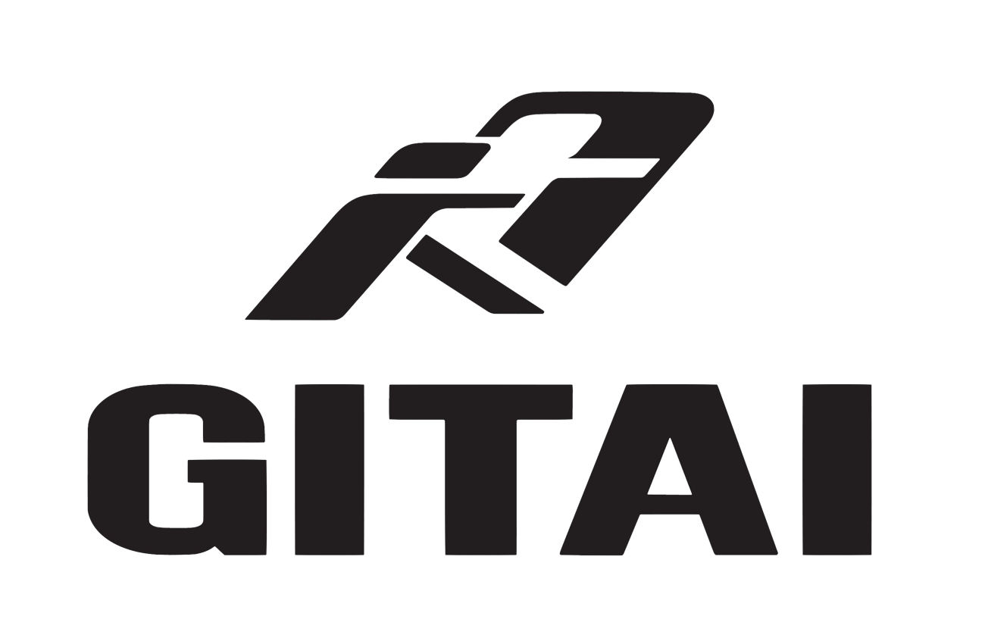



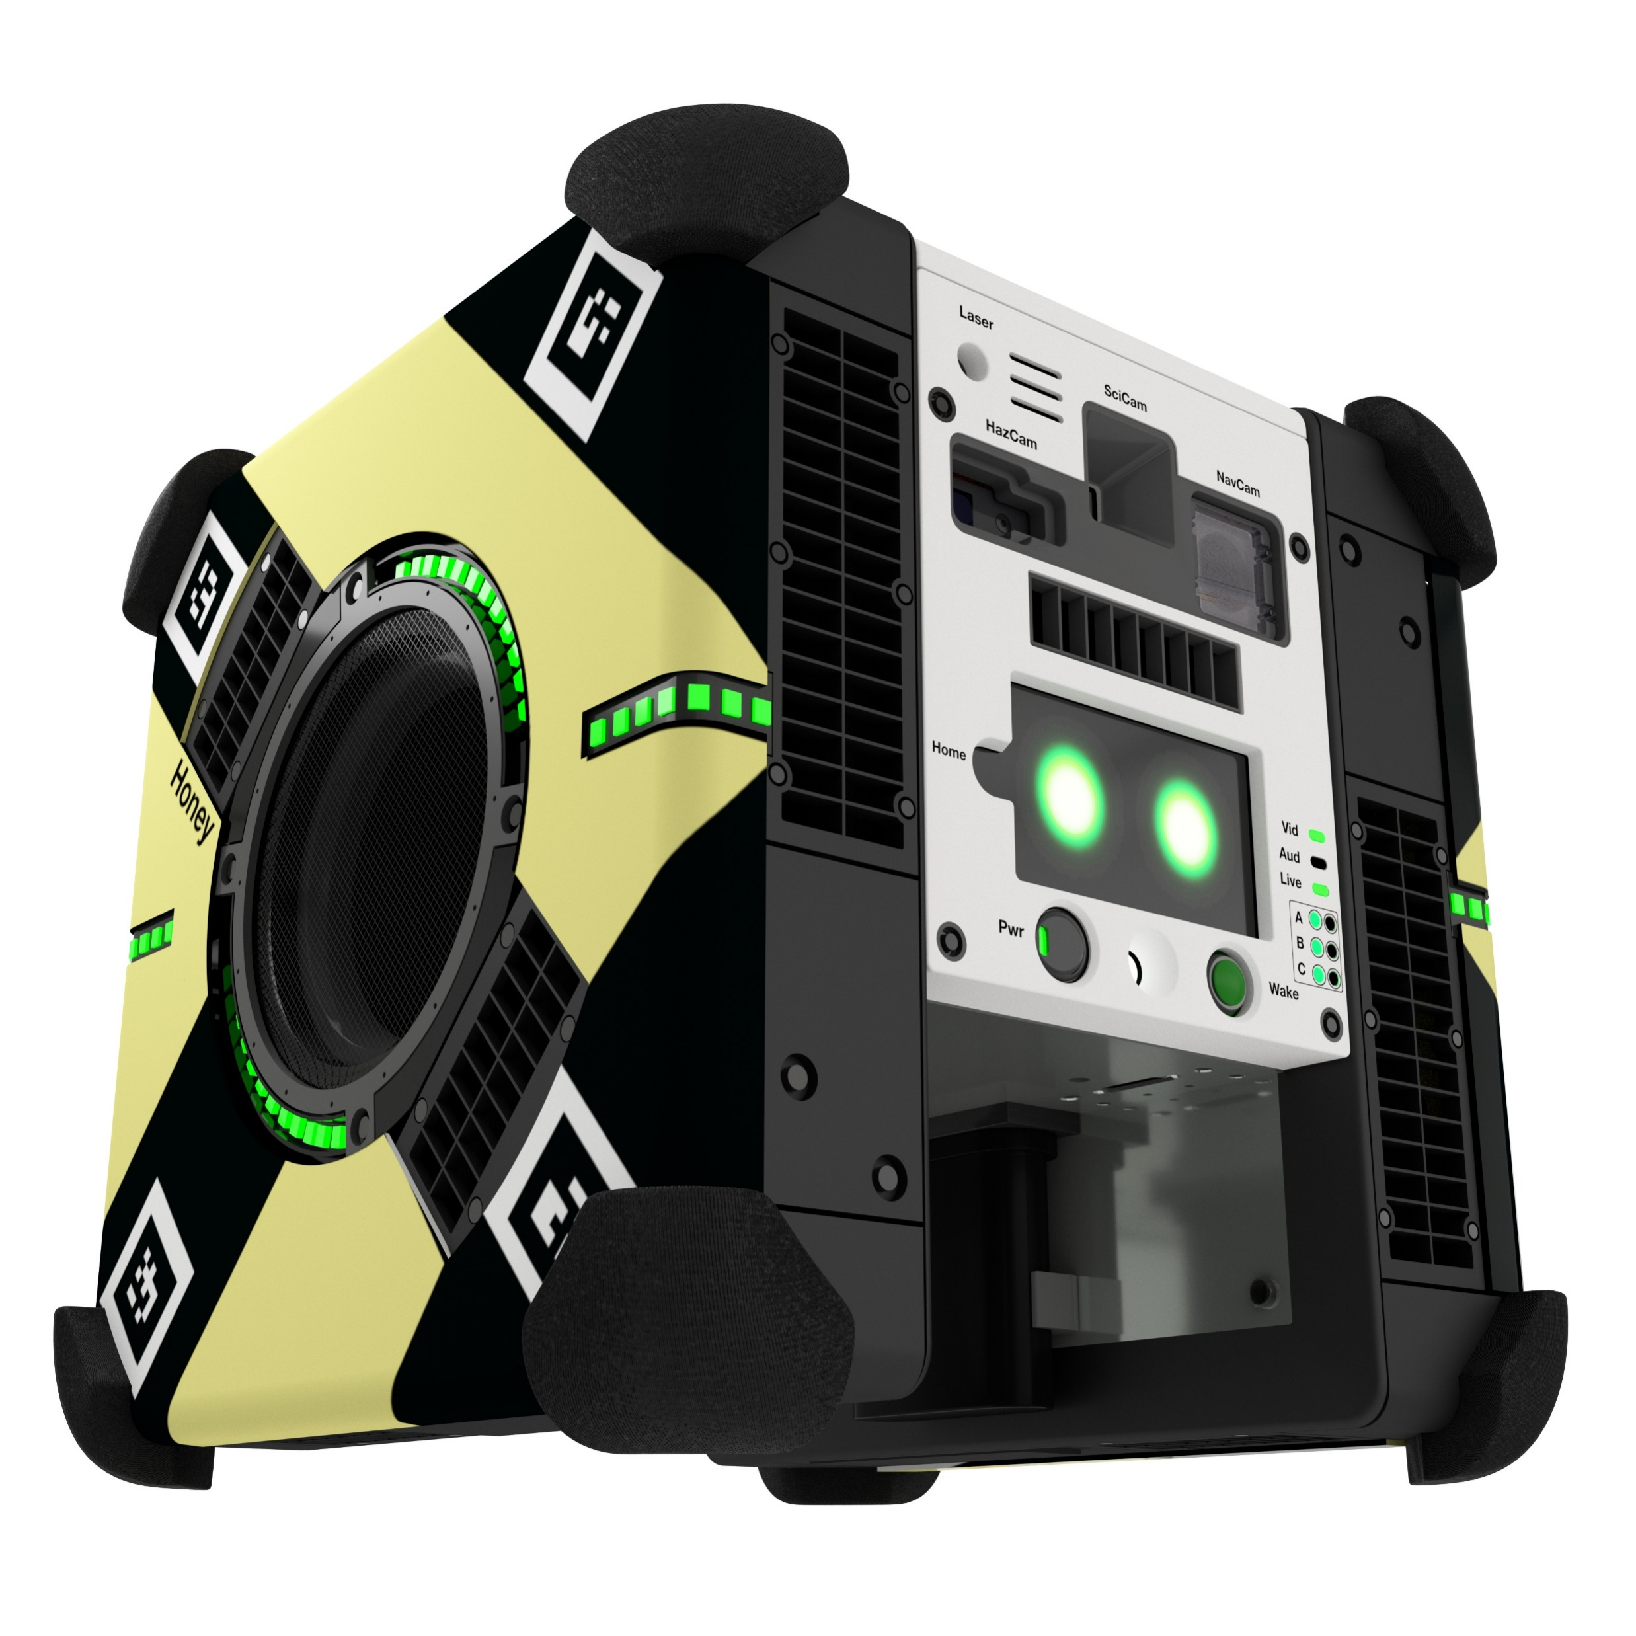
Market Research
Inspection Capability
B. Apodaca et al., "In-Orbit Space Structure Inspection Trajectory Generation," IEEE RAL, 2025, doi: 10.1109/LRA.2025.3583621.
Amortized cost / hour

Slide 6
System Overview
Picture of Satellite Goes Here
XU CubeSat, nitrogen thrusters, X sensor, 6 DOF
Operates external from space station, launchable from airlock
Algorithm & autonomy stack:
Model processing
Viewpoint generation & clustering
Path generation
Trajectory generation
Path execution & control

Slide 7
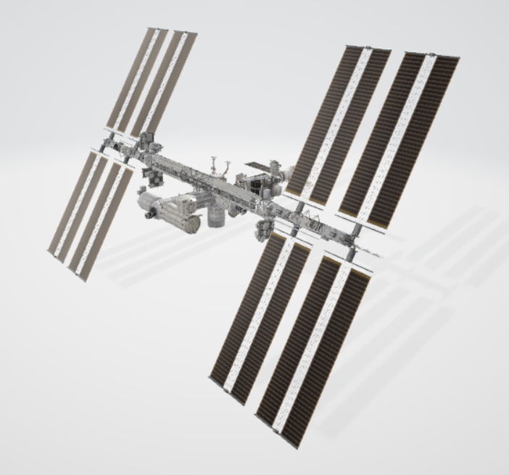
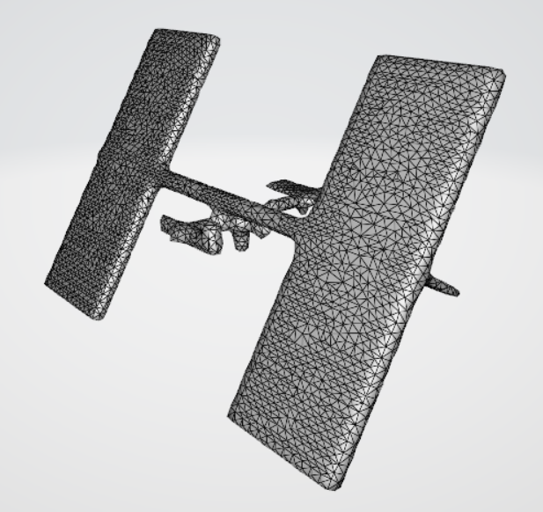
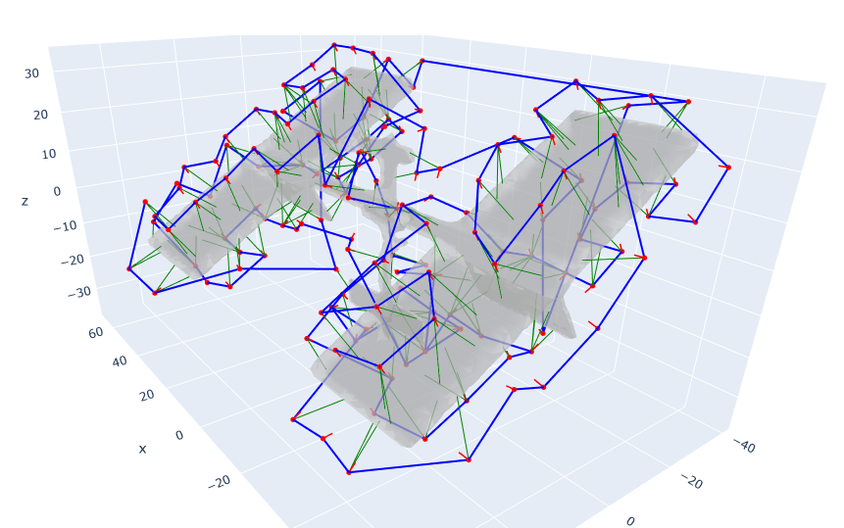
Technical Contributions: Planning

Slide 8
Technical Contributions: Control
Video of satellite maneuvering goes here

Slide 9
Next Steps: Current Risks, Limitations)
Refine stack to eliminate risks, failure cases, limitations:
Refine collision detection, some manual checks still required
Implement mechanisms to automatically tune pipeline parameters to optimize coverage e.g., clustering, model pre-processing
Move from free-floating dynamics to Clohessy-Wiltshire in optimization step

Slide 10
Thank You for Listening
Questions?

