Slide 1
🖖Vue 3🖖
@GauteMeekOlsen

Slide 2
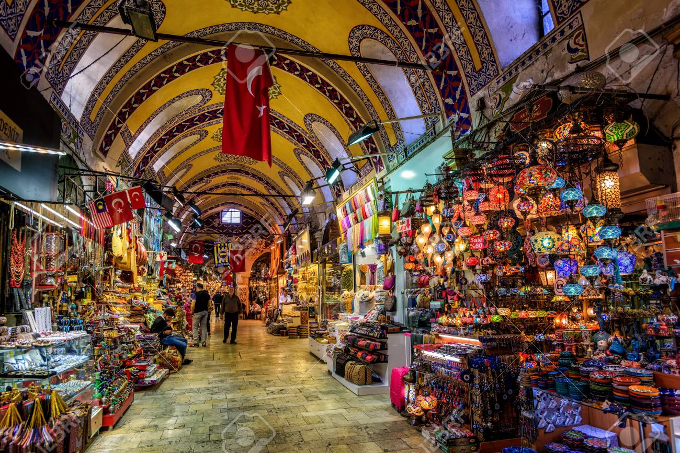




What’s happening?
Show some websites
Bazaar
Cathedral

Slide 3
Optimization
Optimized Rendering
Show spreadsheet
Template explorer
Full source map support
Static tree hoisting
Better at reusing static DOM elements
Tree shaking
dead code elimination
Import {computed} from ‘vue’

Slide 4
Improvements
TypeScript
Full source map
RFCs

Slide 5
Changes
Next slides

Slide 6
Composition API
Demo

Slide 7
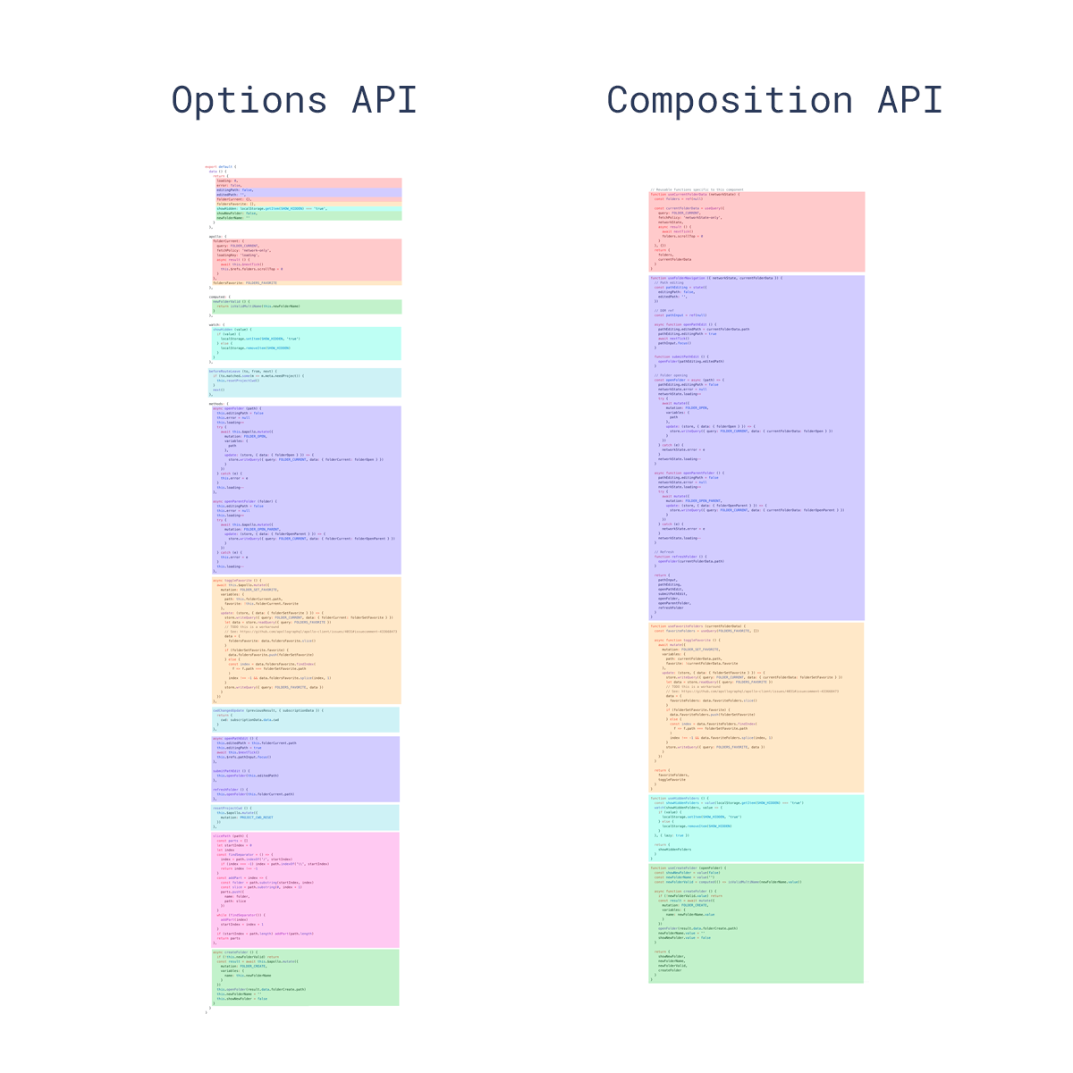

Slide 8
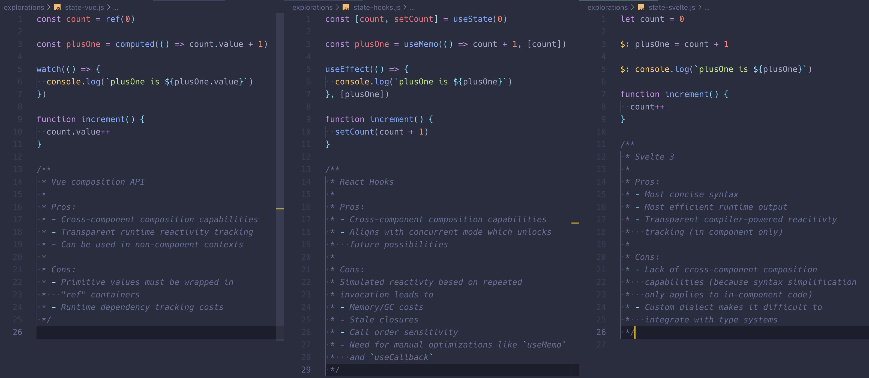
Tweet @youyuxi

Slide 9
Fragment
Demo

Slide 10
Suspense
Demo

Slide 11
Portal
Demo

Slide 12
Multiple v-model
Demo

Slide 13
Transitions: v-enter-from
demo

Slide 14
Global API change
// before
Vue.use(/* ... */)
Vue.mixin(/* ... */)
Vue.component(/* ... */)
Vue.directive(/* ... */)
// after
const app = createApp(App)
app.use(/* ... */)
app.mixin(/* ... */)
app.component(/* ... */)
app.directive(/* ... */)

Slide 15
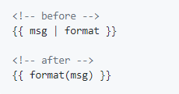
Filter removed
ESNext Proposal: The Pipeline Operator

Slide 16
What’s Left?
Docs & Migration Tools / Guides
Router
Vuex
CLI
DevTools
IE11 Compataibility build

