Slide 1


an introduction
www.reahl.org
Iwan Vosloo
iwan@reahl.org

Slide 2
Overview
Python only, high level (and what this means)
Hello World
Basic building blocks
Address book application
Other tidbits

Slide 3
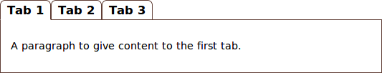
Widgets
Python only, high level
panel = TabbedPanel(view, 'mytabbedpanel')
panel.add_tab( Tab(view, 'Tab 1', '1', P.factory(text='A paragraph ... first tab.')) )
panel.add_tab( Tab(view, 'Tab 2', '2', P.factory(text='.. and for the second.')) )
panel.add_tab( Tab(view, 'Tab 3', '3', P.factory(text='Lastly, …')) )

Slide 4
What it takes
Python only, high level
/
/image
/other_view
/form1
Java
Script
HTML
+
CSS

Slide 5
Others (not Python though)
Python only, high level
Wt++
GWT
Echo
<html>
<body>
</body>
</html>
ul.reahl-menu > li > a {
display: inline-block;
}
$(this.element).find(">a").first()
.click(function(){
_this.doSomething();
return false;
});

Slide 6
What you need to know
Hello World
OO programming
Basic Python development tools
(virtualenv, setuptools/distribute)
SqlAlchemy / Elixir

Slide 7
Structure of a project
Hello World
hello
/
etc/
web.config.py
.reahlproject
hello.py

Slide 8
Project metadata
Hello World
<project type="egg">
<deps purpose="run">
<egg name="reahl-component"/>
<egg name="reahl-web"/>
<egg name="reahl-sqlalchemysupport"/>
<egg name="reahl-web-elixirimpl"/>
</deps>
</project>
hello
/
etc/
.reahlproject
hello.py

Slide 9
Command line tools: reahl
Hello World
reahl
setup Runs setup.py <command> for each project in the current selection.
reahl setup -- develop -N

Slide 10
What makes an application?
Hello World
from reahl.web.fw import UserInterface
from reahl.web.ui import TwoColumnPage
class HelloUI(UserInterface):
def assemble(self):
self.define_page(TwoColumnPage)
self.define_view(u'/', title=u'Home')
hello
/
etc/
.reahlproject
hello.py

Slide 11
Configuration
Hello World
reahl-control listconfig --missing --files --info etc
hello
/
etc/
web.config.py
from hello import HelloUI
web.site_root = HelloUI
.reahlproject
hello.py

Slide 12
Running it...
Hello World
reahl-control createdbuser etc
reahl-control createdb etc
reahl-control createdbtables etc
reahl serve etc

Slide 13
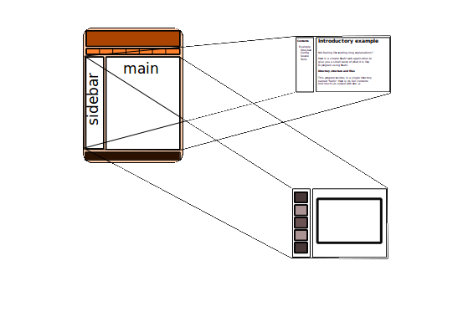
Views, Slots, a page
Basic building blocks

Slide 14
Defining a View using Slots
Basic building blocks
hello/
etc/
from reahl.web.fw import UserInterface
from reahl.web.ui import TwoColumnPage, P
class HelloUI(UserInterface):
def assemble(self):
self.define_page(TwoColumnPage)
home = self.define_view(u'/', title=u'Home')
home.set_slot(u'header', P.factory(text=u'Hello World'))
home.set_slot(u'main', P.factory(text=u'Some text...'))
reahl.config.py
.reahlproject
hello.py

Slide 15
UserInterfaces
Basic building blocks
web.site_root
MyUserInterface
/
AccountUI
/account
/account/login
/account/register
/about
/contact

Slide 16
Factories
Basic building blocks
class reahl.web.ui.P(view, text=None, css_id=None, html_escape=True)
P.factory(text=u'Hello World')
Factories are created before a View becomes available – think of them as delayed constructors with the first argument missing

Slide 17
Request cycle
Basic building blocks
Factories created
construct & .assemble
UserInterface
construct View & all its Widgets
render
Only necessary Factories
used to instantiate

Slide 18
Widgets composed of Widgets
Basic building blocks
hello/
from reahl.web.fw import UserInterface
from reahl.web.ui import TwoColumnPage, P, Panel
class ReahllyBadPoem(Panel):
def __init__(self, view):
super(ReahllyBadPoem, self).__init__(view)
self.add_child(P(view, text=u'Reahl is for real.'))
self.add_child(P(view, text=u'You can use it.'))
class HelloUI(UserInterface):
def assemble(self):
self.define_page(TwoColumnPage)
home = self.define_view(u'/', title=u'Home')
home.set_slot(u'header', P.factory(text=u'Hello World'))
home.set_slot(u'main', ReahllyBadPoem.factory())
etc/
reahl.config.py
.reahlproject
hello.py

Slide 19
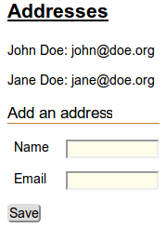
The app skeleton
Address book app
AddressBookPanel
AddressBox
AddressBox
AddAddressForm
InputGroup

Slide 20
Models and user input
Address book app
Address
name
email
AddressBox
save()
Address
name
email
TextInput
save()
Button

Slide 21
@exposed Fields
Address book app
import elixir
from reahl.sqlalchemysupport import Session, metadata
from reahl.component.modelinterface import exposed, EmailField, Field
class Address(elixir.Entity):
elixir.using_options(session=Session, metadata=metadata)
elixir.using_mapper_options(save_on_init=False)
email_address = elixir.Field(elixir.UnicodeText)
name = elixir.Field(elixir.UnicodeText)
@exposed
def fields(self, fields):
fields.name = Field(label=u'Name', required=True)
fields.email_address = EmailField(label=u'Email', required=True)

Slide 22
Inputs, layout and Fields
Address book app
TextInput
Address
EmailField
name
email
save()
LabelledBlockInput

Slide 23
Inputs linked to Fields
Address book app
from reahl.web.ui import Form, TextInput, LabelledBlockInput,InputGroup
class AddAddressForm(Form):
def __init__(self, view):
super(AddAddressForm, self).__init__(view, u'add_form')
new_address = Address()
grouped_inputs = self.add_child(InputGroup(view, label_text=u'Add an..'))
name_input = LabelledBlockInput( TextInput(self, new_address.fields.name) )
grouped_inputs.add_child( name_input )

Slide 24
@exposed Events
Address book app
from reahl.sqlalchemysupport import Session
from reahl.component.modelinterface import exposed, Event, Action
class Address(elixir.Entity):
# fields and most persistence related stuff not shown...
def save(self):
Session.add(self)
@exposed
def events(self, events):
events.save = Event(label=u'Save', action=Action(self.save))

Slide 25
Buttons linked to Events
Address book app
Button
Address
name
email
Event
save()

Slide 26
Buttons linked to Events
Address book app
from reahl.web.ui import Form, Button
class AddAddressForm(Form):
def __init__(self, view):
super(AddAddressForm, self).__init__(view, u'add_form')
new_address = Address()
# grouped_inputs and not shown...
self.define_event_handler(new_address.events.save)
grouped_inputs.add_child(Button(self, new_address.events.save))

Slide 27
Some other tidbits
Other tidbits
What happened to Ajax?
Database schema migration
Internationalisation
Navigation
Access control

Slide 28
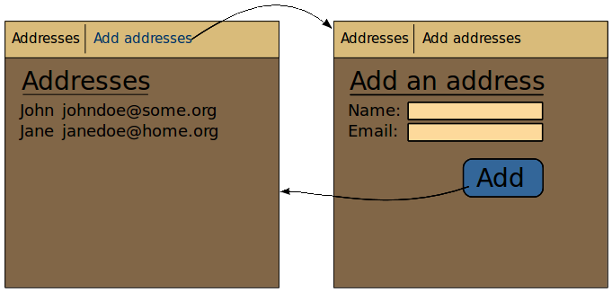
Navigation
Other tidbits

Slide 29
Navigation
Other tidbits
Button(self, new_address.events.save)
class AddressBookUI(UserInterface):
def assemble(self):
addresses = self.define_view(u'/', title=u'Addresses')
addresses.set_slot(u'main', AddressBookPanel.factory())
add = self.define_view(u'/add', title=u'Add an address')
add.set_slot(u'main', AddAddressForm.factory())
self.define_transition(Address.events.save, add, addresses)
bookmarks = [f.as_bookmark(self) for f in [addresses, add]]
self.define_page(AddressBookPage, bookmarks)

Slide 30
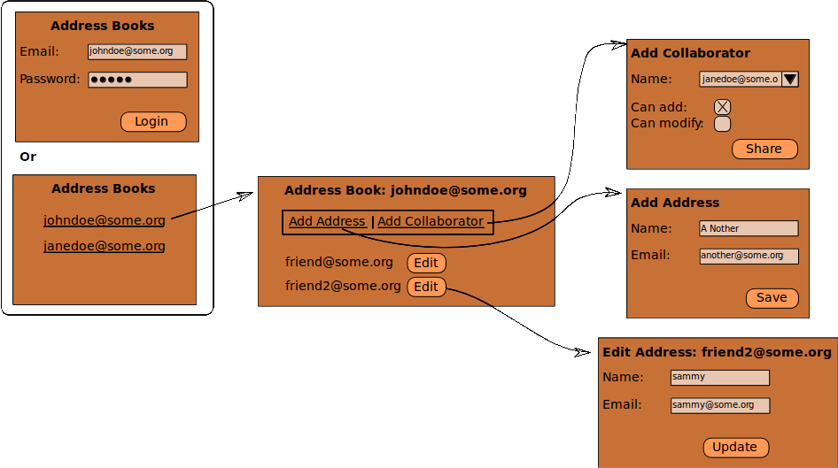
Access control
Other tidbits

Slide 31
Access control
Other tidbits
class Address(elixir.Entity):
@exposed
def fields(self, fields):
fields.name = Field( label=u'Name', required=self.can_be_added(), writable=Action(self.can_be_added))
fields.email_address = EmailField( label=u'Email', required=True, writable=Action(self.can_be_edited))
@exposed(u'save', u'update', u'edit')
def events(self, events):
events.save = Event( label=u'Save', action=Action(self.save) )
events.update = Event( label=u'Update' )
events.edit = Event( label=u'Edit', writable=Action(self.can_be_edited) )

Slide 32
Thanks
www.reahl.org
iwan@reahl.org
reahl-discuss@googlegroups.com

