Slide 1
Website Clickstream Analytics
GROUP 2
Ankitha Abhimanyu
Goutham Chandru Manghnani
Vidhya Babu

Slide 2
Data Collection
Dataset received from the challenge posted by Zappos.com
Represents clickstream data of the customers visiting the website
Clickstream analysis
E-commerce analysis
Traffic analysis

Slide 3
Dataset Description
Business Problem
Analyze and assess the business performance
predict the no of orders placed
Analyze for trends and bring insights
No of Instances = 21061
No of Attributes = 11
day , site , new customer , platform , visits , distinct sessions , gross sales , bounces , add to cart , product page views , search page views
Target Variable “Orders” has continuous values

Slide 4
Preprocessing Steps
Missing Values
Inclusion of
New Attributes
Correlation and Multicollinearity
Dict Vectorizer
Variable
Transformation

Slide 5
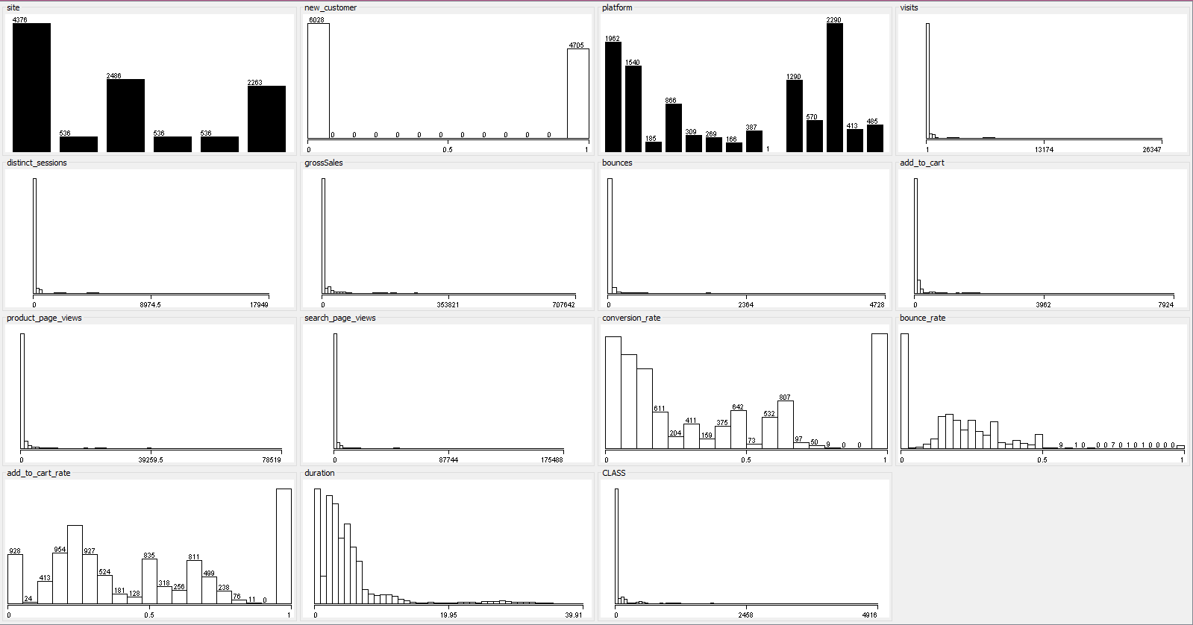
Attributes Visualization

Slide 6
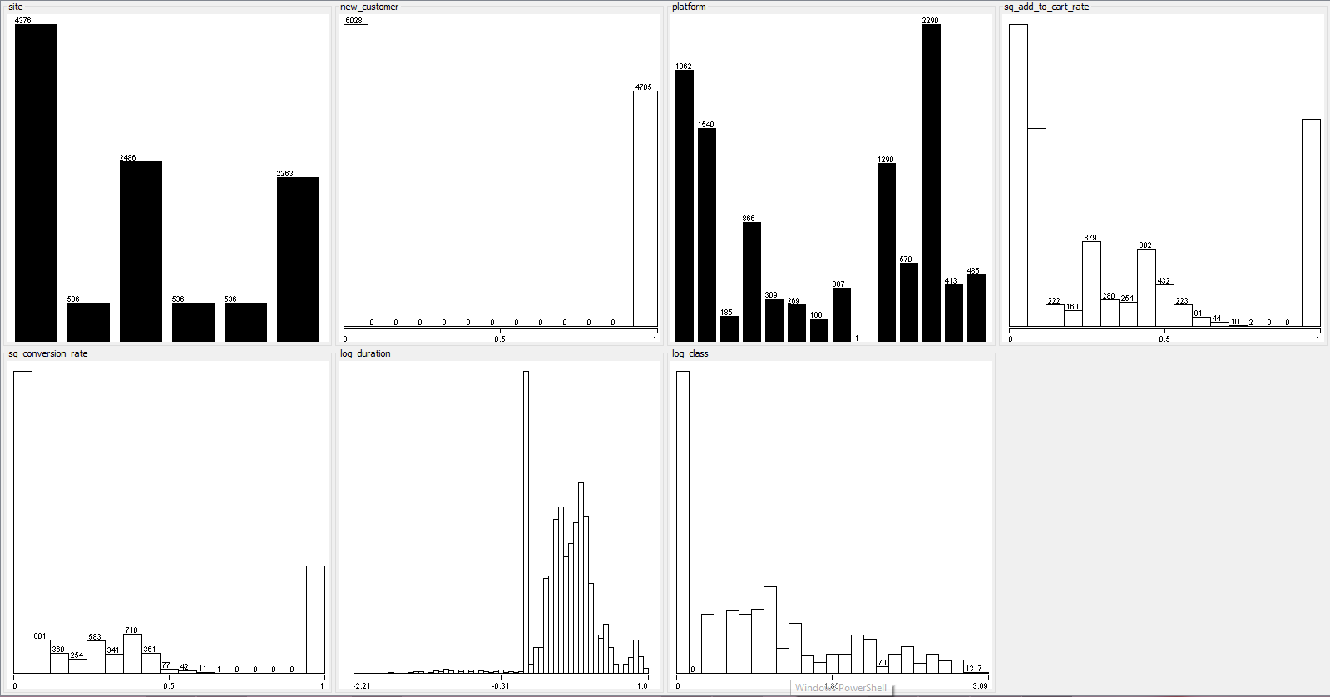
Attributes Visualization after Transformation

Slide 7
Regression
Target variable “Order” has continuous values
General Purpose : Is to learn more about the relationship between several independent or predictor variables and a dependent variable.
Evaluate Model Fit :
R Square (Coefficient of determination) - Common statistic to evaluate model fit
Root Mean Square Error - Good measure of how accurately the model predicts the response

Slide 8
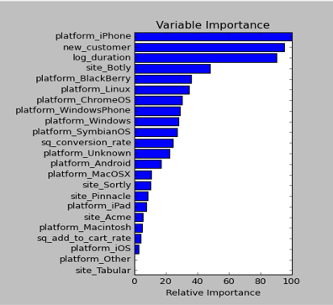
Feature Importance

Slide 9
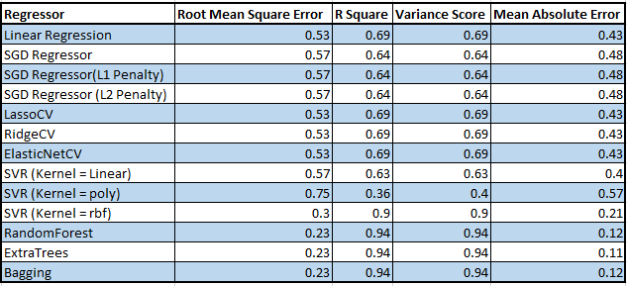
Regressor Results

Slide 10
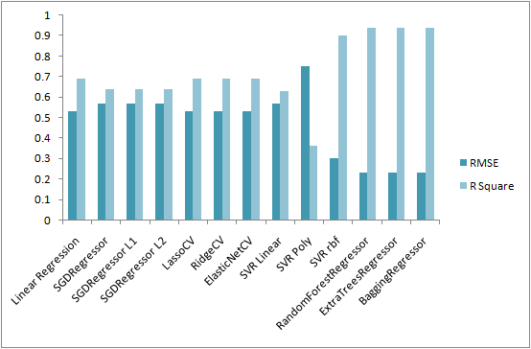
RMSE & R Square

Slide 11
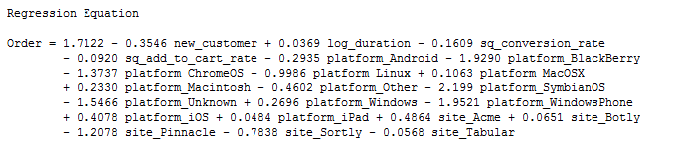

Multiple Linear Regression
Prediction model with test values
The prediction interval is more meaningful than the confidence interval

Slide 12
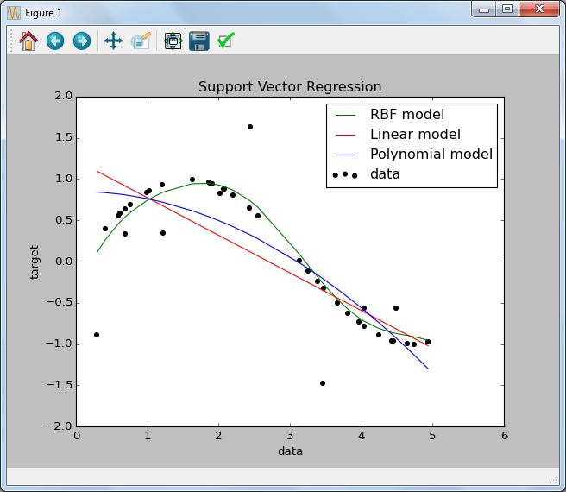
Support Vector Regression

Slide 13
Bagging Regressor
Bootstrap Aggregating
Goal : Improve the performance of base model
Expected error = Bias + Variance + Noise
Averaging reduces variance
When does Bagging work?

Slide 14
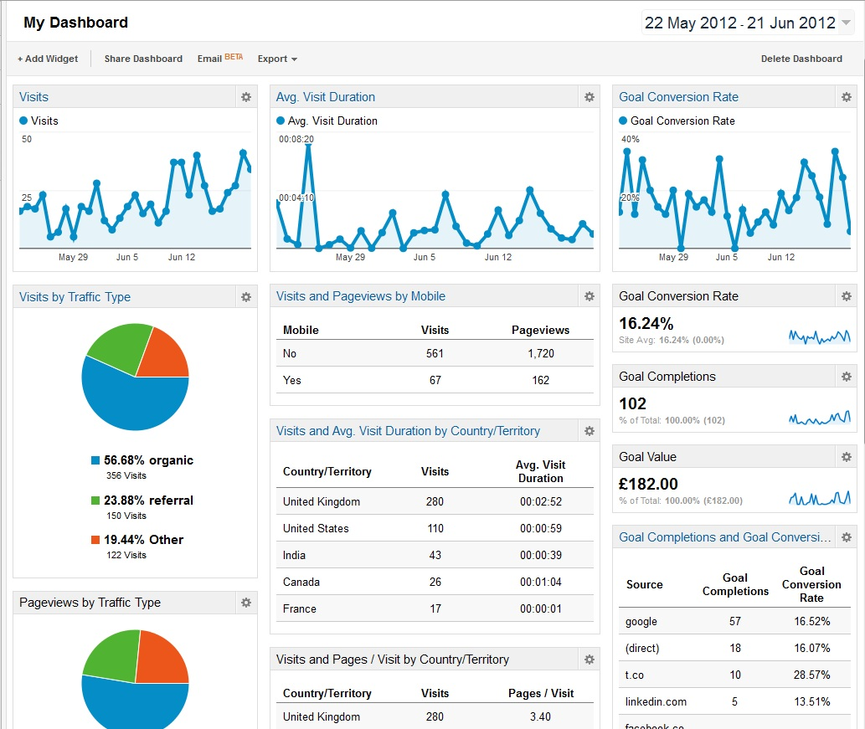
Google Analytics Management Dashboard
Google Analytics Management Dashboard

Slide 15
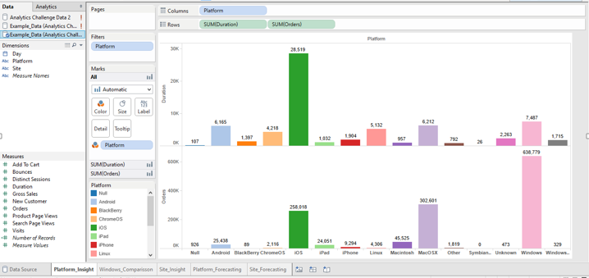
Platform Insights
Google Analytics Management Dashboard

Slide 16
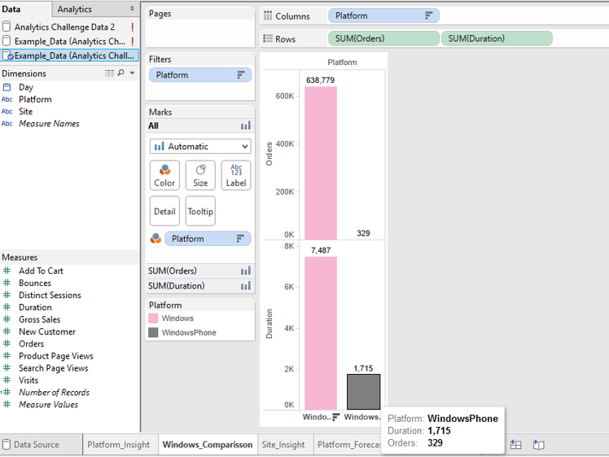
Windows OS Vs Windows Phone

Slide 17
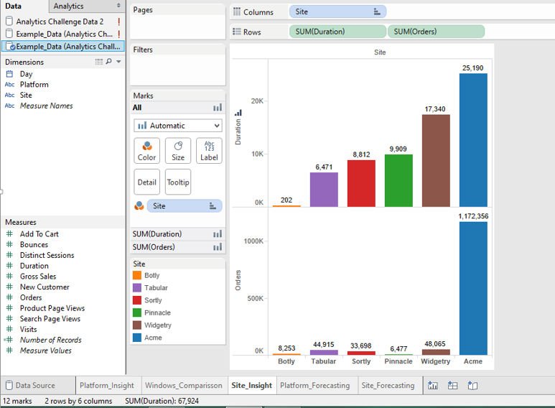
Site Insights

Slide 18
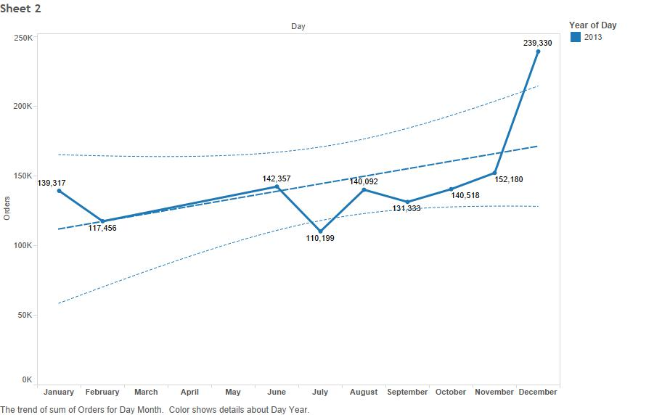
Sum of Orders for every month in the year 2013

Slide 19
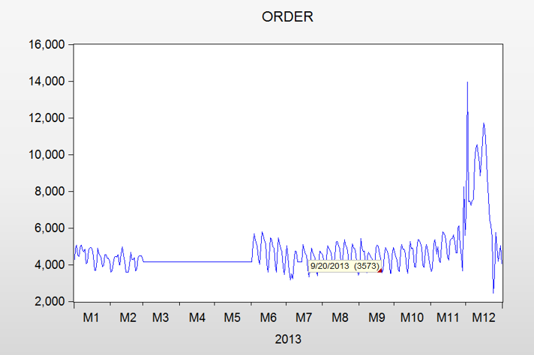
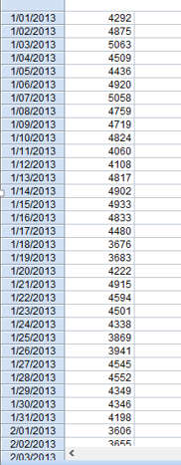
Line Graph for Orders for every day in the year 2013

Slide 20
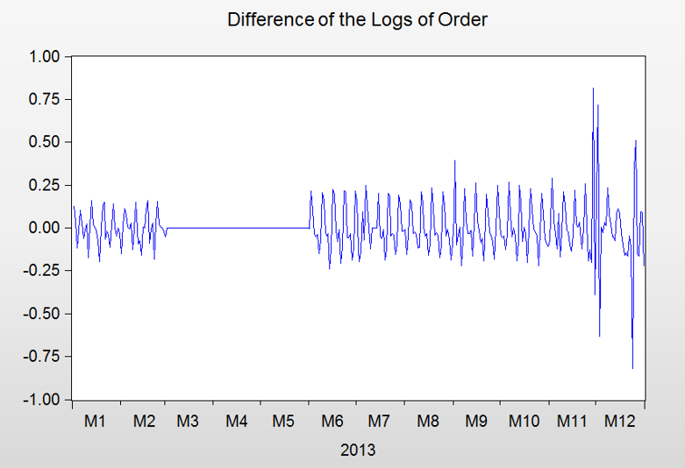
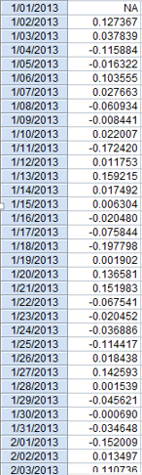
Line Graph after taking the difference in Log of Orders - Transformation

Slide 21
Trend and Seasonality
No Trend observed
Seasonality observed
SARMA (4,1) X (3,0) S=7

Slide 22
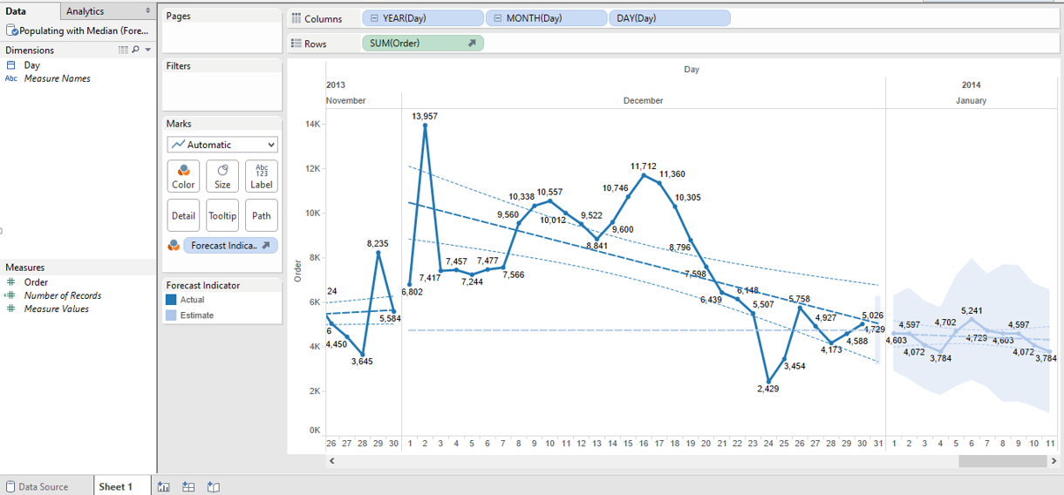
Forecasting Orders for Quarter 1 in 2014 - With Median values imputed

Slide 23
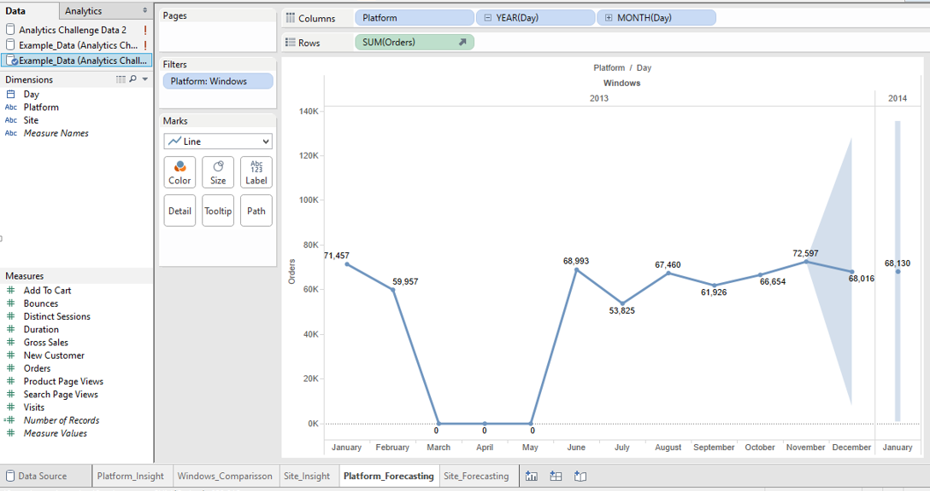
Forecasting Orders for Windows Platform - for January 2014

Slide 24
Thanks !
Any questions?

